Slide 1
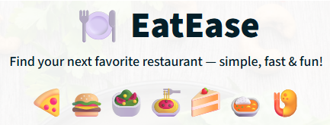
Restaurant Recommendation System
Discover the Best Places to Eat Around You
https://eatease.streamlit.app/

Slide 2
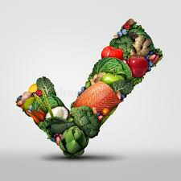
About the Project
EatEase is an intelligent restaurant recommendation web application designed to help users discover the best dining spots based on their unique preferences.
Built using a real Swiggy dataset, it delivers personalised results filtered by city, cuisine, cost range, and customer ratings.
Key Features:
Simple and interactive web interface for seamless browsing
Real-time filtering and advanced search options
Customer feedback system and integrated chatbot for queries
Displays trending cuisines and popular dishes across locations

Slide 3




Problem Statement
Decision Fatigue
Time Wastage
With hundreds of restaurants available online, users often feel overwhelmed deciding where to eat or what to order.
People waste valuable time scrolling endlessly through multiple apps trying to find affordable and highly-rated places nearby.
Lack of Personalisation
Most platforms don't offer quick, personalised restaurant options tailored to specific budgets and preferences.

Slide 4
Proposed Solution
EatEase simplifies food discovery by providing a clean, user-friendly experience that puts the right restaurants at your fingertips in seconds.
01
02
Smart Filtering
Quality Assurance
Filter restaurants based on location, cuisine type, and budget constraints to see only what matters to you.
View only highly rated and relevant options that match your criteria, saving time and ensuring satisfaction.
03
04
Detailed Insights
Interactive Support
Check ambience, service details, and customer reviews for each restaurant before making your choice.
Give feedback and chat for quick help, making your restaurant discovery journey smooth and hassle-free.

Slide 5

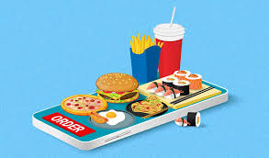
Tech Stack Used
Category
Tools / Technologies
Frontend
Streamlit
Backend / Logic
Python
Data Handling
Pandas, NumPy
Styling
HTML + Custom CSS
Dataset Source
Real Swiggy Restaurant Dataset
Extra Features
Emoji visuals, Feedback, Chatbox

Slide 6



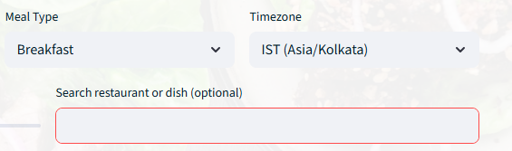


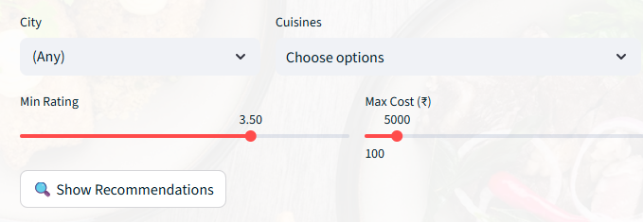

System Flow
User Input
Select filters including city, cuisine, cost range, and minimum rating preferences.
Data Processing
Python and Pandas clean and process the dataset to match your requirements.
Smart Filtering
The system intelligently filters restaurants that perfectly match your criteria.
Results Display
Matching restaurants appear instantly on the Streamlit web interface.
User Interaction
Provide feedback or ask questions.

Slide 7

Advantages
User-Friendly Design
Accurate Suggestions
Trending Insights
Easy to navigate interface with visually appealing layout that makes restaurant discovery enjoyable and intuitive.
Advanced filtering algorithms deliver precise restaurant recommendations that match your exact preferences and requirements.
Displays popular cuisines, customer favourites, and trending dishes to help you discover what's hot in your area.
Scalable Performance
Interactive Engagement
Efficiently handles large datasets without compromising on speed or user experience, ensuring quick results every time.
Built-in feedback submission and chatbot support create a two-way communication channel for better user satisfaction.

Slide 8
Challenges Faced
Memory Management
1
Loading large CSV files caused memory issues—resolved by implementing chunk loading techniques for efficient data processing.
2
Data Cleaning
Had to handle rupee symbols, missing ratings, and incorrect cost entries—created robust cleaning functions to standardise the dataset.
UI Design
3
Struggled with white spaces and layout inconsistencies—adjusted fonts, spacing, and visual hierarchy for better aesthetics.
4
Filter Accuracy
Encountered mismatched city and cuisine filters—fixed the logic to ensure precise and relevant output for users.
User Engagement
5
Needed to improve interaction—added feedback forms, chatbot support, and food visuals to enhance overall experience.

Slide 9
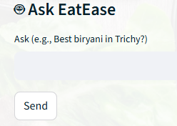






Future Enhancements
Exciting possibilities to make EatEase even more powerful and user-centric
Live API Integration
User Accounts
Connect with Swiggy and Zomato APIs for
real-time restaurant data, live menus, and current availability.
Add login system with personalised profiles to save favourite
restaurants and track order history.
GPS-Based Suggestions
Persistent Storage
Integrate location services to automatically
show nearest restaurants based on your current GPS coordinates.
Store user feedback and preferences permanently in a
database for improved personalisation over time.
Mobile Optimisation
Deals & Offers
Create a dedicated mobile-friendly version
and native app for convenient access on the go.
Add special offer banners, live deals section, and exclusive
discount notifications to help users save money.
Thank You!
"EatEase helps you find good food faster—simple, smart, and satisfying."
Any questions?

