Slide 1

SRI MANAKULA VINAYAGAR
ENGINEERING COLLEGE
(An Autonomous Institution)
Department of Electronics and Communication Engineering
Reconfigurable Band Notch Filter for Cognitive Radio in Defense Electroveil
Guided by
Presented by
Dr. N. SARANYA
SANTHIYA B (21UEC158)
Assistant Professor
IV Year A Section
Department of ECE
Department of ECE

Slide 2

Outline of the Presentation
Introduction about domain
Problem Statement
Literature Survey
Objective
Existing System
Requirements
Work flow of project
Expected Outcome
Initial Implementation
Proposed System
Design Specification
Results and Discussion
Comparison of Proposed Structure
References

Slide 3
Introduction about domain
A reconfigurable bandstop filter for cognitive radio in defense applications enables dynamic adjustment of frequency ranges, allowing radios to operate across multiple bands and avoid interference.
This technology is crucial for adapting to the electromagnetic environment in real-time, enhancing secure and efficient communication.
It also supports flexible spectrum management, vital in defense for reliable information exchange in varying scenarios.

Slide 4
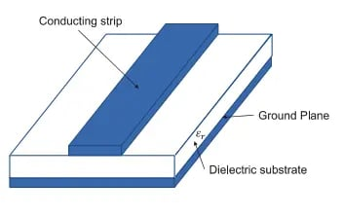
Problem Statement
The rapid evolution of wireless communication and RF technologies demands adaptable filtering solutions to overcome interference and optimize signal quality.
Traditional filters lack the flexibility required to meet these dynamic needs. To tackle this issue, a reconfigurable microstrip bandstop filter capable of dynamically tuning its frequency response is designed and validated.
By incorporating advanced components and simulation techniques, this innovative filter aims to enhance the adaptability and performance of communication systems in an increasingly complex frequency spectrum.

Slide 5
Literature Survey
TITLE | AUTHOR | FREQUENCY OF OPERATION | BANDWIDTH | DRAWBACKS
Design and Optimization of a Compact Microstrip Filtering Coupler With Low Losses and Improved Group Delay for High- Performance RF Communication Systems (2024) | Salal I. Yahya | 1.84-2.11 GHz | 13.7% | Limited frequency range, complex optimization, sensitivity to fabrication tolerances, and group delay constraints for ultra-low latency applications.
A Reconfigurable Filter Using Ground Structure for Wideband Common- Mode Suppression (2024) | Zhibin Zeng | 1.8-8.1 GHz | Wideband Tunability | Limited tuning range precision, complexity in maintaining consistent differential-mode performance across wideband frequencies.
Varactor Based Ccontinuously Tunable Microstrip Bandpass Filters (2024) | Mengjie Qin | 0.55-2.7GHz | Flexible Tuning Range | Complexity in achieving precise tuning control, sensitivity to varactor nonlinearity, and challenges in maintaining performance consistency over a broad tuning range.

Slide 6
Frequency Selective Limiters Using Triple Mode Filters(2023) | Wei Yang | 1.5-2 GHz | Tunable Bandwidth | Increased circuit complexity, potential insertion loss due to multiple resonant elements, and challenges in precise control of independent tuning across multiple bands.
High- Q High Power Tunable Filters Manufactured With Injection Molding Technology(2022) | Michael D. Sinanis | 2.8–5.2 GHz | Over 119% Fractional Bandwidth | limitations in the mechanical durability of injection-molded ABS, challenges in maintaining precision tuning under varying environmental conditions, and possible trade-offs in performance consistency during mass production.
Novel High- Q Partially Air- Filled Pedestal Resonator and Filter Integrated in a Printed Circuit Board(2022) | Leanne Johnson | 5 GHz | Ultra- Wide Tuning Range | complex fabrication requirements, potential difficulties in achieving precise air-gap control, and sensitivity to manufacturing tolerances, which could impact reproducibility and scalability.

Slide 7
Multi- Band Bandpass and Bandstop RF Filtering Couplers with Dynamically- Controlled Bands (2018) | Roberto Gomez- Garcia | 1.3-1.8 GHz | Tunable Bandwidth | Increased circuit complexity, potential insertion loss due to multiple resonant elements, and challenges in precise control of independent tuning across multiple bands.
A New Class of Highly- Miniaturized Reconfigurable UWB Filters for Multi- Band Multi- Standard Transreceiver Architecture (2017) | Mohamed Kheir | 3.36-10.53GHz | Over 119% Fractional Bandwidth | Complexity in tuning across a wide bandwidth, increased sensitivity to component tolerances, and potential nonlinearity issues with varactor and PIN diodes affecting signal integrity.
A Compact Bandpass Filter Manifold With Ultrawide Frequency and Bandwidth Tuning (2017) | Mohammed R A. Nasser | 1.8-3.85GHz | Ultra- Wide Tuning Range | Implementation complexity, temperature sensitivity, nonlinearities, and limited frequency range

Slide 8
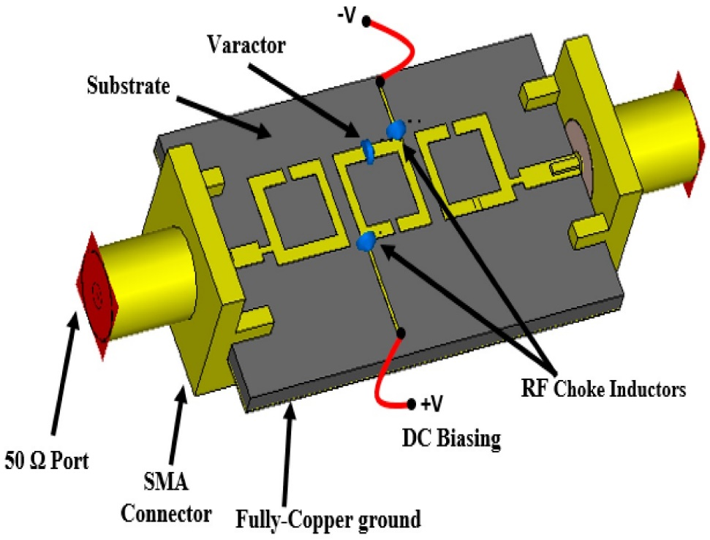

Objective
To design and develop a reconfigurable bandstop filter with adaptive frequency response capabilities to meet evolving signal processing demands.
This filter will streamline system complexity, reduce physical size, and lower costs by integrating multiple filtering functions within a single device, eliminating the need for additional filters.
By enabling dynamic frequency adjustments, the reconfigurable filter will maximize bandwidth utilization and optimize signal processing across diverse applications. Additionally, the compact design will ensure suitability for compact, versatile systems.

Slide 9
Existing System
Drawbacks in the existing system are:
Limited Frequency Range – The existing system operates around 1.5 GHz, restricting its application in multi-band and wideband communication systems. Expanding the frequency range requires additional design modifications, increasing complexity.
High Insertion Loss – The filter exhibits significant insertion loss in the passbands, leading to unwanted signal attenuation. This can degrade overall system performance, especially in applications requiring high signal integrity.
Fabrication Sensitivities – Small deviations in manufacturing processes such as etching, alignment, or soldering can cause variations in frequency response. These inconsistencies affect mass production and reproducibility of performance.

Slide 10
Non-Linear Behavior at High Power – The system exhibits non-linearities at higher power levels due to the use of active tuning elements. This may lead to signal distortion and degraded performance in high-power RF applications.
Size Constraints for Lower Frequencies – Achieving notch characteristics at lower frequencies requires an increase in physical size. This limitation affects the compactness of the design, making integration into portable systems challenging.
Limited Temperature Stability – Variations in ambient temperature can cause shifts in the notch frequency due to changes in material properties. This results in performance instability, requiring compensation mechanisms..
High Cost for Mass Production – The need for precision fabrication, tuning elements, and extensive testing increases production costs. This makes large-scale manufacturing expensive compared to conventional filter designs.

Slide 11

Hardware Requirement
FR-4 Substrate
Capacitor (1-5 pF)
Vector Network Analyzer
Requirements
Software Requirement
Advanced Design System
Matlab
PCB Design Software

Slide 12
Work flow of project
Basic Bandstop Filter Design
Six-element metamaterial loaded band notch filter with finite ground plane with capacitor
Restructuring the Filter to Attain Reconfiguration
Material and Specification Identification
Six-element metamaterial loaded band notch filter with finite and infinite ground plane
Prototype Development
Evolution of Proposed Structure
Single and Three element metamaterial loaded band notch filter
Testing and Validation

Slide 13
Expected Outcome
To attain reconfigurability
And to attain s₁₁ less than -10dB
To attain s₂₁=0dB

Slide 14


Proposed Method
Reconfigurable Band Notch Filter
Efficient Interference Mitigation: By selectively rejecting unwanted signals at specific frequencies while preserving the desired signal integrity, the filter ensures enhanced system performance, making it ideal for cognitive radio applications and other adaptive communication systems.
Compact and Low-Cost Design: Utilizing split ring resonators (SRRs) and a cost-effective FR-4 substrate, the filter maintains a compact footprint and affordability while achieving high reconfiguration accuracy and reliability in real-time operational environments.

Slide 15
Wideband Frequency Reconfigurability: The proposed filter efficiently operates over a broad frequency range (1 GHz – 12 GHz), making it adaptable for multi-band and ultra-wideband (UWB) applications.
High Selectivity with Minimal Insertion Loss: The metamaterial-based structure provides sharp and deep notch filtering while maintaining low insertion loss in passbands, preserving signal integrity.
Robust Against Environmental Variations: The design ensures stable performance across temperature fluctuations and minimizes sensitivity to fabrication tolerances, guaranteeing consistency in real-world applications.

Slide 16
Design Specification
Particular | Specification
Substrate | FR-4 Material
Thickness of substrate | 1.6mm
Conducting material | Copper
Conducting material thickness | 35µm
tan ⸹ | 0.011
Software used | Advanced Design Software tool(ADS)
Characteristic impedance | 50Ω

Slide 17

Calculation
Formulas:
W/h = 2/π [ B – 1 – ln (2B – 1) + (Ɛ_{r} – 1) / 2Ɛ_{r} {ln(B – 1) + 0.39 – 0.61/ Ɛ_{r}} ]
A = Z₀ / 60 $\sqrt{(Ɛr+1)/2}$ + ($(Ɛr+1$ / $Ɛr−1)$ ( 0.23 + 0.11/ $Ɛr$))
B = (377 π) / 2 Z₀ $\sqrt{Ɛr}$
L = 180⁰ ( π / 180⁰ ) / $\sqrt{Ɛeff}$ K₀
Ɛ_{eff =} (Ɛ_{r}+ 1) / 2 + (Ɛ_{r}- 1 )/ 2 ( 1 / $\sqrt{1+12h/ w }$)
K₀ = (2πf) / c
Calculated values
A=1.785
B=5.52
Ko=125.66 rad/m
w≈2mm
Ɛ_{eff} =3.457
L≈15mm

Slide 18
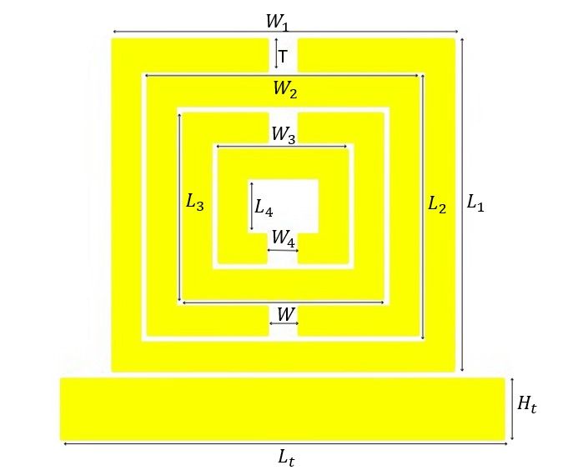
Iteration-1:Single-element Meta material loaded Band Notch Filter
PARAMETERS | DIMENSIONS (mm)
L₁ | 11
L₂ | 8.6
L₃ | 6.2
L₄ | 3.8
W₁ | 11.6
W₂ | 8.2
W₃ | 4.8
W₄ | 1.4
T | 1
Lₜ | 15
Hₜ | 2
L₂
L₁
Lₜ
Single cell with compact square spiral structure with a transmission line at the bottom with two ports labeled as Port 1 and Port 2

Slide 19
Expected Graph
Frequencies notched
6
7.8

Slide 20
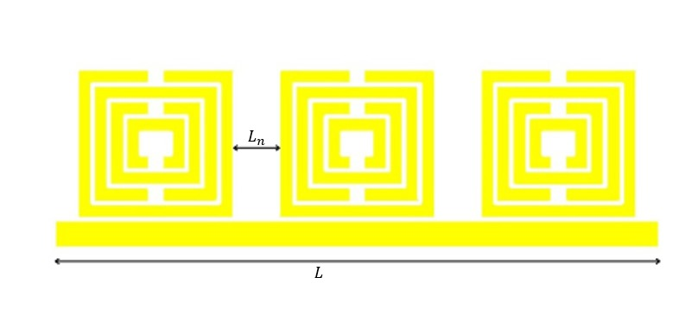
Iteration-2: Three element Meta material loaded Band Notch Filter
Pattern | Dimensions
L | 45 mm
Lₙ | 3.4 mm
Lₙ
L
An array of three-square spiral structures aligned horizontally with a shared feedline connecting Port 1 and Port 2.

Slide 21
Expected Graph
Frequencies Notched
2.5
4.6
5.4
5.9
7.6
8.8

Slide 22
Iteration-3: Six element Meta material loaded Band Notch Filter with infinite ground plane
A six-element metasurface structure with symmetric split ring resonators arranged in a 3x2 grid, featuring a central horizontal feed line

Slide 23
Expected Graph
Frequencies Notched
1.6
2.2
3.8
5.1
6.5
7.4
8.8
9.5

Slide 24
Iteration-4 :Six element Meta material loaded Band Notch Filter with finite ground plane
Pattern | Dimensions
Gₕ | 34.4194
In this structure ground plane has been added with four ports port1,port 2,port 3 and port 4.

Slide 25
Expected Graph
Frequencies notched
1.6
2-3
3.8
4.5
5.1
6.3
7.4
8.9
9.4

Slide 26
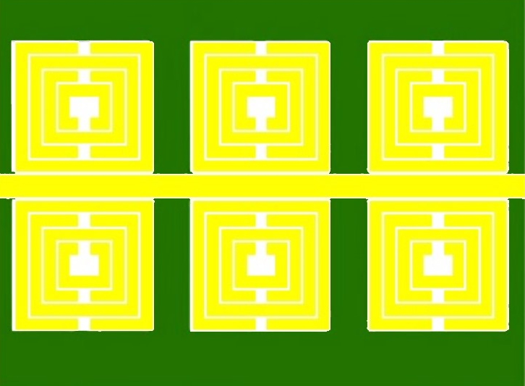
Iteration-5 : Six element Meta material loaded Band Notch Filter with DFGP
In this structure the ground plane is defected to increase the number of frequency bands that are notched

Slide 27
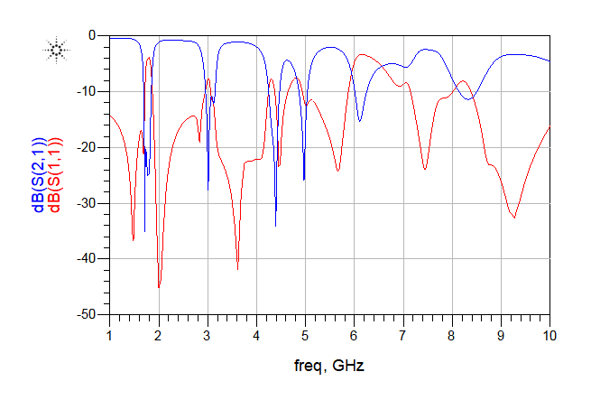
Expected Graph
Frequencies notched
1.6
2
2.9
3.7
4.4
5.7
7.4
9.2

Slide 28
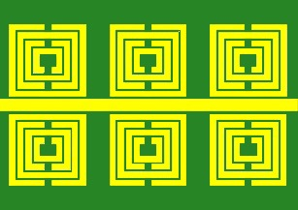
Iteration-6: Six element Meta material loaded Band Notch Filter with modified DFGP
In this structure the defected ground plane has been modified to increase the number of frequency bands that are notched

Slide 29
Expected Graph
Frequencies notched
1.7
2
3.8
5.7
7-8
8.3
11.2

Slide 30
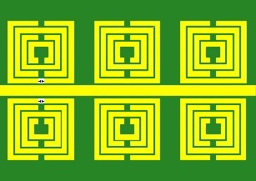
Iteration-7: Six element Meta material loaded Band Notch Filter with finite ground plane with capacitor
A capacitor (1–5 pF) has been integrated into this structure to achieve frequency reconfigurability. By varying the capacitance, the resonance frequency of the band-notch filter can be dynamically tuned, enabling adaptability to different frequency bands. This approach enhances the filter’s performance for applications requiring real-time spectrum agility, such as cognitive radio and adaptive wireless communication systems.

Slide 31
Comparison of Proposed Structure
Specification | Number of Notch Bands
Single element Meta material loaded Band Notch Filter | 2
Three element Meta material loaded Band Notch Filter | 4
Six element Meta material loaded Band Notch Filter with infinite ground plane | 5
Six element Meta material loaded Band Notch Filter with finite ground plane | 5
Six element Meta material loaded Band Notch Filter with DFGP | 5
Six element Meta material loaded Band Notch Filter with modified DFGP | 6

Slide 32
Comparison of Proposed Structure
C=1 |  |  | C=2 |  |  | C=3 |  |  | C=4 |  |  | C=5
New |  | M | New |  | M | New |  | M | New |  | M | New |  | M
Pass |  | Stop | Pass |  | Stop | Pass |  | Stop | Pass |  | Stop | Pass |  | Stop
1.5 | 7 | 2 | 1.3 | 7 | 3.5-4.1 | 1.4 | 7 | 2.5 | 1.4 | 7 | 2.5 | 1.5 | 7 | 2.5
2.8 | 7.3 | 2.5 | 2 | 9 | 2.5 | 2 | 9.7 | 2.8 | 2 | 9.2 | 2.8 | 2.2 | 9 | 2.8
 | 8.7 | 3.8-4.1 | 2.9 |  | 5.7 | 3 |  | 3.6-4.1 | 3 |  | 3.6-4.1 | 3.6 |  | 3.6-4.1
 | 11.2 | 5.7 | 3.4 |  |  | 3.5 |  | 5.7 | 3.5 |  | 5.7 |  |  | 5.7

Slide 33
Comparison of the Proposed Filter with the existing structure
Reference | Technology | Reconfigurability | Band- Width control | Insertion loss (dB) | Frequency Range (GHz)
[12] | Microstrip, Tuning Stubs | Moderate | Fixed | 1.2 | 1.5-6
[13] | Microstrip, PIN Diodes | High (BPF/BSF Switching) | Switchable | 0.86 (BPF) | 2.4
[14] | Waveguide, Reconfigurable Elements | High | Discrete | 0.9 | 3-9
[19] | Substrate Integrated Waveguide | Moderate High | Tunable | 1.5 | 2-6
[20] | Waveguide, Magneto-Tunable Photonic Structures | High | Discrete Tuning | Low | 4-10
Proposed Filter | Microstrip, Metamaterial, Capacitor-Tuned | High (Capacitor- Tuned Notch) | Adjustable | Low | 1-12

Slide 34
References
F. Farzami, S. Khaledian, A. C. Stutts, B. Smida and D. Erricolo, "Embedded Split Ring Resonator Tunable Notch Band Filter in Microstrip Transmission Lines," IEEE Access, vol. 10, pp. 37294-37304, 2022, doi: 10.1109/ACCESS.2022.3164699.
A. Rajput and B. Mukherjee, "An Electronically Reconfigurable Single to Dual-Band Bandstop Filter for RFID and Modern Wireless Communication Application," IEEE Journal of Radio Frequency Identification, vol. 6, pp. 534-539, 2022, doi: 10.1109/JRFID.2022.3202364.
H. Islam, S. Das, T. Bose and T. Ali, "Diode Based Reconfigurable Microwave Filters for Cognitive Radio Applications: A Review," IEEE Access, vol. 8, pp. 185429-185444, 2020, doi: 10.1109/ACCESS.2020.3030020.
W. Yuan, X. Liu, H. Lu, W. Wu and N. Yuan, "Flexible Design Method for Microstrip Bandstop, Highpass, and Bandpass Filters Using Similar Defected Ground Structures," IEEE Access, vol. 7, pp. 98453-98461, 2019, doi: 10.1109/ACCESS.2019.2928816.
N. Zhang, Z. Deng and F. Sen, "CPW Tunable Band-Stop Filter Using Hybrid Resonator and Employing RF MEMS Capacitors," IEEE Transactions on Electron Devices, vol. 60, no. 8, pp. 2648-2655, Aug. 2013, doi: 10.1109/TED.2013.2270359.

Slide 35
THANK YOU

