Slide 1
Overview
User Profiling system based on opinions and networks
Automated motives scoring
Smart Audio System

Slide 2
User profiling system overview
ABSA
Aspect Terms
Data Processing
Labelled aspect based sentences
ABSA using GRU with attention
Aspect level sentiments for emails
Post Data Exploration via user sentiment profiling
Email Data
(Enron+ and Veriato)
HIN Representation Learning
Email network information
(i.e, Sender and Receiver IDs)
HIN representation learning using Skipgram
Employee profiles (i.e, a time based dense vector E(t))
Preliminary system integration with sub teams
Anomaly Detection
Anomaly detection using IF
Anomaly scores A(t)
2

Slide 3






Enron to Enron+
CERT book to insider threat
Personal Problems
Professional Problems
Cara Semperger
Leaves Enron to join a competitor
Cara becomes an Insider
ENRON+ CORPUS
ENRON CORPUS
Notes:
For reference, please add to thank you slide

Slide 4
The ABSA Framework
Attention
α
Aspect Embedding
va
va
va
va
Company
Sentiment prediction, y
(Company, -1)
h1
h2
h3
hN
r
h*
H, hidden layer
Final feature representation
L2
LSTM
LSTM
LSTM
LSTM
BiLSTM
L1
LSTM
LSTM
LSTM
LSTM
0.5 | - 0.17 | 0.8 | -0.04 | 0.3 | .. | ..
Word Embedding
w1
w2
w3
wN
Input Sentence
The meeting went well, but ### company has raised its concerns regarding the model proposed in terms of scalability and real time application.
Notes:
For example , given that the input to the module is this aspect based sentence where the aspect term here is company, the module will predict the sentiment towards this term.
More specifically, from the input sentence we feed the normal and reversed sequence word embeddings to the bidirectional LSTM
Then to let the model be aware that we are predicting for the aspect term company , we append the embedding for this aspect term to the output of the LSTM
This will go through the attention mechanism to identify the part of the sentence to focus on.
and produce a final feature representation which it then use to predicts 1 of the 3 sentiments, positive, negative or neutral for the given input sentence and aspect term.
We evaluated this framework in the following slides

Slide 5
ABSA using GRU with Attention mechanism
Softmax
Sentiment prediction
(Company, -1)
Attention Layer
Scaled Dot-Attention
Aspect-to-Sentence Attention
GRU
Contextual Embedding
GRU
…
…
Word Embedding
GLOVE
Sense Embedding
Affective Space
Sentence
Aspect
The meeting went well but, ### company has raised its concerns regarding the model proposed in terms of scalability and real time application.
company

Slide 6
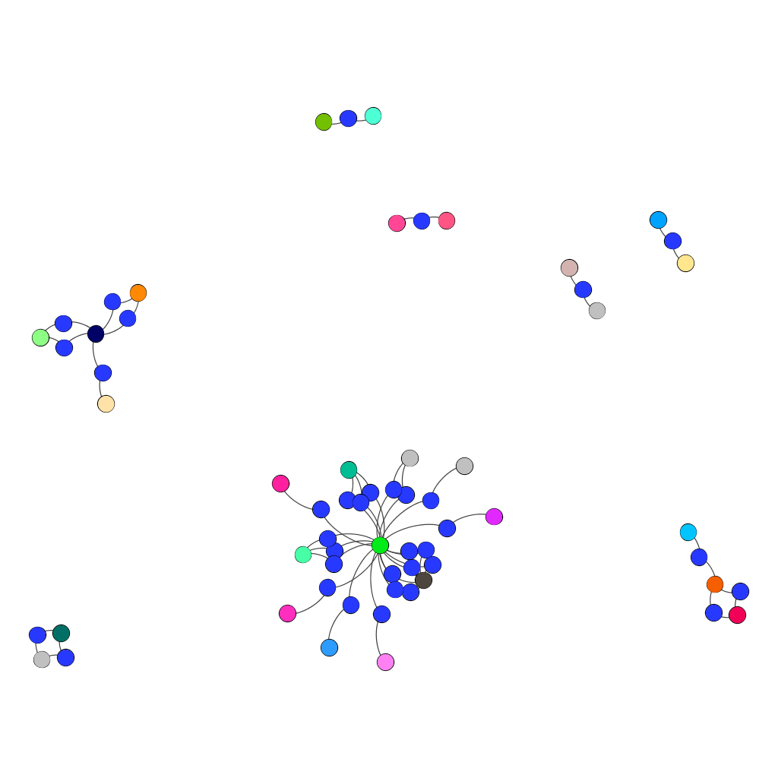



HIN Modelling
ABSA for email
Node 1
Node 3
Edge 1
Edge 2
Node 2:
Sender
Receiver
Notes:
To perform representation learning, we first model the email network as a HIN, where the nodes in the network can be either sender, receiver node, or the email node which encompasses the timestamp and ABSA results for the email

Slide 7
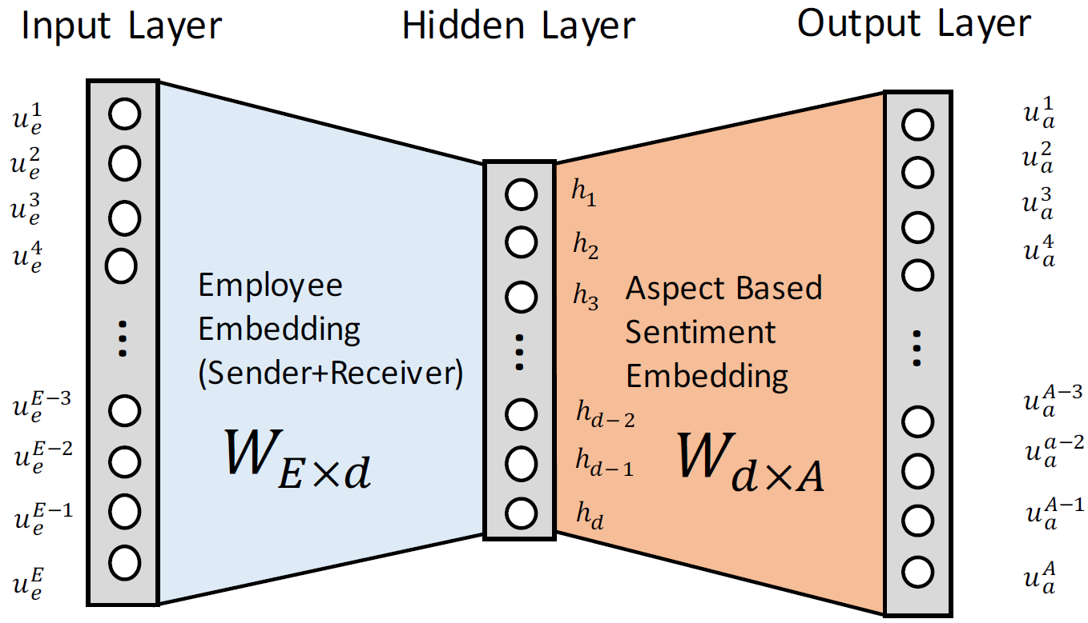
Revised skipgram model
Improvements:
Combines sender and receiver profile
Reduce number of parameters to train
Reduce number of training pairs
Code optimization

Slide 8
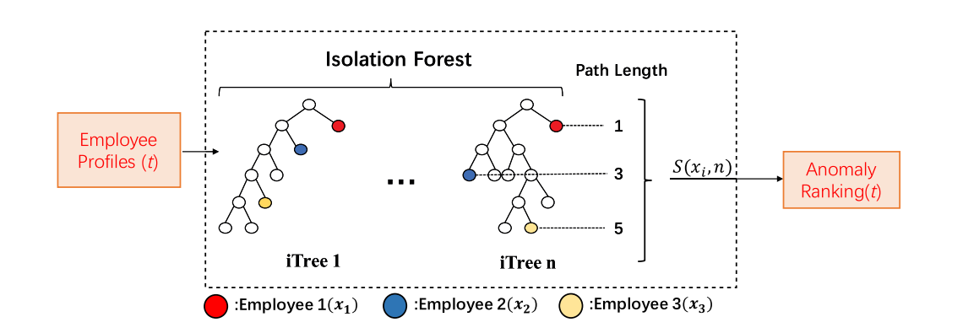
Anomaly Detection

Slide 9
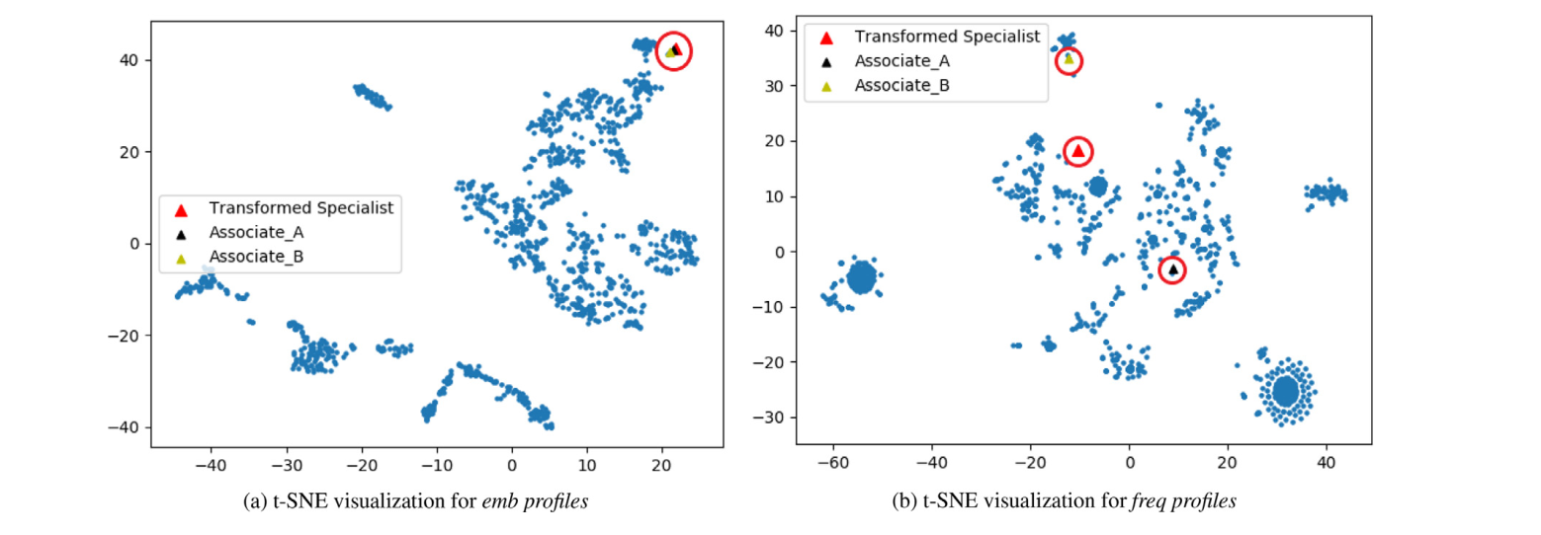
Results

Slide 10
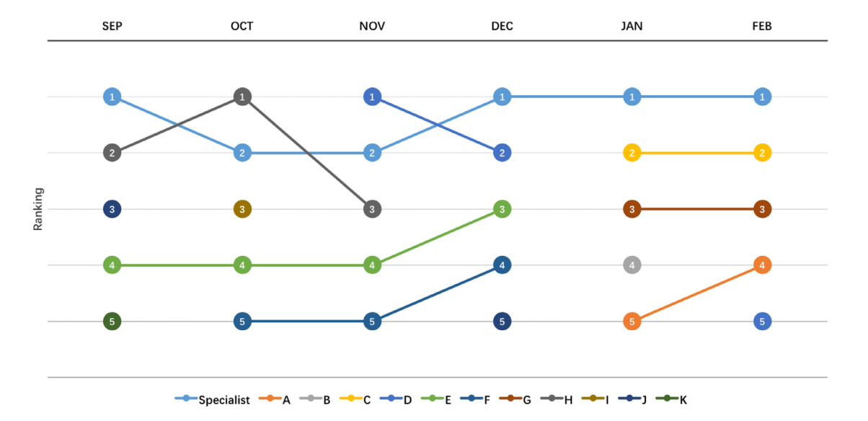
Risk Assessment Scores

Slide 11
Automated Motive Scoring in Text
Why the need for automation?
Traditional content-coding is time-consuming and requires well-trained human coders
Our Work:
Implementation of Bi-LSTM with attention framework combining feature analysis from rule-based system
Substantial improvement in accuracy
Integration with sub-system for insider threat analysis
Notes:
Why the need for automation:
Traditional way of scoring implicit motives in text requires well trained human coders who follow certain guidelines for scoring. This task is was highly time consuming and hence the need for automating the process.
As a part of team P2’s deliverable, a simple Bi-LSTM model was implemented to automate the scoring process.
However, with the highly unbalanced dataset and the complex nature of the task (e.g., multiple rules, ambiguity, etc.), a straightforward deep learning model as such could only achieve substandard performance.

Slide 12
Examples for motive and non-motive sentences
Motive Sentences:
Achievement:
Abraham Lincoln started the great revolution in America, in the year 1950.
We have sustained higher growth rate than any other organization.
Power:
By taking this step we will impress them with our capabilities
Affiliation:
We wish for friendship between our two countries
Non-motive sentences:
We endured the storm.
I was pissed
Routine Activities:
She convinced the jury
Negations:
He did not have very great power of reasoning.
Simple question:
Did she score well?

Slide 13
The Proposed Framework
Sentence scored for
Achievement motive
BERT
Deep learning framework for motive analysis
Word Embedding
Content Words
Manager
praised
John
doing
good
job
Content Extraction
Rule Based Analysis
POS tagging and Name Entity Recognition
The (DT)
manager (NN)
praised (VBD)
John (NNP) (Name)
for (IN)
doing (VBG)
a (DT)
good (JJ)
job (NN)
Input Sentence
The manager praised John for doing a good job.
Example

Slide 14
Performance Analysis- Beamforming

Slide 15

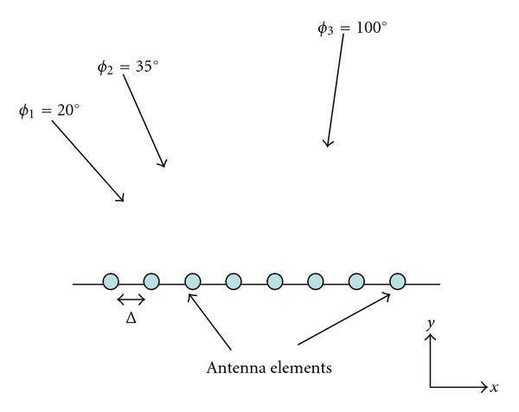

Direction of Arrival Estimation

Slide 16
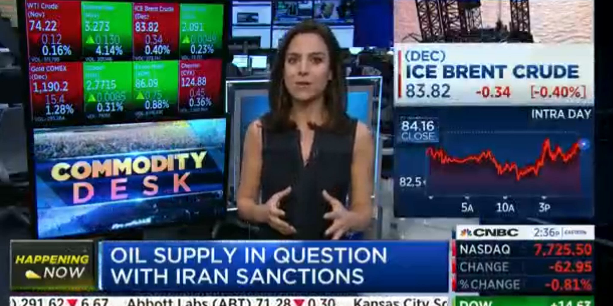
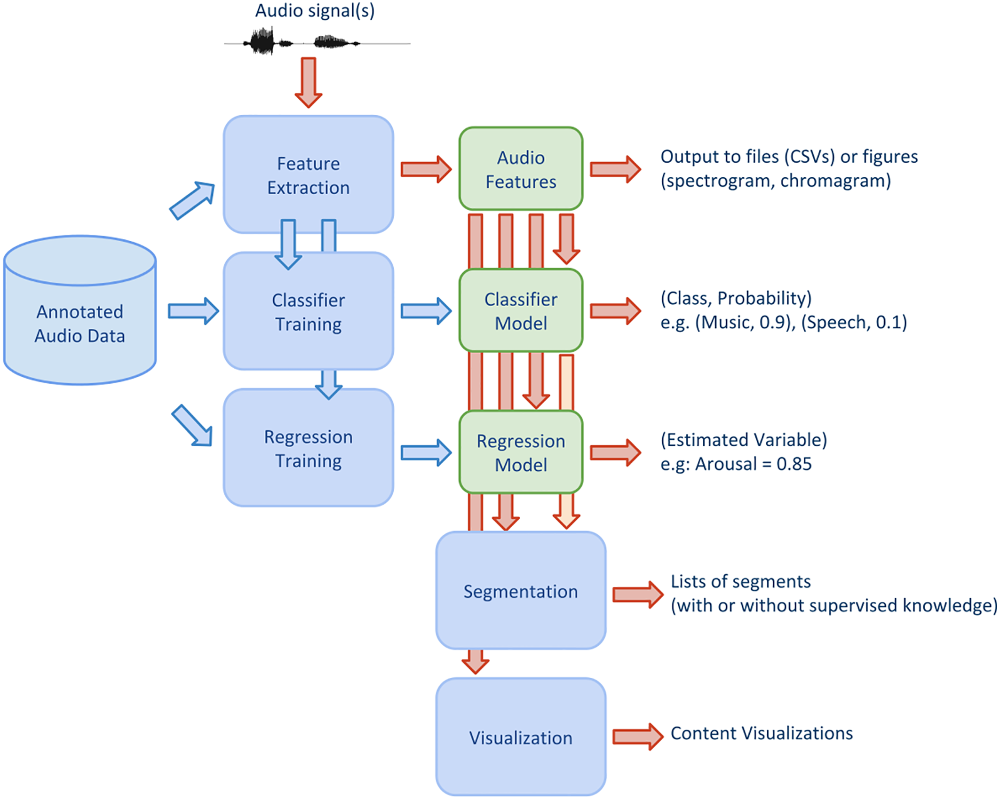
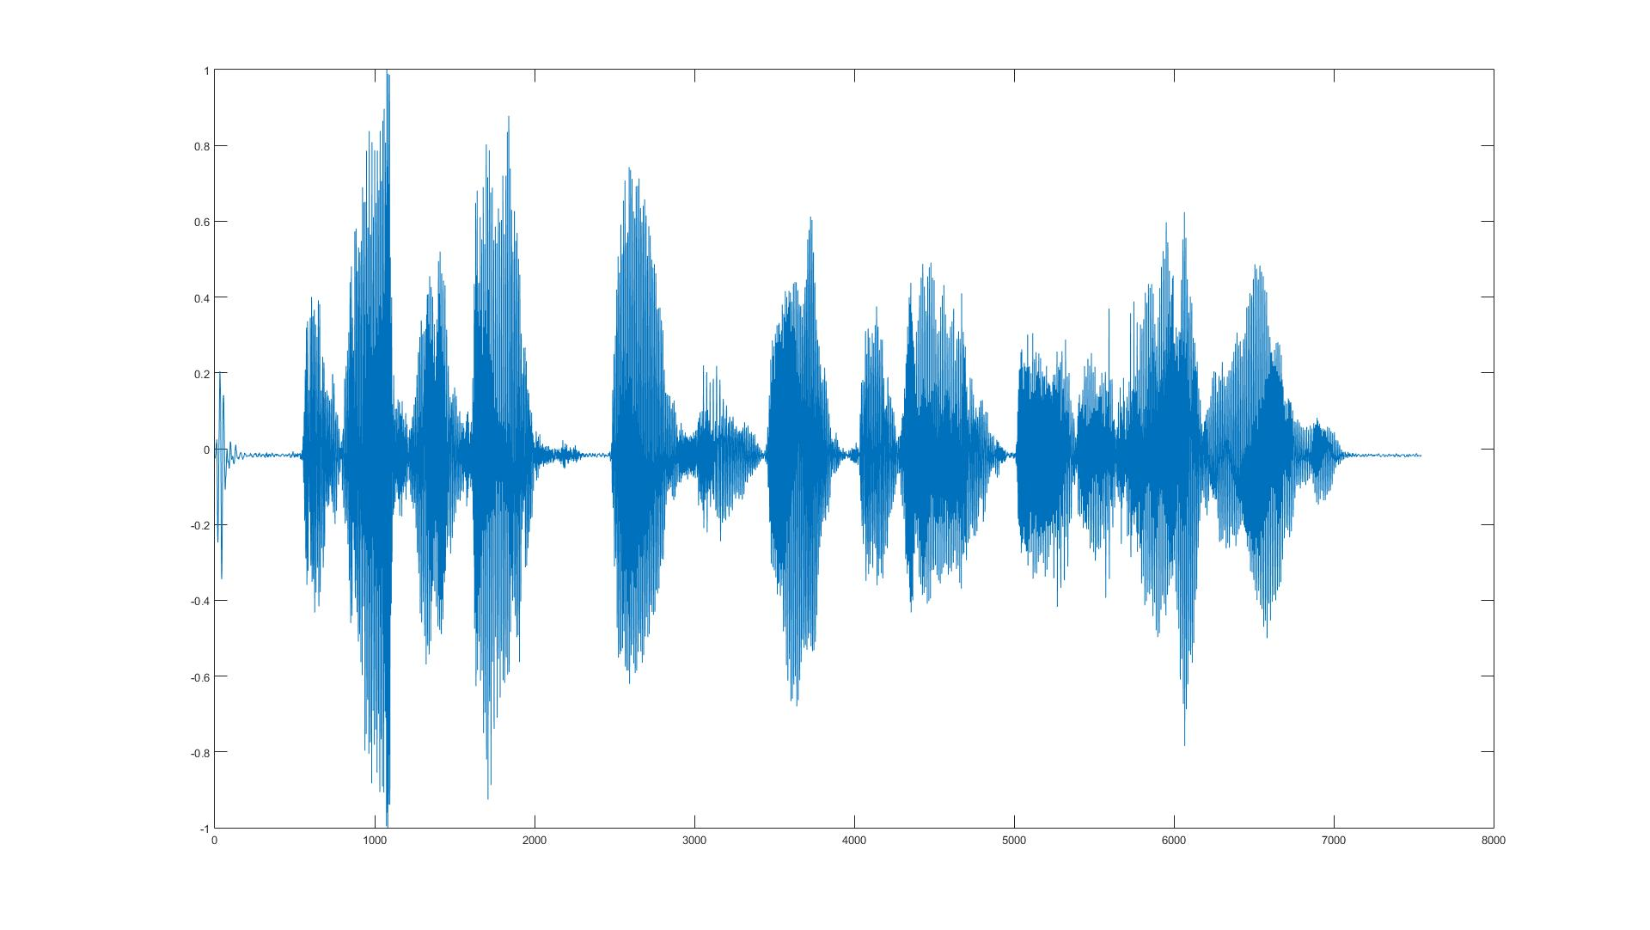
Audio Analysis

Slide 17
Thank You

Slide 18
ABSA evaluation (dataset)
Full Enron email corpus of 150 employees, incorporated with simulated insider scenario
Between December 2000 to October 2002
Labelled sentences split into 80% for training and 20% for testing
Total number of emails | 495,553
Number of aspect-based email sentences | 65,524
Number of labelled sentences | 4193 (6.399%)
Sentiment polarity breakdown (labelled sentences) | Positive: 1,118 Negative: 957 Neutral: 2,118
Techniques | Average Precision (%) | Average Recall (%) | Average F-measure (%) | Accuracy (%)
Revised ABSA Model | 68.44 | 68.44 | 68.44 | 68.44
Notes:
Total 4193 sentiment polarity from 2935 based on ? Aspects.

Slide 19
HIN Representation Learning using Skipgram
Input Layer
Output Layer
Sender ID, S
Receiver ID, R
Hidden Layer
Employee5
Employee1
…
…
…
(company, -1)
(company,-1)
…
ABSA Results, ABSA (Ac, A_{S})
Employee1
Employee5
Notes:
Given as instance in the HIN, such that employee1 sends an email comprising of a sentence with negative sentiment for the company aspect to employee5
The skipgram model can be trained by the target context pairs as shown in the figure.
Here, target refers to the input layer sender id and context refers to the output layer receiver id and the aspect categories and sentiment tuple
We discuss the experimental design to obtain the output for this module in the following

Slide 20
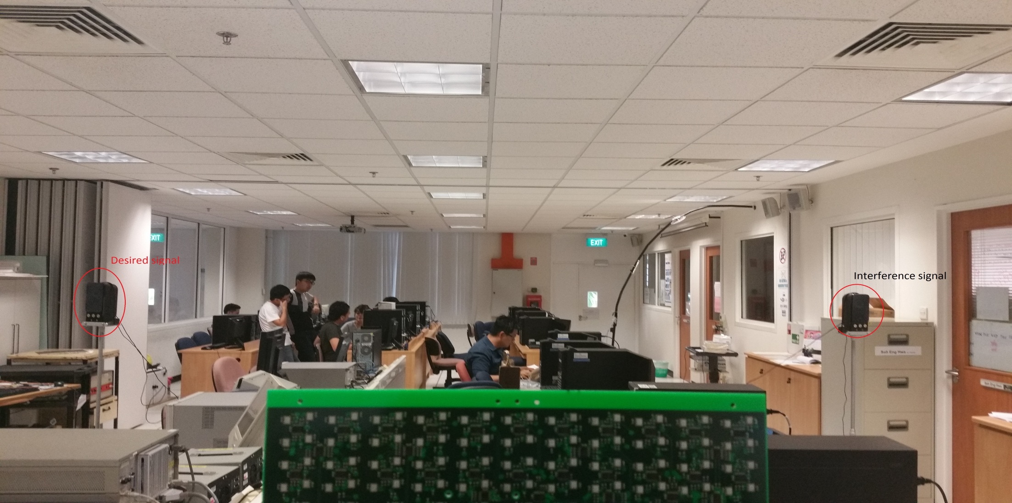
Test scenario

