Slide 1
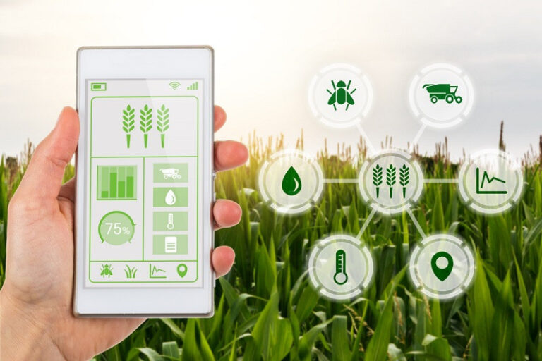
A.V.C COLLEGE OF ENGINEERING Department Of Computer Science & Engineering DIGITAL PLATFORM FOR FARMERS
-B.Santhoshini (820320104032)
-R.Sowndharya (820320104039)

Slide 2
ABSTRACT
The digital platform for farmers is a comprehensive online platform that serves as a one-stop-shop for farmers to access a variety of services and information related to agriculture.
This platform aims to enhance the efficiency and productivity of farming activities by providing farmers with access to real-time market information, weather updates, soil health analysis, and other relevant data. The platform also facilitates the buying and selling of agricultural products, connects farmers with buyers, and provides access to credit and insurance services.
With its user-friendly interface and customized features, the digital platform for farmers is an essential tool for small-scale and large-scale farmers alike, enabling them to make informed decisions and optimize their farming operations.

Slide 3
EXISTING SYSTEM
AGROSTAR - mobile app that connects Indian farmers with agriculture.
FARMLOGS - help farmers to manage their crops
FARMCROWDY - It is a Nigerian digital platform that allows farmers to raise capitals from investors.
HELLO TRACTOR - It is a platform that connects farmers with tractor owners in Africa.
EKUTIR – It is an Indian company that provide platform for small holder farmers

Slide 4
PROPOSING SYSTEM
CROP MANAGEMENT – Manage the crops more efficiently which includes soil moisture, temperature and other environmental factors.
MARKET ANALYSIS – It provides real time market data such as prices and demand.
WEATHER FORECASTING – It provides the farmers to keep them up-to-date by making decisions about irrigation, harvesting and other critical tasks.
FINANCIAL MANAGEMENT – It includes tools for tracking expenses, managing loans and credits, and monitoring the cash flow.
KNOWLEDGE SHARING – This features allows the farmers to share their tips for pest infestations, strategies for improving soil health etc..
MOBILE ACCESSIBILITY – This is very helpful for farmers to access the tools and information in the field via mobile phones.
INTEGRATION – Integrate with existing farming system such as GPS tracking, automated irrigation systems and machinery control systems.

Slide 5
TECHNOLOGY STACK
FRONT - END DEVELOPMENT: HTML, CSS and JAVASCRIPT.
BACK - END DEVELOPMENT: Use a server side language such as PYTHON or NODE.JS.
DATABASE: We can use MongoDB, Cassandra(used to manage the variety of data types),PostgreSQL(open source DB) and MySQL. Here we are using MySQL
CLOUD HOSTING: We can host the platform on cloud-based infrastructure such as AWS or Microsoft Azure
DATA VISUALIZATION: We could use the libraries such as D3,js or plotly(gain insights with trends and patterns) to provide farmers with interaction of their data.

Slide 6
MODULES AND THEIR DEFINITION
Crop Types: Types of crops in Tamil Nadu.
Crop details by district: Crop cultivation details by district wise.
Crop Problems: manage common pests and diseases that can affect their crops.
Crop solutions: It uses data and technology to optimize crop yields and minimize waste.
Traceability: It helps to trace their products from farm to market..
Equipments used in OTHER REGIONS: Smart tractors, mobile apps and soil sensors.
Equipments used in INDIA: Kisan Call Centers, Kishi Vigyan kendras, soil testing labs, Weather forecasting, Mobile apps and Farm machinery.

Slide 7
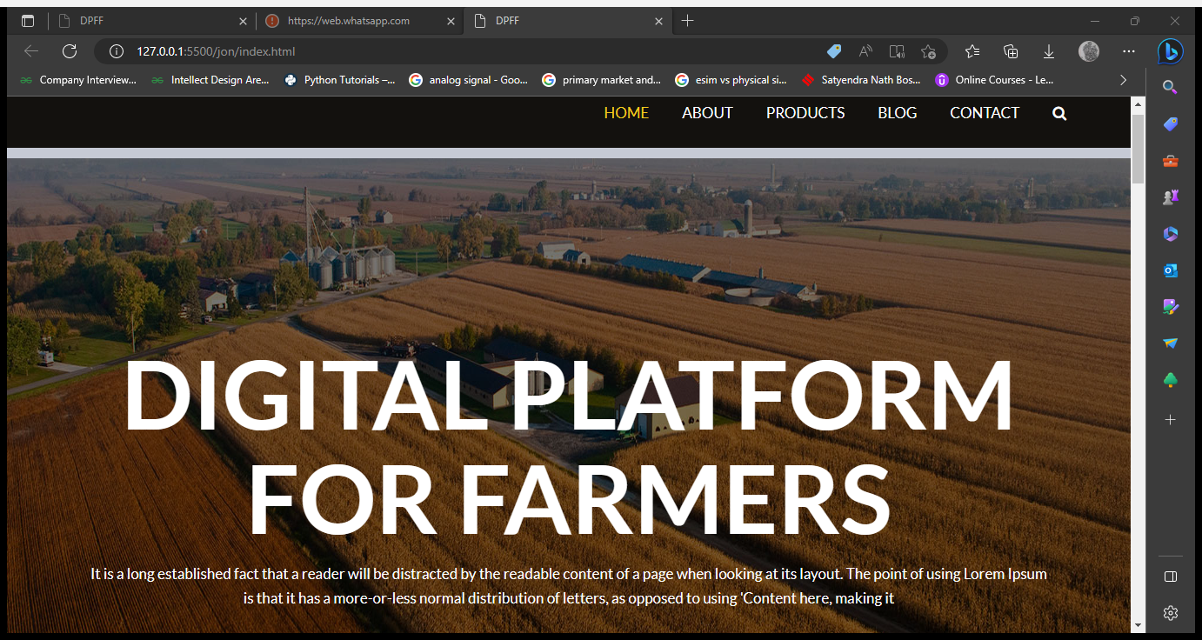
MODULES

Slide 8
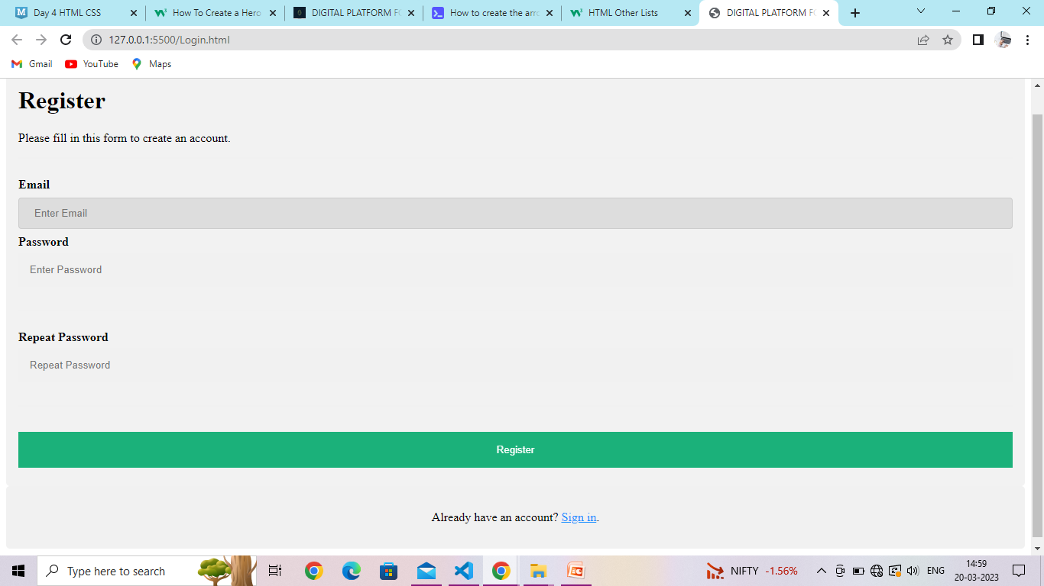

Slide 9
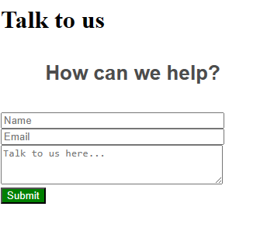
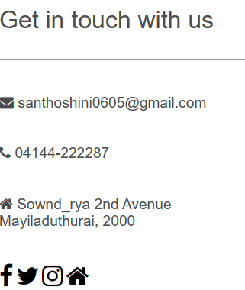

Slide 10
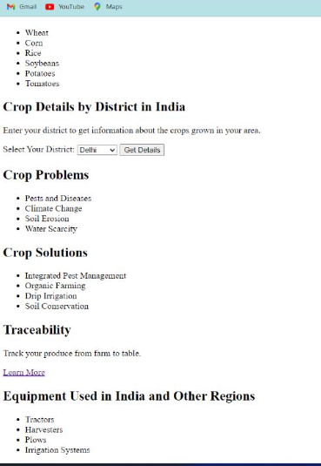

Slide 11
LITERATURE SURVAY
Shamshiri R., et al (2019), list the following use cases of Digital Agriculture:
• Sensor-based field mapping
• Wireless crop monitoring
• Climate monitoring and forecasting
• Stats on farm production
• Wireless equipment monitoring
• Predictive analytics for crop and livestock
• Livestock tracking and Geo-referencing
• Smart logistic and warehousing

Slide 12

Digital platforms for farmers have the potential to revolutionize the agricultural industry by improving efficiency, increasing yields, and reducing costs. These platforms offer a range of services, including access to markets, weather forecasts, agricultural inputs, and financial services.

