Slide 1

Air Quality Prediction Using Support Vector Regression
Santhosh Kumar
Data Science & Analyst Enthusiast

Slide 2
Problem Overview:
Air quality monitoring relies on expensive reference instruments
Low-cost sensors provide indirect and noisy measurements
Direct sensor readings cannot reliably estimate pollutant concentration
Objective: Evaluate whether SVR can map sensor signals to ground-truth pollutant values
Emphasis on both model performance and practical limitations

Slide 3
Dataset overview:
Dataset: UCI Air Quality Dataset (open source: Kaggle website)
Pollutants analyzed: CO, NOx, NO2, Benzene (C6H6)
Ground Truth values from reference-grade analyzers
Sensor signals from metal-oxide gas sensors (PT08.S1–PT08.S5)
NMHC(GT) excluded due to poor data quality (High missing data)

Slide 4
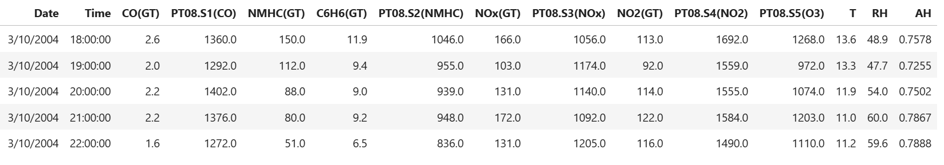
SAMPLE DATASET:

Slide 5
Data wrangling
Removed irrelevant and empty columns
Treated invalid readings (-200) as missing values and replaced with Nan
Used median to replace Nan for skewed sensor data and pollutants
Used mean for environmental variables
Created a clean, model-ready dataset for ML and visualization

Slide 6
Exploratory Insights
Benzene shows compact and stable distribution
NOx exhibits high variability and heavy-tailed behavior
Sensor signals are skewed and non-Gaussian
Clear differences in sensor sensitivity across pollutants
Insights guided model choice and evaluation expectations

Slide 7
Model Choice
Selected Support Vector Regression for robustness to noise
Linear SVR used as baseline model
RBF kernel used to capture non-linear sensor behavior
Feature scaling applied due to distance-based learning
Same modeling pipeline used across all target pollutants

Slide 8
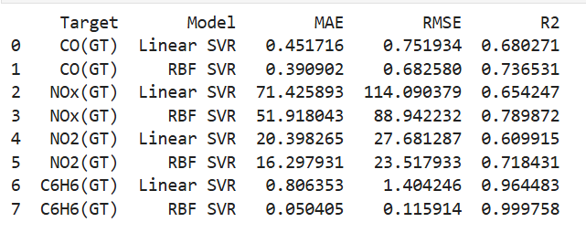
Model Performance Summary
RBF SVR consistently outperformed Linear SVR
Benzene achieved near-perfect predictability
CO and NO2 showed moderate prediction accuracy
NOx had the highest error due to chemical complexity
Performance differences reflect sensor–pollutant relationships

Slide 9
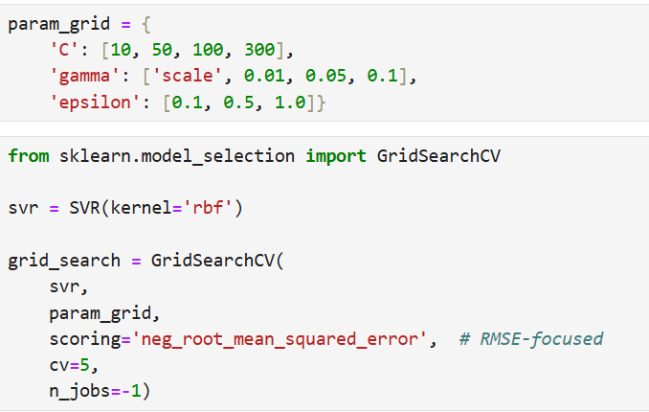
Hyperparameter Tuning
Tuning applied selectively to NOx due to high error
Focused on improving robustness under noisy conditions
Single-parameter tuning performed to avoid overfitting
Modest error reduction observed
Results highlight limits of ML with noisy sensor data

Slide 10
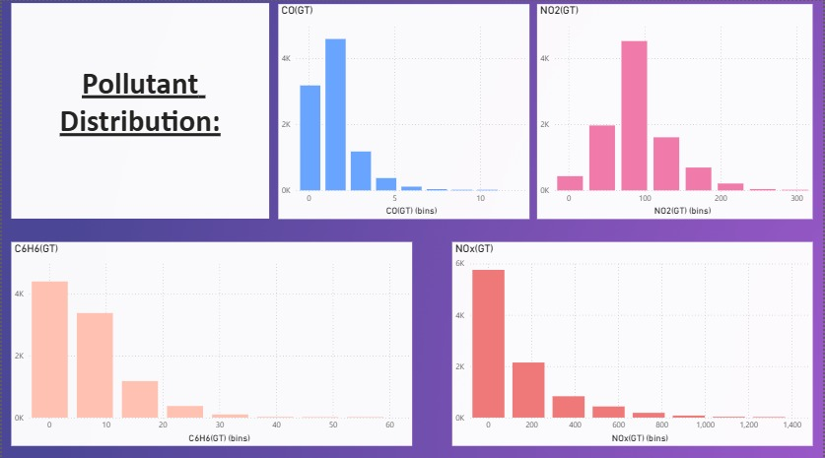
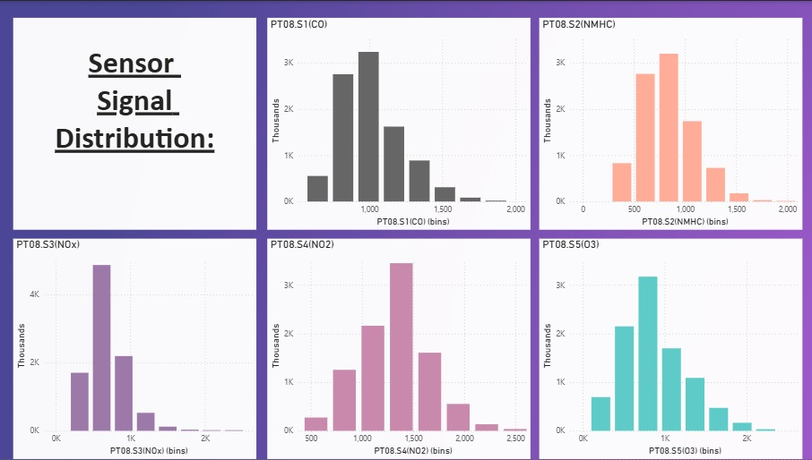
Power BI Dashboard

Slide 11
Conclusion
SVR effectively models non-linear sensor-pollutant relationships
Strong performance depends on sensor sensitivity
Benzene is highly predictable; NOx remains challenging
ML cannot fully overcome sensor noise limitations
Project demonstrates both capability and realism in applied ML

