Slide 1
Early Prediction of Diabetes Risk Using Machine Learning
Santhosh Kumar

Slide 2
Introduction
Diabetes is one of the most widespread chronic diseases worldwide, affecting millions of people across different age groups. According to the International Diabetes Federation, nearly 1 in 10 adults globally is diabetic, and this number is expected to rise in the coming decades.
The real challenge is that diabetes often develops silently. Many patients only discover it at an advanced stage, by which time complications such as cardiovascular disease, kidney damage, nerve problems, or vision loss may already have set in.

Slide 3
Early detection can prevent these complications and improve quality of life.
Traditional diagnosis relies on medical tests such as fasting blood glucose or HbA1c. While accurate, these tests are not always accessible or affordable in every setting.
A predictive model using demographic and symptom-based data could help identify individuals at risk early, allowing them to seek proper medical screening.

Slide 4
Problem Statement
The goal of this project is to build a machine learning model that predicts whether an individual is at risk of developing diabetes, based on their age, gender, and reported symptoms.
Key Objectives:
Analyze the relationship between demographic factors and symptoms.
Build and compare machine learning model to predict diabetes risk.

Slide 5
Identify the most important features contributing to risk prediction.
Provide insights that can help healthcare professionals in early-screening and preventive care.
Input Features: Age, Gender, Polyuria, Polydipsia, Sudden weight loss, Weakness, Polyphagia, Genital thrush, Visual blurring, Itching, Irritability, Delayed healing, Partial paresis, Muscle stiffness, Alopecia, Obesity
Output Features: Class(Positive - early diabetes signs, Negative – no risk)

Slide 6
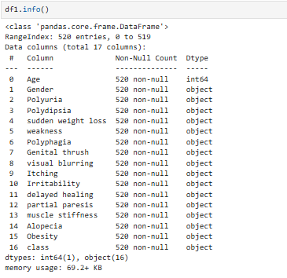
Dataset Overview
Source: Kaggle dataset.[Link]
Size: 520 rows × 17 features

Slide 7
Data Preprocessing
Encoding:
Converted categorical Yes/No → 1/0; Gender → binary.
Converted Gender (categorical column) to Binary value, using LabelEncoder
Converted Target variable(Class) to Binary value by assigning
1-Positive and 0-Negative

Slide 8
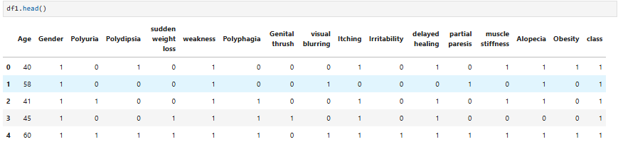

Slide 9
Exploratory Data Analysis (EDA)
Class Distribution:
Positive cases (at risk): 61.5% (320 records)
Negative cases: 38.5% (200 records)
Indicates that majority of individuals in this dataset show early signs of diabetes risk.
Gender Distribution:
Male: 328 (63%) &Female: 192 (37%)
Dataset contains more Male records as compared to Female records.

Slide 10
Gender vs Class:
Both males and females have high positive cases.
Females: 173 Positive vs 19 Negative → Higher risk prevalence.
Males: 147 Positive vs 181 Negative → More balanced.
Obesity vs Class:
Obesity appears in both Positive and Negative groups.
While obesity is a known risk factor, it alone doesn’t determine diabetes risk here.
Other symptoms combined with obesity likely provide stronger predictive power.

Slide 11
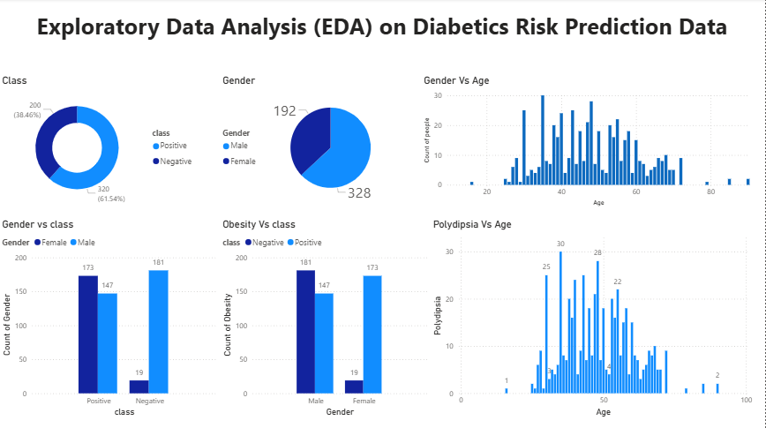
Age Distribution (Gender vs Age, Polydipsia vs Age):
Most individuals fall between 30–60 years.
Younger (<30) and older (>70) age groups are fewer but still present.
Polydipsia (excessive thirst) is more common in the 40–55 age range, aligning with typical diabetes onset age.

Slide 12
Model Building
Train-Test Split (75/25):
The dataset was split into 75% training and 25% testing to evaluate model performance on unseen data.
This ensures that the model generalizes well and avoids overfitting.
Baseline Model – Logistic Regression:
Logistic Regression was chosen as the baseline model due to its simplicity, interpretability, and ability to handle binary classification problems.

Slide 13
Tree-Based Model – Decision Tree:
A Decision Tree classifier was implemented to capture non-linear relationships and interactions between symptoms.
Hyperparameter Tuning :
To improve performance, GridSearchCV was used to tune hyperparameters for both Logistic Regression and Decision Tree models.
Pipeline Integration:
A Pipeline was created to automate the entire workflow:
Preprocessing: Encoding categorical features, scaling numerical variables.

Slide 14
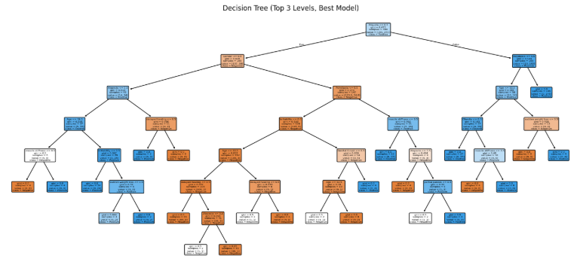

Slide 15
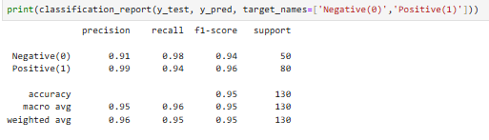
Model Evaluation:
Metrics to Report:
Accuracy: 95.38%
Precision: 98.68%
Recall/Sensitivity: 93.75%
F1-score: 96.15%
ROC-AUC curve: 97.35%

Slide 16
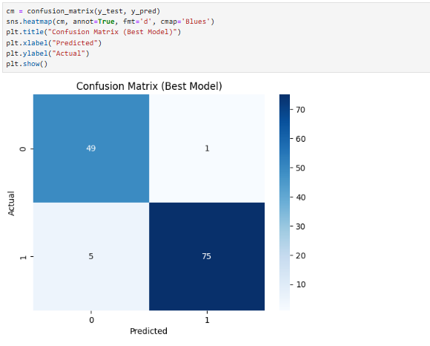
Confusion Matrix:

Slide 17
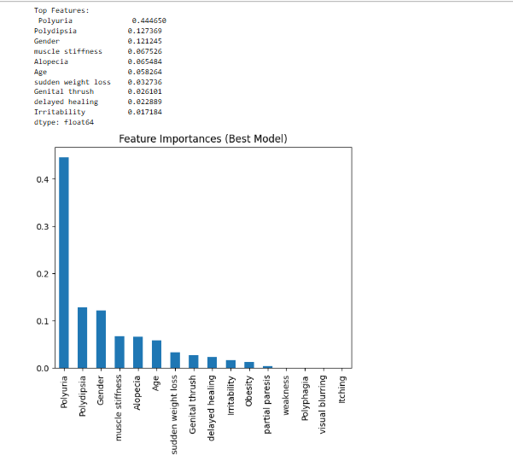
Feature Importance:
Top Features: Polyuria : 0.444650 Polydipsia : 0.127369 Gender : 0.121245 muscle stiffness : 0.067526 Alopecia : 0.065484 Age : 0.058264 sudden weight loss : 0.032736 Genital thrush : 0.026101 delayed healing : 0.022889 Irritability : 0.017184

Slide 18
Result:
The tuned Decision Tree model achieved outstanding performance (95%+ accuracy) with both high precision and recall, making it well-suited for healthcare applications where early risk detection is critical. Symptom-based predictors such as Polyuria and Polydipsia provide valuable insights for preventive screening.
Early detection through predictive modeling can guide individuals to seek medical screening sooner, reducing long-term health complications.
A streamlined pipeline ensures this solution can be scaled and deployed in real-world settings (hospital dashboards, health apps).

Slide 19

Links:
Python_notebook
Pipeline_python_notebook
Interactive_dashboard
Thank You!!!

