Slide 1



SRI RAMAKRISHNA INSTITUTE OF TECHNOLOGY, COIMBATORE-10 (An Autonomous Institution) (Educational Service: SNR Sons Charitable Trust) (Accredited by NAAC with ‘A’ Grade & NBA) (Approved by AICTE, New Delhi and permanently Affiliated to Anna University, Chennai)
Department of Computer Science and Engineering
Review 2
Web Server Log
Analysis System
Guided by:
Mr. Jim Mathew Philip,
Assistant Professor(Selection Grade),
CSE.
Presented by:
Vijaykrishnaa S – 1702128,
Santhosh Kumar P – 1702106,
Praveen K – 1702082.
1
Notes:
1

Slide 2
Introduction
In the digital era, Logs – everywhere and huge
Logs carry the most important pieces of information for troubleshooting if it is a problem.
If it is a Security Incident, logs are the primary focus for Incident Response.
Logs contain a large amount of information depending on the system being logged.
With the growth of Web Applications, there is huge need to log all events happening in the web application.
With the growth of internet connected systems, it is difficult for us to look up the entire log file manually.

Slide 3
SYSTEM ARCHITECTURE
Importing Log File
Extracting Information
Analysing
Visualisation
Results

Slide 4
MODULES
The Main Module:
The Main module consists of imports of all other modules, and it does the launch of the GUI application. (main.py)
The Front End GUI Module:
The Front End module has all the GUI handling parts like initiating the window, accessing and transferring controls over the processes, etc. (frontEndGUI.py)
The Log Analyzing Module:
The Log Analyzing module has the most fundamental part of the program – analyzing and segregating information about the web server log. (logaLyzer.py)
The Graph Generator Module:
Lastly, the Graph Generator module helps visualize the segregated data with help of graphs. (graphGenerator.py)

Slide 5
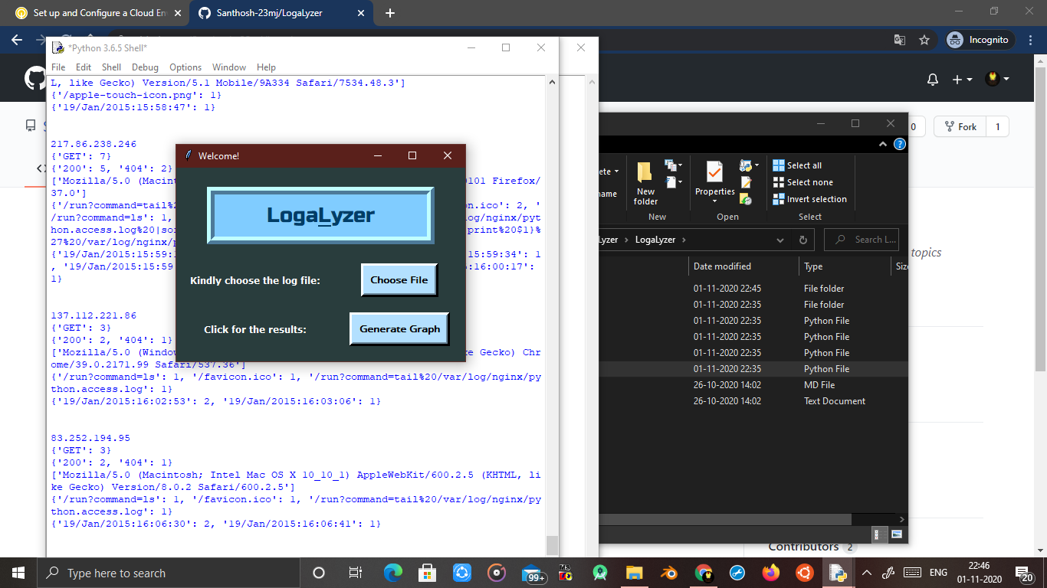
OUTPUT 1

Slide 6
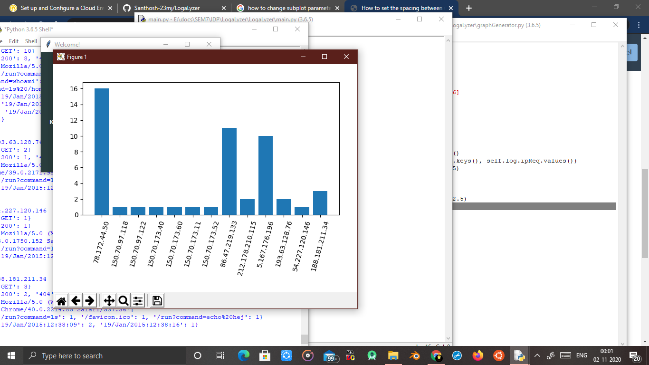
OUTPUT 1

Slide 7
Thank you!
Project’s GitHub Link: https://github.com/Santhosh-23mj/LogaLyzer

Slide 8
IN PROGRESS…

