Slide 1



SRI RAMAKRISHNA INSTITUTE OF TECHNOLOGY, COIMBATORE-10 (An Autonomous Institution) (Educational Service: SNR Sons Charitable Trust) (Accredited by NAAC with ‘A’ Grade & NBA) (Approved by AICTE, New Delhi and permanently Affiliated to Anna University, Chennai)
Department of Computer Science and Engineering
Review 3
Web Server Log
Analysis System
Guided by:
Mr. Jim Mathew Philip,
Assistant Professor(Selection Grade),
CSE.
Presented by:
Vijaykrishnaa S – 1702128,
Santhosh Kumar P – 1702106,
Praveen K – 1702082.
1
Sri Ramakrishna Institute Of Technology-Final Review
1
Notes:
13

Slide 2
Introduction
In the digital era, Logs – everywhere and huge
Logs carry the most important pieces of information for troubleshooting if it is a problem.
If it is a Security Incident, logs are the primary focus for Incident Response.
Logs contain a large amount of information depending on the system being logged.
With the growth of Web Applications, there is huge need to log all events happening in the web application.
With the growth of internet connected systems, it is difficult for us to look up the entire log file manually.
2
Sri Ramakrishna Institute Of Technology-Final Review
Notes:
<number>

Slide 3
ABSTRACT
This project is based on analysis of Log files from web servers.
Log files from the web servers are fed as input to the system and it reads the entire log file and things are visually summarised using graphs.
The information showed visually are IP and their counts, Request method and their counts, User-Agents used, files and their frequency of access.
From this output wide variety of tasks can be done further, like analysing User-Agents and provide more features.
3
Sri Ramakrishna Institute Of Technology-Final Review

Slide 4
LITERATURE SURVEY
S. NO. | NAME | TECHNIQUES | MERITS | FUTURE WORK
1 | Analysis of Web Site Using Web Log Expert Tool Based on Web Data Mining. | Web mining, Web Access Logs, Log Files, Analysing. | Determination of System Error, Helps improving Terms and Policies. | Effective improvement of the Algorithm.
2 | Web Usage Pattern Analysis Through Web Logs: A Review. | Web usage pattern, Web server log, Knowledge extraction. | Discovering hidden patterns, identifying non-human users(bots). | Measures to improve popularity using recommendations system.
Sri Ramakrishna Institute Of Technology-Final Review
3

Slide 5
EXISTING SYSTEM
The Existing System contains the methods to analyse the log for number of visitors, errors in the system, getting user reports to check for bots, etc.
We cannot see an effective GUI in the existing project.
Sri Ramakrishna Institute Of Technology-Final Review
5

Slide 6
PROPOSED SYSTEM
Along with the features if the existing system, we are trying to give more user friendly visualisations.
This can be done with the help of good GUI system in the project.
We are also trying to improve the output graphs for easier understanding.
Sri Ramakrishna Institute Of Technology-Final Review
6

Slide 7
Importing Log File
Extracting Information
Analysing
Visualisation
Results
SYSTEM ARCHITECTURE
6
Sri Ramakrishna Institute Of Technology-Final Review

Slide 8
ACTIVITY DIAGRAM
Launch App
Select Log File
Analyse Log File
Analyse another Log File
Export Output
Get Output
6
Sri Ramakrishna Institute Of Technology-Final Review

Slide 9
MODULES
The Main Module:
The Main module consists of imports of all other modules, and it does the launch of the GUI application. (main.py)
The Front End GUI Module:
The Front End module has all the GUI handling parts like initiating the window, accessing and transferring controls over the processes, etc. (frontEndGUI.py)
The Log Analyzing Module:
The Log Analyzing module has the most fundamental part of the program – analyzing and segregating information about the web server log. (logaLyzer.py)
The Output Generator Module:
Lastly, the Graph Generator module helps visualize the segregated data with help of graphs. (outputGenerator.py)
9
Sri Ramakrishna Institute Of Technology-Final Review

Slide 10
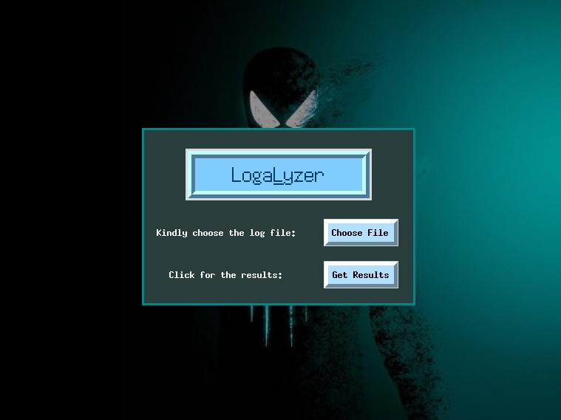
OUTPUT 1
Sri Ramakrishna Institute Of Technology-Final Review
9

Slide 11
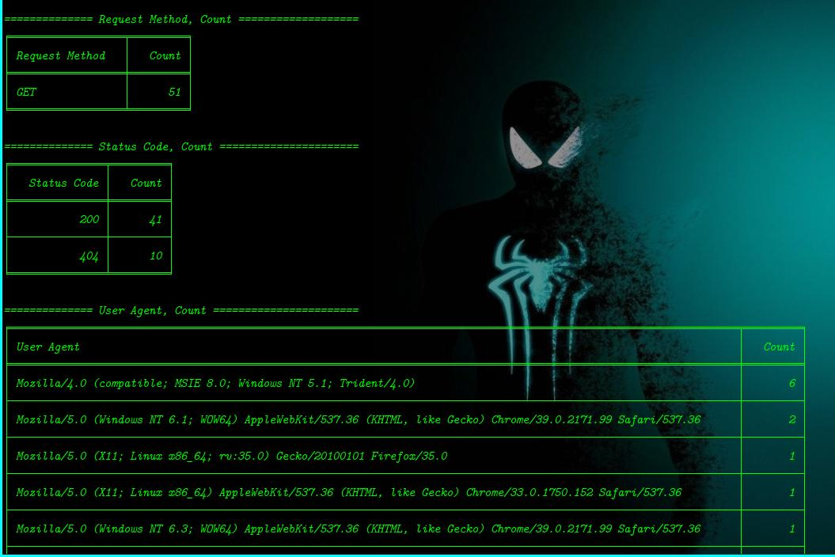
OUTPUT 2
Sri Ramakrishna Institute Of Technology-Final Review
9

Slide 12
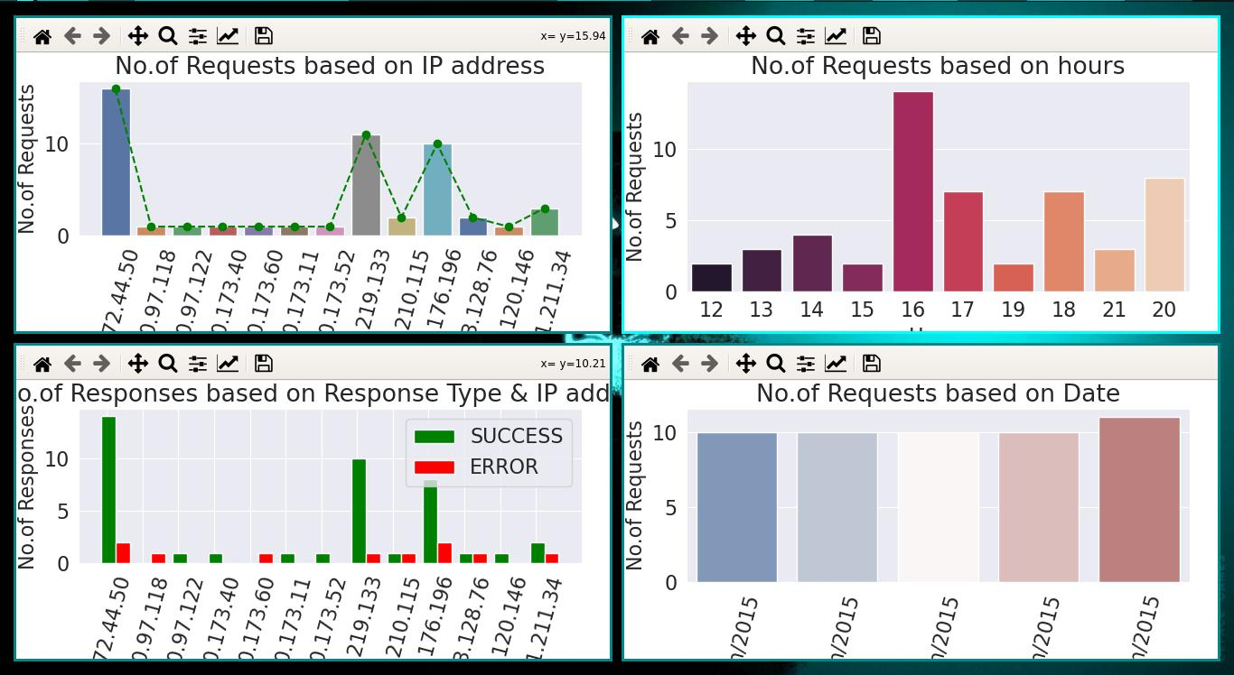
OUTPUT 3
Sri Ramakrishna Institute Of Technology-Final Review
9

Slide 13
Thank you!
Project’s GitHub Link: https://github.com/vijaykrishnaas/LogaLyzer
Sri Ramakrishna Institute Of Technology-Final Review
13

