Slide 1
TOPIC : A MATERIAL DESIGN STUDY APP
TEAM MEMBERS:
SRI RAM C
SANTHOSH S
SUSTHIK RAJA G
MATHAN KUMAR

Slide 2
DESCRIPTION
A Material Design study app is an educational tool designed to help users organize, manage, and track their learning activities through an intuitive and visually appealing interface inspired by Google’s Material Design principles. The app aims to provide a streamlined, user-friendly experience that makes studying more efficient and enjoyable by offering easy navigation, interactive elements, and personalized learning tools. The core features of this app would include: Organized Study Materials: Users can categorize study materials by subject, topic, or lesson, with visually distinct cards and lists for easy browsing and access. Task Management: The app allows users to set tasks, reminders, and study goals, helping them stay on track with their study plans. Study Timers: A built-in timer or Pomodoro clock helps users manage study sessions and break times, encouraging focused, productive learning.

Slide 3
PROGRAM:
Package com.example.owlapplication import android.content.Context import android.content.Intent import android.os.Bundle import androidx.activity.ComponentActivity import androidx.activity.compose.setContent import androidx.compose.foundation.Image import androidx.compose.foundation.clickable import androidx.compose.foundation.layout.* import androidx.compose.foundation.rememberScrollState import androidx.compose.foundation.verticalScroll import androidx.compose.material.Card import androidx.compose.material.Text import androidx.compose.runtime.Composable import androidx.compose.ui.Alignment import androidx.compose.ui.Modifier import androidx.compose.ui.draw.scale import androidx.compose.ui.graphics.Color import androidx.compose.ui.res.painterResource import androidx.compose.ui.res.stringResource import androidx.compose.ui.text.font.FontWeight import androidx.compose.ui.text.style.TextAlign

Slide 4
Class MainActivity : ComponentActivity() { override fun onCreate(savedInstanceState: Bundle?) { super.onCreate(savedInstanceState) setContent { StudyApp(this) } } } @Composable fun StudyApp(context: Context) { Column( modifier = Modifier .padding(20.dp) .verticalScroll(rememberScrollState()) ) { Spacer(modifier = Modifier.height(20.dp))

Slide 5
Column( horizontalAlignment = Alignment.CenterHorizontally ) { Image( painterResource(id = R.drawable.img_1), contentDescription = “”, modifier = Modifier .height(150.dp) .scale(scaleX = 1.2F, scaleY = 1F) ) Text(text = stringResource(id = R.string.course1),color = Color(0xFFFFA500), fontSize = 16.sp) Text( text = stringResource(id = R.string.topic1), fontWeight = FontWeight.Bold, fontSize = 20.sp, textAlign = TextAlign.Center, ) } } Spacer(modifier = Modifier.height(20.dp))

Slide 6
Mainactivity2.Kt: package com.example.owlapplication import android.os.Bundle import androidx.activity.ComponentActivity import androidx.activity.compose.setContent import androidx.compose.foundation.Image import androidx.compose.foundation.background import androidx.compose.foundation.layout.* import androidx.compose.foundation.rememberScrollState import androidx.compose.foundation.verticalScroll import androidx.compose.material.Text import androidx.compose.runtime.Composable import androidx.compose.ui.Alignment import androidx.compose.ui.Modifier import androidx.compose.ui.draw.scale import androidx.compose.ui.graphics.Color import androidx.compose.ui.res.painterResource import androidx.compose.ui.res.stringResource import androidx.compose.ui.text.font.FontWeight import androidx.compose.ui.text.style.TextAlign import androidx.compose.ui.unit.dp

Slide 7
Spacer(modifier = Modifier.height(60.dp)) Text( text = stringResource(id = R.string.course1), color = Color(0xFFFFA500), fontSize = 16.sp, modifier = Modifier.align(Alignment.CenterHorizontally) ) Spacer(modifier = Modifier.height(20.dp)) Text( text = stringResource(id = R.string.topic1), fontWeight = FontWeight.Bold, fontSize = 26.sp, modifier = Modifier.align(Alignment.CenterHorizontally) ) Spacer(modifier = Modifier.height(20.dp)) Text( text = stringResource(id = R.string.subheading1_1), modifier = Modifier.align(Alignment.Start), fontSize = 20.sp )

Slide 8
UserDatabaseHelper.Kt: package com.example.owlapplication import android.annotation.SuppressLint import android.content.ContentValues import android.content.Context import android.database.Cursor import android.database.sqlite.SQLiteDatabase import android.database.sqlite.SQLiteOpenHelper class UserDatabaseHelper(context: Context) : SQLiteOpenHelper(context, DATABASE_NAME, null, DATABASE_VERSION) { companion object { private const val DATABASE_VERSION = 1 private const val DATABASE_NAME = “UserDatabase.db” private const val TABLE_NAME = “user_table” private const val COLUMN_ID = “id” private const val COLUMN_FIRST_NAME = “first_name” private const val COLUMN_LAST_NAME = “last_name” private const val COLUMN_EMAIL = “email” private const val COLUMN_PASSWORD = “password” }

Slide 9
Override fun onCreate(db: SQLiteDatabase?) { val createTable = “CREATE TABLE $TABLE_NAME (“ + “$COLUMN_ID INTEGER PRIMARY KEY AUTOINCREMENT, “ + “$COLUMN_FIRST_NAME TEXT, “ + “$COLUMN_LAST_NAME TEXT, “ + “$COLUMN_EMAIL TEXT, “ + “$COLUMN_PASSWORD TEXT” + “)” db?.execSQL(createTable) } override fun onUpgrade(db: SQLiteDatabase?, oldVersion: Int, newVersion: Int) { db?.execSQL(“DROP TABLE IF EXISTS $TABLE_NAME”) onCreate(db) } fun insertUser(user: User) { val db = writableDatabase val values = ContentValues() values.put(COLUMN_FIRST_NAME, user.firstName) values.put(COLUMN_LAST_NAME, user.lastName) values.put(COLUMN_EMAIL, user.email)

Slide 10
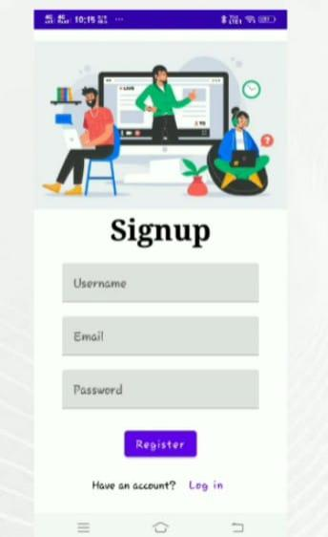

Slide 11
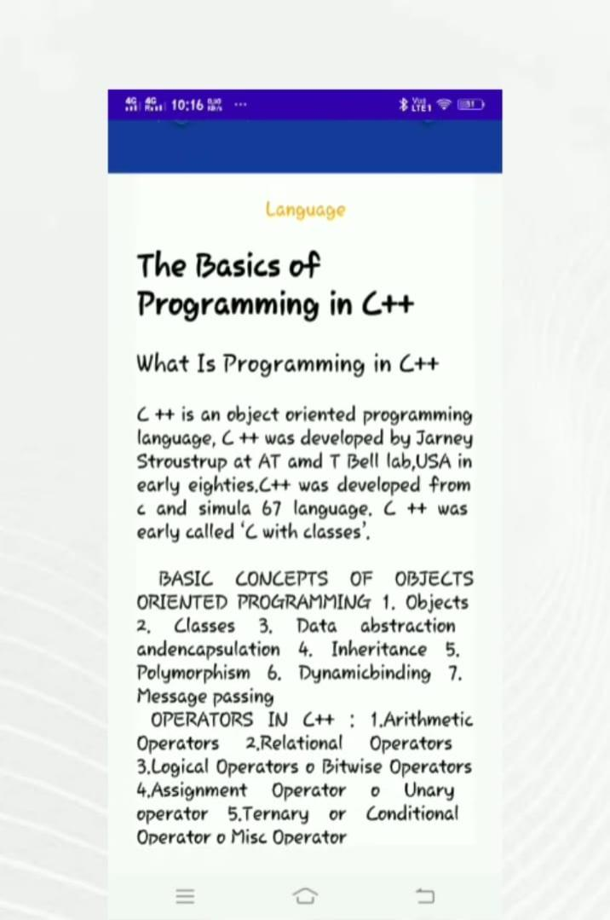

Slide 12
