Slide 1

Spring Boot

Slide 2
What is Spring Boot
Spring – Framework
Boot – BootStrap
Bootstrap spring application from the scratch

Slide 3
What is Spring Boot?
Official definition (spring.io):
Spring Boot makes it easy to create stand-alone, production-grade Spring based applications that you can "just run“
Developed by Pivotal Team
Used to create micro services
Notes:
Anonymous1.java

Slide 4
What is micro service?
An architecture that allows the developers to develop and deploy services independently.
Each service has its own process and this achieves the lightweight model to support business applications.

Slide 5
Problems with Spring
Huge framework
Multiple setup steps (Spring can do many things)
Multiple configuration steps
Multiple build and deploy steps
Handling dependency management is a difficult task when the project grows
Spring boot will abstract out these steps
So that we can focus only on business logic
Notes:
Anonymous1.java

Slide 6
Spring Boot - Characteristics
Opinionated
Start with something (Good starting point)
Tweak it later based on requirements
Convention over configuration (Look at 80% use cases)
Stand alone (Just run, no looking for servlet container & configure etc.)
Production ready
Notes:
Anonymous1.java

Slide 7
Spring Boot - Characteristics
You can get started with minimum configurations without the need for an entire Spring configuration setup.
Notes:
Anonymous1.java

Slide 8
Spring Boot - Advantages
Easy to understand and develop spring applications
Increases productivity
Reduces the development time
Notes:
Anonymous1.java

Slide 9
Spring Boot – Goals
To avoid complex XML configuration in Spring
To develop a production ready Spring applications in an easier way
To reduce the development time and run the application independently
Offer an easier way of getting started with the application
Notes:
Anonymous1.java

Slide 10
Spring Boot – Set up
- JAVA 8 JDK
- Spring STS (Spring Tool Suite)
- flavor of Eclipse
- tweaked to work with spring boot
- Download from https://spring.io/tools3/sts/all
- Java dependencies:
Use Maven as dependency management tool
Notes:
Anonymous1.java

Slide 11
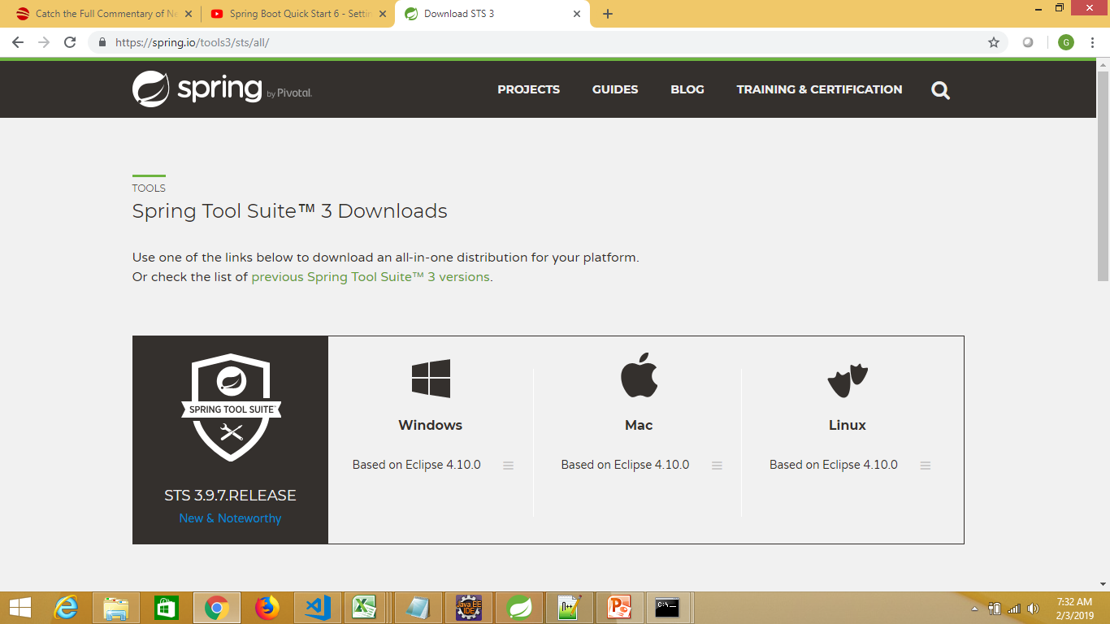
Download STS and install https://spring.io/tools3/sts/all/

Slide 12
Managing Dependencies
In Enterprise applications, we depend on other libraries (.jar files)
Downloading and keeping in the classpath – difficult step, we need to manage such dependencies
For Spring Boot, we will be using MAVEN as dependency management tool

Slide 13
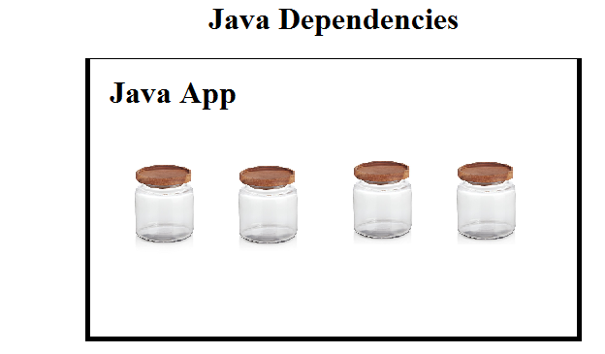
Java Dependencies
Normally, we go to websites
Download required jar files
Add to the classpath

Slide 14
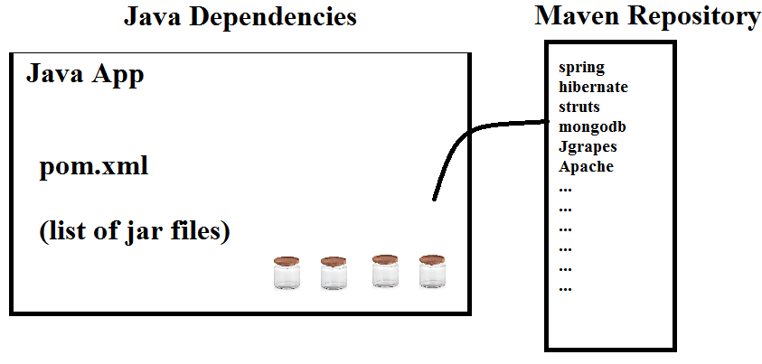
Java Dependencies with Maven

Slide 15
Create starter project with Maven
We can use Maven to create starter project
Starter project: Template (using archetype)
Archetype is a Maven project templating toolkit. An archetype is defined as an original pattern or model from which all other things of the same kind are made.
So, we will be using this concept to create spring boot application too

Slide 16
Creating spring boot application
There are multiple ways:
1. Create a simple maven project, turn it into Spring Boot application
2. Using online Spring Intializr
3. Using Spring Boot CLI with groovy scripts
4. Using Spring Starter Project in STS
Notes:
Anonymous1.java

Slide 17
Creating a maven project
Create a Maven Project and make it as a child of spring-boot-starter-parent, has opinionated setup (default configuration for instance, JDK).
Add in pom.xml:
<parent>
<groupId>org.springframework.boot</groupId>
<artifactId>spring-boot-starter-parent</artifactId>
<version>1.4.2.RELEASE</version>
</parent>
<parent> is the maven concept (Inheritance)
Notes:
Anonymous1.java

Slide 18
Do you know?
<parent>
<groupId>org.springframework.boot</groupId>
<artifactId>spring-boot-starter-parent</artifactId>
<version>1.4.2.RELEASE</version>
</parent>
This version would go ahead and pull all the pre-set versions of required jar files
We don’t need to worry about the versions of individual jar files
This is called as “Bill Of Materials”, which is approved by Spring Boot
Notes:
Anonymous1.java

Slide 19
Include meta-dependency
Next, we want to create web application (think about all dependent .jar files)
Add in pom.xml and update maven project:
<dependencies>
<dependency>
<groupId>org.springframework.boot</groupId>
<artifactId>spring-boot-starter-web</artifactId>
</dependency>
</dependencies>
This starter project has all the dependency list (.jar) so we don’t need to list out individual jar files
Notes:
Anonymous1.java

Slide 20
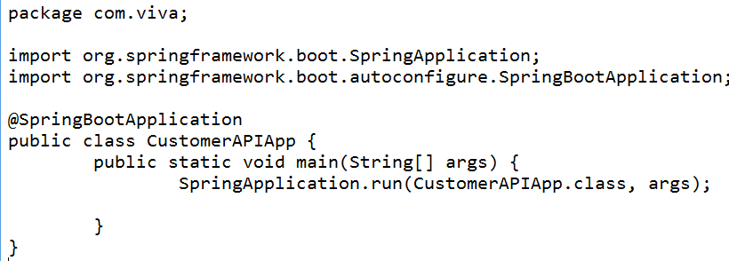
Create a Java class with main method
Name: CustomerAPIApp
Add main() method
This is going to bootstrap the application
Notes:
Anonymous1.java

Slide 21
Run the project Java Application
Right click this class
Run as Java application
This is just a dummy project
It has nothing
Let’s add the controller class now
Look at the console:
Notes:
Anonymous1.java

Slide 22
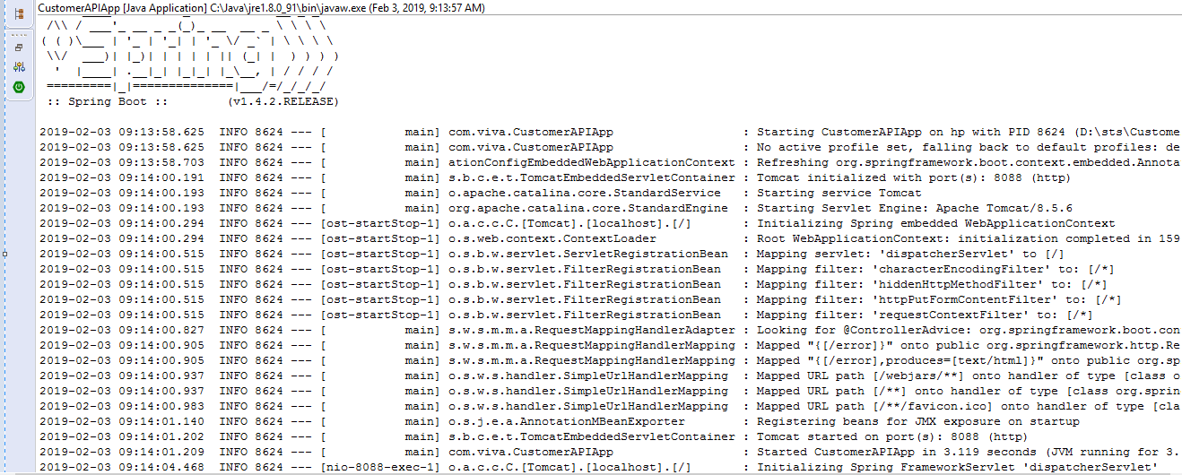
Look at the console
Notes:
Anonymous1.java

Slide 23
Changing the container’s port no
If any other application listens to port number 8080
You would get a failure message
In this case, we need to change the port number of the tomcat container
Just add “application.properties” with the following one line to /src/main/resources folder and restart the application
server.port = 8088
Now, tomcat will be started on port no. 8088
Notes:
Anonymous1.java

Slide 24
Starting Spring Boot The magic line - SpringApplication.run()
1. Sets up default configuration (addresses 80% use cases) – convention over configuration
2. Starts Spring application context (Spring Container)
- Creates a contains - runtime environment
- starts when spring application starts
3. Performs class path scan
- Marking your class with annotation
- Looking at the annotation, it will be creating
component accordingly
4. Starts tomcat server
Notes:
Anonymous1.java

Slide 25
The magic of annotation
The spring framework scans all the classes for the annotations:
@controller – the class will be treated as controller class
@service – the class will be treated as service class
@SpringBootApplication – the class will be treated as spring boot application
Spring infers all this from annotations

Slide 26
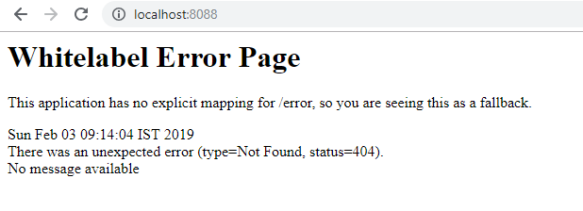
Access the URL
http://localhost:8088/
It would display the error page, since there is no explicit mapping, so you would get a fall back page
Notes:
Anonymous1.java

Slide 27
Why Spring Boot is stand-alone?
Did you add Tomcat container?
All you needed was to just invoke the run method on SpringApplication class
You didn’t need to download any .jar files
Running a web application is just like running a stand-alone Java program from a main method.
Notes:
Anonymous1.java

Slide 28
Add a controller class
Let’s map a URL to a controller class
So, when we access the URL, let’s display some message on the browser
Let’s start with a simple example ←
http://localhost:8080/hi ← URL (‘hi’ is the request)
We should display “Hi to Spring Boot”
Notes:
Anonymous1.java

Slide 29
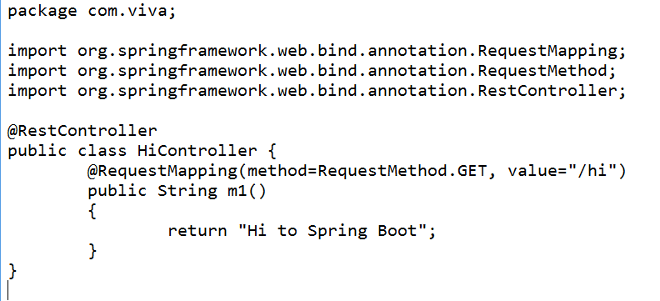
Add Controller class
Controller class is a Java class
It has @RestController annotation at class level
It has @RequestMapping annotation at method level
The web layer in Spring Boot application leverages spring-mvc framework which is a child project of entire spring framework.
Notes:
Anonymous1.java

Slide 30
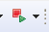
Restart the application
Click the Relaunch icon from STS
Open the browser
Type:
http://localhost:8080/hi
It should print "Hi to Spring Boot"
Notes:
Anonymous1.java

Slide 31
Modularize your app
For better modularity, you can place this class in another package “com.ofss.mycontroller”
Notes:
Anonymous1.java

Slide 32
Spring Boot Starters
Dependency management is a difficult task for big projects.
Spring Boot resolves this problem by providing a set of dependencies for developers convenience.
For instance, if you want to use Spring and JPA for database access, it is sufficient if you include spring-boot-starter-data-jpa dependency in your project (pom.xml)

Slide 33
Spring Boot Starters
Note that all Spring Boot starters follow the same naming pattern spring-boot-starter- *, where * indicates that it is a type of the application.
Examples:
spring-boot-starter-web
spring-boot-starter-actuator
spring-boot-starter-security
spring-boot-starter-thymeleaf
More can be found at https://docs.spring.io/spring-boot/docs/current/reference/html/using-boot-build-systems.html

Slide 34
Case Study – Customer Management System
Imagine, we are going to build REST API using Spring Boot for a Chartered Accountant
The CA maintains different customers’ data
The main entities are:
CUSTOMER
BANK
PORTFOLIO
I am going to walk through this problem throughout this course and show the implementation
Notes:
Anonymous1.java

Slide 35
Returning list objects
Building a REST API:
http://localhost:8088/customers
It should return a list of customer objects
We need a Customer class with properties like firstName, phoneNumber, emailId
Create some good bunch of Customer objects (with values) and add it to Collection List
Return this list from the controller class
Implement this and restart the application
Notes:
Anonymous1.java

Slide 36
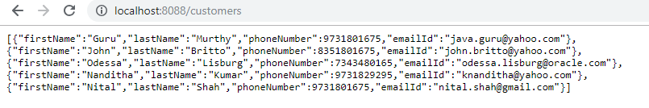
Returning objects
When the URL is fired, it would return an array of JSON objects
Notes:
Anonymous1.java

Slide 37
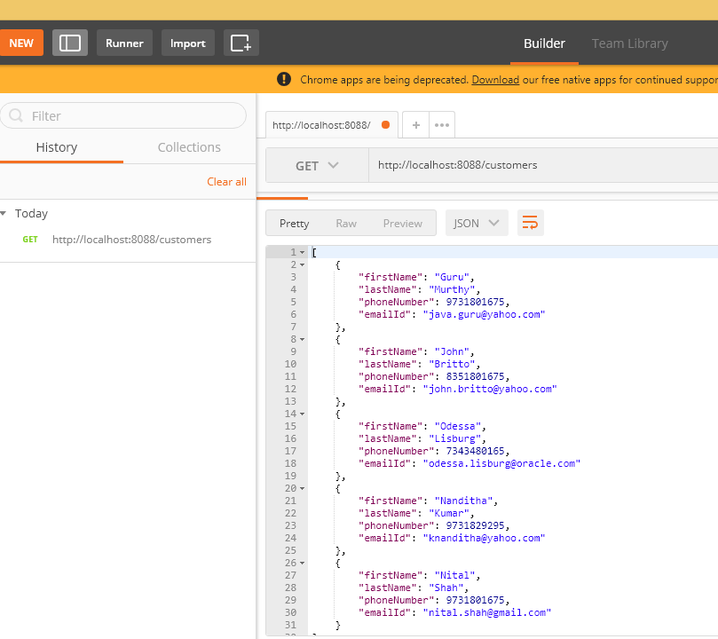
Verify in postman
Notes:
Anonymous1.java

Slide 38
Customers API – How to design?
When designing / developing REST API, you need to think about:
We need to identify the resources:
Resources Deal with NOUNS or ENTITIES
Recall: CUSTOMER, BANK, PORTFOLIO
In terms of Customers API, Customer is the resource
The consumers can access these resources using different HTTP methods:
GET – for reading
POST – for creating / inserting
DELETE – for removing
PUT – for updating completely
PATCH – for updating partially
Notes:
Anonymous1.java

Slide 39
Designing Customers API
Resources:
Customer
Bank
Portfolio
Notes:
Anonymous1.java

Slide 40
Designing Customers API
GET /customers Gets all customers
We already developed this
Here, the root URL is the name of the resource but in plural
We could also have query parameters and path parameters
Similarly:
GET / banks Gets all bank details
GET / portfolio Gets all portfolio details (list of investments held by a customer)
Notes:
Anonymous1.java

Slide 41
Designing Customers API
GET /customers/id – Gets a customer
POST /customers – Creates a new Customer
We need to send the POST BODY
PUT /customers/id – Updates a customer
POST body contains the information to be updated.
DELETE /customers/id – Deletes a specific customers
Notes:
Anonymous1.java

Slide 42
Introducing service classes/layer
In any application, service class / layer is a place where other components seek the services
For instance, the controller ask service class to give a list of customers, give the database connection, open a specific file etc.
In Spring framework, service class is a normal class with @service annotation
Notes:
Anonymous1.java

Slide 43
Create a service class
Service class name: CustomerService
Annotate this class with @service annotation
package: com.ofss.service
Define a private variable “allCustomers” which contains a List of Customer objects
Method name: getAllCustomers()
This method returns the variable “allCustomers”
Notes:
Anonymous1.java

Slide 44
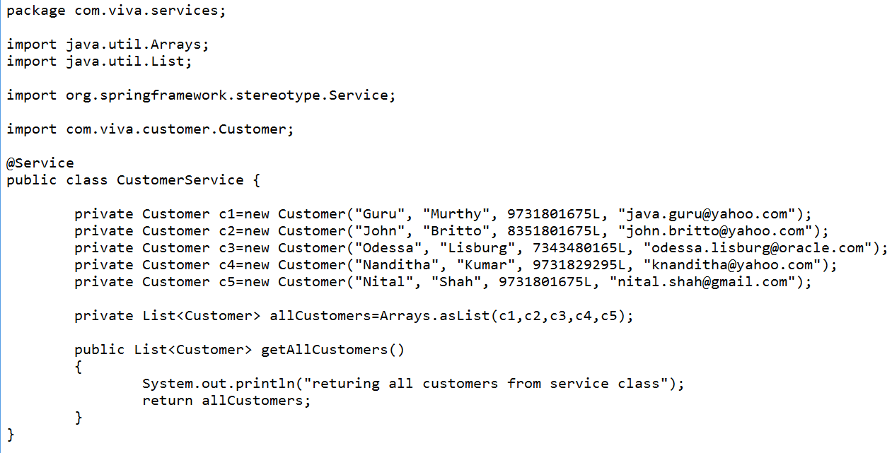
Create a service class
Notes:
Anonymous1.java

Slide 45
Create a service class
Service class is singleton in Spring
When the spring application starts, it creates only one instance of the class which is marked with @service annotation
We are going to use this pre-instantiated service class object in controller class using DI mechanism (@Autowired)
Notes:
Anonymous1.java

Slide 46
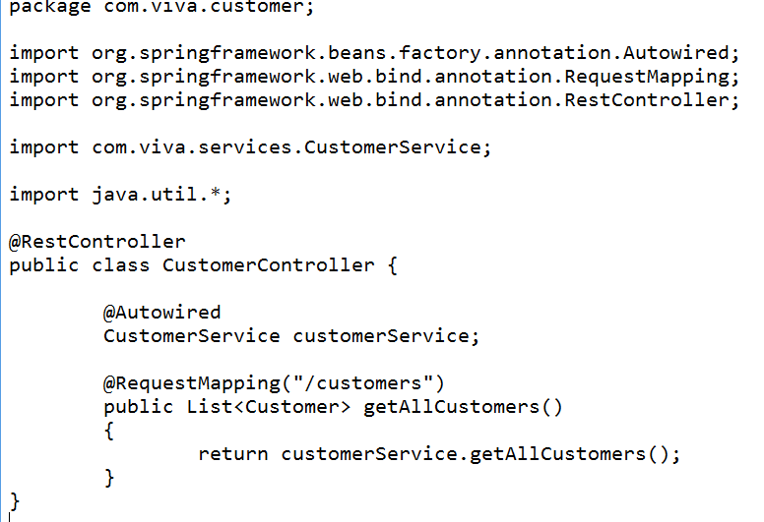
Modify the controller class now
Notes:
Anonymous1.java

Slide 47
Implementing /customers/name API Getting a single resource
Let’s now implement the GET method for the URL /customers/name
This API should return the customer details for the given customer name
The URL:
GET method for /customers/name
Notes:
Anonymous1.java

Slide 48
Add a controller method
Add the following method in the controller class:
@RequestMapping("/customers/{name}") ← This is called PATH parameter
public Customer getCustomer(@PathVariable String name)
{
return customerService.getCustomer(name);
}
Path Variable and method parameter names could be different:
@RequestMapping("/customers/{name}") ← This is called PATH parameter
public Customer getCustomer(@PathVariable(“name” String customerName)
{
return customerService.getCustomer(name);
}
Notes:
Anonymous1.java

Slide 49
Add a service method
Add the following in CustomerService class
public Customer getCustomer(String name)
{
Customer cust=null;
for (Customer c:allCustomers)
{
if (c.getFirstName().equals(name))
cust=c;
}
return cust;
}
Notes:
Anonymous1.java

Slide 50
Invoke the API
Now, from the browser, give the following URL:
http://localhost:8088/customers/Guru ← This is called PATH parameter
You should see the details about the customer “Guru”
{"firstName":"Guru","lastName":"Murthy","phoneNumber":9731801675,"emailId":"java.guru@yahoo.com"}
Check the same in POSTMAN
Notes:
Anonymous1.java

Slide 51
Implementing POST method Adding a single resource
How about adding a new Customer to our existing list.
In this we must use “POST” method for the URL: /customers
But, we need to send whole bunch of details (firstname, lastname, phonenumber, emailid)
For this we must prepare JSON request body
Notes:
Anonymous1.java

Slide 52
Implementing POST method Add a service method
public void addCustomer(Customer cust)
{
allCustomers.add(cust);
// add new customer to our existing list
}
Notes:
Anonymous1.java

Slide 53
Creating a new Customer using this API?
In POSTMAN tool:
Give the URL: http://localhost:8088/customers
Select POST method
In request body, select raw:
Add the following JSON object:
{
"firstName": "Raju",
"lastName": "Rama",
"phoneNumber": 123456243,
"emailId": "raju.rama@yahoo.com"
}
In the Headers, create one key:
Content-Type and give the value application/json
Notes:
Anonymous1.java

Slide 54
Creating a new Customer using this API
Verification:
Invoke the URL http://localhost:8088/customers
In GET method
You should see the changes
Notes:
Anonymous1.java

Slide 55
HANDS-ON
Implement the API to delete a customer
URL: http://localhost:8088/customers/Guru
Method type: DELETE
This should remove the customer with the firstName = “Guru”
Notes:
Anonymous1.java

Slide 56
Spring Initializr
This is another way of creating Spring Boot application
Go to the website: https://start.spring.io/
Fill up some required details
Your spring boot application is ready
Download as .zip file and extract local folder
In STS, import this .pom as maven project
Just run the program
Your application will just run ☺
Just take care of the tomcat port #
Notes:
Anonymous1.java

Slide 57
Spring Boot CLI
This is the command line interface
You can create spring boot application using this
This is not very popular
Just use this for demo purpose
Go to this web site
https://docs.spring.io/spring-boot/docs/current/reference/html/getting-started-installing-spring-boot.html
Download and extract the following file into local folder
spring-boot-cli-2.1.2.RELEASE-bin.zip
Notes:
Anonymous1.java

Slide 58
Test Spring Boot CLI
Spring Boot CLI uses groovy script
Groovy is another language like Java
Go to the “bin” folder
D:\spring-boot-cli-2.1.2.RELEASE-bin\spring-2.1.2.RELEASE\bin
Run “spring.bat” file
It would give all the options
Check the Spring Boot CLI version:
D:\groovy-scripts>spring.bat --version
Spring CLI v2.1.2.RELEASE
D:\groovy-scripts>
We need to write controller class using groovy script
Notes:
Anonymous1.java

Slide 59
Write Controller in groovy script
Spring Boot CLI uses groovy script
Groovy is another language like Java
Create a file helloctrl.groovy (extension is groovy)
Write the following into it and save this file
@RestController
class helloctrl
{
@RequestMapping("/")
String hello()
{
"Hello Groovy"
}
}
Notes:
Anonymous1.java

Slide 60
Run the groovy script
Change the port number of tomcat in spring.bat as follows
set CLASSPATH=%SPRING_HOME%\lib\*"%JAVA_EXE%" %JAVA_OPTS% -cp "%CLASSPATH%" -Dserver.port=8087 org.springframework.boot.loader.JarLauncher %CMD_LINE_ARGS%
Run as following:
D:\groovy-scripts>spring.bat run helloctrl.groovy
Access this application in browser
http://localhost:8087/
Use this option for prototyping or creating simple applications
Notes:
Anonymous1.java

Slide 61
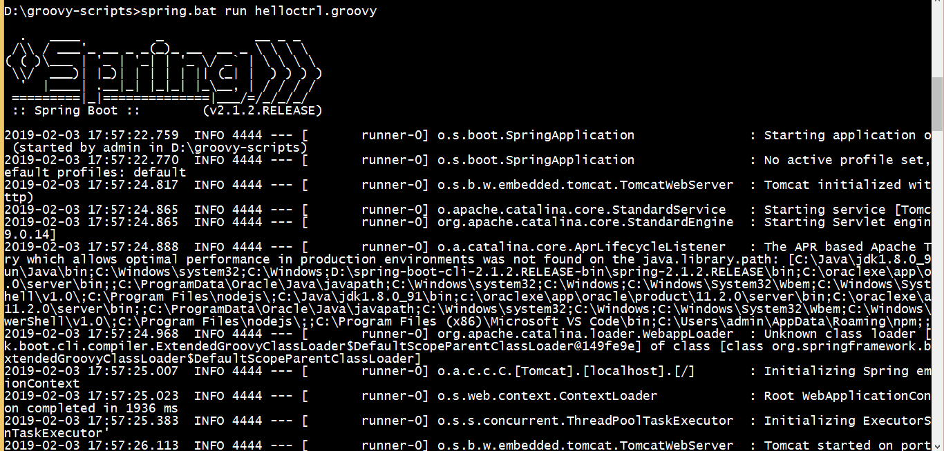
Groovy script in execution
Notes:
Anonymous1.java

Slide 62
Using STS IDE Spring Starter Project
Recall bootstrapping from spring initializr (https://start.spring.io)
Select File…New…Spring Starter Project and fill the details

Slide 63
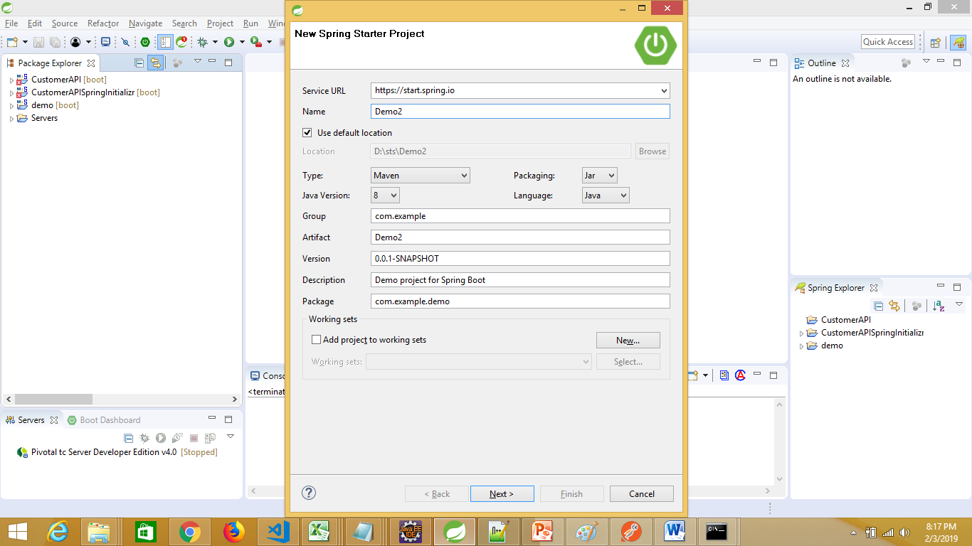
Using STS IDE Spring Starter Project

Slide 64
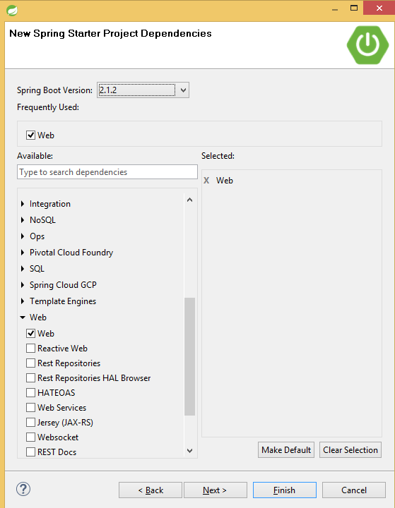
Using STS IDE Spring Starter Project
Select next
Select the Spring boot version
Select the dependency
Select Web in our case
Select Select
Select finish
Right click project,
run as “Spring Boot App”
Or
Right click on main class,
run as “Java Application”

Slide 65
Dependency Injection
Spring is very famous for its DI concept
IoC – Inversion of Control
Dependency Injection is of two types:
Constructor based
Setter based
Examples:
@Autowired

Slide 66
Customizing Spring Boot application
Add application.properties file in resource folder
Add “server.port=8091” to change the default port number of tomcat (8080 to 8091)

Slide 67
Customizing Spring Boot application
Add application.properties file in resource folder
Add “debug=true” to enable the debug

Slide 68
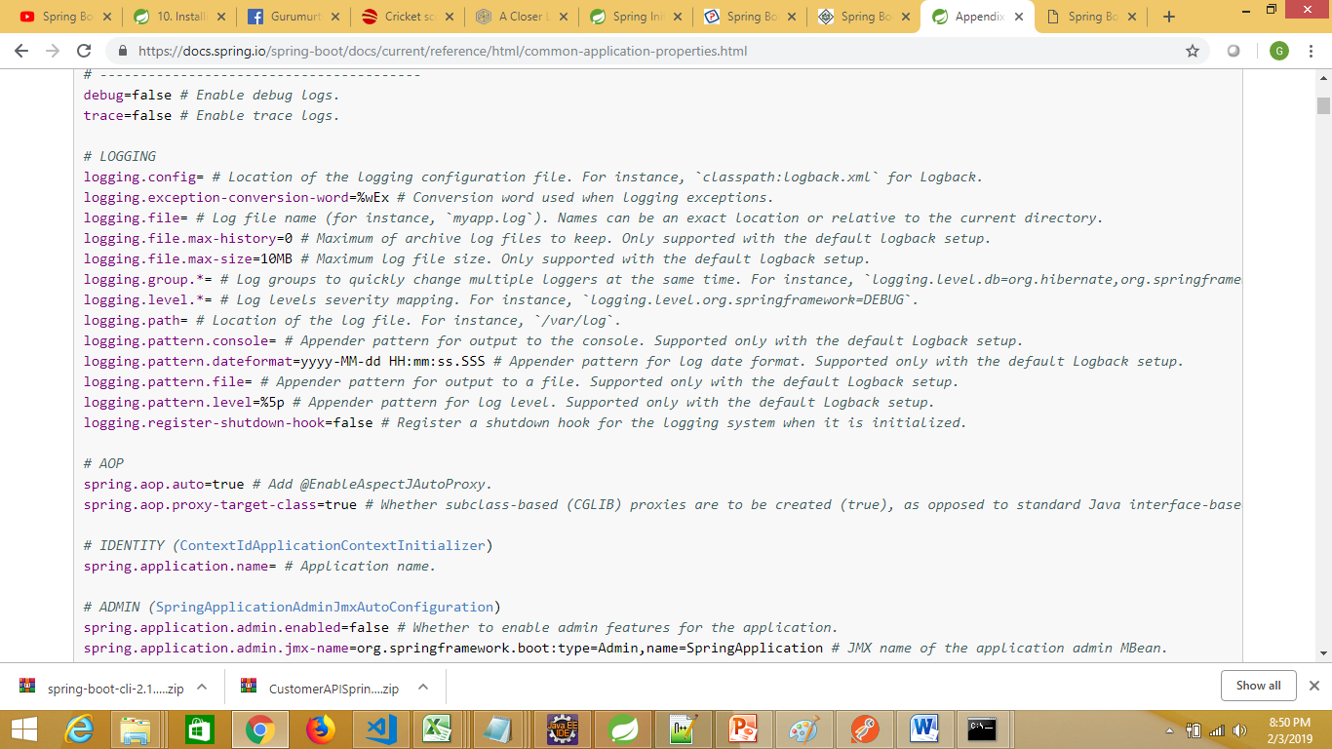
How to find the property names?
The official documentation contains all property names
https://docs.spring.io/spring-boot/docs/current/reference/html/common-application-properties.html

Slide 69
Thank You

