Slide 1
Spring MVC

Slide 2
Understanding web.xml in Servlets
<servlet>
<servlet-name>HelloServlet</servlet-name>
<servlet-class>
com.ofss.HelloServlet
</servlet-class>
/servlet>
<servlet-mapping>
<servlet-name>HelloServlet</servlet-name>
<url-pattern>/HelloServlet</url-pattern>
</servlet-mapping>

Slide 3
Issues with servlets
We need to write all controller code
Check the request and forward to appropriate web resource
Lots of if condition (boiler-plate, plumbing code)
Examples:
If Login, invoke ValidateServlet
If Show, invoke Show.jsp

Slide 4
How Web Frameworks can help?
We don’t need to write all controller code ourselves
The framework provides a central controller class
All the requests will go to controller class first
The controller will check the request
Based on the request, user will be forwarded to appropriate page.
Web Frameworks maintain an .xml file for this purpose
In this .xml file, we can map the request and the pages to be forwarded

Slide 5
Web Frameworks - Examples
Struts
Turbine
WebWork
Cocoon
Spring MVC
Maverick
Echo
SOFIA
Jaffa
Japple
JSF – MyFaces
Wicket

Slide 6
What is Spring MVC?
Web Framework
It provides Model – View – Controller architecture
Model – POJO (application data)
View – Presenting the data
Controller – processing user request, building appropriate model and passing it to view for rendering

Slide 7
DispatcherServlet
In Spring MVC, DispatcherServlet is the heart.
It handles all the HTTP requests and responses
It follows Front Controller design pattern

Slide 8
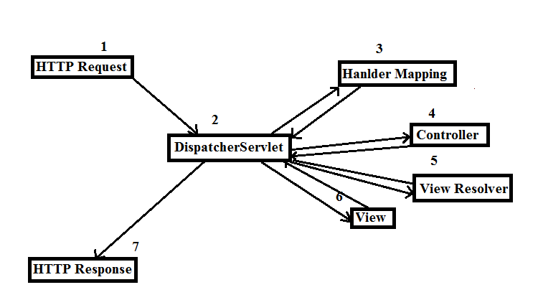
The flow

Slide 9
Explaining the flow
Client sends an HTTP request
DispatcherServlet consults the HandlerMapping and calls the appropriate Controller.
The Controller takes the request and calls the appropriate service methods based on used GET or POST method. The service method will set model data based on defined business logic and returns view name to the DispatcherServlet.
The DispatcherServlet will take help from ViewResolver to pickup the defined view for the request.
Once view is finalized, The DispatcherServlet passes the model data to the view which is finally rendered on the browser.

Slide 10
Configuration?
web.xml (for DispatcherServlet)
<servlet-name>-servlet.xml (for resolving the View)
Controller class (for business logic and returning the view)
.jsp for rendering the output/response

Slide 11
Demo With one controller class

Slide 12
Demo With two controller classes

Slide 13
Thank you

