Slide 1

Customer Segmentation Analysis for Insurance Portfolio Optimization
Data-Driven Insights and Recommendations

Slide 2
Project Objectives
Apply clustering algorithms to group policyholders
Identify customer segments with common insurance needs
Tailor marketing strategies and product offerings
Enhance customer engagement
Increase cross-selling opportunities

Slide 3
Project Methodology
Data Collection
Data Preprocessing
Data Collected from website
Cleaning
Engineering
Normalizing
Clustering Algo
Evaluation
K Means
Feature Selection
Model Training
Silhouette – 0.679
Calinski-Harabasz– 2443.51
Davies-Bouldin – 0.402

Slide 4
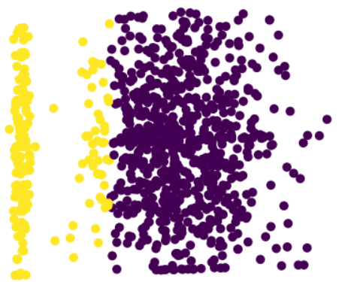
Customer Segment Customer Segment Scatter
Two distinct customer segments identified
Cluster 0 (Higher Risk)
Cluster 1 (Lower Risk)
Key Insights
Risk profile varies significantly between segments
Different incident types dominate each cluster
Premium and claim amount correlation with risk profile
Age and occupation influence on cluster membership
Key differentiating factors
Claim Amounts
Risk Profiles
Insurance Needs
The scatter plot illustrates our customer segmentation into distinct clusters, revealing key behavioral patterns and preferences across our customer base.

Slide 5
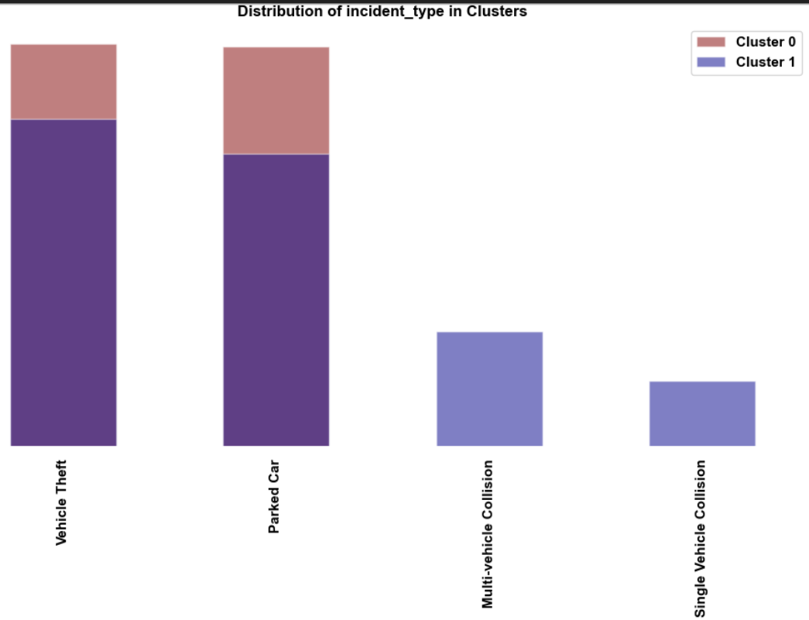
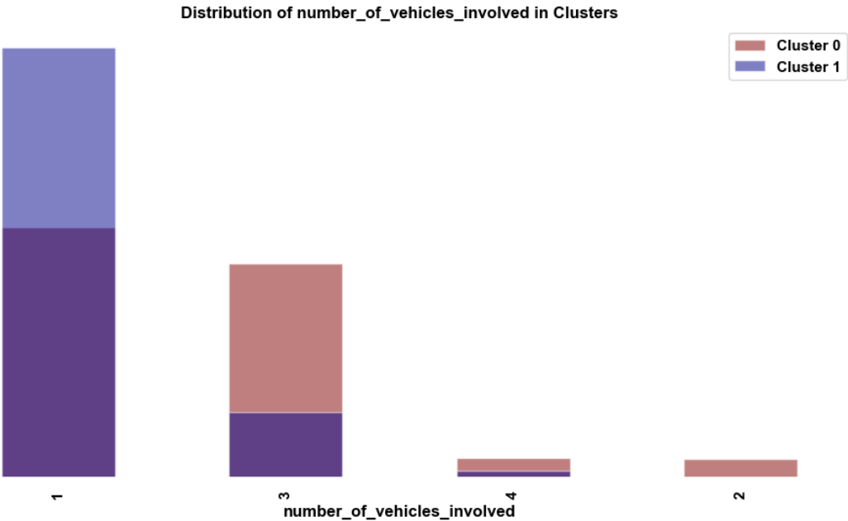
Customer Characteristics with example Plots
Cluster 0 - Higher Risk Segment
Higher claim amounts and premiums
More prone to multi-vehicle collisions
Higher likelihood of bodily injuries
Comprehensive coverage
Medical expense coverage
Multi-car policies
Cluster 1 - Lower Risk Segment
Lower claim amounts and premiums
More susceptible to vehicle theft
Fewer bodily injuries
Affordable basic coverage
Strong theft protection
Single-car policies
These Plots explains vehicle collision and the number of vehicle involved. This is an example of how we are tailoring details from the data.

Slide 6
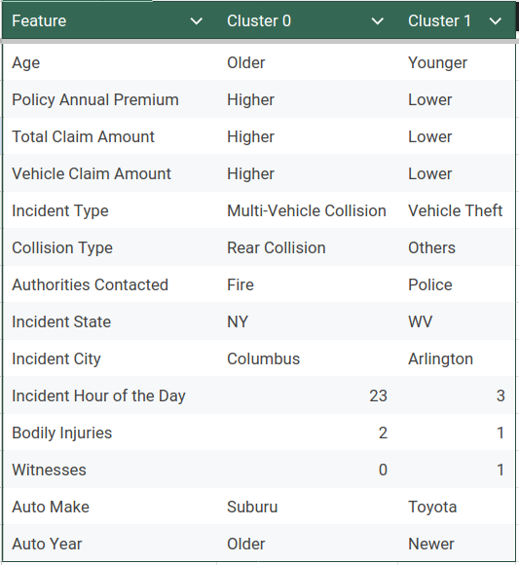
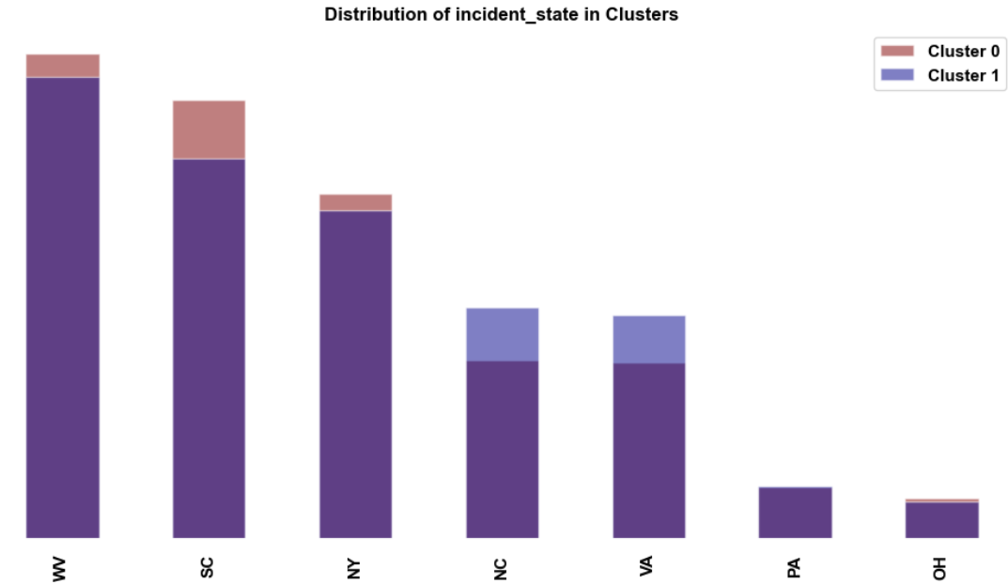
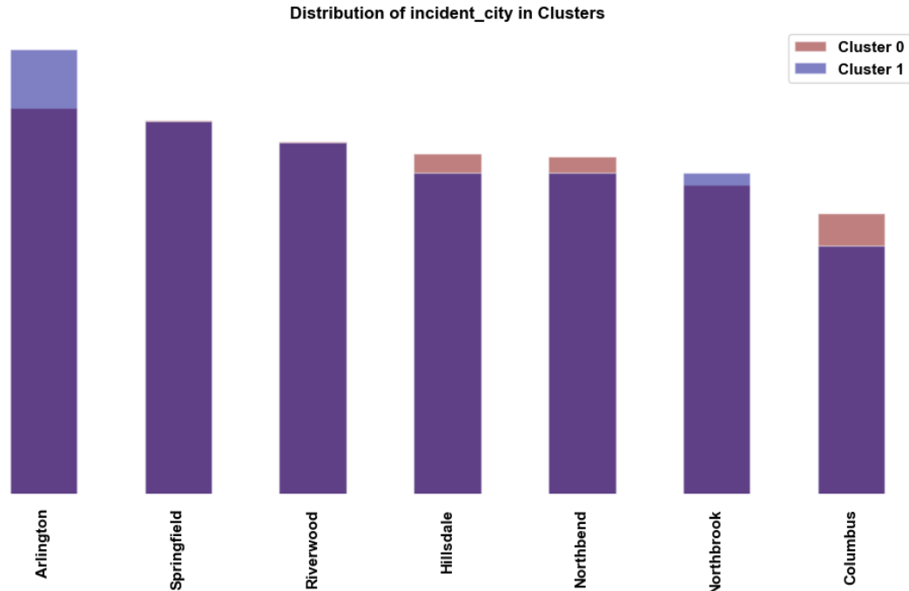
Customer Characteristics Geographic Analysis Plots

Slide 7
Business Implications
Cluster 0
Tailored Marketing Strategies:
Emphasize safety features and accident prevention
Highlight comprehensive coverage benefits
Promote family and multi-car discounts
Product Development Recommendations
Premium packages with enhanced accident and medical coverage
Add-ons for rental car coverage and roadside assistance
Bundled policies (auto + home/life)
Cross-Selling Opportunities
Life insurance and disability coverage
Umbrella policies for additional liability protection
Home insurance with bundling discounts
Customer Engagement Strategies
Personalized risk assessments and safety consultations
Regular policy reviews to ensure adequate coverage
Loyalty programs rewarding long-term, claim-free customers
Cluster 1
Tailored Marketing Strategies:
Focus on affordability and value
Emphasize theft protection features
Promote young driver programs and safe driver discounts
Product Development Recommendations
Budget-friendly basic plans with optional add-ons
Theft protection packages
Usage-based insurance options
Cross-Selling Opportunities
Renters insurance
Personal property coverage for valuable items
Travel insurance
Customer Engagement Strategies
Mobile app for easy policy management and claims reporting
Educational content on improving driving habits and reducing premiums
Gamification elements to encourage safe driving and policy engagement

Slide 8
Implementation Roadmap Expected Outcome
Phase 1: Refine marketing messages and channels
Phase 2: Develop and launch tailored products
Phase 3: Implement cross-selling initiatives
Phase 4: Roll out engagement strategies
Phase 5: Monitor KPIs and adjust strategies
Increased customer acquisition in targeted segments
Improved customer retention rates
Higher cross-selling success
Enhanced customer satisfaction and engagement
Optimized risk portfolio

Slide 9
Implementation Roadmap Expected Outcome
1
1
Refine marketing messages and channels
Refine marketing messages and channels
2
2
Develop and launch tailored products
Develop and launch tailored products
3
3
Implement cross-selling initiatives
Implement cross-selling initiatives
4
4
Roll out engagement strategies
Roll out engagement strategies
5
5
Monitor KPIs and adjust strategies
Monitor KPIs and adjust strategies

Slide 10
Conclusion
Summary of Findings:
Through the application of clustering algorithms, we have successfully segmented policyholders into two distinct groups with differing risk profiles and insurance needs. The insights derived from this analysis form the foundation for targeted marketing, personalized product offerings, and improved customer engagement strategies.
Business Impact:
Implementing the strategies outlined in this presentation is expected to improve customer retention by tailoring product offerings to specific segments, optimize sales through cross-selling initiatives, and reduce risk by aligning coverage with customer behavior and preferences.
Next Steps:
As we move forward, we will continuously refine these customer segments by incorporating real-time data, exploring additional clustering algorithms, and expanding the analysis to new variables such as transaction histories and advanced behavioral metrics. Monitoring key performance indicators (KPIs) will allow us to adjust our strategies dynamically and maximize business impact.

