Slide 1

Customer Segmentation Analysis for Insurance Portfolio Optimization
Optimizing Insurance Offerings Through Data-Driven Insights

Slide 2
Project Objectives
Apply clustering algorithms to group policyholders based on characteristics and behavior
Identify customer segments with common insurance needs and preferences
Tailor marketing strategies and product offerings to specific clusters
Enhance customer engagement and increase cross-selling opportunities

Slide 3
Project Methodology
Data Collection
Data Preprocessing
Data Collected from website
Cleaning
Engineering
Normalizing
Clustering Algo
Evaluation
K Means
Feature Selection
Model Training
Silhouette – 0.679
Calinski-Harabasz– 2443.51
Davies-Bouldin – 0.402

Slide 4
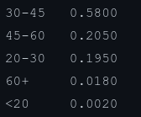

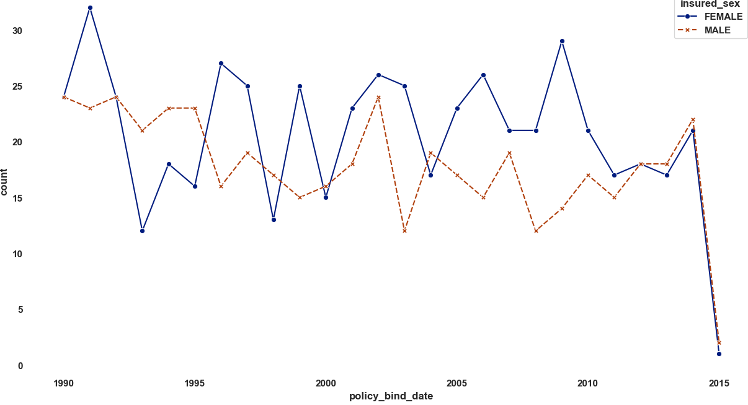
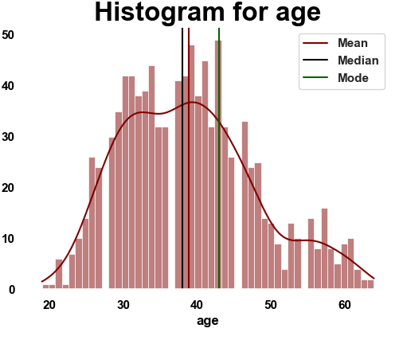
Key Insurance Market Insights
Demographic Patterns:
Higher insurance adoption rate among female customers compared to males
Two key age groups show significant insurance patterns

Slide 5
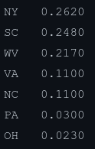

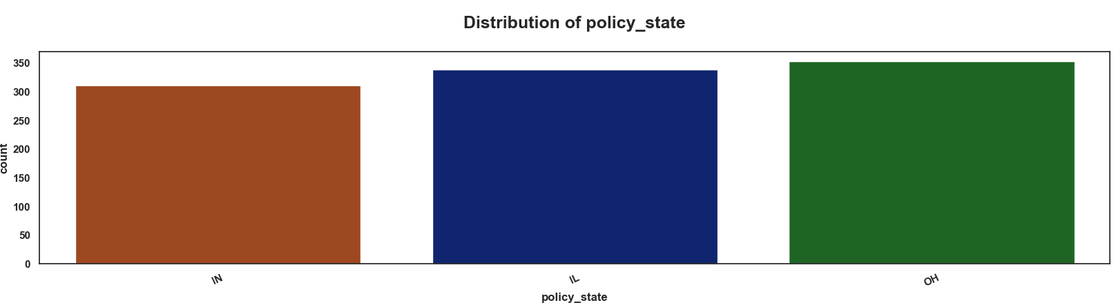
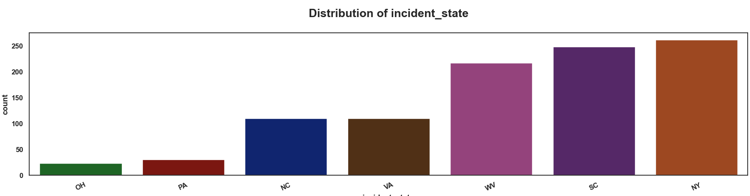
Key Insurance Market Insights
Geographic Insights:
Lower insurance penetration in Indiana compared to other states
Lower accident rates in OH, OA, VA, and NC, presenting growth opportunities

Slide 6
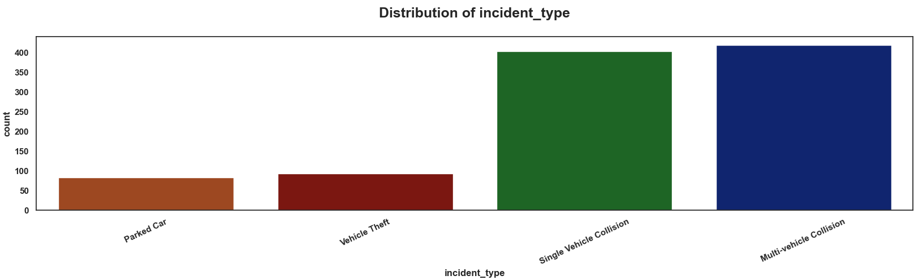
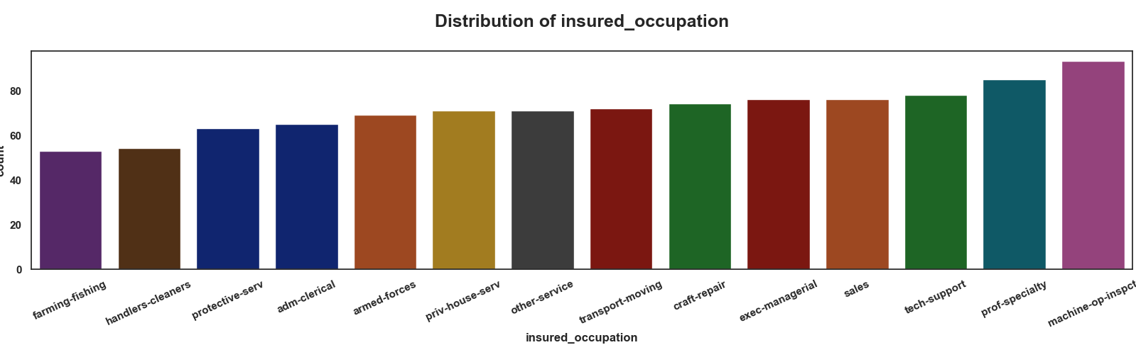
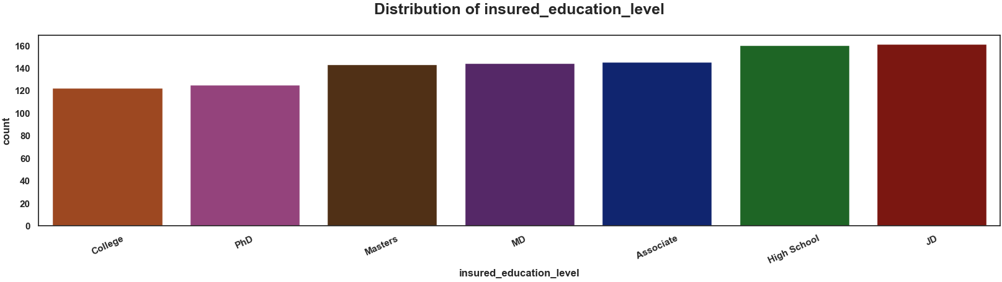
Key Insurance Market Insights
Coverage Analysis:
Lower insurance rates among college graduates, PhD holders, farmers, and cleaning service workers
Property damage claims constitute the majority of accident insurance payouts
Vehicle theft and parking lot incidents show lower frequency, suggesting potential for specialized coverage

Slide 7
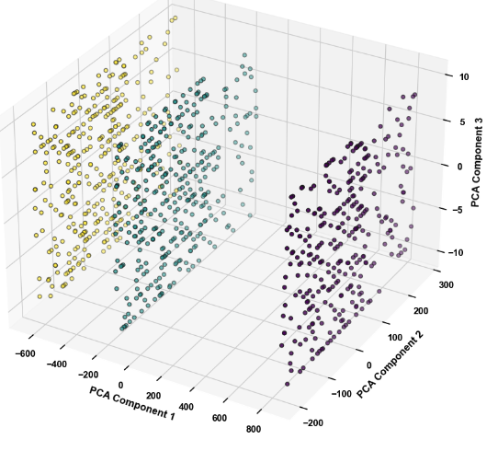

Customer Segment Overview Customer Segment Scatter
Three distinct customer segments identified
Based on the Key differentiating factors Machine Learning model created 3 clusters which clearly visible in the scatter plot below.
Cluster 0 Mature High Value Segment
Cluster 1 Young Premium Payers
Cluster 2 Balanced Risk Group
Key differentiating factors:
Age of policyholders
Claim amounts and frequency
Policy premiums
Vehicle age and claim patterns

Slide 8
Customer Characteristics
Cluster 0 - Mature High-Value Segment
Oldest average age
Highest total claim amount and vehicle claim amount
Higher likelihood of bodily injuries
Most incidents occur at 10 AM
Oldest average vehicle age
Multi-car policies
This cluster represents older, potentially higher-risk customers with more expensive claims. They may benefit from comprehensive coverage options and risk mitigation services.
This cluster represents a balanced group with moderate risk and claim amounts. They might be interested in customizable coverage options and loyalty programs.
Cluster 1 - Young Premium Payers
Youngest average age
Highest policy annual premium
Lowest total claim amount
Most incidents occur at 5 PM
Mid-range vehicle age Singl-car policies
Cluster 2 - Balanced Risk Group
Oldest average age
Lowest policy annual premium
Moderate total claim amount
Most incidents occur at 4 AM
Newest average vehicle age
This cluster consists of younger policyholders paying higher premiums but with lower claim amounts. They might be interested in usage-based insurance or rewards programs for safe driving.

Slide 9
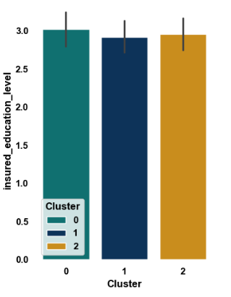
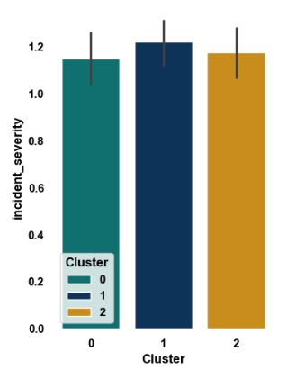
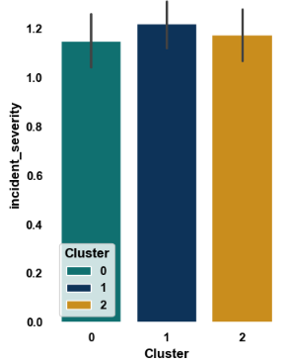
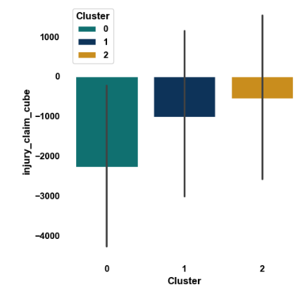
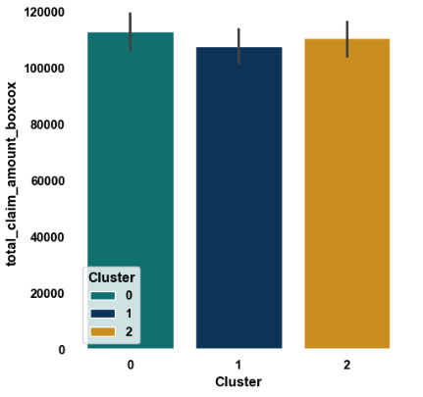
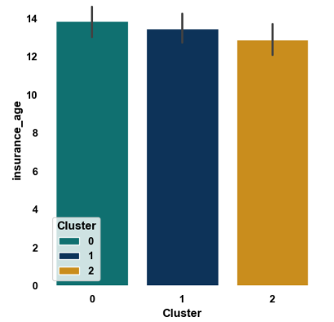
Customer Characteristics – Visual Observation

Slide 10
Business Implications
Cluster 0
Tailored Marketing Strategies:
Focus on comprehensive protection and expert risk management
Emphasize personalized service and high-value customer benefits
Product Development Recommendations
Premium packages with extensive coverage and concierge services
Specialized policies for high-value vehicles and assets
Cross-Selling Opportunities
High-value home insurance and umbrella policies
Executive life insurance and retirement planning services
Customer Engagement Strategies
Personalized risk assessments and quarterly coverage reviews
Exclusive events and workshops on wealth protection
Cluster 1
Tailored Marketing Strategies:
Highlight tech-driven solutions and flexible coverage options
Showcase value proposition of higher premiums vs. lower claim likelihood
Product Development Recommendations
Usage-based insurance with smartphone integration
Bundled policies with lifestyle-specific add-ons (e.g., travel, gadget insurance)
Cross-Selling Opportunities
Renters insurance and personal article policies
Travel insurance and short-term vehicle coverage
Customer Engagement Strategies
Gamified mobile app for policy management and safe driving rewards
Social media engagement and influencer partnerships
Cluster 2
Tailored Marketing Strategies:
Promote balanced, customizable coverage at competiive rates
Emphasize loyalty programs and safe driving incentive
Product Development Recommendations
Modular insurance plans with mix-and-match coverage options
Loyalty-driven policies with increasing benefits over time
Cross-Selling Opportunities
Multi-policy discounts for home and auto bundles
Life insurance with flexible terms and coverage
Customer Engagement Strategies
Omnichannel communication with option for traditional or digital interaction
Community-based initiatives promoting safe neighborhoods and driving habits

Slide 11
Implementation Roadmap Expected Outcome
Phase 1: Refine marketing messages and channels for each cluster
Phase 2: Develop and launch tailored products for each segment
Phase 3: Implement cross-selling strategies and loyalty programs
Phase 4: Enhance customer engagement platforms and personalized services
Increased customer acquisition and retention in targeted segments
Higher customer lifetime value through appropriate product matching
Reduced loss ratios through better risk assessment and pricing
Improved customer satisfaction and brand loyalty

Slide 12
Implementation Roadmap
Expected Outcome
1
1
Refine marketing messages and channels
Increased customer acquisition and retention in targeted segments
2
2
Develop and launch tailored products
Higher customer lifetime value through appropriate product matching
3
3
Implement cross-selling initiatives
Implement cross-selling initiatives
4
4
Roll out engagement strategies
Roll out engagement strategies
5
5
Monitor KPIs and adjust strategies
Monitor KPIs and adjust strategies

Slide 13
Conclusion
Summary of Findings:
Through the application of clustering algorithms, we have successfully segmented policyholders into two distinct groups with differing risk profiles and insurance needs. The insights derived from this analysis form the foundation for targeted marketing, personalized product offerings, and improved customer engagement strategies.
Business Impact:
Implementing the strategies outlined in this presentation is expected to improve customer retention by tailoring product offerings to specific segments, optimize sales through cross-selling initiatives, and reduce risk by aligning coverage with customer behavior and preferences.
Next Steps:
As we move forward, we will continuously refine these customer segments by incorporating real-time data, exploring additional clustering algorithms, and expanding the analysis to new variables such as transaction histories and advanced behavioral metrics. Monitoring key performance indicators (KPIs) will allow us to adjust our strategies dynamically and maximize business impact.

Slide 14


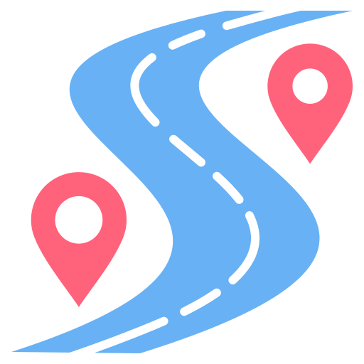


Customer Characteristics
Business Implications
Implementation Roadmap
Tailored Marketing Strategies:
Focus on comprehensive protection and expert risk management
Emphasize personalized service and high-value customer benefits
Product Development Recommendations:
Premium packages with extensive coverage and concierge services
Specialized policies for high-value vehicles and assets
Cross-Selling Opportunities:
High-value home insurance and umbrella policies
Executive life insurance and retirement planning services
Customer Engagement Strategies:
Personalized risk assessments and quarterly coverage reviews
Exclusive events and workshops on wealth protection
Roadmap:
Refine marketing messages and channels based on the customer segment and implications
Develop and launch tailored products
Implement cross-selling strategies and loyalty programs.
Enhance customer engagement platforms and personalized services.
Mature High-Value Segment
This cluster represents older, potentially higher-risk customers with more expensive claims. They may benefit from comprehensive coverage options and risk mitigation services.
Oldest average age
Highest total claim amount and vehicle claim amount
Higher likelihood of bodily injuries
Most incidents occur at 10 AM
Oldest average vehicle age
Multi-car policies

Slide 15
Customer Characteristics
Business Implications
Implementation Roadmap
Tailored Marketing Strategies:
Highlight tech-driven solutions and flexible coverage options
Showcase value proposition of higher premiums vs. lower claim likelihood
Product Development Recommendations:
Usage-based insurance with smartphone integration
Bundled policies with lifestyle-specific add-ons (e.g., travel, gadget insurance)
Cross-Selling Opportunities:
Renters insurance and personal article policies
Travel insurance and short-term vehicle coverage
Customer Engagement Strategies:
Gamified mobile app for policy management and safe driving rewards
Social media engagement and influencer partnerships
Roadmap:
Refine marketing messages and channels based on the customer segment and implications
Develop and launch tailored products
Implement cross-selling strategies and loyalty programs.
Enhance customer engagement platforms and personalized services.
Young Premium Payers
This cluster consists of younger policyholders paying higher premiums but with lower claim amounts. They might be interested in usage-ba`sed insurance or rewards programs for safe driving.
Youngest average age
Highest policy annual premium
Lowest total claim amount
Most incidents occur at 5 PM
Mid-range vehicle age Singl-car policies

Slide 16
Customer Characteristics
Business Implications
Implementation Roadmap
Tailored Marketing Strategies:
Promote balanced, customizable coverage at competiive rates
Emphasize loyalty programs and safe driving incentive
Product Development Recommendations:
Modular insurance plans with mix-and-match coverage options
Loyalty-driven policies with increasing benefits over time
Cross-Selling Opportunities:
Multi-policy discounts for home and auto bundles
Life insurance with flexible terms and coverage
Customer Engagement Strategies:
Omnichannel communication with option for traditional or digital interaction
Community-based initiatives promoting safe neighborhoods and driving habits
Roadmap:
Refine marketing messages and channels based on the customer segment and implications
Develop and launch tailored products
Implement cross-selling strategies and loyalty programs.
Enhance customer engagement platforms and personalized services.
Balanced Risk Group:
This cluster represents a balanced group with moderate risk and claim amounts. They might be interested in customizable coverage options and loyalty programs.
Oldest average age
Lowest policy annual premium
Moderate total claim amount
Most incidents occur at 4 AM
Newest average vehicle age

