Slide 1

Customer Segmentation Analysis for Insurance Portfolio Optimization
Data-Driven Insights and Recommendations

Slide 2
Project Objectives
Apply clustering algorithms to group policyholders
Identify customer segments with common insurance needs
Tailor marketing strategies and product offerings
Enhance customer engagement
Increase cross-selling opportunities

Slide 3
Project Methodology
Data Collection
Data Preprocessing
Data Collected from website
Cleaning
Engineering
Normalizing
Clustering Algo
Evaluation
K Means
Feature Selection
Model Training
Silhouette – 0.679
Calinski-Harabasz– 2443.51
Davies-Bouldin – 0.402

Slide 4
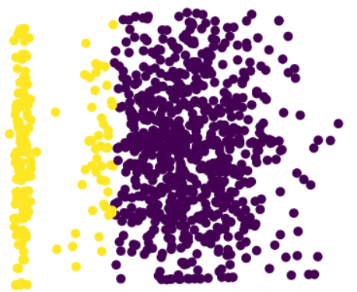
Customer Segment Customer Segment Scatter
Two distinct customer segments identified
  Cluster 0 (Higher Risk)
  Cluster 1 (Lower Risk)
Key Insights
  Risk profile varies significantly between segments
  Different incident types dominate each cluster
  Premium and claim amount correlation with risk profile
  Age and occupation influence on cluster membership
Key differentiating factors
  Claim Amounts
  Risk Profiles
  Insurance Needs
The scatter plot illustrates our customer segmentation into distinct clusters, revealing key behavioral patterns and preferences across our customer base.

Slide 5
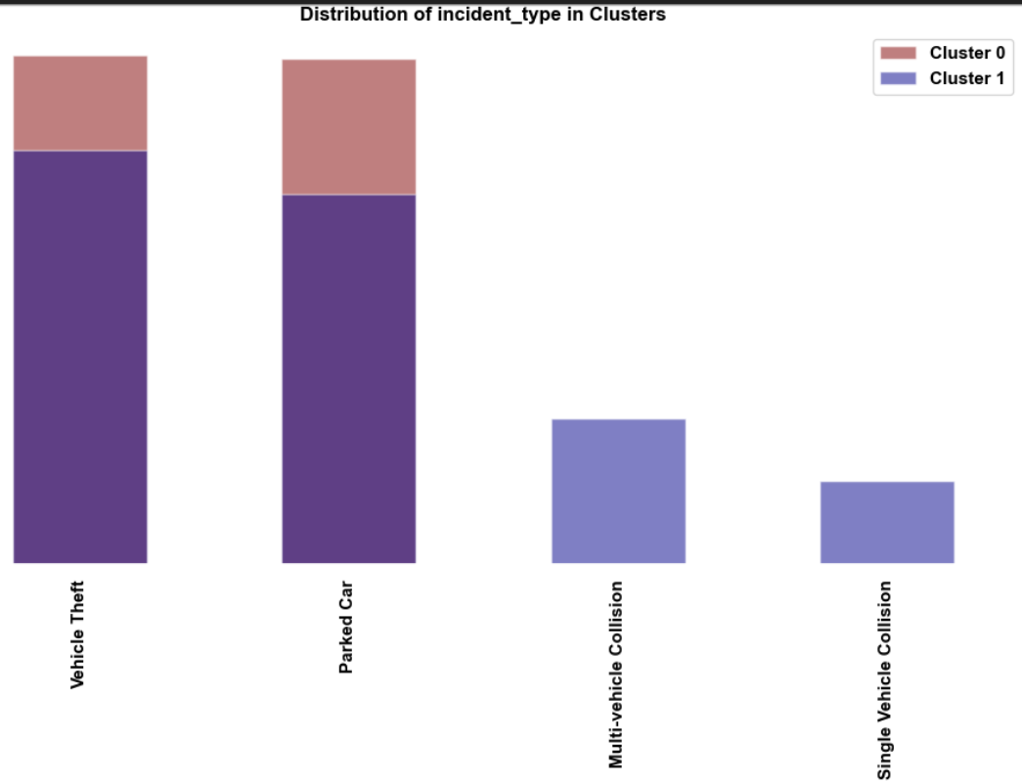
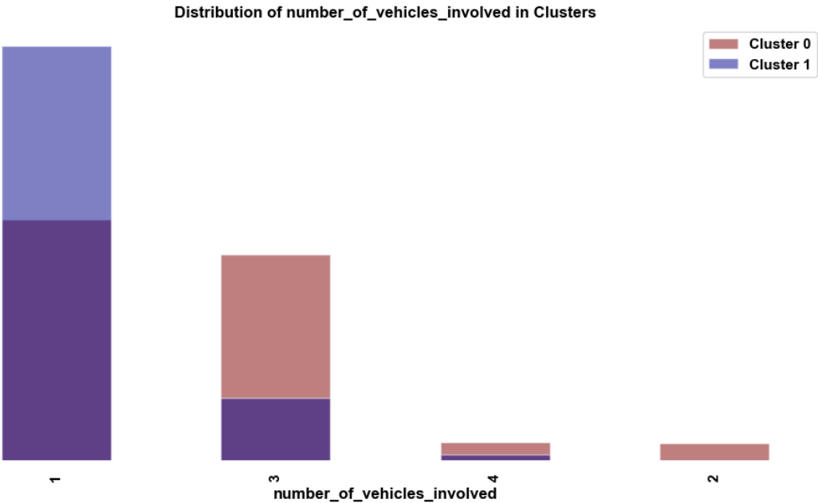
Customer Characteristics with example Plots
Cluster 0 - Higher Risk Segment
Higher claim amounts and premiums
More prone to multi-vehicle collisions
Higher likelihood of bodily injuries
Comprehensive coverage
Medical expense coverage
Multi-car policies
Cluster 1 - Lower Risk Segment
Lower claim amounts and premiums
More susceptible to vehicle theft
Fewer bodily injuries
Affordable basic coverage
Strong theft protection
Single-car policies
These Plots explains vehicle collision and the number of vehicle involved.
This is an example of how we are tailoring details from the data.

Slide 6
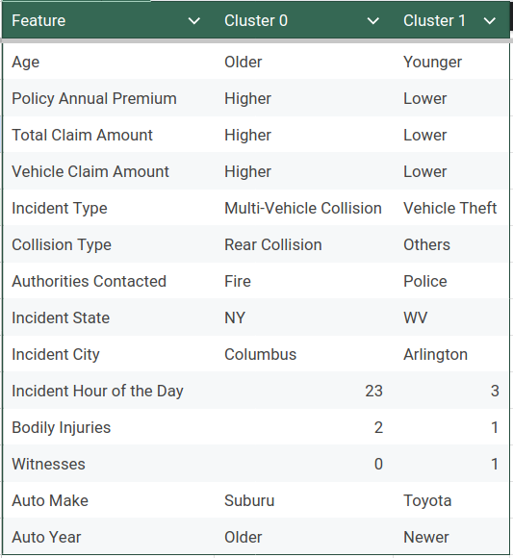
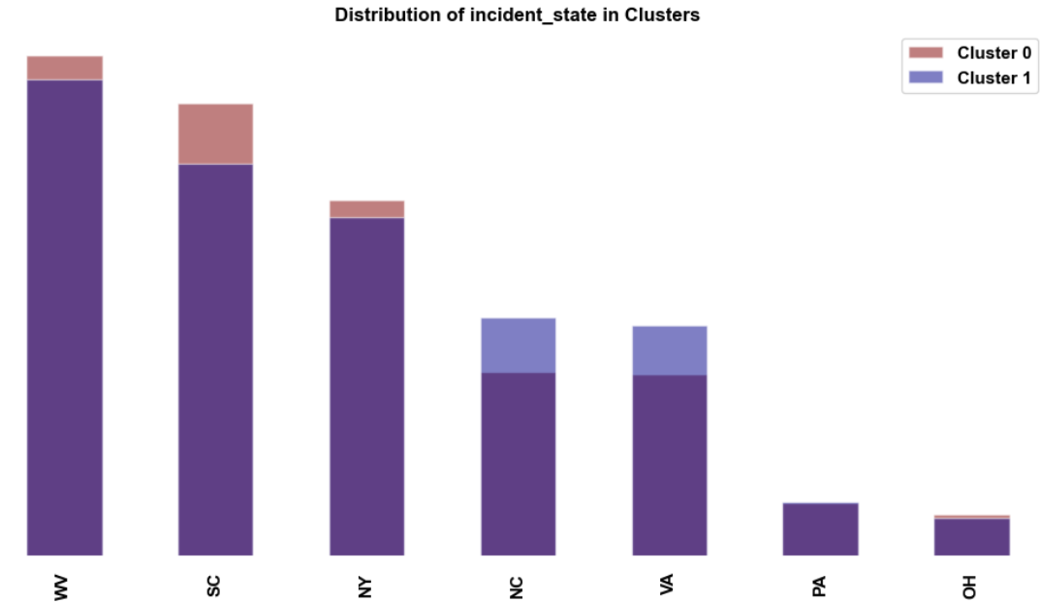
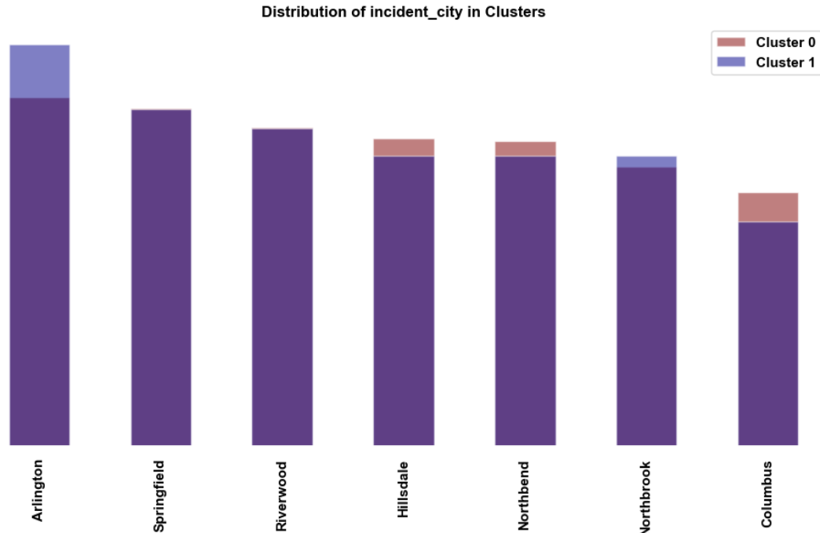
Customer Characteristics Geographic Analysis Plots

Slide 7
Business Implications
Cluster 0
Tailored Marketing Strategies:
  Emphasize safety features and accident prevention
  Highlight comprehensive coverage benefits
  Promote family and multi-car discounts
Product Development Recommendations
  Premium packages with enhanced accident and medical coverage
  Add-ons for rental car coverage and roadside assistance
  Bundled policies (auto + home/life)
Cross-Selling Opportunities
  Life insurance and disability coverage
  Umbrella policies for additional liability protection
  Home insurance with bundling discounts
Customer Engagement Strategies
  Personalized risk assessments and safety consultations
  Regular policy reviews to ensure adequate coverage
  Loyalty programs rewarding long-term, claim-free customers
Cluster 1
Tailored Marketing Strategies:
  Focus on affordability and value
  Emphasize theft protection features
  Promote young driver programs and safe driver discounts
Product Development Recommendations
  Budget-friendly basic plans with optional add-ons
  Theft protection packages
  Usage-based insurance options
Cross-Selling Opportunities
  Renters insurance
  Personal property coverage for valuable items
  Travel insurance
Customer Engagement Strategies
  Mobile app for easy policy management and claims reporting
  Educational content on improving driving habits and reducing premiums
  Gamification elements to encourage safe driving and policy engagement

Slide 8
Implementation Roadmap Expected Outcome
Phase 1: Refine marketing messages and channels
Phase 2: Develop and launch tailored products
Phase 3: Implement cross-selling initiatives
Phase 4: Roll out engagement strategies
Phase 5: Monitor KPIs and adjust strategies
Increased customer acquisition in targeted segments
Improved customer retention rates
Higher cross-selling success
Enhanced customer satisfaction and engagement
Optimized risk portfolio

