Slide 1
TravelAura
Nishanth M - 23BCS110 (Full Stack Development)
Santhosh Krishnan M - 23BCS116 (Full Stack Development)
Sujan S - 23BCS120 (Full Stack Development)

Slide 2
AGENDA
Problem Statement
Objectives
Database Design
Platform and Languages
Implementation Results / Screenshots

Slide 3
Problem Statement
Tourists and travel enthusiasts often face challenges in discovering, planning, and booking their trips due to scattered information, outdated resources, and cumbersome booking processes.
Tourism operators struggle to reach potential visitors, manage bookings, update information, and gather feedback efficiently.
The lack of an integrated, user-friendly platform hampers both tourists’ experiences and operators’ ability to manage offerings, resulting in lost opportunities and reduced satisfaction.

Slide 4
Objectives
Enable tourism operators to easily manage listings, availability, and customer interactions through a user-friendly admin interface.
Support multiple languages and accessibility standards to cater to a diverse, global audience.
Facilitate user reviews, ratings, and feedback from customers.

Slide 5
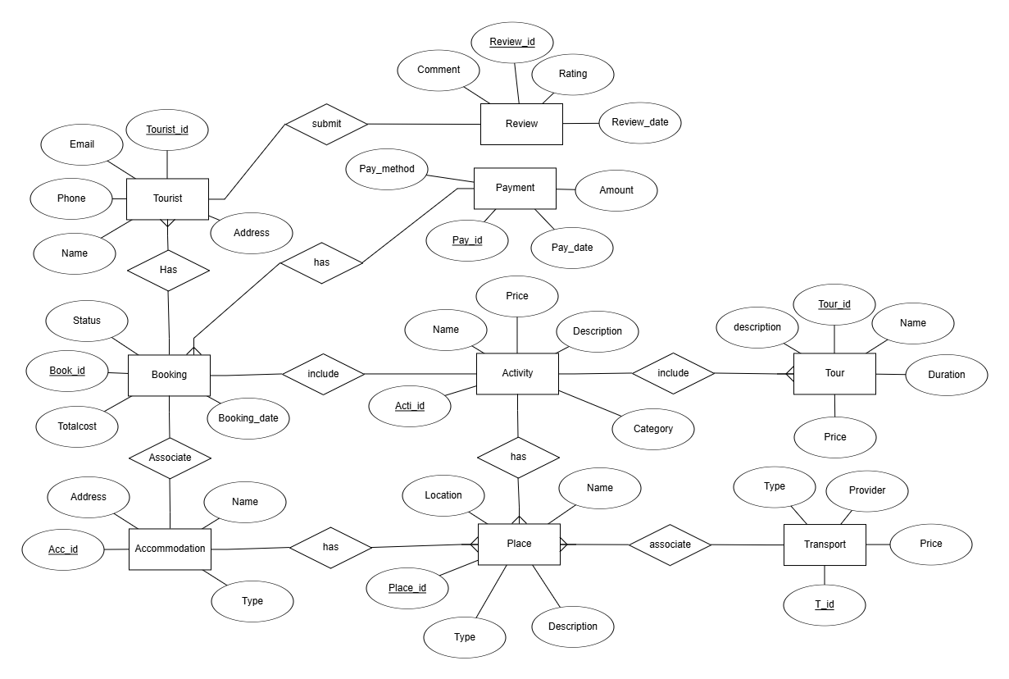
ER-DIAGRAM

Slide 6
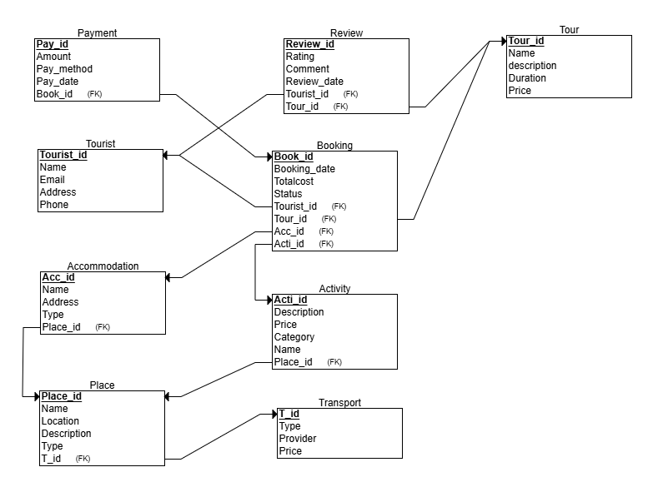
Schema Diagram

Slide 7
Technology Stack (front-end/back-end)
Front-end: HTML, CSS, JavaScript
Back-end: Node js
Database: MongoDB

Slide 8
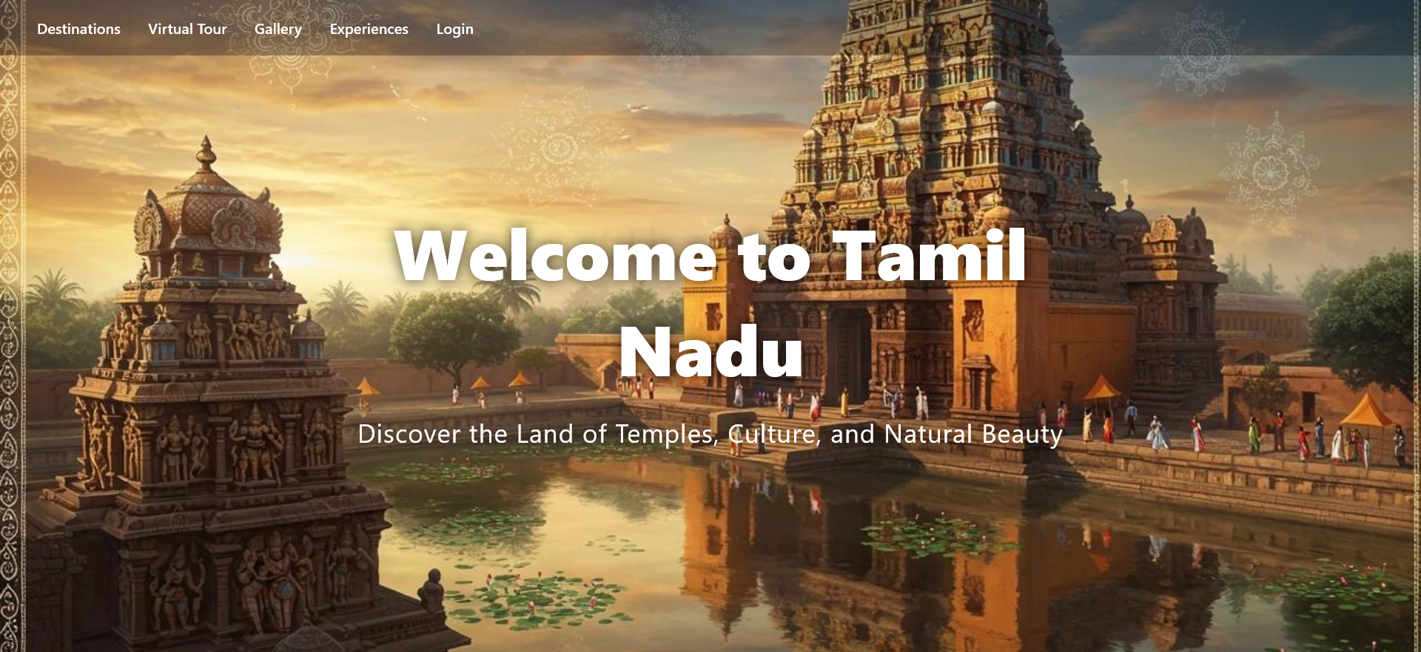
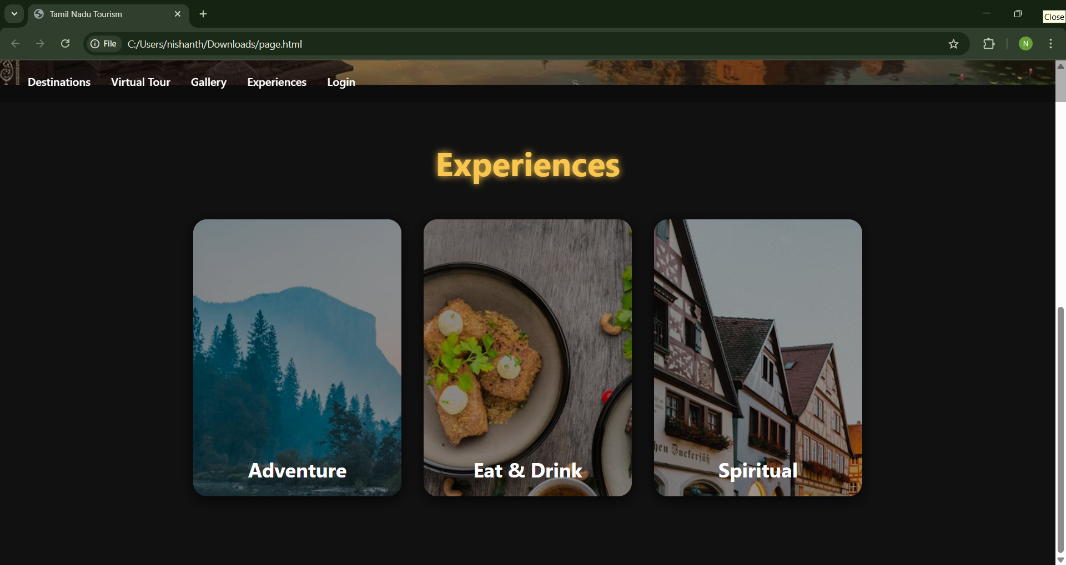
UI Screenshots
Main Page

Slide 9
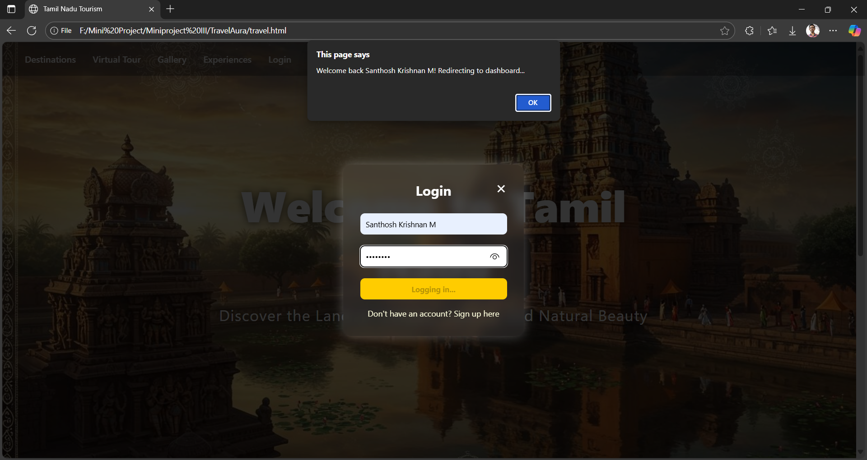
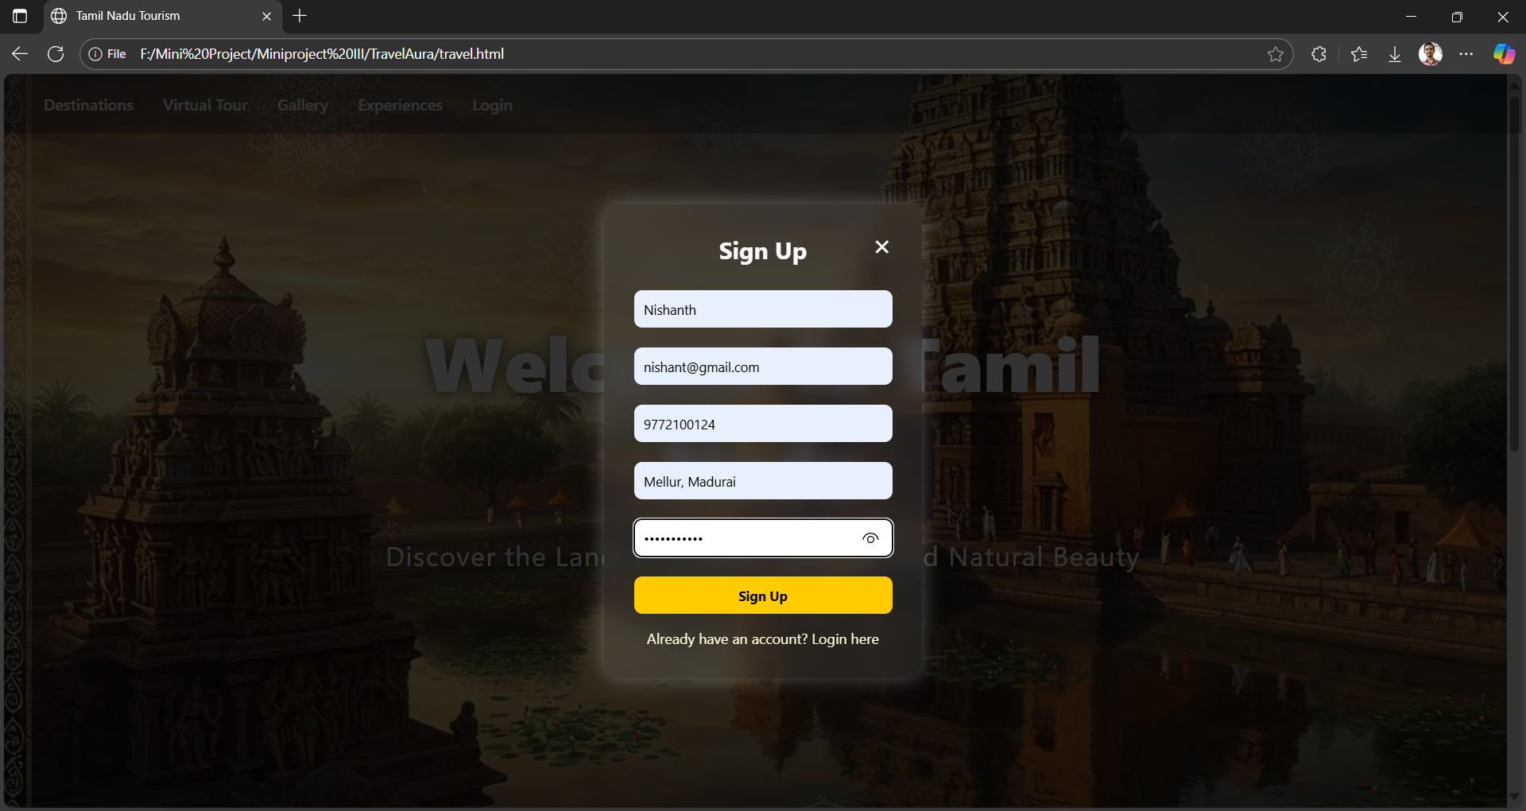
UI Screenshots
Sign In Page
Sign Up Page

Slide 10
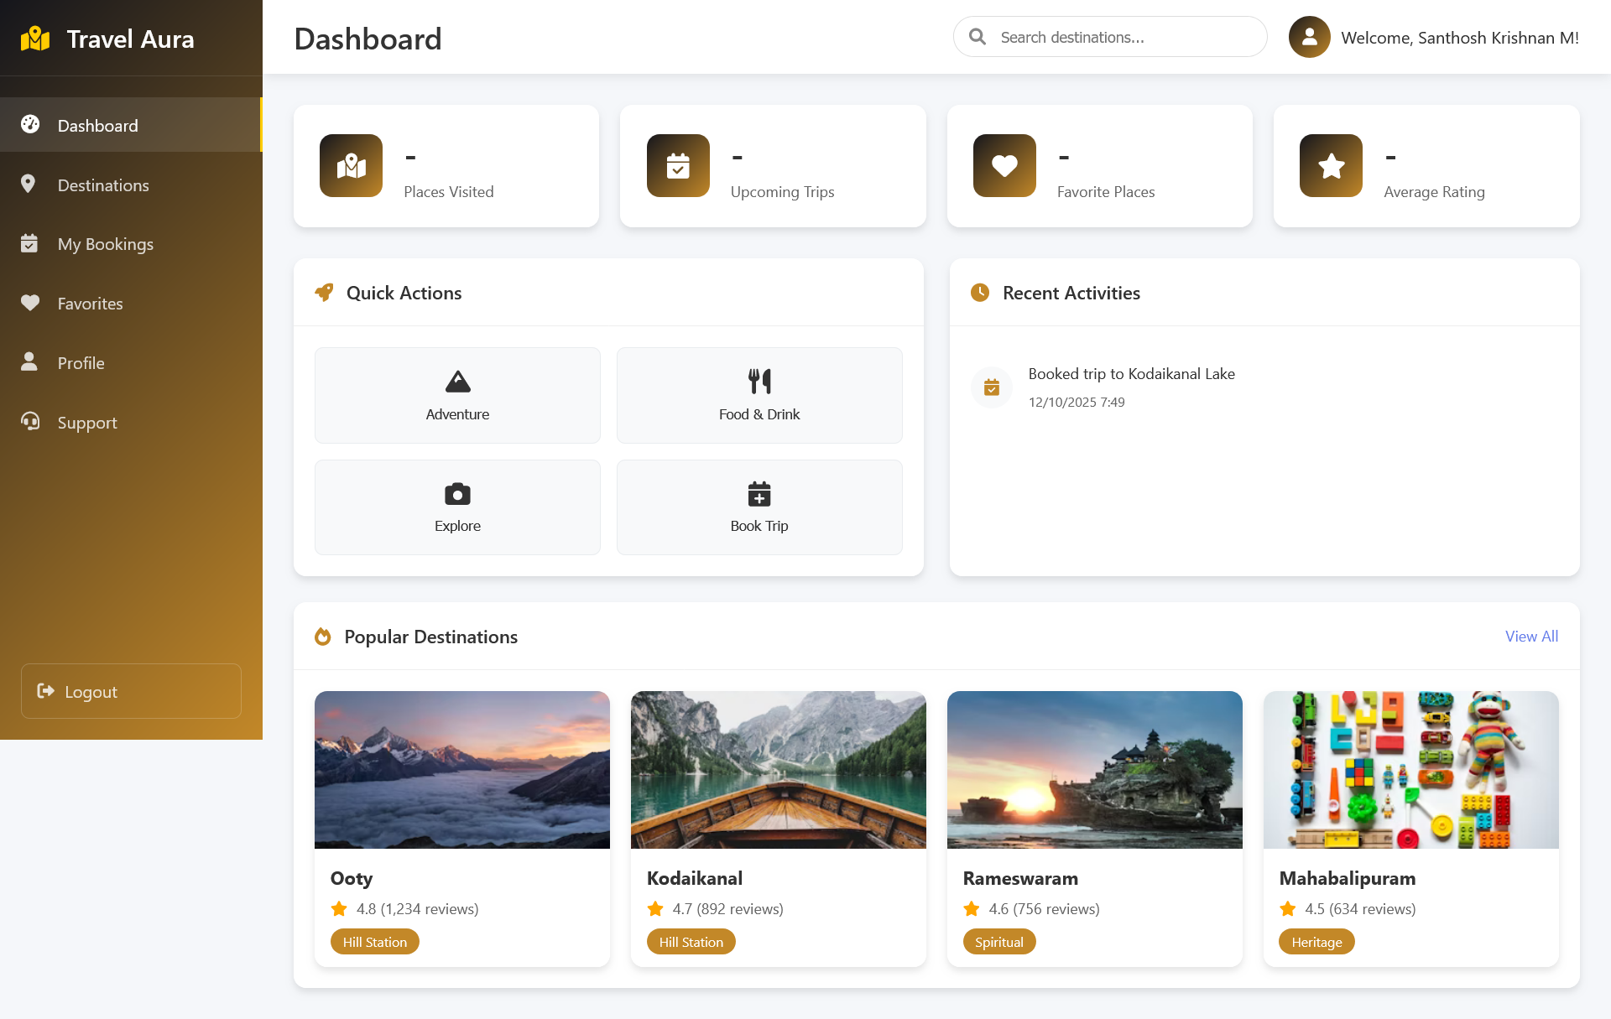
UI Screenshots
Dashboard Page

Slide 11
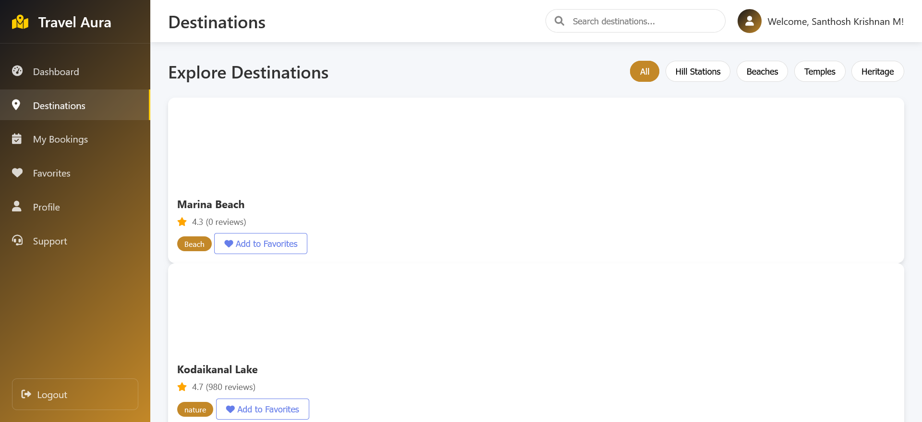
UI Screenshots

Slide 12
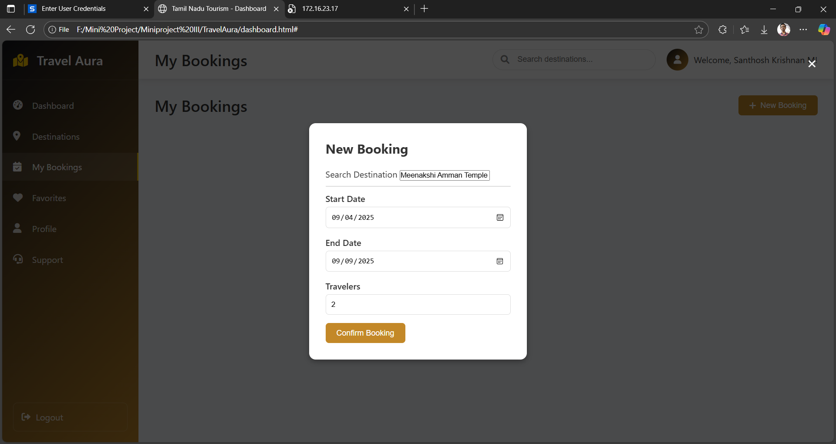
UI Screenshots

Slide 13
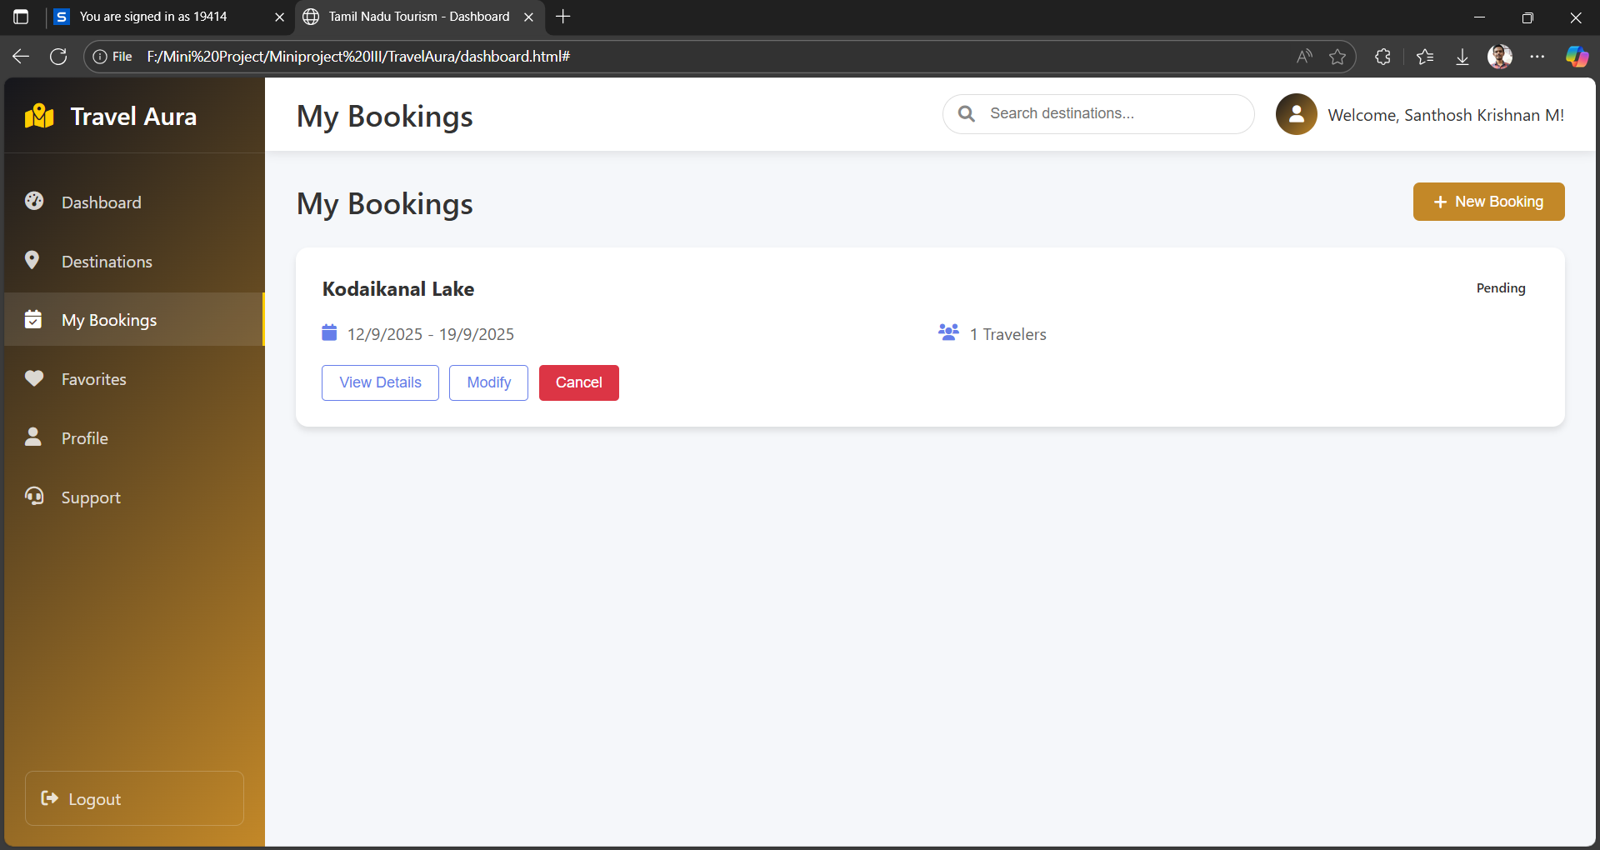
UI Screenshots

Slide 14
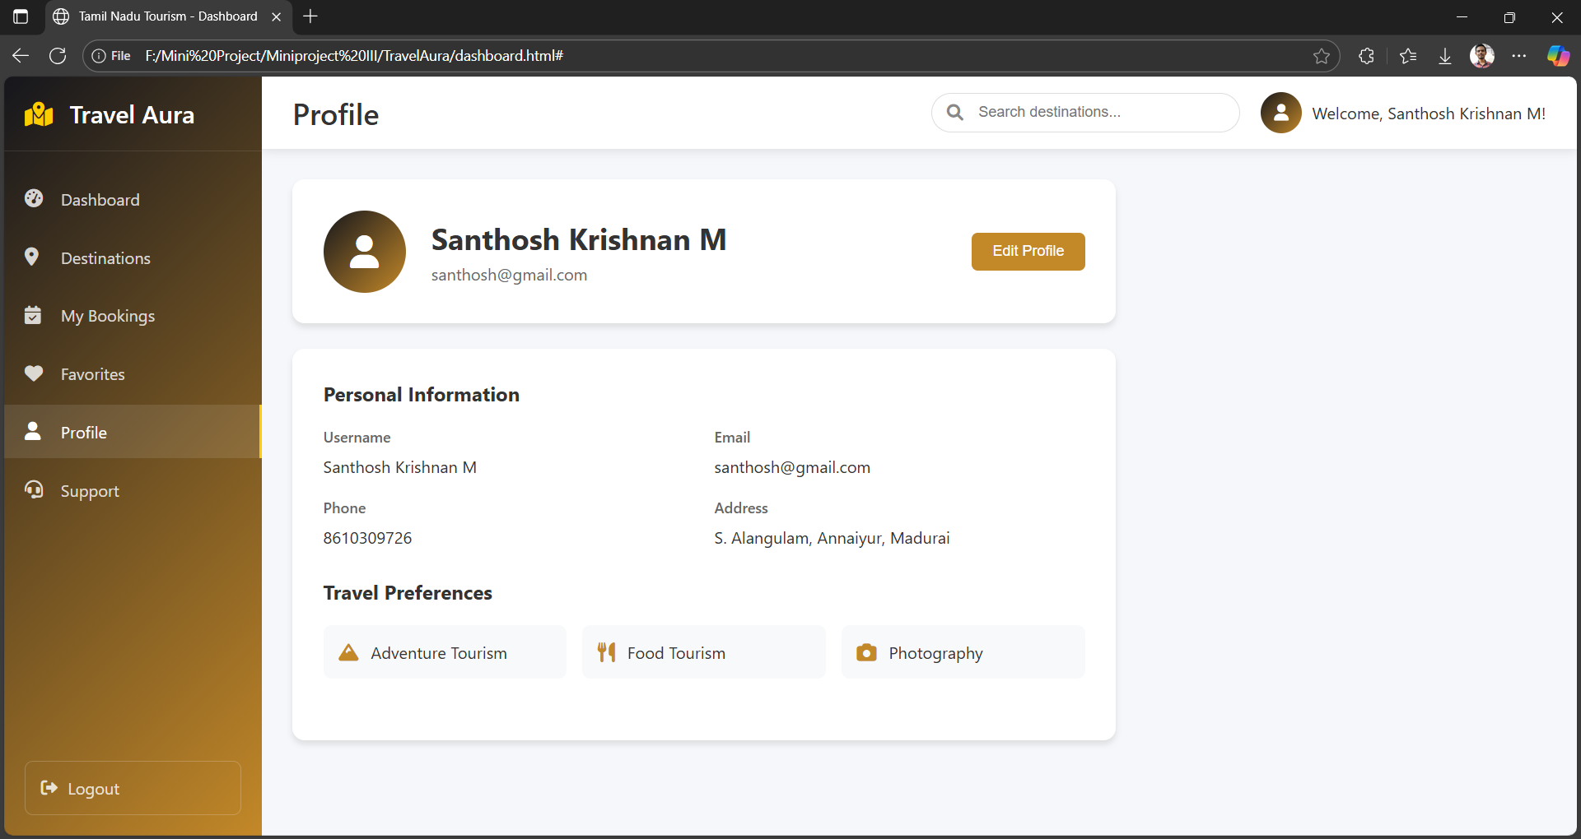
UI Screenshots

Slide 15
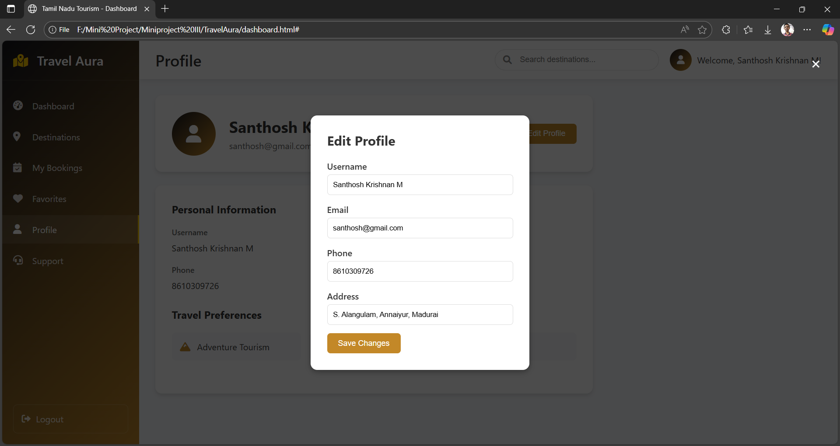
UI Screenshots

Slide 16
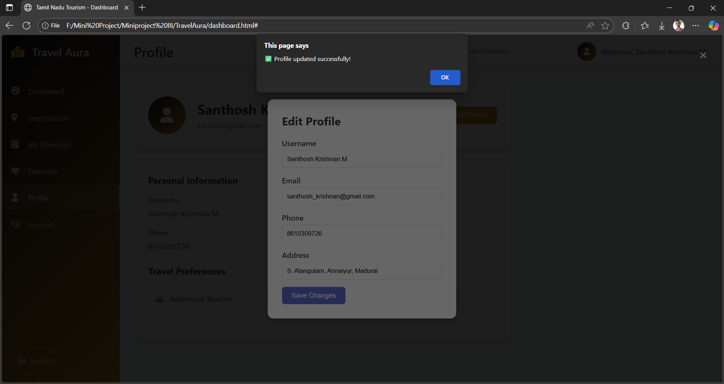
UI Screenshots

Slide 17
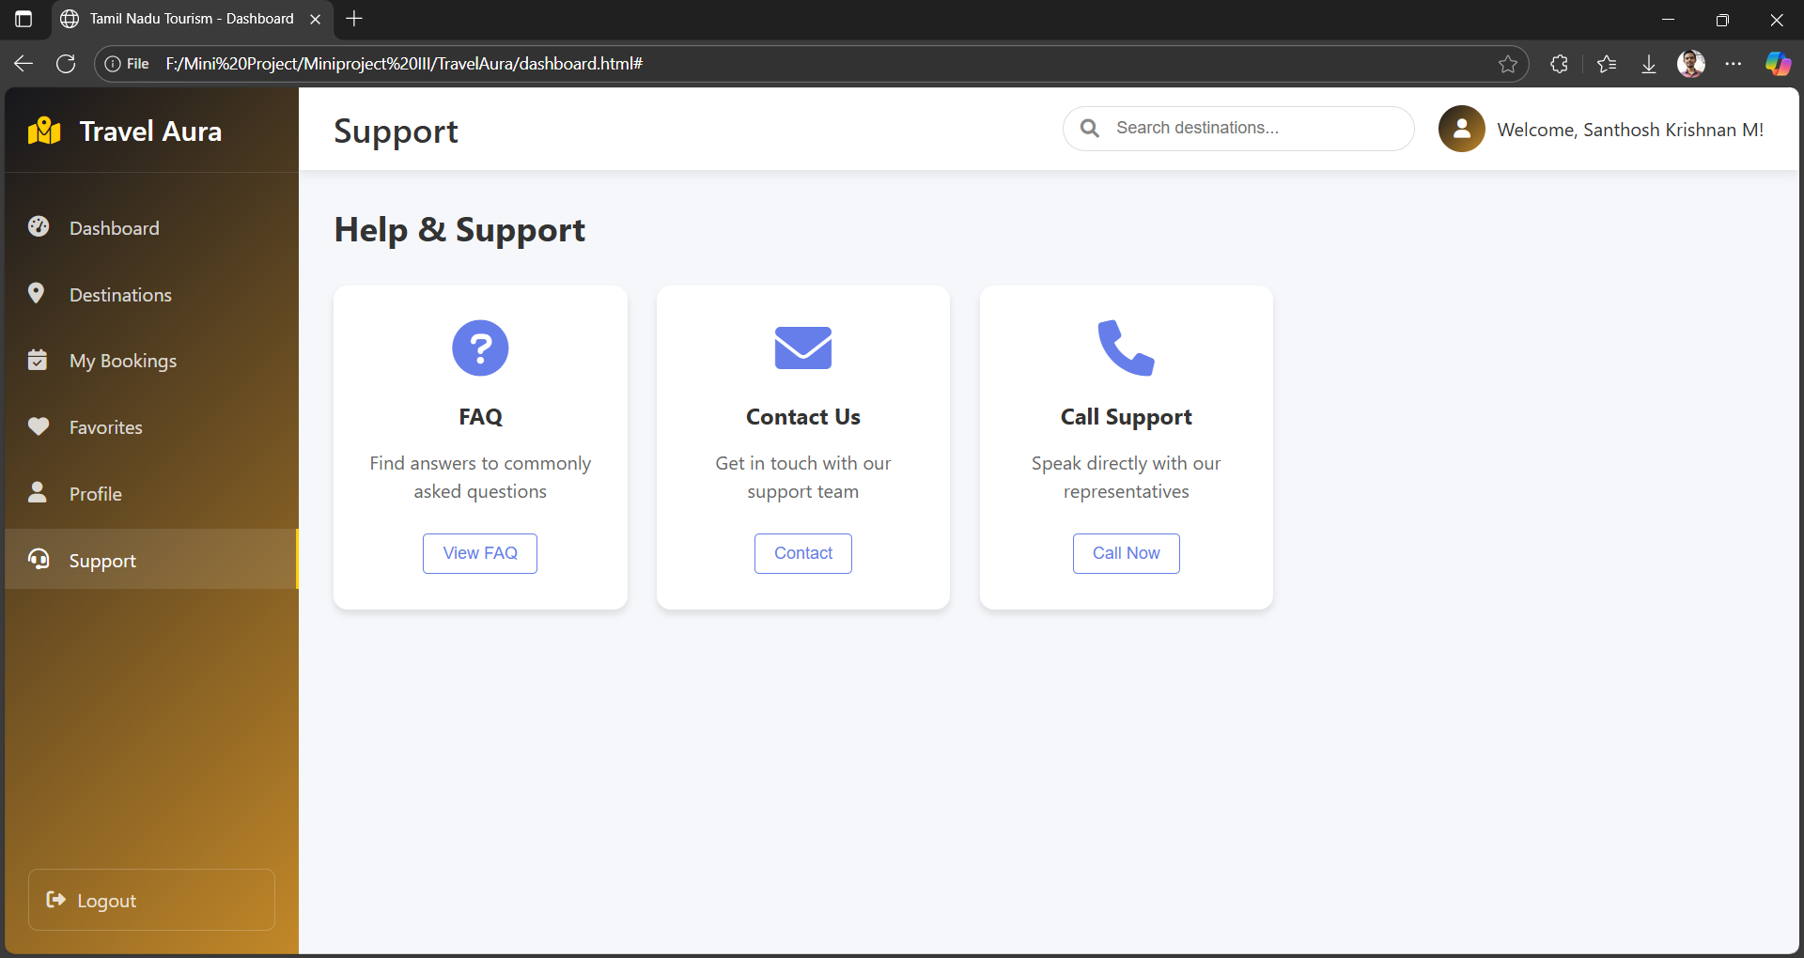
UI Screenshots

Slide 18
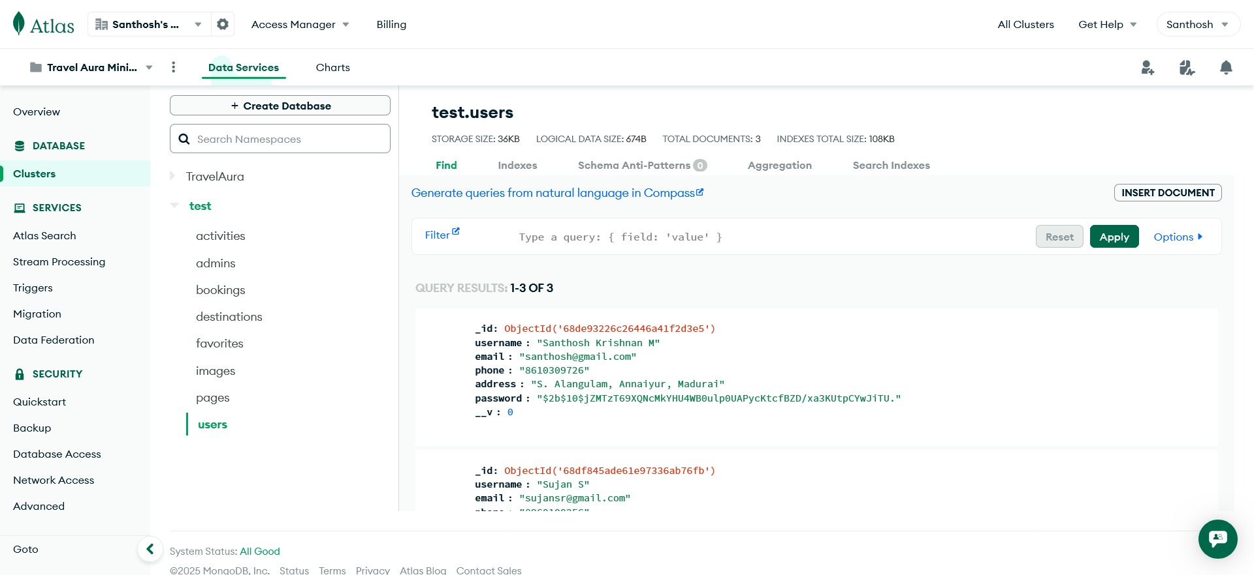
Database Connection

Slide 19
Links to refer
https://travel-aura-enb6.onrender.com/
https://github.com/Santhosh-KrishnanM/Miniproject-III

Slide 20
Thank You…

