Slide 1
CS- 584 MACHINE LEARNING FINAL PROJECT Speech Emotion Recognition
INSTRUCTOR : Dr.Yan Yan
BATCH NO:40
TEAM MEMBERS
Punalraj Parthasarathy (A20519421)
Santhosh Mani (A20518627)

Slide 2
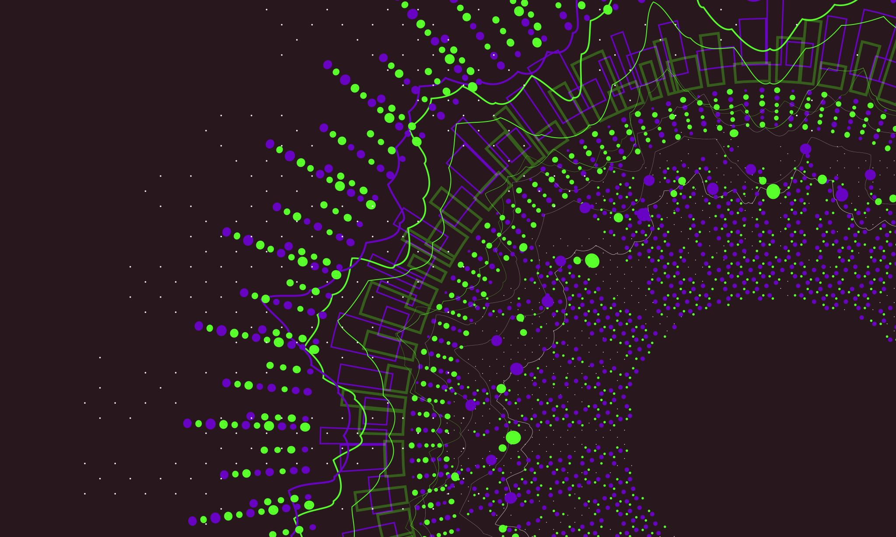
AGENDA
INTRODUCTION
DATASET
DATA PRE-PROCESSING
DATA VISUALIZATION
DATA AUGMENTATION
FEATURE EXTRACTION
DATA PREPARATION
MODELLING
TRAINING
TESTING
ACCURACY
FUTURE WORK

Slide 3

INTRODUCTION
Emotional speech recognition is a growing field in machine learning that involves detecting emotions in spoken language. This project aims to explore the use of machine learning algorithms for recognizing emotions in speech.
Speech Emotion Recognition, abbreviated as SER, is the act of attempting to recognize human emotion and affective states from speech. This is capitalizing on the fact that voice often reflects underlying emotion through tone and pitch. This is also the phenomenon that animals like dogs and horses employ to be able to understand human emotion.

Slide 4
DATASETS
Datasets used in this project:
Ryerson Audio-Visual Database of Emotional Speech and Song (Ravdess)
Crowd-sourced Emotional Multimodal Actors Dataset (Crema-D)
Dataset 1: (Ravedess)
This portion of the RAVDESS contains 1440 files: 60 trials per actor x 24 actors = 1440. The RAVDESS contains 24 professional actors (12 female, 12 male), vocalizing two lexically-matched statements in a neutral North American accent. Speech emotions include calm, happy, sad, angry, fearful, surprised, and disgusted expressions. Each expression is produced at two levels of emotional intensity (normal, strong), with an additional neutral expression.
Dataset 2: (Crema-D)
CREMA-D is a data set of 7,442 original clips from 91 actors. These clips were from 48 male and 43 female actors between the ages of 20 and 74 coming from a variety of races and ethnicities (African America, Asian, Caucasian, Hispanic, and Unspecified). Actors spoke from a selection of 12 sentences. The sentences were presented using one of six different emotions (Anger, Disgust, Fear, Happy, Neutral, and Sad) and four different emotion levels (Low, Medium, High, and Unspecified).

Slide 5
DATA PRE-PROCESSING
Since we have chosen different datasets with different naming conventions. we are doing data pre-processing using different methods for all the datasets and combining them into a single data frame with their emotion and the path of the respective audio file.
Ravedess Filename example: 03-01-06-01-02-01-12.wav
Audio-only (03)
Speech (01)
Fearful (06)
Normal intensity (01)
Statement "dogs" (02)
1st Repetition (01)
12th Actor (12) Female, as the actor ID number is even
Crema-D Filename example: 1049_WSI_ANG_XX.wav

Slide 6


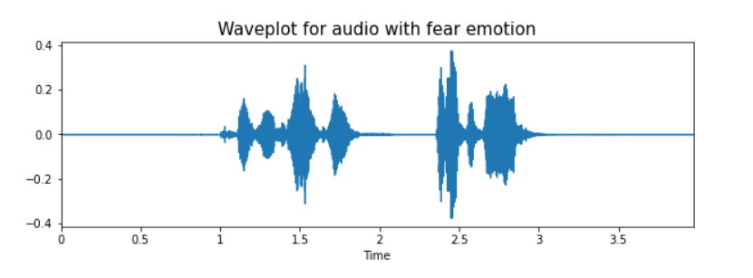
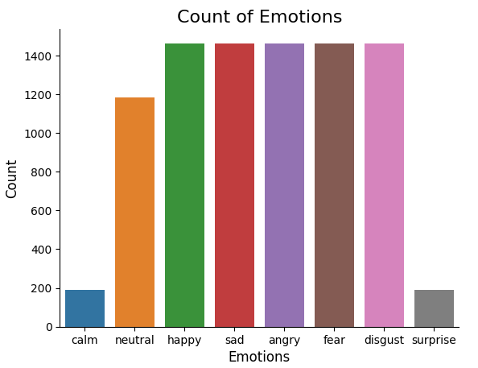
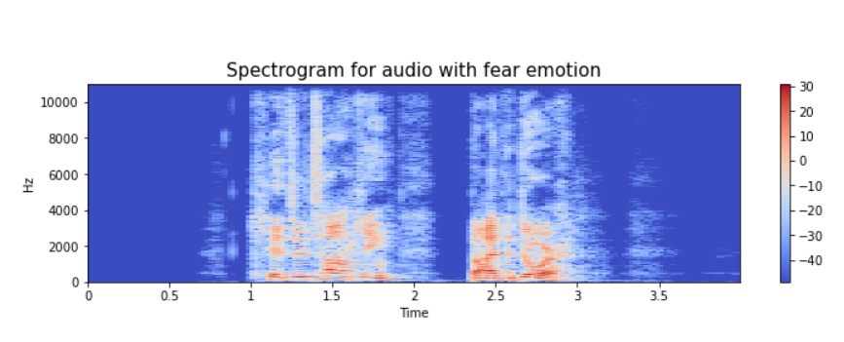
DATA VISUALISATION

Slide 7

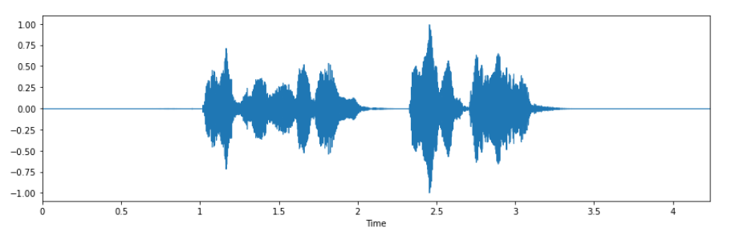
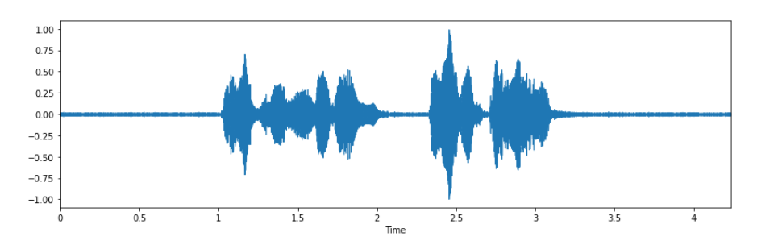
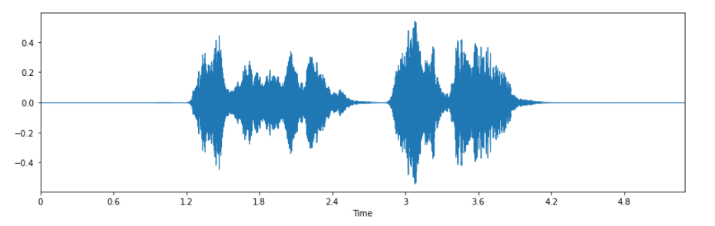
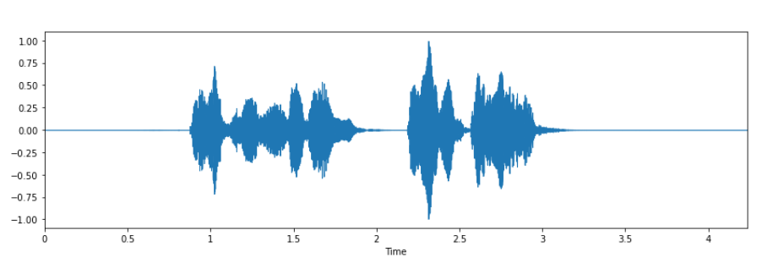
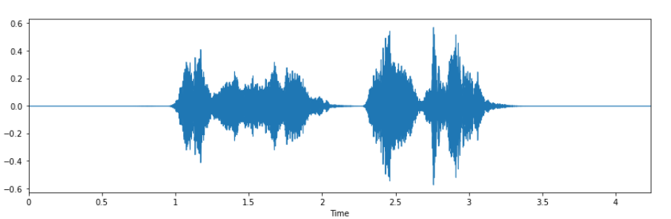
Data Augmentation
Simple Audio
Noise Injection
Data augmentation is the process by which we create new synthetic data samples by adding small perturbations on our initial training set.
To generate syntactic data for audio, we can apply noise injection, shifting time, changing pitch and speed.
The objective is to make our model invariant to those perturbations and enhance its ability to generalize.
Stretching
Shifting
Pitch
Notes:
data = data + noise_amp*np.random.normal(size=data.shape[0]) for noise injection
Shifting def shift(data):
shift_range = int(np.random.uniform(low=-5, high = 5)*1000)
return np.roll(data, shift_range)
We are using librosa.effects.time_stretch for performing stretching
We are using librosa.effects.pitch_shift for performing pitch

Slide 8
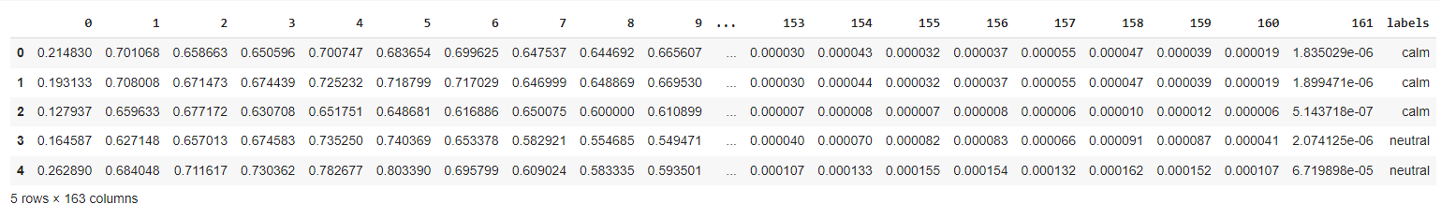
FEATURE EXTRACTION
Extraction of features is a very important part in analyzing and finding relations between different things. As we already know that the data provided of audio cannot be understood by the models directly, so we need to convert them into an understandable format for which feature extraction is used.
The features that we have extracted:
Zero Crossing Rate
Chroma_stft
MFCC (Mel Frequency Cepstral Coefficients)
RMS(root mean square) value
MelSpectogram to train our model.
Notes:
Zero Crossing Rate (ZCR): ZCR is a measure of the number of times a signal crosses the zero-axis. It is often used to identify the onset and offset of audio signals, and can be used to estimate features such as pitch and timbre.
Chroma_stft: Chroma_stft is a feature extraction technique used in audio processing to represent the harmonic content of an audio signal in a musically meaningful way. It is calculated by mapping the power spectrum of an audio signal onto the 12-tone scale used in Western music.
MFCC (Mel Frequency Cepstral Coefficients): MFCC is a widely used feature extraction technique in audio processing that is based on the Mel scale. It involves taking the Fourier transform of short time frames of an audio signal, and then mapping the resulting spectrum onto the Mel scale. The resulting Mel spectrum is then transformed into the cepstral domain using the discrete cosine transform, resulting in a set of coefficients that capture the spectral characteristics of the audio signal.
RMS (Root Mean Square) value: RMS is a measure of the average power of an audio signal. It is calculated by taking the square root of the mean of the squared amplitude values of the signal.
MelSpectrogram: A mel-spectrogram is a visualization of the power spectrum of a sound signal that is commonly used in audio processing and analysis. It is a 2D representation of the frequency content of an audio signal over time, where the x-axis represents time, the y-axis represents frequency, and the color represents the amplitude or power of the frequency component at a specific time. It is often used as an input to machine learning models for tasks such as speech recognition and sound event detection.

Slide 9
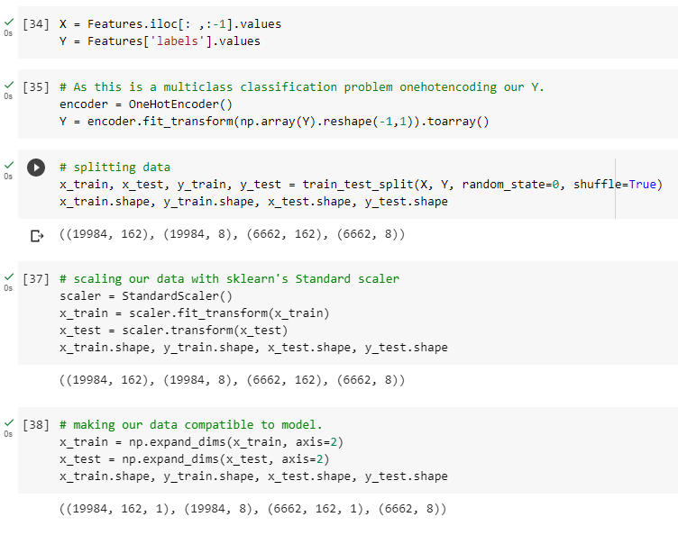
DATA PREPARATION
OneHotEncoder is used to transform categorical data into a numerical representation
The random_state parameter is used to set a specific random seed for the random number generator used by the function, ensuring that the same split is obtained each time the function is called with the same input data and parameter values.
The shuffle parameter is used to randomly shuffle the data before splitting it into train and test sets.
Standard Scalar is used to standardize the input features by scaling them to zero mean and unit variance.
The fit_transform method of the StandardScaler object is used to apply the scaling transformation to the x_train data. This method fits the scaler on the training data and then applies the transformation to it. The resulting transformed data is assigned to x_train
Next, the transform method of the StandardScaler object is used to apply the same scaling transformation to the x_test data. Since the scaler was already fit on the training data, the same scaling parameters are applied to the test data. The resulting transformed data is assigned to x_test.
Finally, the shape attribute of each of the variables is printed to verify that the dimensions of the training and test sets have not changed as a result of the scaling transformation.
Notes:
As of now we have extracted the data, now we need to normalize and split our data for training and testing.
We have split our training to test ratio = 75-25

Slide 10
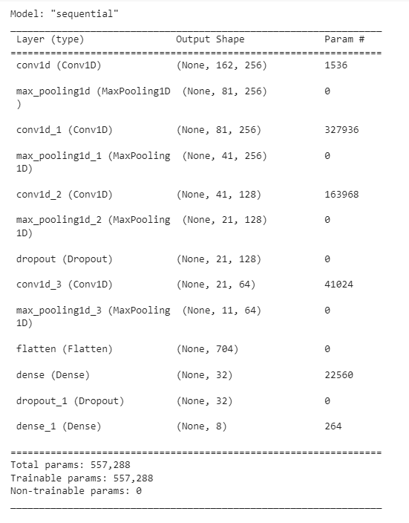
MODELLING
The CNN model architecture is defined using the Sequential class, which allows layers to be added to the model in sequence.
The model architecture consists of multiple layers of one-dimensional convolutional (Conv1D) and pooling (MaxPooling1D) layers, followed by a flattening layer, a couple of fully connected (Dense) layers, and a final output layer.
The Conv1D layers use a 1D convolutional filter with a specified number of filters, kernel size, and activation function to extract features from the input data.
The MaxPooling1D layers use a pooling operation to down sample the output from the previous convolutional layer, which helps to reduce overfitting and improve computational efficiency.
The Flatten layer flattens the output from the previous layer into a 1D vector, which is then passed to the fully connected Dense layers.
The Dense layers are fully connected layers that apply a linear transformation to the input data, followed by a specified activation function.
The final Dense layer uses a softmax activation function to produce the output probabilities for each class.
The model is compiled using the compile method, which specifies the optimizer, loss function, and evaluation metric to use during training.
The summary method is then used to print a summary of the model architecture, including the number of parameters in each layer.
Notes:
ReLU helps to prevent the exponential growth in the computation required to operate the neural network

Slide 11
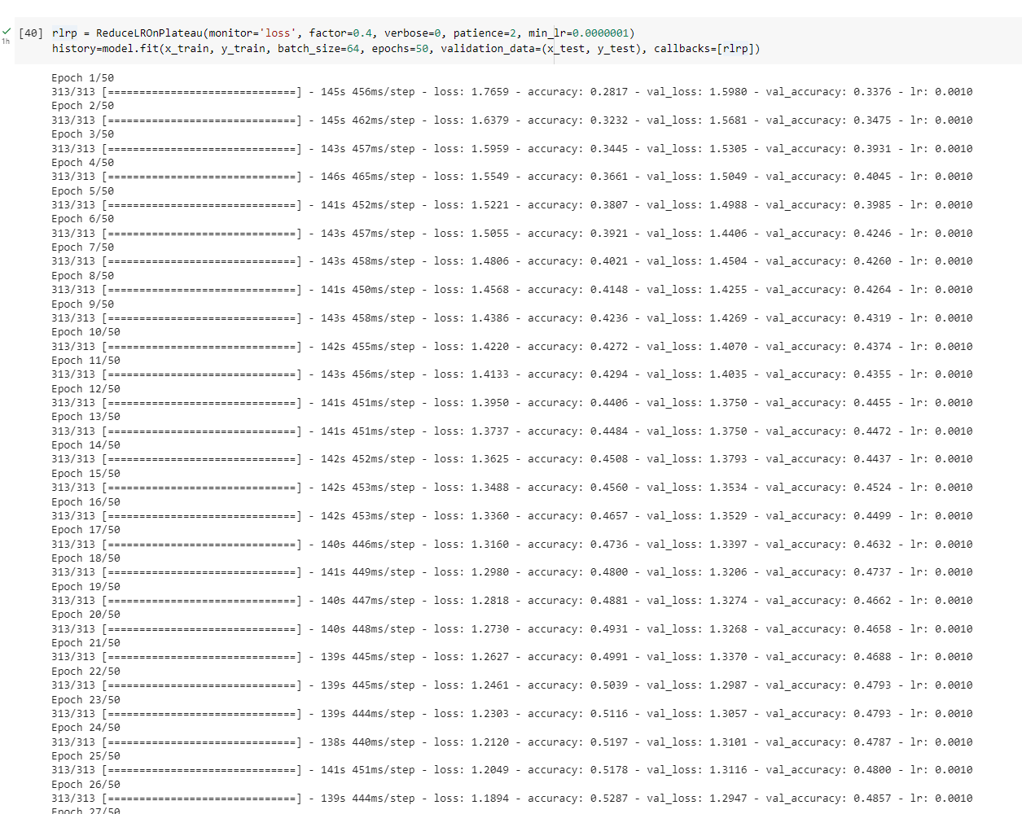
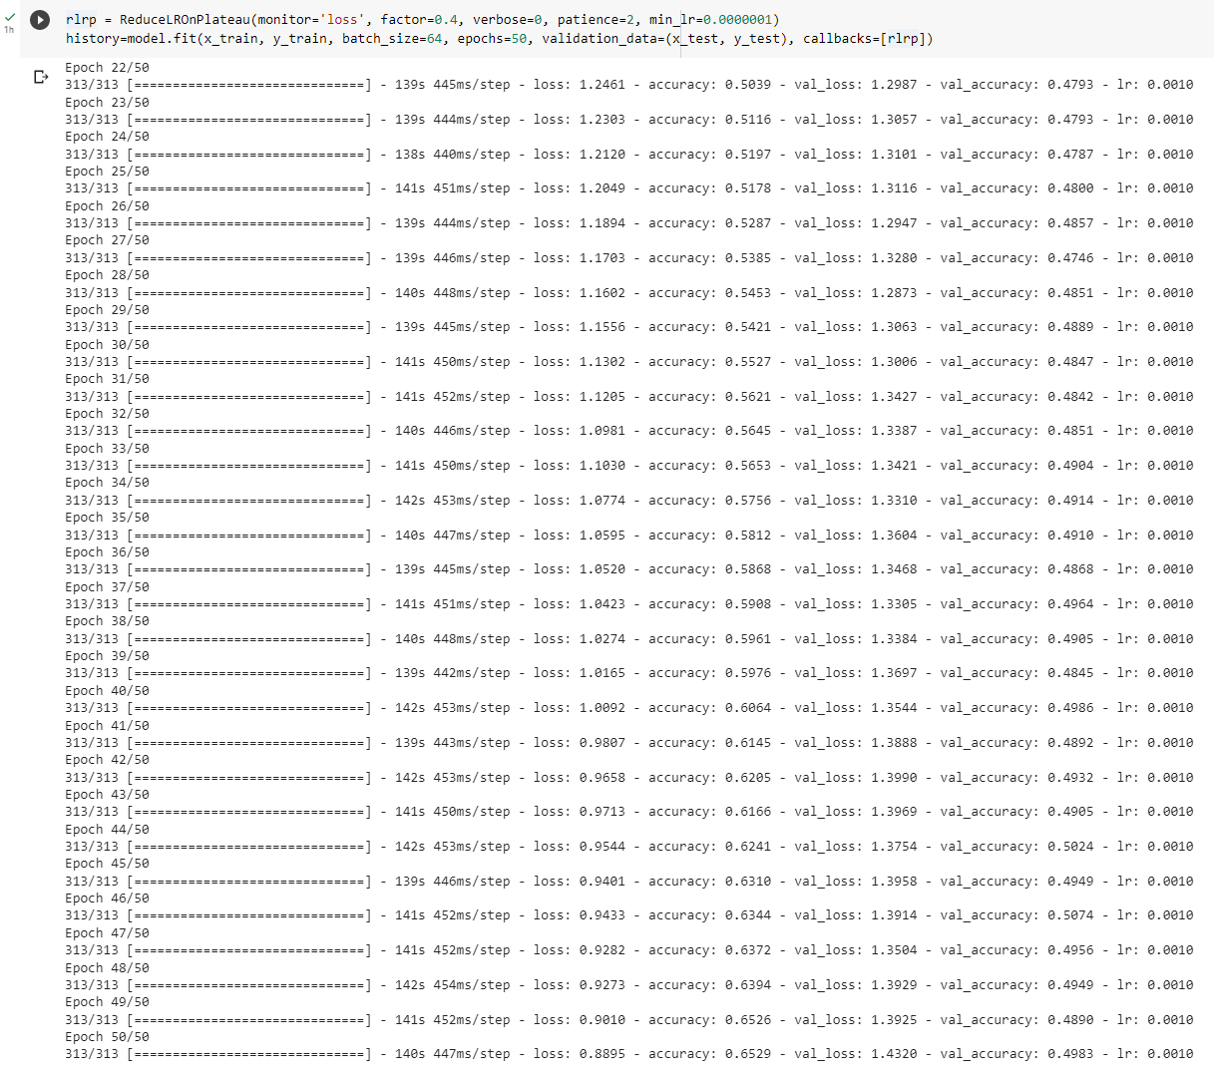
TRAINING
We have trained our model for 50 Epochs and allowed minimum learning rate of 0.0000001
The history variable is used to store information about the training process, such as the loss and accuracy at each epoch. This information can be used to visualize the training progress and evaluate the performance of the model.

Slide 12
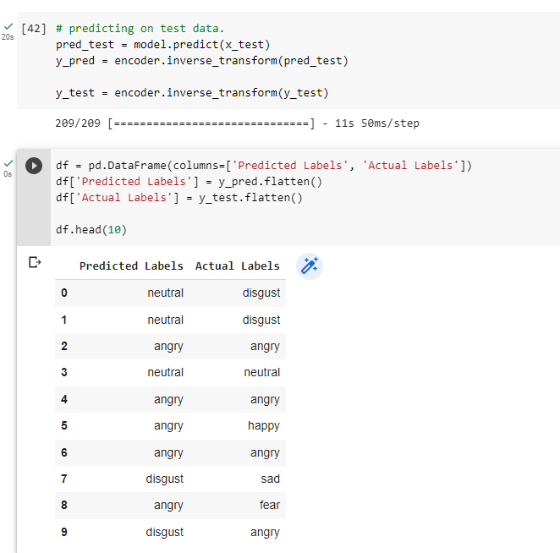
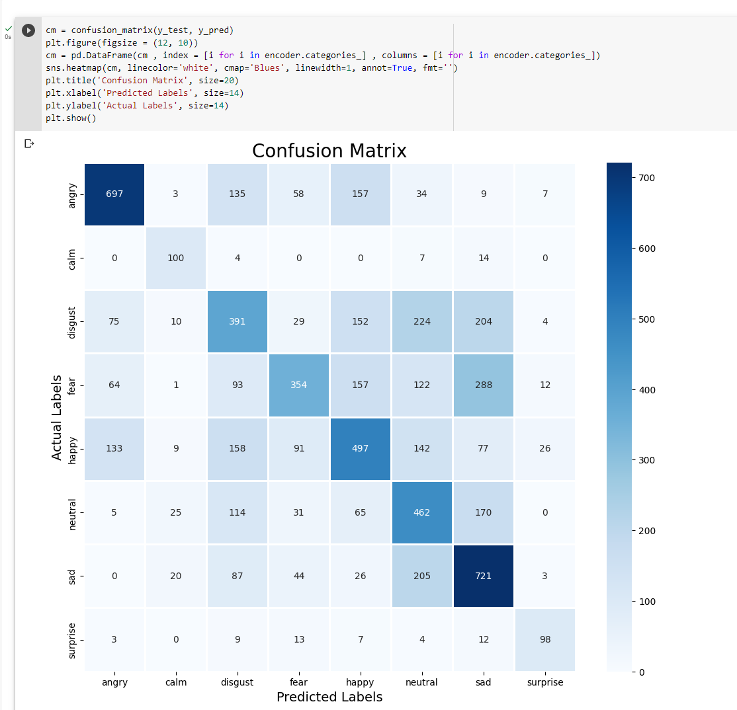
TESTING

Slide 13
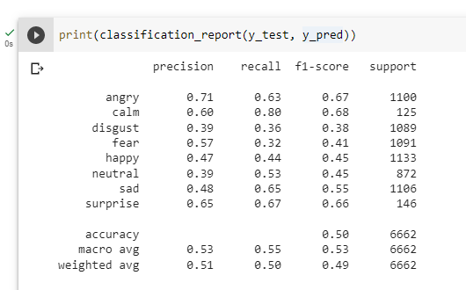
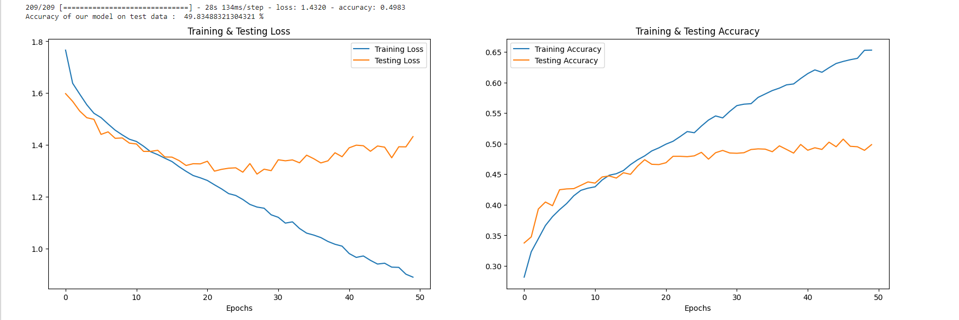
ACCURACY

Slide 14
FUTURE WORK
Collecting more datasets to improve accuracy of the model.
Fine-tuning the model architecture and hyper-parameters to improve performance, such as exploring deeper neural networks or different loss functions.
Investigating new features and combinations of features that could better capture emotional content in speech.

Slide 15
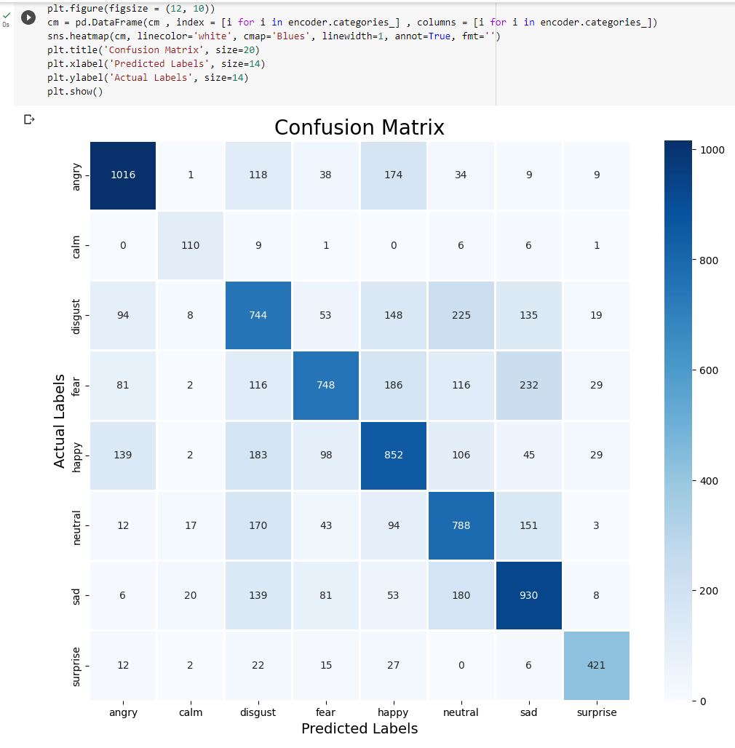
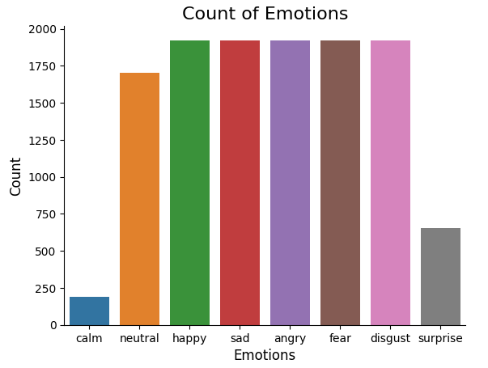
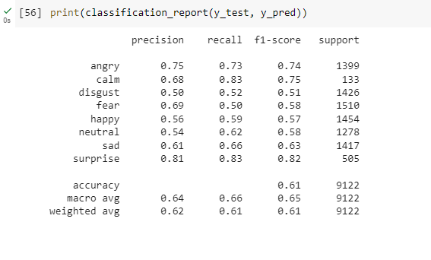
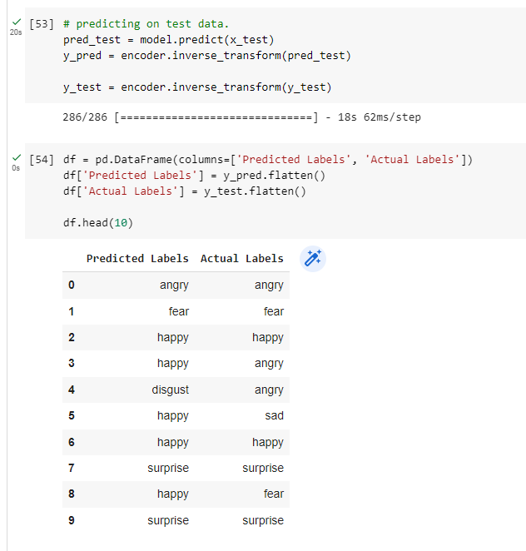
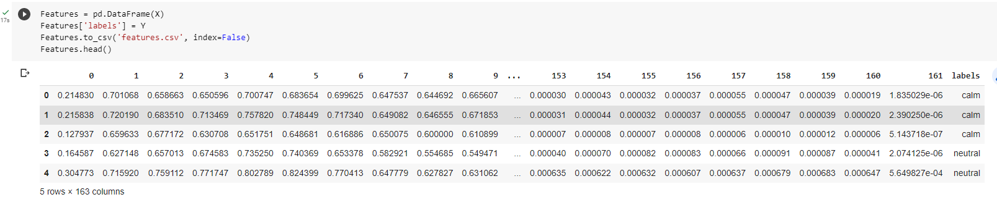
RESULTS AFTER ADDING ADDITIONAL DATASETS

Slide 16
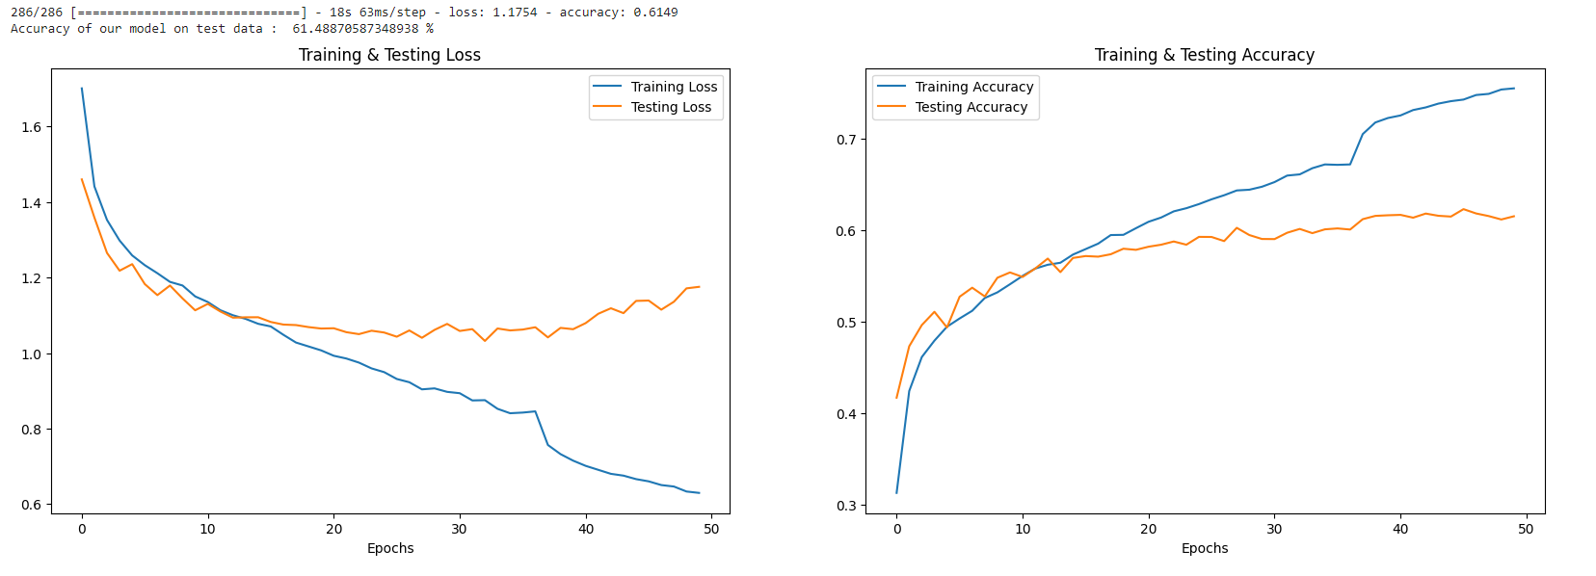
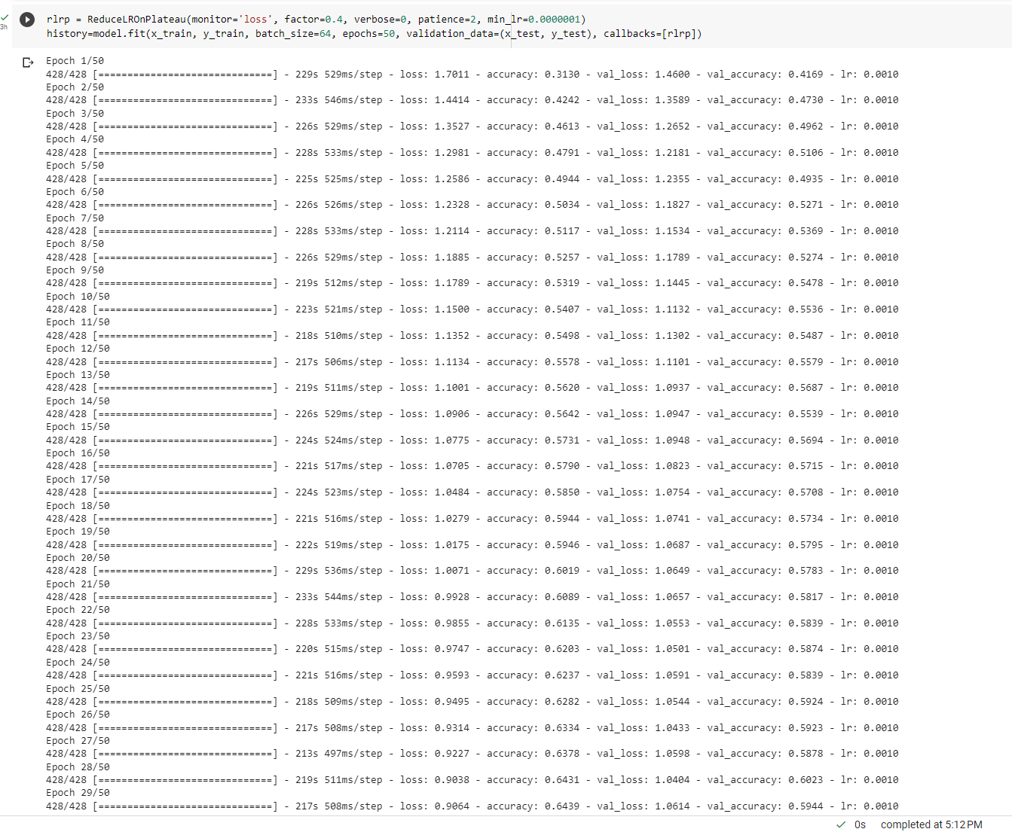
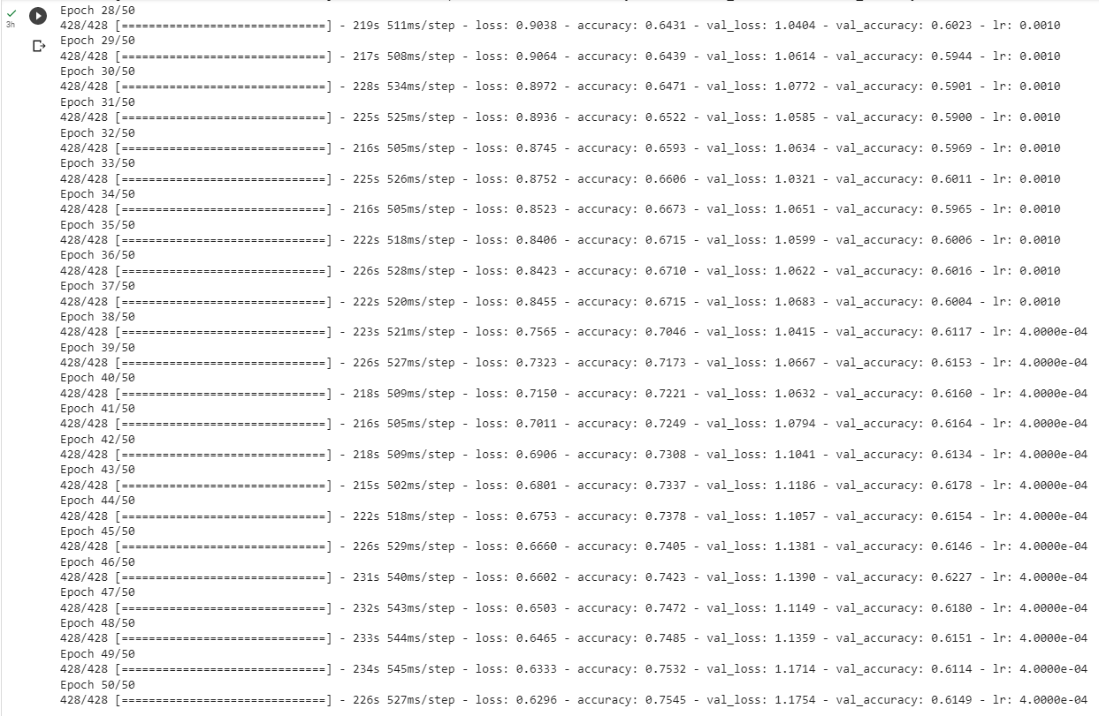
(Cont..)

Slide 17
THANK YOU

