Slide 1
Digital Portfolio
STUDENT NAME: V. Santhosh
REGISTER NO AND NMID: 212403876/ 1419DA56E661F32851F4A68CAB8AB51D
DEPARTMENT: BCA
COLLEGE: COLLEGE/ UNIVERSITY : Tagore college of arts and science, Chromepet-44 (University of Madras)

Slide 2
PROJECT TITLE
Santhosh
portfolio project

Slide 3


AGENDA
Problem Statement
Project Overview
End Users
Tools and Technologies
Portfolio design and Layout
Features and Functionality
Results and Screenshots
Conclusion
Github Link
3/21/2024 Annual Review

Slide 4

PROBLEM STATEMENT
In today’s competitive landscape, traditional resumes often fall short in showcasing creativity, practical skills, and interactive experience. Recruiters and clients increasingly seek a more engaging, intuitive, and visually dynamic way to evaluate candidates.
The challenge lies in building a digital platform that not only outlines academic qualifications and technical expertise but also brings those skills to life through live, hands-on demonstrations.
To bridge this gap, I developed my portfolio project — a professional, interactive space designed to effectively present my abilities and showcase real-world projects in action.

Slide 5

PROJECT OVERVIEW
This project is a personal portfolio website designed to showcase my technical expertise, skill set, and project work—all in one cohesive platform.
The site is organized into key sections including About Me, Skills, Services, Portfolio, and Contact, offering a clear and intuitive navigation experience.
Built with a modern, responsive layout, the design ensures optimal performance and accessibility across all devices. It not only represents my professional abilities but also reflects my personality and approach to design and development.
Ultimately, this portfolio acts as a digital identity—helping me connect with recruiters, clients, and peers in a meaningful and impactful way.

Slide 6

WHO ARE THE END USERS?
This portfolio is thoughtfully designed to cater to multiple key audiences:
Recruiters & Employers – To efficiently assess my technical skills, project experience, and creative approach.
Clients – For potential freelance work or collaborations by showcasing my capabilities and past projects.
Peers & Educators – To foster knowledge sharing, encourage discussions, and build valuable professional connections.
By addressing the needs of these audiences, the portfolio functions as a dynamic tool for both career growth and professional visibility.

Slide 7

TOOLS AND TECHNIQUES
The portfolio was built using a strong combination of front-end and programming technologies:
Frontend: HTML, CSS, and JavaScript were used to design the user interface and interactivity.
Programming Knowledge: Python, Java, and C++ were applied for logic-building and showcasing coding expertise.
Hosting: GitHub Pages was used to deploy and maintain the website online.
These tools ensure that the portfolio is not only visually appealing but also technically strong and reliable.

Slide 8
POTFOLIO DESIGN AND LAYOUT
The design philosophy focuses on simplicity, modern visuals, and user experience. A blue-themed color scheme is maintained for professionalism and consistency.
The layout is divided into clean sections:
About Me
Skills (with progress bars)
Services offered
Portfolio showcase
Contact form
This structure ensures easy navigation, readability, and engagement for any visitor.
‹#›

Slide 9
FEATURES AND FUNCTIONALITY
The portfolio includes multiple interactive features that improve usability and engagement:
Interactive navigation bar for smooth movement across sections.
Skill progress bars to visually showcase technical strengths.
Portfolio section with projects and categories.
Contact form for direct communication with clients or recruiters.
GitHub integration for direct access to code repositories.
These functionalities make the portfolio a dynamic platform rather than a static resume.

Slide 10

RESULTS AND SCREENSHOTS
The portfolio was successfully deployed at:
https://santhosh-v04.github.io/Naan-Mudhalvan-Portfolio/src/index.html
Key results:
Professional Online Presence: An accessible digital identity for recruiters and clients.
Skill Demonstration: Visual proof of coding and designing abilities.
User Experience: Mobile-friendly, responsive, and eashttps://nareshkumar6707.github.io/naresh-kumar/y-to-navigate layout.
Screenshots of different sections (Home, Skills, Portfolio, Contact) can be showcased during the presentation to demonstrate its effectiveness.
3/21/2024 Annual Review
‹#›

Slide 11
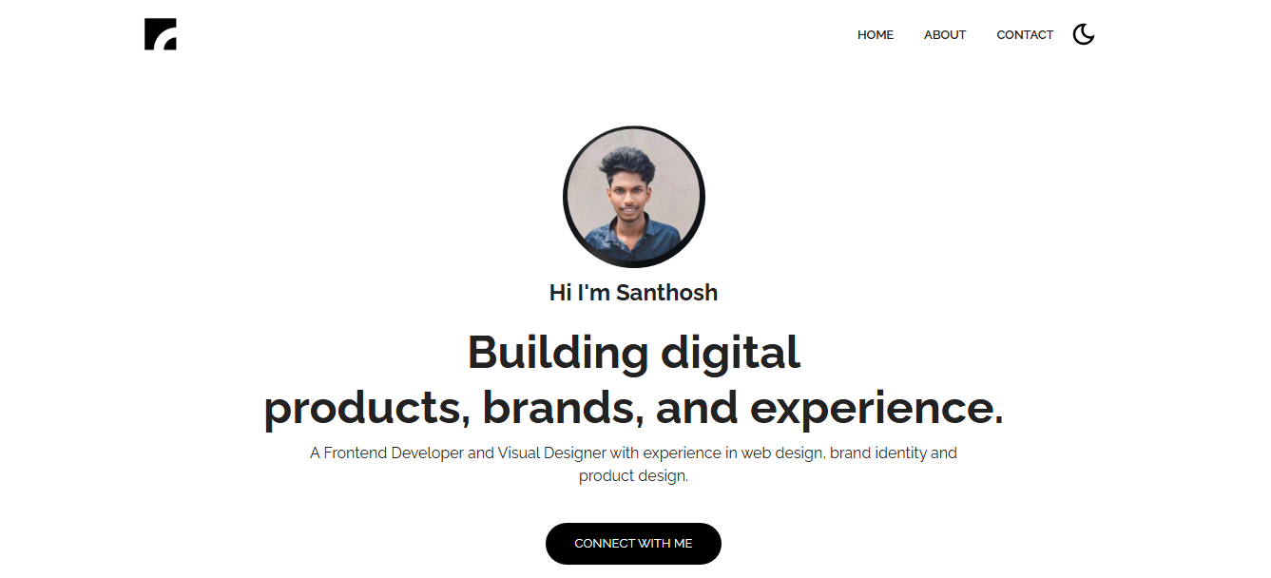

Slide 12


Slide 13
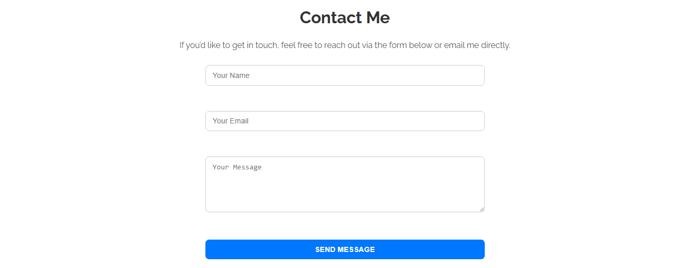

Slide 14


Slide 15
CONCLUSION
The portfolio project proves that a digital resume/portfolio is far more impactful than a static CV. It highlights skills, projects, and creativity in an interactive way.
It also provides me with a strong professional identity, helping me stand out in academic and career opportunities.
🔗 GitHub Repository: https://santhosh-v04.github.io/Naan-Mudhalvan-Portfolio/src/index.html
‹#›

