Slide 1

Android application for keeping up with the latest headlines
Presented by :
Santhosh kumar

Slide 2
Introduction to AndroidIntroduction to AndroidDevelopment
Android development is a dynamicAndroid development is a dynamicfield that allows developers to createfield that allows developers to createapplications for millions of users. In thisapplications for millions of users. In thispresentation, we will explore thepresentation, we will explore thecoding perspective of developing ancoding perspective of developing anAndroid application specificallyAndroid application specificallydesigned for real-time news updates.designed for real-time news updates.Let’s dive into the essentialLet’s dive into the essentialcomponents and techniques involved.

Slide 3
Understanding Real-Time Updates
Real-time updates are crucial for deliveringReal-time updates are crucial for deliveringtimely information to users. This slide covers howtimely information to users. This slide covers howweb sockets and push notifications can beweb sockets and push notifications can beutilized to ensure that users receive the latestutilized to ensure that users receive the latestnews without needing to refresh the applicationnews without needing to refresh the applicationmanually.

Slide 4
Coosing te RigtCoosing te RigtFramework
Selecting the appropriate framework isSelecting the appropriate framework isvital for the success of your application.vital for the success of your application.We will discuss popular choices likeWe will discuss popular choices likeAndroid Jetpack, which simplifiesAndroid Jetpack, which simplifiesdevelopment and enhancesdevelopment and enhancesperformance, making it easier toperformance, making it easier toimplement real-time features.

Slide 5
Backend Integration
Backend IntegrationA robust backend is essential for managing dataA robust backend is essential for managing dataflow. This slide will explain how to integrate withflow. This slide will explain how to integrate withRESTful APIs and utilize cloud services to fetchRESTful APIs and utilize cloud services to fetchand store news articles, ensuring a seamlessand store news articles, ensuring a seamlessexperience for users.

Slide 6
Implementing UserImplementing UserInterface
The user interface plays a key role inThe user interface plays a key role inuser engagement. We will exploreuser engagement. We will explorebest practices for designing anbest practices for designing anintuitive UI that highlights real-timeintuitive UI that highlights real-timenews updates, ensuring users cannews updates, ensuring users caneasily navigate through the content.

Slide 7
Testing and Debugging
Effective testing and debuggingEffective testing and debuggingstrategies are crucial for a successfulstrategies are crucial for a successfullaunch. This slide covers differentlaunch. This slide covers differenttesting methodologies, including unittesting methodologies, including unittesting and UI testing, to ensure thattesting and UI testing, to ensure thatthe application performs reliably underthe application performs reliably undervarious conditions.

Slide 8
Deployment Strategies
Once development is complete,Once development is complete,deploying your application is the nextdeploying your application is the nextstep. We will discuss variousstep. We will discuss variousdeployment strategies, including usingdeployment strategies, including usingthe Google Play Store and beta testingthe Google Play Store and beta testingto gather user feedback before the finalto gather user feedback before the finalrelease.release.Conclusion a

Slide 9
dependencies {
implementation 'com.squareup.retrofit2:retrofit:2.9.0' implementation 'com.squareup.retrofit2:converter-gson:2.9.0' implementation 'androidx.recyclerview:recyclerview:1.3.0' implementation 'androidx.lifecycle:lifecycle-viewmodel:2.6.0'}

Slide 10
<LinearLayout xmlns:android="http://schemas.android.com/apk/res/android" android:layout_width="match_parent" android:layout_height="match_parent" android:orientation="vertical">
<androidx.recyclerview.widget.RecyclerView android:id="@+id/recyclerView" android:layout_width="match_parent" android:layout_height="match_parent"/>
</LinearLayout>

Slide 11
public class Article {
private String title;
private String url;
public String getTitle() {
return title;
}
public String getUrl() {
return url;
}
}

Slide 12
import retrofit2.Call;
import retrofit2.http.GET;
import retrofit2.http.Query;
public interface NewsApiService {
@GET("v2/top-headlines")
Call<NewsResponse> getTopHeadlines(
@Query("country") String country,
@Query("apiKey") String apiKey
);
}

Slide 13
import java.util.List;
public class NewsResponse {
private List<Article> articles;
public List<Article> getArticles() {
return articles;
}
}

Slide 14
import android.view.LayoutInflater;
Import android.view.View;
import android.view.ViewGroup;
import android.widget.TextView;
import androidx.annotation.NonNull;
Import androidx.recyclerview.widget.RecyclerView;
import java.util.List;
public class NewsAdapter extends RecyclerView.Adapter<NewsAdapter.NewsViewHolder> { private List<Article> articles;
public NewsAdapter(List<Article> articles) { this.articles = articles;
}

Slide 15
@NonNull
@Override
public NewsViewHolder onCreateViewHolder(@NonNull ViewGroup parent, int viewType) {
View view = LayoutInflater.from(parent.getContext()) .inflate(android.R.layout.simple_list_item_1, parent, false);
return new NewsViewHolder(view);
}
@Override
public void onBindViewHolder(@NonNull NewsViewHolder holder, int position) { holder.title.setText(articles.get(position).getTitle());
}

Slide 16
@Override
public int getItemCount()
{
return articles.size();
}
static class NewsViewHolder extends RecyclerView.ViewHolder { TextView title; NewsViewHolder(@NonNull View itemView) { super(itemView);
title = itemView.findViewById(android.R.id.text1);
}
}
}

Slide 17
import android.os.Bundle;
import android.widget.Toast;
import androidx.appcompat.app.AppCompatActivity;
import androidx.recyclerview.widget.LinearLayoutManager;
import androidx.recyclerview.widget.RecyclerView;
import java.util.List;import retrofit2.Call;
import retrofit2.Callback;
import retrofit2.Response;import retrofit2.Retrofit;
import retrofit2.converter.gson.GsonConverterFactory;
public class MainActivity extends AppCompatActivity {
private static final String BASE_URL = "https://newsapi.org/";
private static final String API_KEY = "YOUR_API_KEY";

Slide 18
@Override
protected void onCreate(Bundle savedInstanceState) { super.onCreate(savedInstanceState); setContentView(R.layout.activity_main);
RecyclerView recyclerView = findViewById(R.id.recyclerView); recyclerView.setLayoutManager(new LinearLayoutManager(this));
Retrofit retrofit = new Retrofit.Builder() .baseUrl(BASE_URL) .addConverterFactory(GsonConverterFactory.create()) .build();
NewsApiService service = retrofit.create(NewsApiService.class); service.getTopHeadlines("us", API_KEY).enqueue(new Callback<NewsResponse>() {
@Override
public void onResponse(Call<NewsResponse> call, Response<NewsResponse> response) { if (response.isSuccessful() && response.body() != null) { List<Article> articles = response.body().getArticles(); recyclerView.setAdapter(new NewsAdapter(articles));
}
}

Slide 19
@Override
public void onFailure(Call<NewsResponse> call, Throwable t) { Toast.makeText(MainActivity.this, "Failed to load news", Toast.LENGTH_SHORT).show();
}
});
}
}

Slide 20
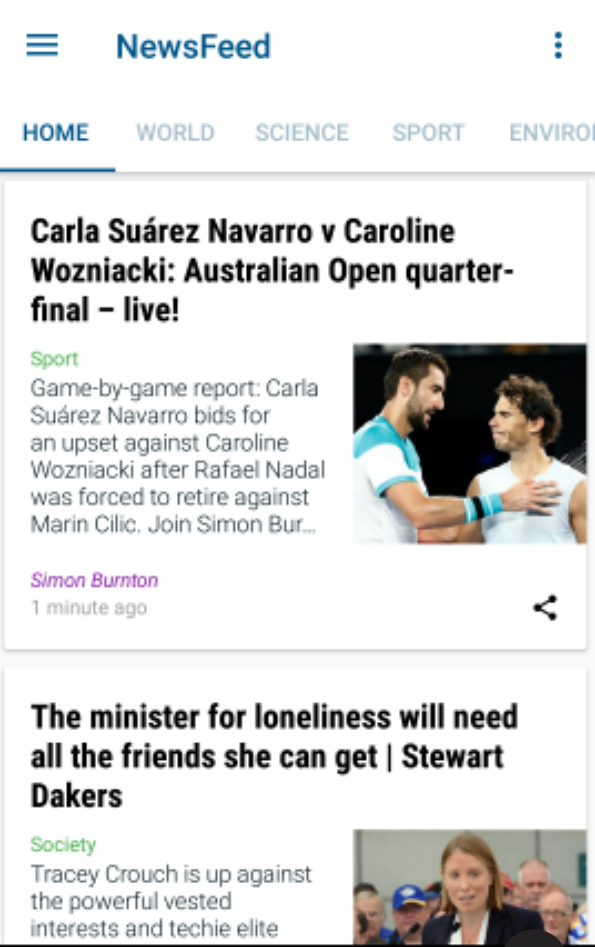
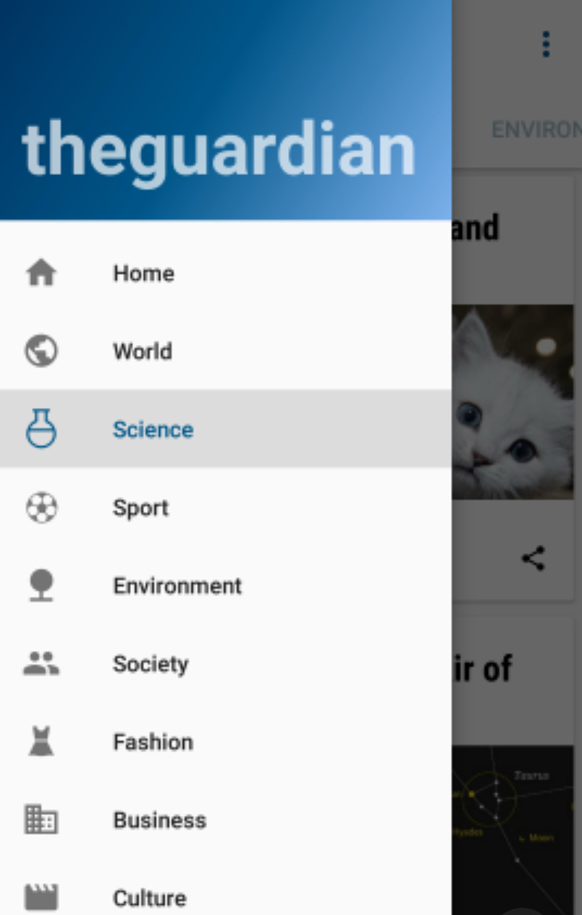
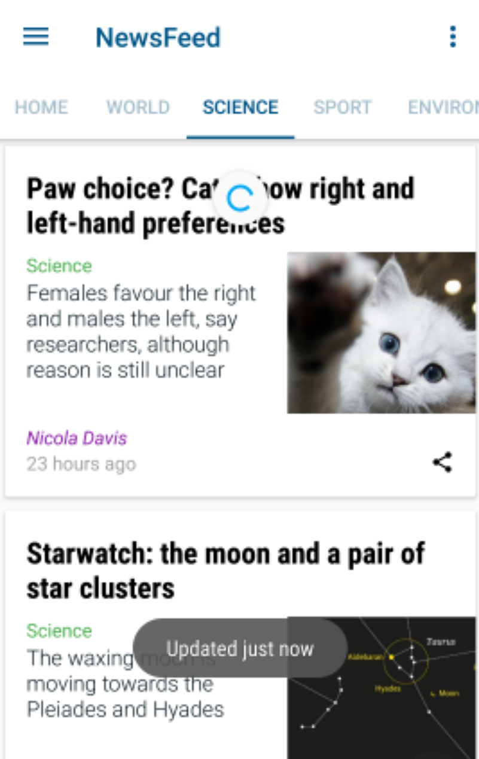
Output

