Slide 1
Comprehensions
By
Anirudh K M
Analyst, Mobius Knowledge Services

Slide 2
List comprehension
Comprehensions provide a concise way to create data structures. Common applications are to make new data structures where each element is the result of some operations applied to each member of another sequence or iterable, or to create a subsequence of those elements that satisfy a certain condition.

Slide 3
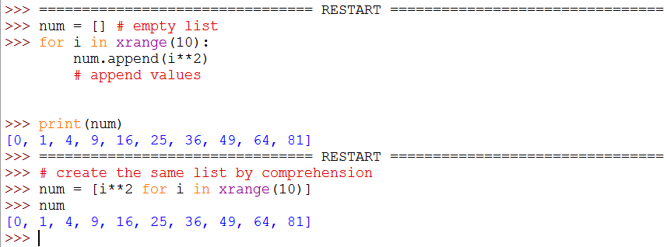
List - Illustration

Slide 4
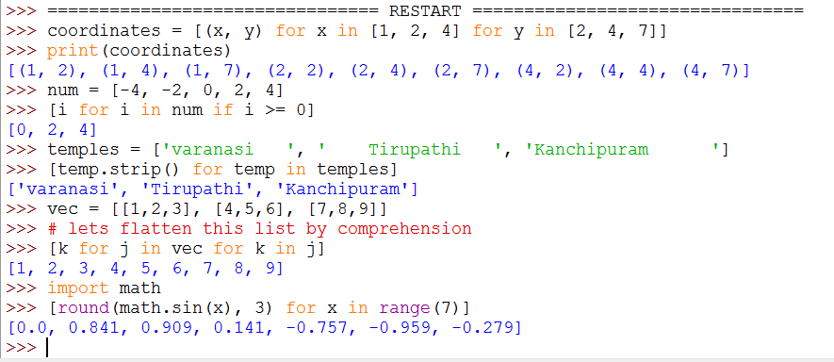
More examples List comprehension

Slide 5
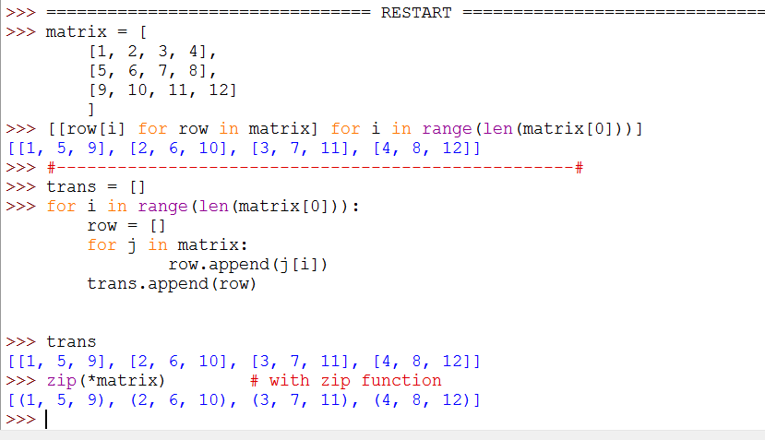
Nested list comprehension

Slide 6
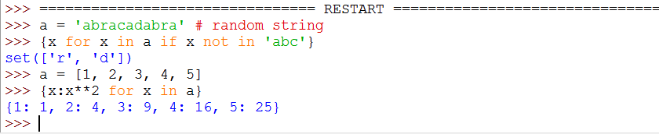
Dict and set Comprehension
This is similar to that of list comprehension, but with a slight change in the syntax.

Slide 7
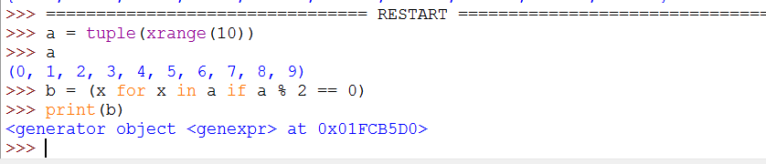
Tuple Comprehension
Oh!!! We see the values aren’t printed, we see some alien object being created.
So what’s that??!!! ☹
We will look about these when we see the topic generators.

