Slide 1
Testing and Debugging
By
Anirudh K M
Analyst, Mobius Knowledge Services

Slide 2
Introduction
Testing and Debugging can play a major before the program comes to live.
Lets see the definition of these two at first.
Testing:
In this way we execute the program with various sample inputs to check its consistency for producing correct results.
Debugging:
In this way we fix the program which does not work as per our wish.

Slide 3
Designing of code
Before conducting a test or debugging, always make sure that the code is designed neatly.
Make sure you follows the PEP-8 rules for your program.
Break the code into small functions, so that each blocks can be tested and debugged independently.
Define the variable names sensibly.
Design a clear algorithm for your program, before scripting.

Slide 4
Designing of code
Have a set of input and output to test on.
Document your codes properly, so as to increase readability and understandability.

Slide 5
Testing
The main aim of testing, is to make sure that the code runs correctly for all possible legal inputs.
But its understandable that we can’t run the code with all inputs to test it.
That’s where a test suite comes in.

Slide 6
Test suite
A Test suite, can be defined as a set of sampling input for a particular program.
Define your test suite such that, if the program executes correctly for these values, then it should work well for all possible legal inputs.

Slide 7
What if no test suite?
If we can’t define a proper test suite for our program, here are the following ways in which we can test the program.
Random testing.
Black box testing.
Glass box testing.

Slide 8
Random Testing
Random testing can be easily defined, such that the efficiency of the code increases with the no of input trails increased.
Can’t be quite tedious, but if you have no other choice with test suites, you have no other choice but left with random testing.

Slide 9
Black box testing
This test is done without looking at the code.
So this type of testing can be done by persons who don’t have prior knowledge about the programming.
This testing can really help to expose potential bugs in your program.

Slide 10
Glass box testing
This type of testing is done by looking at the code.
Glass box test suite is called path-complete if each line of the code is tested at least once.
A programmer must make sure that this glass box testing is done.
You have to remember that your Python program is dynamically compiled not statically compiled.

Slide 11
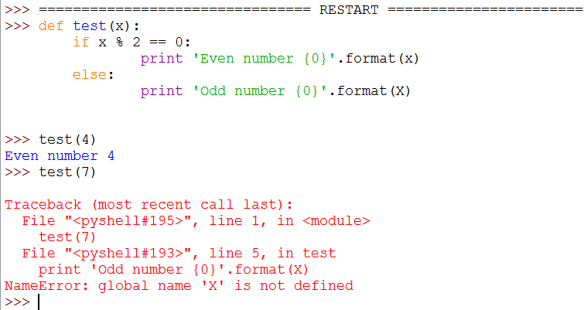
Illustration – Dynamically compiled

Slide 12
Rules for glass box testing
Execute all the branches of ‘if’ statement.
Ensure all except statements are executed.
In case of loops and recursions, have tests with:
Body of block is not entered.
Body of block executed once.
Body of block executed more than once.
Cases that makes the exit from the body.

Slide 13
Final test
After finishing these tests, conduct these tests:
Unit testing:
In this each module of the program is being tested.
Integration test:
In this the whole block of code is tested.
Make sure you cycle between these tests, so as to achieve maximum efficiency.

Slide 14
Debugging
The term debugging can be defined as such that the program failed to produce the desired result.
Let us look at the various types of bugs that can be present in our program.

Slide 15
Runtime bugs
Overt: In this the code crushes or runs forever.
Covert: In this the code produces some results, but the value may be incorrect.
Persistent: In this the bug appears each time when the code is executed.
Intermittent: In this the bug appears on few cases only, when even run on the same input.

Slide 16
Categories
Overt and persistent:
This bugs are easier to detect.
Its good to use defensive programming, to avoid these types of bugs.
Overt and intermittent:
These types of bugs can be harder to handle, but with careful analysis of the program, this can be handled.
Covert:
This can be highly irritating, its harder to debug these unless you have good insight of the programming language and the logic implemented.

Slide 17
Debugging
Debugging skill is one of the most important skill that a programmer must have in order to be complete.
Study the program completely, have an idea about the input and output of the program.
Make a record of the tests you make for debugging.

Slide 18
Narrowing down the search
Its important for us to narrow down to locate the exact location of the bug in the program.
One of the most simple ways is just to use the print statement, this can be a great tool to keep track whether the program returns the correct values in various points in the code.

Slide 19
Debugging with binary search
The usage of binary search to locate the bug can be a great idea.
Start looking from the middle of program execution and then like a binary search move down or above the middle to locate the bug’s position.

