Slide 1
Functions and Recursions
By Anirudh K M
Analyst
Mobius Knowledge Services

Slide 2
Introduction
So far we have experienced Python with conditional, looping statements embedded with few basic syntaxes.
But these type of coding doesn’t provide us abstraction, which we needed.
That’s where function comes in handy to us.

Slide 3
Appreciate the greatness of functions
Functions provides us abstraction.
The code is easy to read and understand.
The code becomes easy to edit and reuse.
Debugging of code becomes much easier.
Testing of code becomes easier too.

Slide 4
Functions - syntax
Syntax:
def <function name> (<arguments>):
Set of statements to be executed.
The function can contain ‘n’ number of legal python expressions.
The expressions are evaluated till all expressions are executed.
Else, it is executed till when a keyword return is executed in the function body, which returns a value.
If return keyword is not used then the function returns none.

Slide 5
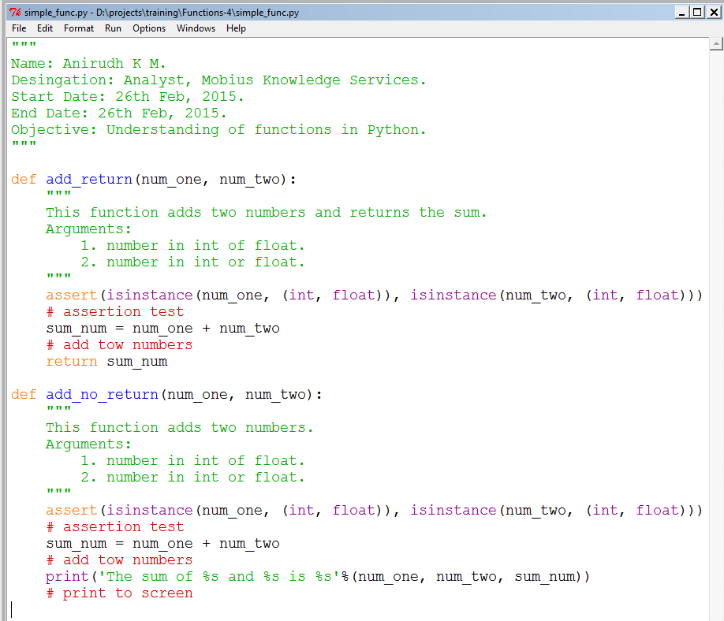
Illustration

Slide 6
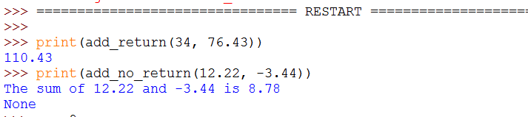
Output

Slide 7
Important points to note
Variables declared inside the functions are limited to the scope the function only.
So we could have same variable names in different functions.
Its better to restrict the function to max of 15 lines, which gives a neat representation.

Slide 8
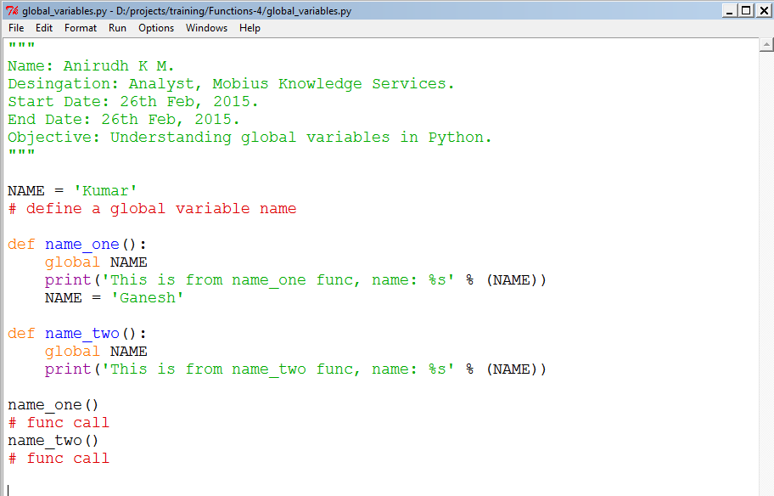
Global variables- Illustration

Slide 9
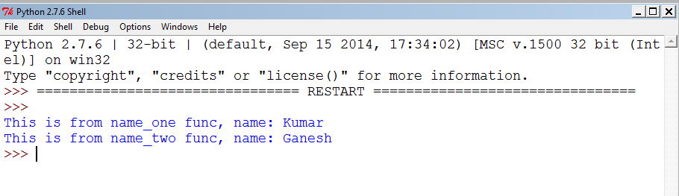
Global variables - Output

Slide 10
Binding of variables
Let’s understand how the variables are being assigned when a function is called.
The first value that is passed is assigned to the first variable of the function and it goes on.
This binding is important to understand when we look upon optional parameters in the next slide.

Slide 11
Optional or Keyword arguments
We saw how to assign arguments to functions.
The beauty of Python is that it supports optional arguments too.
This adds to flexibility in usage of functions.
Let us look at an example.

Slide 12
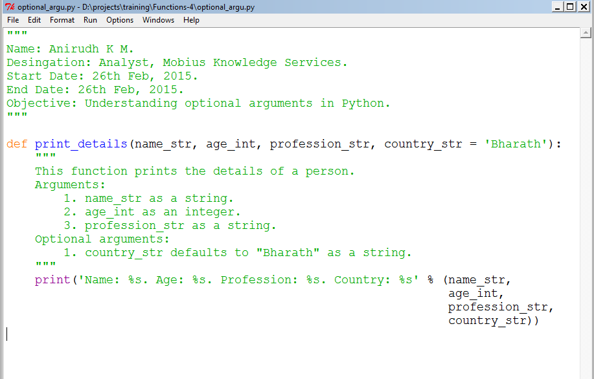
Optional arguments - Illustration

Slide 13
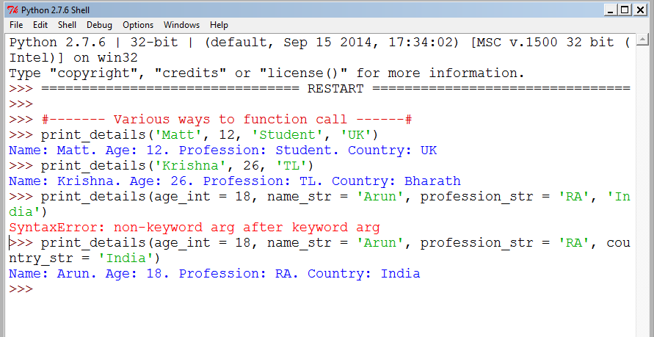
Output-Various ways to call function

Slide 14
Optional arguments
We just saw a simple example in which how the optional argument works.
It is to be noted down that these arguments must be stated at the end of the function, while creating and calling as well.
You can also have ‘n’ of optional arguments you want.

Slide 15
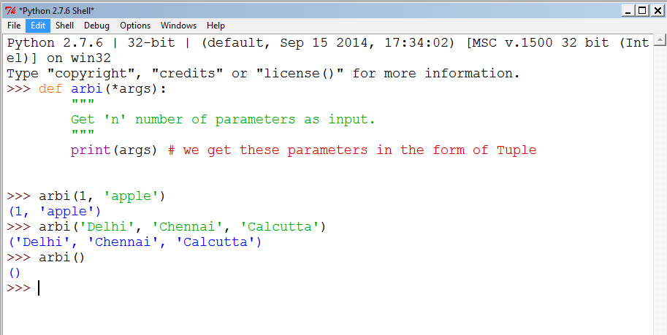
Understanding *args, **kwargs
These two helps in calling a function with ‘n’ arbitrary parameters.

Slide 16
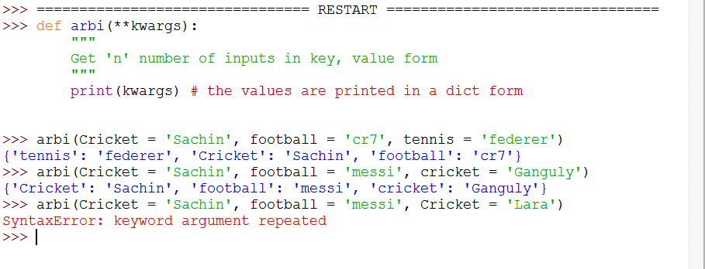
Illustration

Slide 17
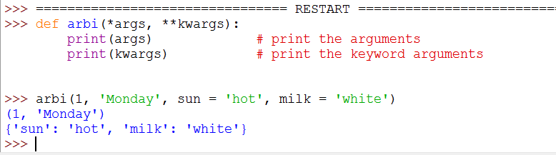
Combining both

Slide 18
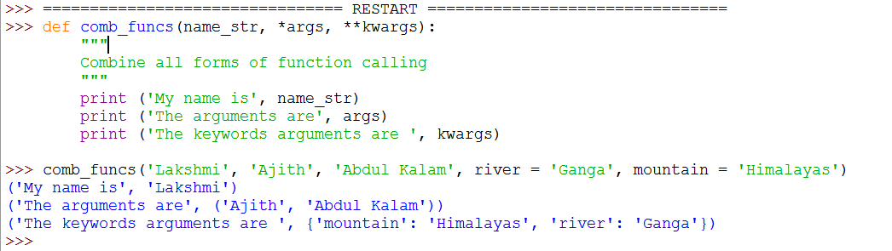
Combining all parameter functions

Slide 19
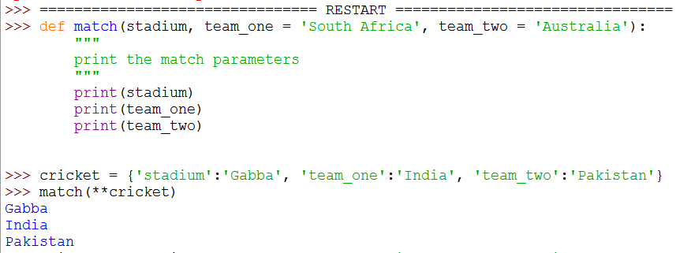
Understanding *args, **kwargs

Slide 20
Recursions
Recursions is one of the agile ways in which we can trigger a function again and again.
Recursions can reduce the complexity of the code.
Now lets look at an example how the recursion works.

Slide 21
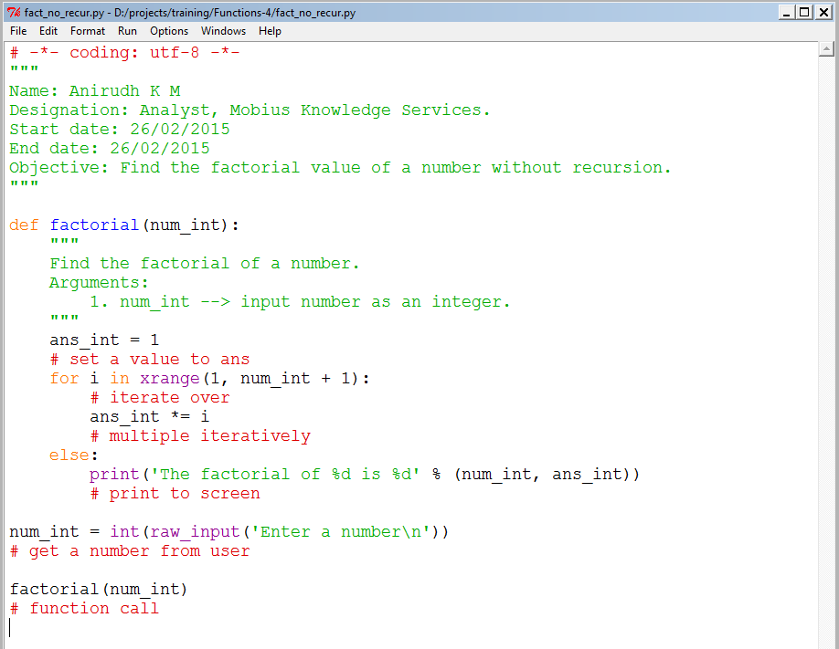
Factorial – without recursions

Slide 22
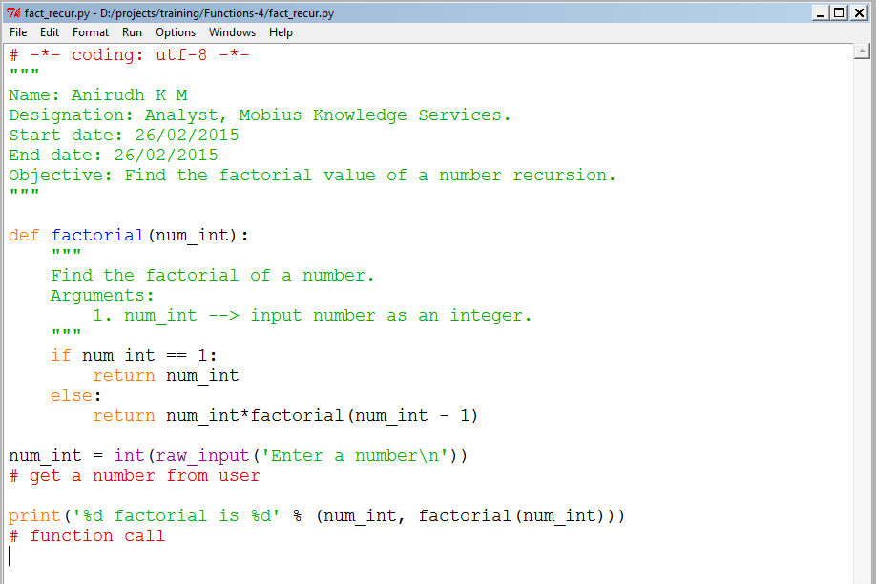
Factorial - recursion

Slide 23
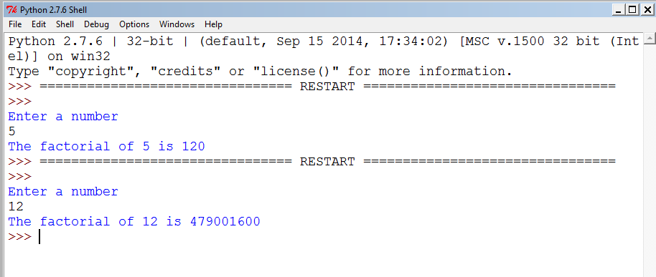
Output

Slide 24
Decorators
Decorators in Python is same as decorating.
The use of decorators in used to decorate functions or generators.
As of now we will just see an example of decorators, we will dive deep into this when we come towards the end of lectures.

Slide 25
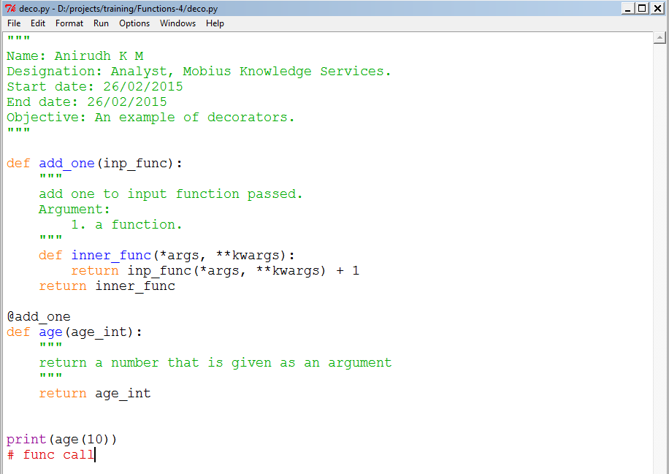
Decorators - Illustration

Slide 26
Lambda functions
Lambda statements are used to create simple functions in a single line.
These are often said to be the syntactic sugar of normal functions.

Slide 27
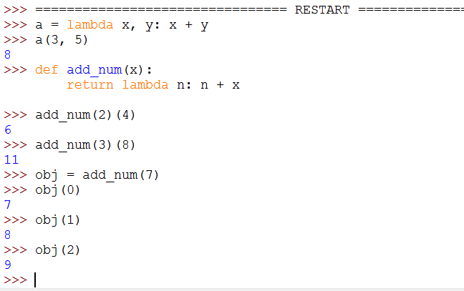
Notes:
<number>

