Slide 1
Modules
By Anirudh K M
Analyst
Mobius Knowledge Services

Slide 2
Introductions
Modules are separate Python programs, which can be imported in another program.
This provides abstraction and neat representation to our code.
Python provides lot of inbuilt modules which we can use to our need.
The keyword import is used to import packages.

Slide 3
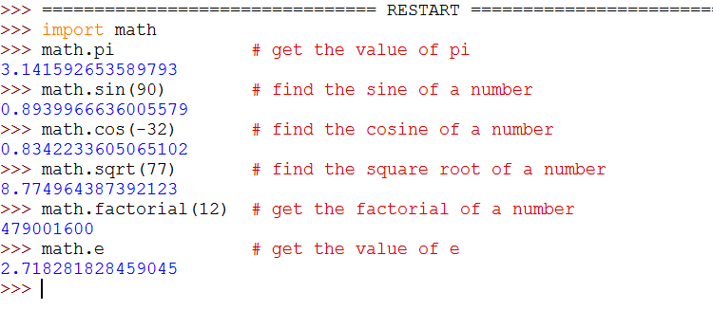
Illustration

Slide 4
Modules
We see that a ‘.’ operator is being used to access a particular module methods.
We could use partial import and complete imports like as follows.
Complete import:
This is used when we need to import all the methods from a module.

Slide 5
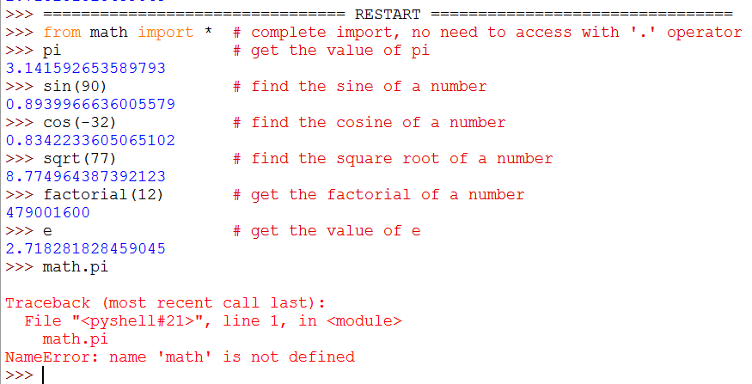
Complete import - Illustration
The syntax for complete import is as follows:
from <package name> import *

Slide 6
Complete import
We see that the methods are being accessed without the ‘.’ operator and the module name is also not needed to specified.
Also we see that an error is thrown if we try to import as we did in the previous case.
Note: This way of importing is not recommending as it can cause lot of confusion and dismay when the code gets longer.

Slide 7
Partial import
The partial import is used to import only the particular methods which we would like to access, instead of importing all the methods of the module.
Syntax:
from <module name> import (method names, ..)

Slide 8
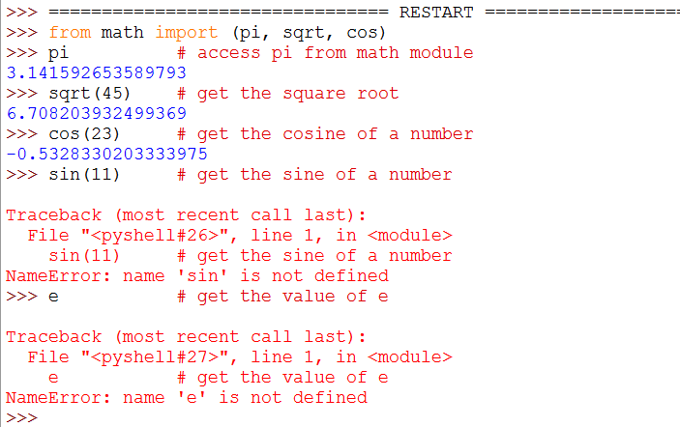
Illustration

Slide 9
Partial import
We see that an error is thrown when we try to access sin and e.
This is because they aren’t imported from the math module.
Note: Generally its good to avoid this way, because it can create confusion when many packages are being imported.

Slide 10
Import from multifolder
Now we see how to import a package which is placed inside multiple directories.
Syntax:
from <folder_1>.<folder_2>.(…) import <file>
Now let us look at an example to understand this.

Slide 11
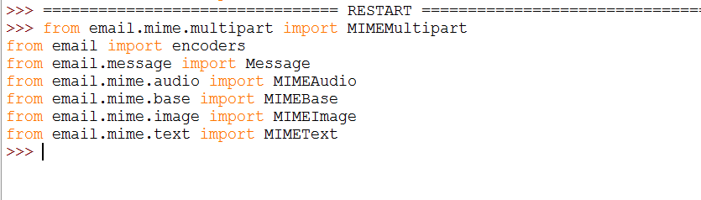
import from folders

Slide 12
Creating your own packages
We can also create our own Python packages, which we can use them.
Now let us create a package named ‘prime.py’.

Slide 13
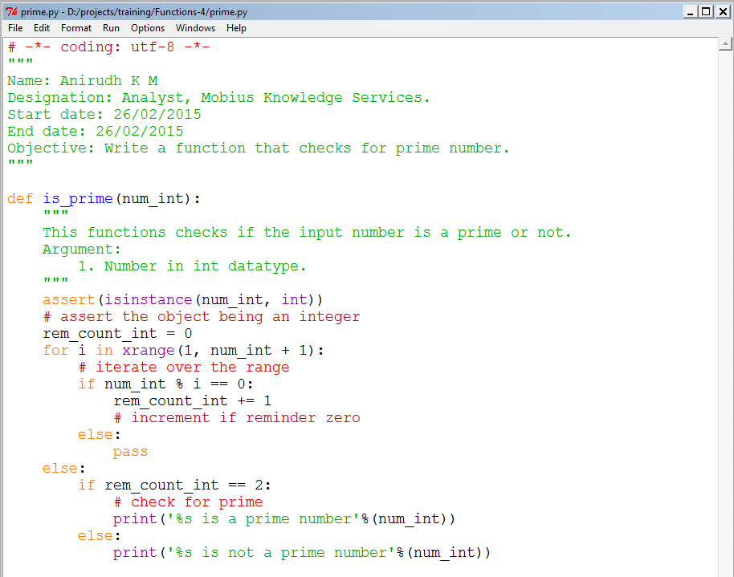
Illustration – prime.py module

Slide 14
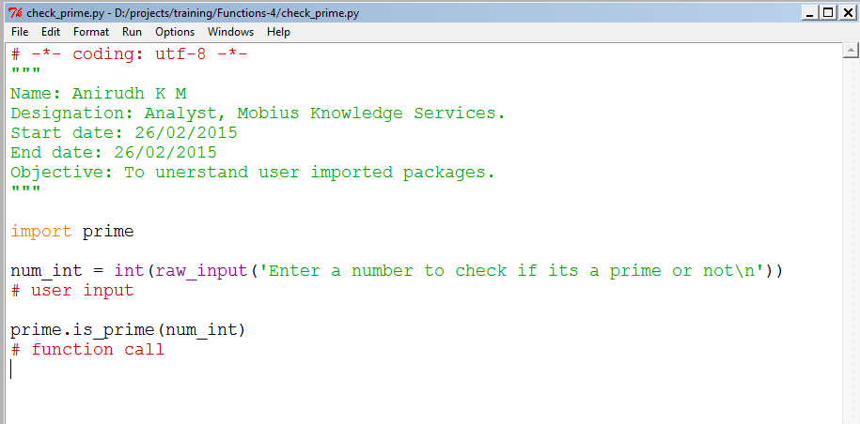
Illustration

Slide 15
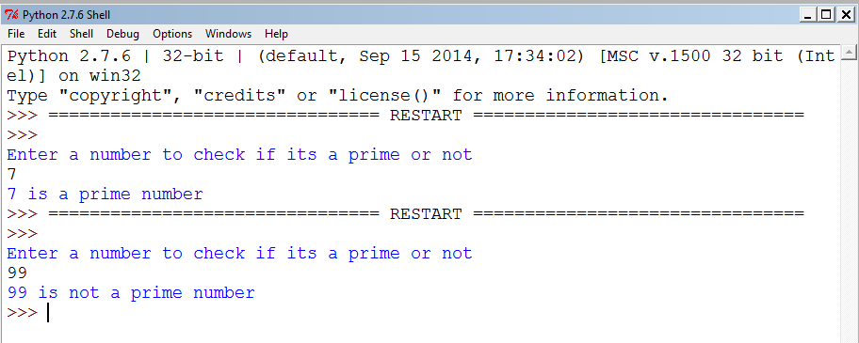
Output

Slide 16
Points to note
In this I have made sure that both prime.py file is in the same directory as which the file which imports it.
If the imported user module is to be in another directory from the script which uses, use the ‘.’ convention to import the module.
You can also note that a file named ‘prime.pyc’ will be created when the file is imported. Try exploring on that more….

