Slide 1
Lists
By
Anirudh K M
Analyst, Mobius Knowledge Services

Slide 2
Introduction - Lists
Lists are almost similar to tuples, but they have few things which distinguishes them.
A list is a mutable object in which the elements are stored in a square bracket.
A empty list = []

Slide 3
Why mutable and immutable
It’s obvious that we would want to treat some variables as fixed values, we don’t want their values to be dynamic. This is where immutable object comes in handy.
But it’s also obvious that mutable objects can provide a great deal of flexibility to our programming.
Also using mutable objects can increase the chance of bug involved.
So we need to have a clear understanding of when to use which.

Slide 4
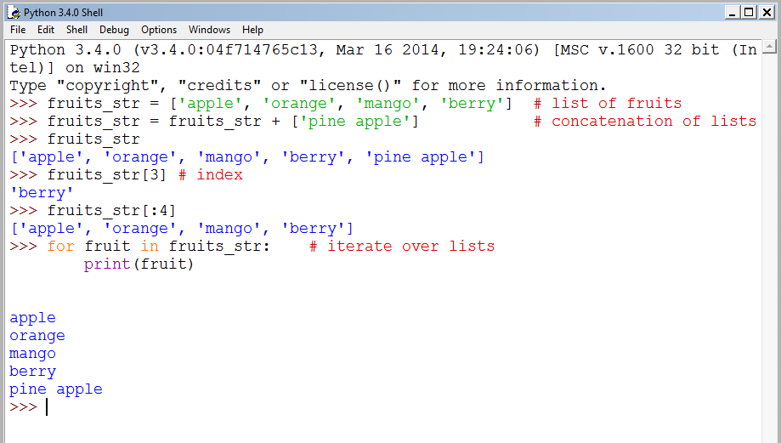
Basic operations - Lists

Slide 5
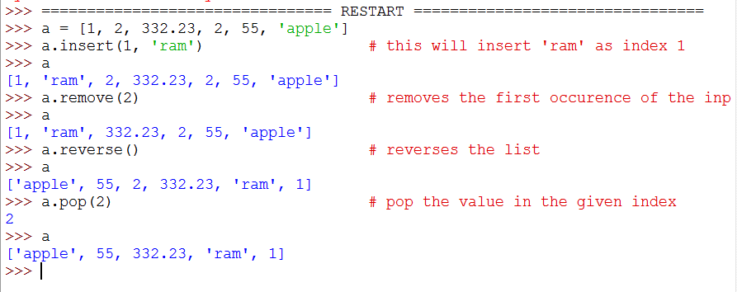
Inbuilt list methods
As we saw for Tuples and strings, let us see few inbuilt methods for lists.

Slide 6
Its important to note that methods like insert, reverse etc modifies the list directly and doesn’t return nothing.
This is the design principle followed for all mutable objects in Python.

Slide 7
Functional programming tools
Lets look at few illustrations which shows examples of using these functional programming tools.
Using these can make your pocket light, when writing a code.

Slide 8
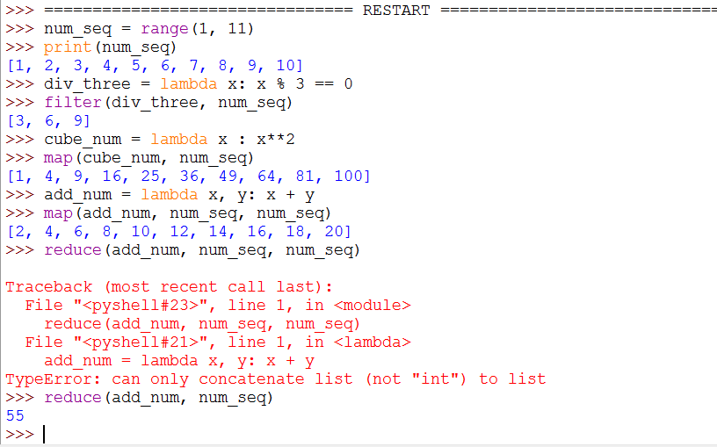
Functional tools

Slide 9
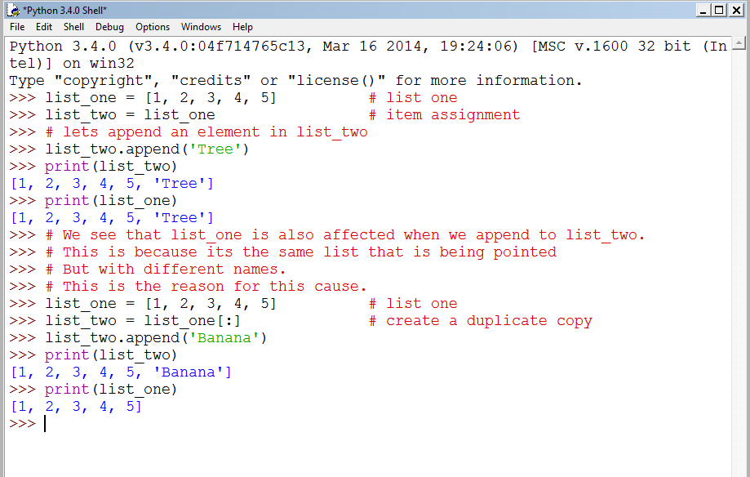
Understanding more on Lists

