Slide 1
Tuples
By Anirudh K M
Analyst
Mobius Knowledge Services

Slide 2
Introduction
Tuples are just compound data type which has sequence of elements enclosed in a parentheses.
Similar to strings, tuples are also immutable objects.
The elements in a tuple can be of any type i.e int, str, function, class, list etc.
Now let us look at few operations on tuples.

Slide 3
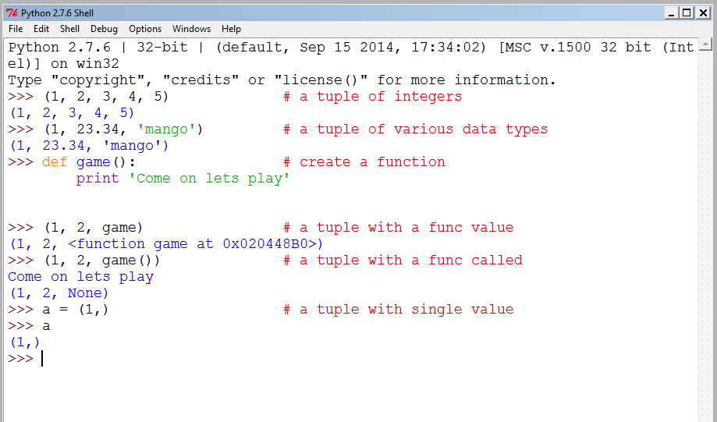
Illustration

Slide 4
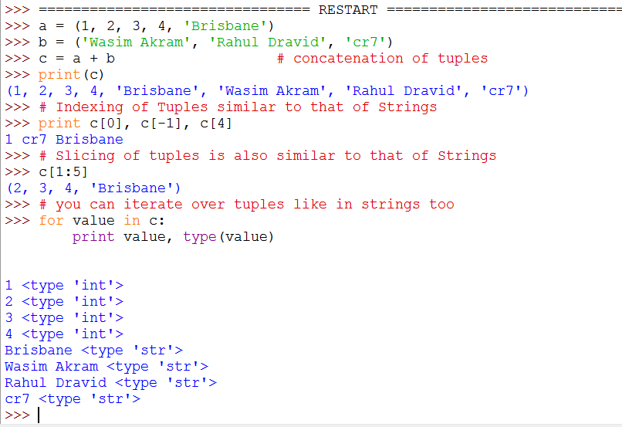
More Operations

Slide 5
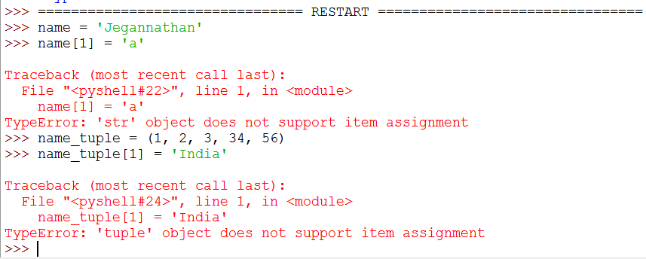
Stressing again
The most important point again I want to stress is that Strings and Tuples are immutable.

Slide 6
We see that an error is thrown saying that a tuple or string does not support item assignment.
That’s why they are said to be immutable.

Slide 7
In built operations
Like in strings, we have inbuilt methods for Tuples has well.
Here as follows:
count
index

Slide 8
