Slide 1
Design and Innovation of
Tools and Technologies
JOUR479V/779V – Computational Journalism
University of Maryland, College Park
Nick Diakopoulos, Ph.D.

Slide 2
Readings
Computational Journalism and the Emergence of News Platforms
Should legacy media move away from “stories” and towards “story platforms”? What’s the strategy?
Why might it be hard for a media organization to sell it’s platform for other media orgs to use?
Currently news orgs are having to integrate with 3rd party platforms like FB and Twitter. What’s at stake?
Notes:
Content differentiation, competitive advantage might provide a disincentive to making external industry platforms?
what’s really at stake here is the capacity to create platforms that are deeply interwoven with journalistic values

Slide 3
Systematic Innovation
“Innovation is organized, systematic, rational work”
– Peter Drucker “Innovation and Entrepreneurship”
Systematic innovation consists of the organized search for change and the analysis of opportunities such change might offer for economic or social innovation
Notes:
Make sure to position myself as interested in computing innovation in product and process – this is less about organizational or marketing innovation (for now).
It’s really about coming up with a method and a process to explore the space of possibility for tech innovation.
How can existing processes be redesigned around newly available technology?

Slide 4
Structured Method
What’s needed?
Problems, User Needs, Process Efficiency
How to make it happen?
Technical Feasibility
Does solution align with values of users?
Adoptability, value-sensitive
Notes:
Make sure to position myself as interested in computing innovation in product and process – this is less about organizational or marketing innovation (for now).
It’s really about coming up with a method and a process to explore the space of possibility for tech innovation.
How can existing processes be redesigned around newly available technology?

Slide 5
Combinatorial Innovation Concept Space
Computing and Technology
News Consumer Needs
Normative Journalism Goals
Needs and goals
Computing and Technology
Notes:
To facilitate thinking and ideation we embedded these issues into a concept space that spans computing, consumer needs, journalism goals, and information processes.
These concepts address what’s needed (i.e. user needs or processes), technical options for addressing those needs, and what values may drive adoptability (journalism goals),

Slide 6
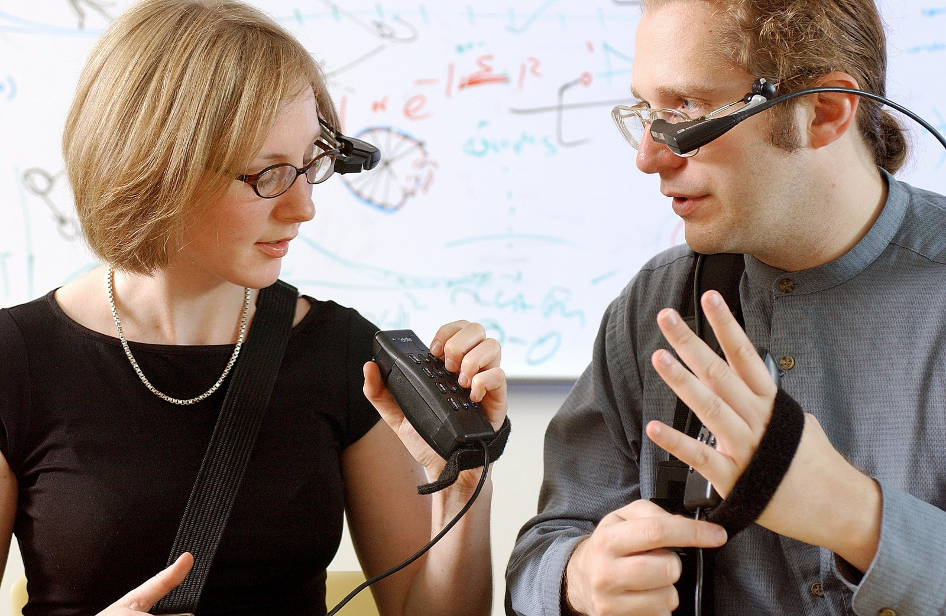

Wearable Computing
The integration of computing into the personal space of the user in an unobtrusive and constantly accessible way (e.g. a computational “prosthetic”).

Slide 7
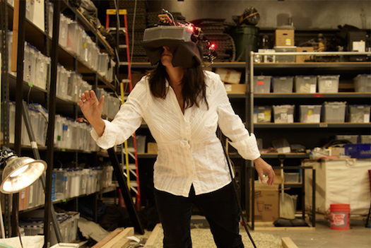
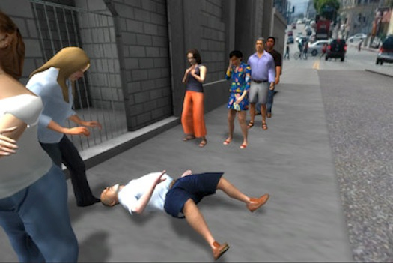
Virtual Reality
Computing and Technology
The realistic 3D simulation of an immersive environment.
Notes:
Former Newsweek correspondent Nonny de la Peña has developed a 3D virtual reality simulation that recreates a real eyewitness account of a crisis in Los Angeles.

Slide 8
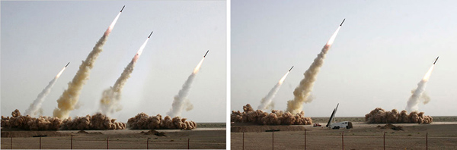
Computer Vision
Techniques for producing information from images that can be used to drive decisions and processes (e.g. navigation, interaction, organization, detection).

Slide 9
News Constituent Needs
Staying Informed
Finding out about relevant events and conditions; satisfying curiosity and general interest; learning and self-education
Personal Identity
Reinforcement for personal values; models of behavior; gaining insight into one’s self
Integration and Social Interaction
Social empathy; sense of belonging; basis for conversation and social interaction
Entertainment
Escaping, relaxing; filling time; emotional release
Notes:
Mention uses and gratifications theory and where these dimensions come from.

Slide 10
Journalism Goals
Truth
Independence, Impartiality, Watchdogging
Informing
Aggregating, Sensemaking, Storytelling
Public Interest
Watchdogging, Forum Organizing

Slide 11
Information Needs
Ease of Use
Information Design, Enriching, Ordering
Noise Reduction
Filtering, Summarizing, Associating / Connecting
Adaptability
Personalization, recommender systems
Quality
Accuracy, validity, reliability, comprehensiveness, currency
Notes:
Value in terms of usefullness in meeting a user need.
List some of these … and sometimes this value added flow is described in terms of a transformation from data to information to knowledge.
Data are numerical entities or veridical facts; information is about relationships between data, groupings or categorizations of data; knowledge is about analysis, interpretation and judgement as a mechanism to drive decision making. The process is recursive.

Slide 12
Brainstorming Activity
In groups of three
Pick a recorder for group
Each group picks 3 cards
1 from each color from the deck
Recorder writes down concepts on recording sheet
Brainstorm a journalistic product / service that combines all concepts on cards
As many as possible in 5 minutes
Recorder writes down 1 sentence description of each idea
After a few rounds we’ll discuss some ideas with whole class
Notes:
Be sure to mention that I’ll be walking around to help answer any questions.

Slide 13
Discussion
Each group, pick 1 or 2 ideas to share
Describe high-level view of idea and what concepts it combines
How feasible are the ideas?
What would it take to implement?

Slide 14


Slide 15
Questions?

