Slide 1




Energy Consumption Trend Analysis
By-
Santhosh Kumar JP

Slide 2

Learning Objectives:
Identify patterns and trends in water, electricity, and gas consumption over time.
Determine the cost impact of energy consumption based on unit prices.
Compare energy consumption across different cities and countries.
Highlight anomalies or outliers in energy consumption.
Recommend strategies for reducing energy costs and optimizing resource usage.
GOAL
Source :
www.freepik.com/

Slide 3

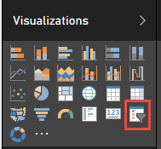
Tools and Technology used :
Tools:
Power BI.
Technologies used:
Microsoft Excel: Source of the dataset.
Power BI Desktop: To create relationships between the sheets (Energy Consumptions, Rates, and Building Master).
Power BI Visuals: Cards, Maps for geographical visualizations, Bar charts, Line charts for trends.
DAX(Data Analysis Expressions): To create calculated columns and measures, Slicers for dynamic exploration of data by city, building, or energy type.
Power BI Service: For publishing and sharing dashboards online.

Slide 4

Methodology:
Data Acquisition: Collected data from the Excel sheets containing utility consumption, rates, and building details. Import the dataset into Power BI for analysis.
Data Cleaning and Transfer: Used Power Query to clean and structure the data, ensuring consistency in formats and merged relevant tables to create relationships between consumption, rates, and building information.
Data Modelling: To establish relationship between tables to enable seamless analysis.
Visualizations and Insights: Developed interactive charts and graphs, such as line charts for trends, bar charts for comparisons, and mas for geographical data.
Publishing and Sharing: Publish the dashboard to Power BI Service for accessibility and sharing.

Slide 5

Problem Statement:
Analyze water consumption trends from 2016 to 2020.
Examine the yearly and building-wise energy consumption patterns.
Investigate the overall energy consumption (water, gas, electricity) from 2016 to 2020.
Assess gas consumption trends across the years 2016 to 2020.
Identify trends in price changes for gas, water, and electricity over the years.
Determine the buildings with the highest consumption of water, gas, and electricity.

Slide 6

Solution:
Import and clean data from the Excel sheets in Power BI.
Create relationships between Energy Consumptions, Rates, and Building Master tables.
Calculate the measures of total energy and other metrices.
Design interactive visualizations like charts, maps, and slicers.
Publish the dashboard to Power BI Service for sharing and updates.

Slide 7

Conclusion:
From 2016 to 2020, water consumption peaked in 2017, while electricity and gas usage steadily increased. Power BI analysis showed rising costs due to higher unit prices with New York and Chicago leading in water and use, and Los Angeles in electricity. Seasonal trends and building-specific patterns highlight opportunities for optimizations and sustainable management.

Slide 8
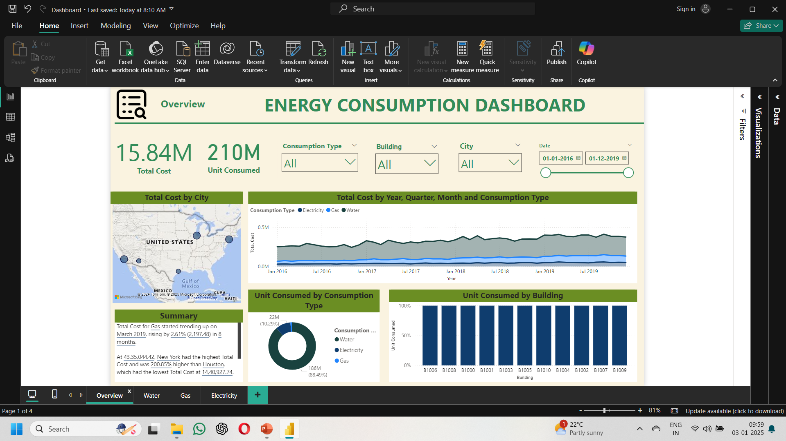
Overview:

Slide 9
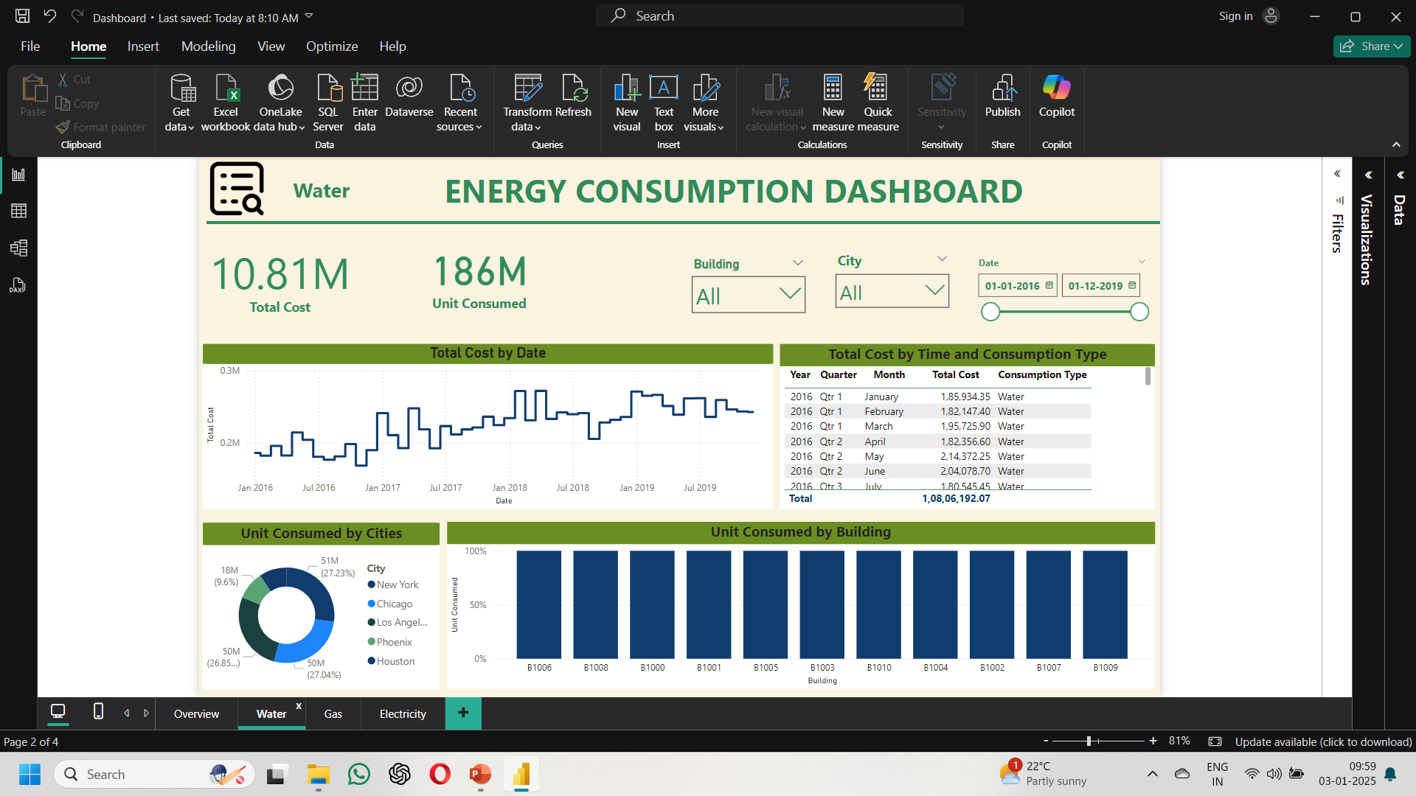
Water:

Slide 10
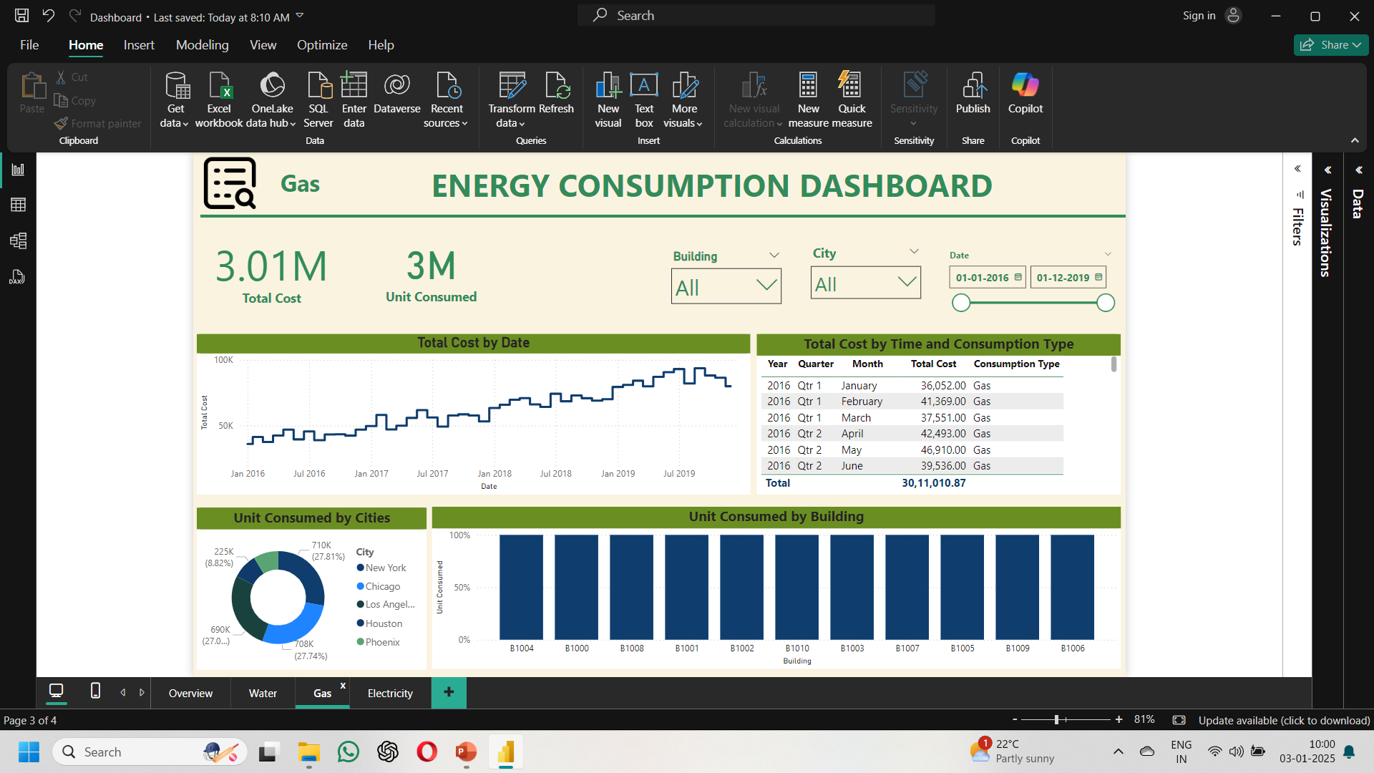
Gas:

Slide 11
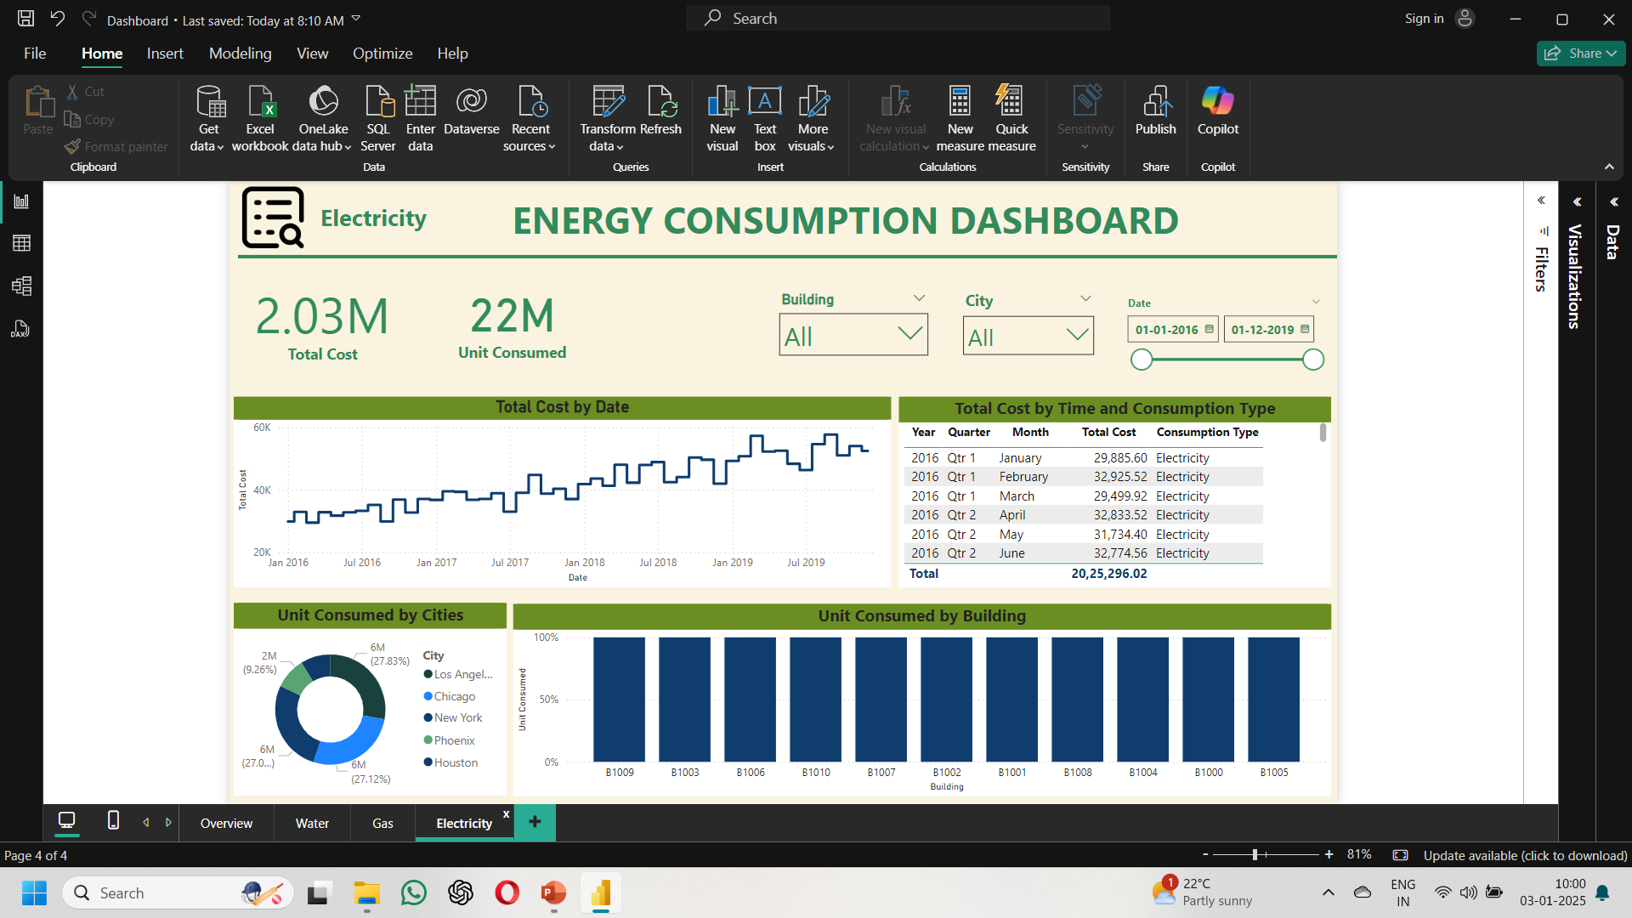
Electricity:

