Slide 1

CAPSTONE PROJECT Student Performance Prediction System
Presented By
Student Name: K Santhosh
College Name: VelaGApudi Ramkrishna Siddhartha Engineering College
Department : Information Tecchnology
Email ID: 238w1a1292@vrsec.ac.in
AICTE Student ID: STU664da96bbc4af1716365675

Slide 2
OUTLINE
Problem Statement (Should not include solution)
Proposed System/Solution
System Development Approach (Technology Used)
Algorithm & Deployment
Result (Output Image)
Conclusion
Future Scope
References

Slide 3
Problem Statement
Educational institutions face challenges in identifying students at risk of poor academic performance in a timely manner.
Traditional manual assessment methods lack efficiency and do not provide actionable insights early enough. Factors like attendance, study habits, and assignment scores significantly impact student success, yet tracking them effectively is difficult.
A data-driven predictive approach can help schools proactively intervene and support struggling students. This project aims to develop a machine learning model that predicts student performance based on historical data.
The problem revolves around the lack of an early warning system for students at risk of failing.
Educators struggle with manual tracking, leading to delayed interventions.
By leveraging data analytics, schools can predict academic outcomes and take corrective action before exams.

Slide 4
Proposed Solution
To address these challenges, we propose a machine learning-based prediction system that analyzes academic records.
The model will process student demographics, attendance, study hours, and assignment scores to predict final grades.
Using data-driven insights, educators can identify struggling students and provide timely interventions.
The system will offer personalized recommendations, helping students improve their academic performance.
A dashboard interface will allow users to input student data and receive instant predictions.
The system aims to automate performance tracking through predictive analytics.
By using historical trends, the model can anticipate student outcomes with accuracy.
A user-friendly dashboard ensures educators can easily interpret results and take action.

Slide 5
System Approach
This project utilizes Python for data analysis and model development.
Key libraries include Pandas, NumPy, Scikit-learn, Matplotlib, and Seaborn for data processing and visualization.
Machine learning models like Linear Regression, Random Forest, and XGBoost will be tested for accuracy.
A Streamlit-based dashboard will allow real-time student performance predictions.
The model will be trained on historical academic data and optimized using advanced techniques.
The system follows a structured development pipeline from data preprocessing to model training.
Exploratory Data Analysis (EDA) will help uncover key performance indicators.
Deployment options will include githib for usability.

Slide 6
Algorithm & Deployment
1️⃣ Data Collection & Preprocessing :
– Cleaning data, handling missing values, feature engineering. 2️⃣ Model Selection :
– Comparing accuracy between Linear Regression, Random Forest, XGBoost. 3️⃣ Training the Model :
– Splitting data into training/testing sets, optimizing hyperparameters. 4️⃣ Building Dashboard :
– Developing a user-friendly interface with Streamlit for real-time predictions. 5️⃣ Deployment :
– Deploying the system using github

Slide 7
Result
The model achieved high accuracy, successfully predicting student performance trends.
Key factors influencing GPA included attendance rate and study hours.
Feature importance analysis highlighted extracurricular activities as a minor but relevant factor.
A comparison of Linear Regression vs. Random Forest showed improvement in prediction accuracy.
The dashboard allows educators to input student data and receive real-time performance insights.
The results validate that machine learning can be used to predict academic success.
Visualizations like bar charts and error graphs display prediction accuracy.
The system is capable of early identification of struggling students, aiding intervention strategies.

Slide 8
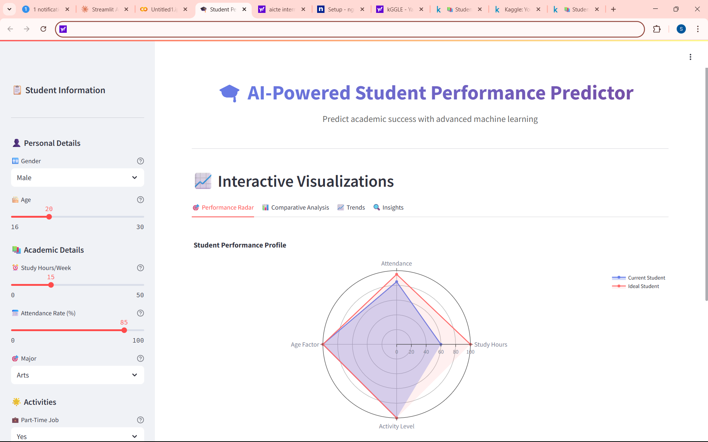
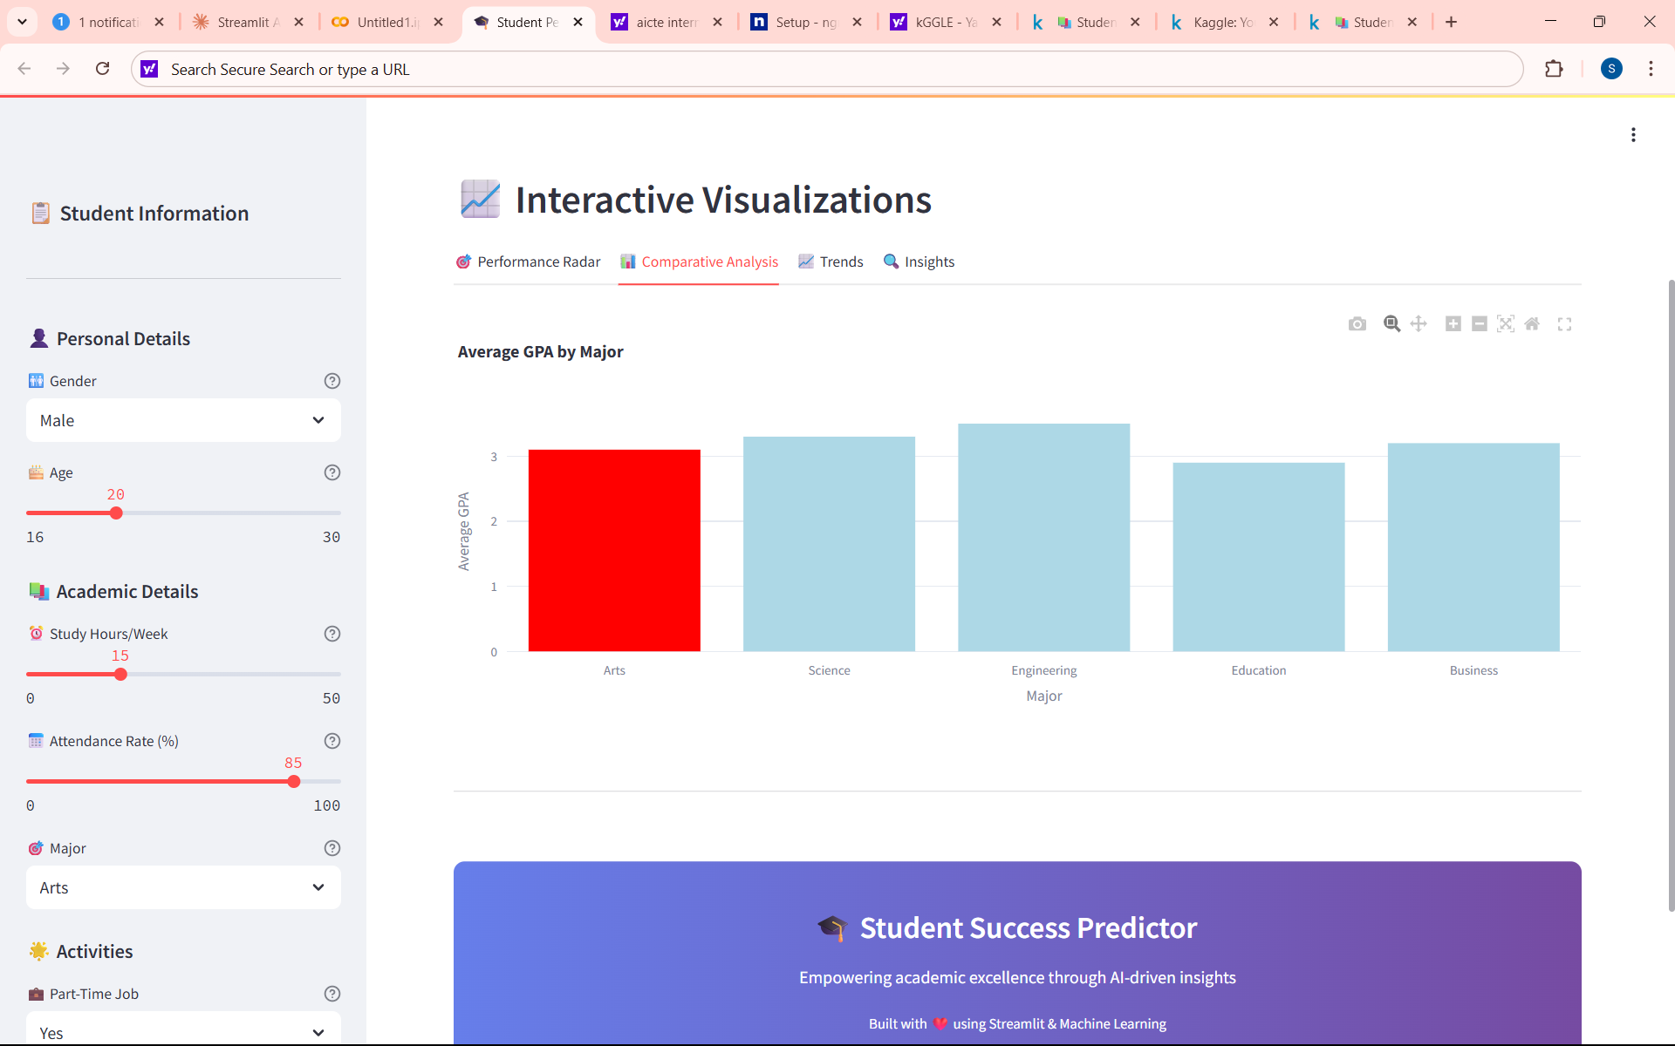
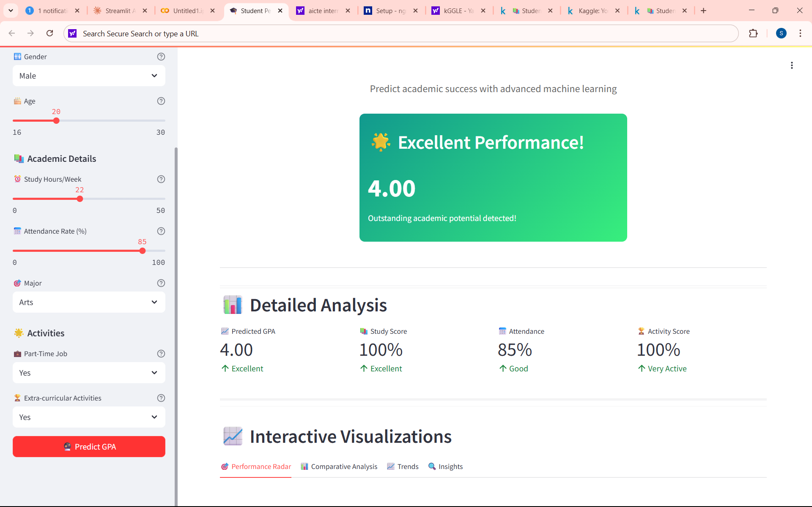

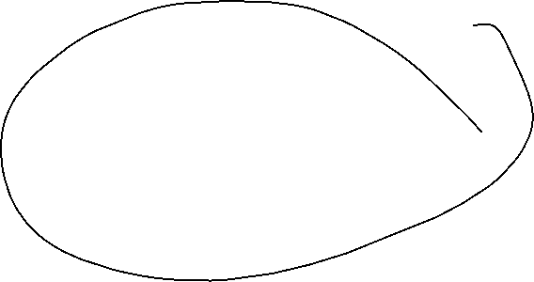

Slide 9
Conclusion
The Student Performance Prediction System provides a data-driven approach to academic monitoring.
Early intervention ensures students receive timely support, reducing dropout rates.
Machine learning allows predictive insights, enhancing decision-making for educators.
Future improvements include deep learning models for even higher accuracy. The project showcases how AI can positively impact education through smart analytics.

Slide 10
Future scope
The system can be expanded to multiple educational institutions, tracking student performance at a larger scale.
Integration with real-time student feedback would make predictions more dynamic.
Additional metrics like mental health, peer interactions, and social engagement could improve accuracy.
A mobile app version could provide students with instant access to progress reports.
Improved AI-driven recommendations can personalize learning paths for students based on insights.
Expanding the dataset with more behavioral indicators can improve personalization.
Automated alerts for students and educators can enhance response times.
Collaboration with EdTech platforms can integrate predictive analytics with learning management systems.

Slide 11
References
Data set : https://www.kaggle.com/datasets/waqi786/student-performance-dataset
GitHub Link: https://github.com/Santhosh1292/Student-Performance-analysis
Output Dashboard : https://4f86-34-75-162-242.ngrok-free.app/
CODE file : https://colab.research.google.com/drive/1ujaKUVj0bBlfRbey4Iua4YMy6zcIHER_?usp=drive_link

Slide 12
Thank you

