Slide 1
Flood monitoring and early warning
DEPARTMENT OF COMPUTER SCIENCE AND ENGINEERING
TEAM NAME : Proj_224785_Team_2 TEAM MEMBERS :
1. RAMKUMAR.N(113321104079)
2.RANJITH.Y(113321104080)
3.SANTHOSH.K(113321104085)
4.SANTHOSH.N(113321104086)
PHASE 4 : CREATING WEBSITE

Slide 2
INNOVATION:
Internet of Things (IoT) Sensors:
The use of a broader range of IoT sensors, including those for soil moisture, water quality, and river levels, can provide a more comprehensive view of flood risk factors.
IoT devices can be more widely distributed, especially in remote or vulnerable areas.
Blockchain for Data Verification:
Blockchain technology can be employed to ensure the integrity and authenticity of flood sensor data, preventing data tampering and enhancing trust in the information provided.
Citizen Science and Crowdsourcing:
Engaging the public through mobile apps and social media to report flooding incidents in real time can provide additional data for early warning systems.
Crowdsourced data can complement official monitoring efforts.
Flood Modeling and Simulation:
Implementing high-resolution hydrodynamic and flood modeling to simulate flood scenarios, allowing for more accurate predictions of flood extent and impact.
Satellite Remote Sensing:
Satellite data can provide valuable information on rainfall, water levels, and flood extents, aiding in the monitoring and early warning process.
Early Warning Communication Channels:
Utilize a combination of communication channels, such as social media, mobile apps, and instant messaging services, to reach a wider audience with flood alerts.
Implement multilingual and accessible alerting systems to ensure

Slide 3
PROJECT OBJECTIVES :
The main objectives of this project are as follows:
1. Develop a robust flood monitoring infrastructure: Create a network of sensors, data collection points, and monitoring stations to continuously gather data related to weather, river levels, and soil moisture.
2. Data collection and analysis: Collect, process, and analyze real-time data to identify potential flood risk factors and patterns.
3. Early warning system: Implement an automated early warning system that issues alerts to relevant authorities and communities when flood risks are detected.
4. Community engagement and preparedness: Establish communication channels to inform and educate local communities about flood risks and preparedness measures.

Slide 4
PROJECT DESCRIPTION :
Floods are one of the most common and devastating natural disasters worldwide. They cause significant damage to infrastructure, disrupt communities, and pose a severe risk to human lives. Developing an effective flood monitoring and early warning system is crucial to mitigating these risks. This project aims to create a comprehensive Flood Monitoring and Early Warning System that leverages advanced technology and data analytics to provide timely and accurate flood alerts, helping communities prepare and respond to flood events.

Slide 5
PLATFORM REQUIRED:
1.Sensor Platform:
* Weather Stations: Collect meteorological data, including rainfall, temperature, humidity, wind speed, and atmospheric pressure.
* River Level Sensors: Measure water levels in rivers and water bodies to track potential flood conditions.
* Soil Moisture Sensors: Monitor ground moisture levels to assess the soil's saturation and flood risk.
2.Data Acquisition Platform:
* Data Loggers: Capture data from sensors and transmit it to a central database.
* Telemetry Systems: Enable real-time data transmission from remote sensors to a centralized server.
* IoT Platforms: Utilize Internet of Things platforms to manage and process sensor data efficiently.
3.Data Processing and Analytics Platform:
* Big Data and Cloud Computing: Use cloud-based platforms for data storage, processing, and analytics to handle the vast amounts of data generated by sensors.
* Data Analytics Software: Develop or use data analysis tools and algorithms to identify flood risk factors, predict flood events, and generate early warnings.
* Geographic Information System (GIS): Incorporate GIS software to visualize and analyze spatial data, such as floodplain mapping and evacuation routes.
4.Early Warning and Alerting Platform:
* Alerting System: Implement an automated alerting system that can trigger warnings based on predefined flood risk thresholds.
* Communication Protocols: Integrate multiple communication channels, including SMS, email, mobile apps, sirens, and social media, to disseminate warnings to relevant authorities and the public.

Slide 6
5.Community Engagement and Education Platform:
* Mobile Apps: Develop mobile applications that provide real-time flood updates, safety guidelines, and evacuation information to the public.
* Community Meetings and Workshops: Organize community engagement events to educate residents on flood preparedness, response, and safety measures.
* Web Portals: Create online platforms that offer access to flood information, flood maps, and educational resources.
6.Local Government and Emergency Response Coordination Platform:
* Emergency Operations Centers (EOCs): Establish EOCs to coordinate flood response efforts, manage resources, and disseminate information to relevant agencies.
* Communication and Collaboration Tools: Use communication platforms, such as incident management software, to facilitate coordination among local government agencies and emergency responders.
7.Remote Monitoring and Control Platform:
* Remote Control Systems: Implement remote control capabilities to adjust and manage flood monitoring equipment, sensors, and alert systems from a centralized location6
8.Data Security and Backup:
* Cybersecurity Measures: Ensure the security of sensor data, alert systems, and databases to protect against data breaches and tampering.
* Data Backup and Redundancy: Establish data backup and redundancy mechanisms to prevent data loss in case of system failures.

Slide 7
WEB DEVELOPMENT TECHNOLOGIES:
1. Front-End Development:
a. HTML, CSS, and JavaScript: The fundamental building blocks for creating web pages, ensuring a responsive and user-friendly interface.
b. JavaScript Frameworks: Use front-end frameworks like React, Angular, or Vue.js to build interactive and dynamic user interfaces.
c. Data Visualization Libraries: Employ libraries such as D3.js or Chart.js to create interactive charts and maps for displaying flood data and trends.
2. Back-End Development:
a. Server-Side Frameworks: Utilize server-side technologies like Node.js, Python (with Flask or Django), Ruby (with Ruby on Rails), or Java (with Spring) to handle data processing, user authentication, and server-side logic.
b. Database Management: Implement a relational database management system (RDBMS) such as MySQL, PostgreSQL, or NoSQL databases like MongoDB for storing sensor data, alerts, and user information.
c. RESTful APIs: Create APIs to serve data and alerts to the front-end and mobile applications.
3.Mobile App Integration:
a. Develop mobile apps for Android and iOS platforms that complement the web platform, providing users with mobile access to alerts, data, and educational resources.
b. Cross-platform development frameworks like React Native or Flutter can streamline the mobile app development process.

Slide 8
4. Mapping and Geospatial Technologies:
a. Geographic Information System (GIS): Use GIS libraries or platforms (e.g., Leaflet, OpenLayers, or Mapbox) to display flood maps, overlay sensor data, and provide geographic context.
b. Geolocation Services: Implement geolocation services to track the positions of sensors and mobile app users in real time.
5.User Authentication and Security:
a. User Authentication: Integrate secure user authentication and authorization systems to control access to sensitive information and administrative functions.
b. Secure Sockets Layer (SSL) and HTTPS: Ensure secure data transmission between users and the server.
6.Data Analysis and Alerting:
a. Data Analysis Algorithms: Implement data analysis algorithms to assess the collected data, identify flood risk factors, and trigger alerts when necessary.
b. Notification Services: Utilize push notification services (e.g., Firebase Cloud Messaging or Apple Push Notification Service) to send alerts to mobile app users.
7.Community Engagement and Education:
a. Content Management System (CMS): Use a CMS (e.g., WordPress or Drupal) to manage educational content, news updates, and community resources.
b. Community Feedback and Reporting: Enable users to report local flood-related issues and provide feedback through the web platform.

Slide 9
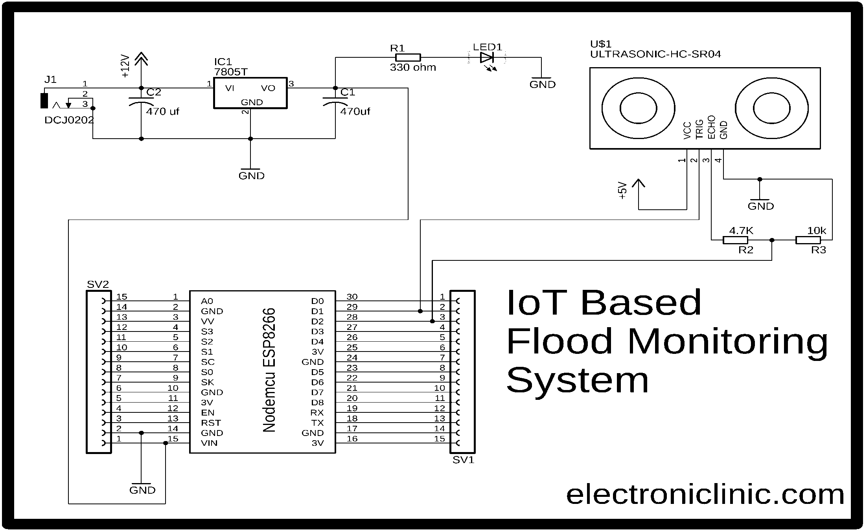
ARDUINO INTEGRATION:

Slide 10
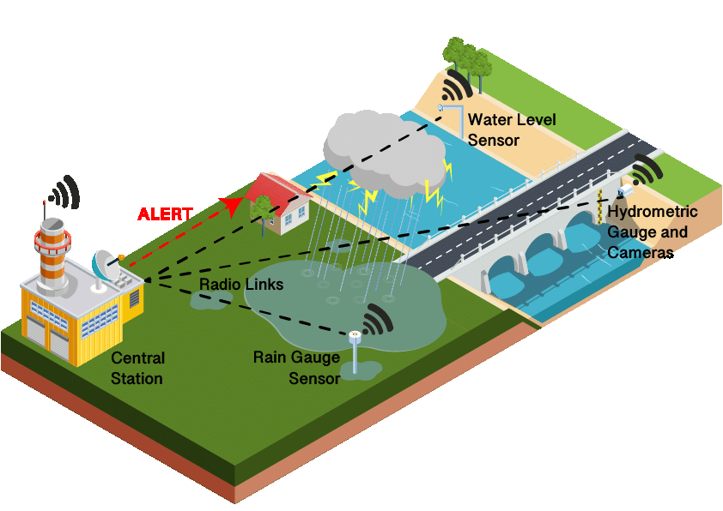
IOT SENSOR
https://.netlify.app/

Slide 11
CODE IMPLEMENTATION:
HARDWARE COMPONENTS: PYTHON SCRIPT DEVELOPMENT: PYTHON SCRIPT
1.Raspberry Pi 1.Setting Up the Central Server DEVELOPMENT FOR
2.Water Flow Sensor Environment CENTRAL SERVER:
3.Solenoid Valve 2.Data Reception
4.Wi-Fi Module 3.Data Storage 1.Importing Required
5.Power Supply 4.Data Visualization Libraries
5.Error Handling 2.Data Visualization
SOFTWARE COMPONENTS: 6.Testing 3.Data Processing and
1.MQTT 7.Control Logic Analysis
2.Python 8.Documentation 4.User Authentication
3.Cloud server 9.Power Management and Access Control
5.Security Measures
6.Automation and Script
Execution
7.Testing and Debugging
8.Data Reception and
Storage

Slide 12
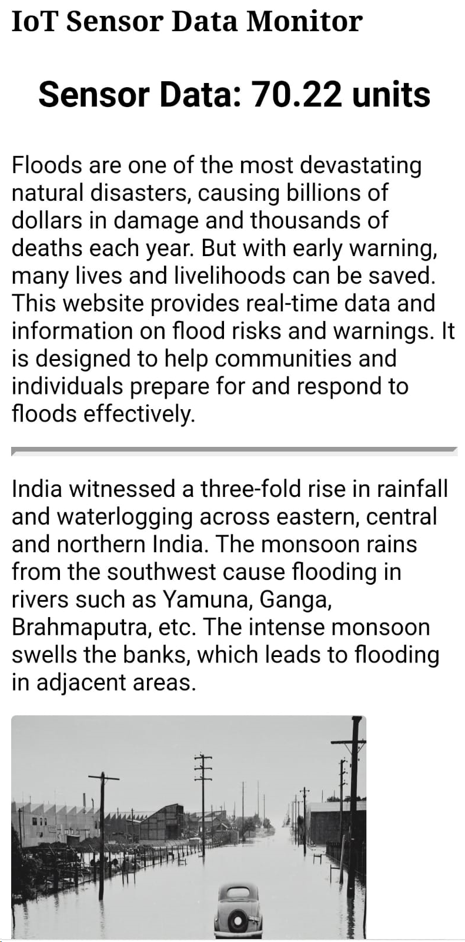
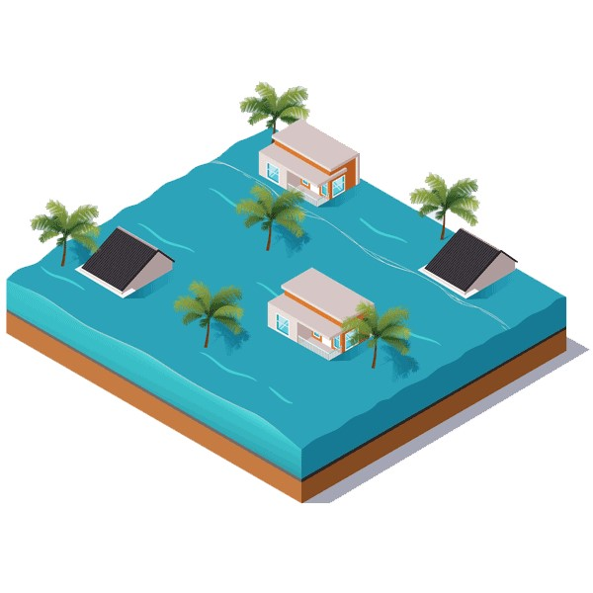
WEBSITE :
CLICK AND SEE THE WEBSITE:
https://flood-montioring.netlify.app/

Slide 13
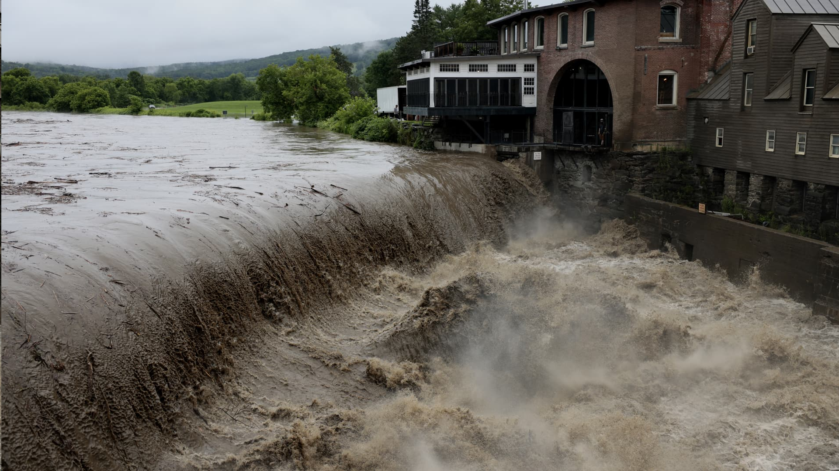
.
CONCLUSION :
The development of a Flood Monitoring and Early Warning System is a critical endeavor to safeguard communities from the devastating effects of floods. By deploying advanced technology, data analysis, and community engagement, this project aims to create a robust system that can make a significant difference in reducing the impact of flood events and saving lives.

Slide 14


