Slide 1



MOVIE RENTAL ANALYSIS DASHBOARD
By Santhosh Kumar P

Slide 2
AGENDA
Project Overview
Data Source & Description
EDA Findings
Dashboards & Insights
Key KPIs
Recommendations
Conclusion

Slide 3
PROJECT OVERVIEW
Objective:
Analyze movie rental data tO UNDERSTAND CUSTOMER BEHAVIOR, GENRE PREFERENCES, AND STORE PERFORMANCE.
GOAL:
PROVIDE ACTIONABLE INSIGHTS TO IMPROVE RENTAL STRATEGY, INVENTORY MANAGEMENT, AND CUSTOMER SATISFACTION THROUGH POWER BI DASHBOARDS AND DATA VISUALIZATION.

Slide 4
DATA SOURCE & DESCRIPTION
DATASETS USED:
The project is built on the Movie Rental (Sakila) database consisting of 16 relational tables.
These cover customer, film, rental, and store operations.
KEY TABLES:
Customer | Film | Rental | Payment | Store | Inventory | Staff | Category | Actor | Film_Actor | Film_Category | Language | Address | City | Country | Film_Text
DESCRIPTION:
Data includes customer demographics, movie details, rental activity, store locations, and payment transactions — enabling a 360° view of business performance.

Slide 5
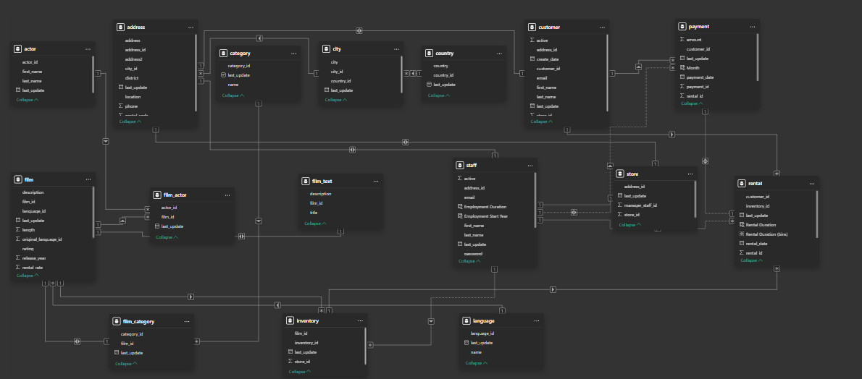
DATA MODELING

Slide 6
EXPLORATORY DATA ANALYSIS (EDA) FINDINGS
TOP GENRES: ACTION, SCI-FI, AND FAMILY LEAD IN RENTALS.
CUSTOMER INSIGHTS: ADULTS RENT THE MOST; KIDS PREFER ANIMATION & FAMILY.
RENTAL TRENDS: PEAK ACTIVITY ON WEEKENDS AND FESTIVE MONTHS.
STORE PERFORMANCE: STORE 1 RECORDS HIGHER RENTALS AND REVENUE.
REVENUE PATTERN: FREQUENT RENTERS DRIVE MAJORITY OF INCOME.

Slide 7
DASHBOARDS & INSIGHTS
Customer Dashboard:
Segmentation (New, Occasional, Frequent renters), top spenders & preferred genres, rentals by age group & location
Movie Dashboard:
Genre-wise rentals & revenue share, top & least-rented movies, rental rate vs duration trend
Store Dashboard:
Store-wise revenue & rental count, regional trends, staff performance
Rental Trends Dashboard:
Monthly & yearly rental patterns, seasonal peaks, revenue trends

Slide 8
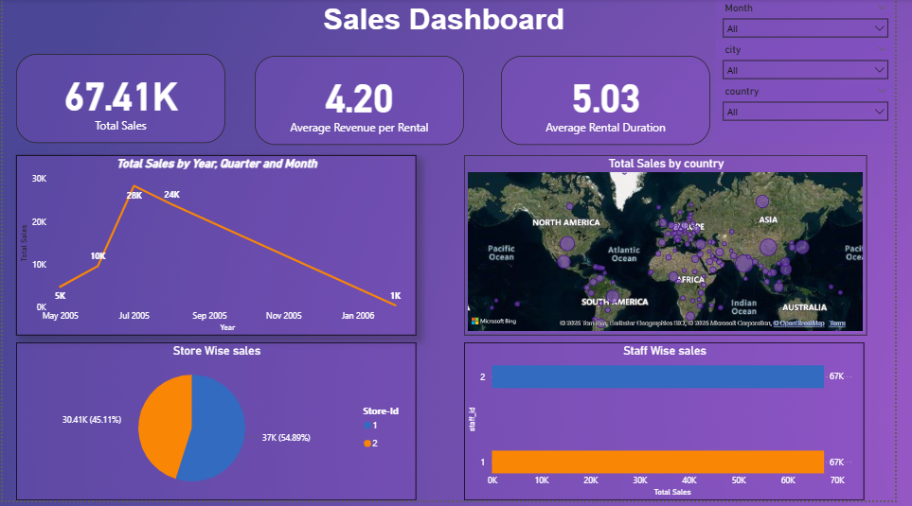

Slide 9
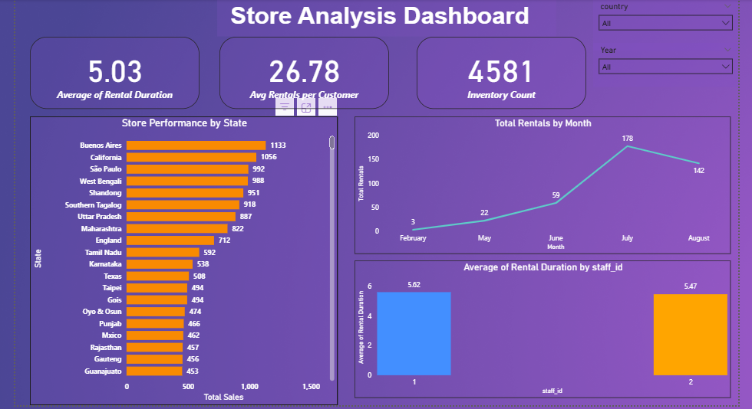

Slide 10
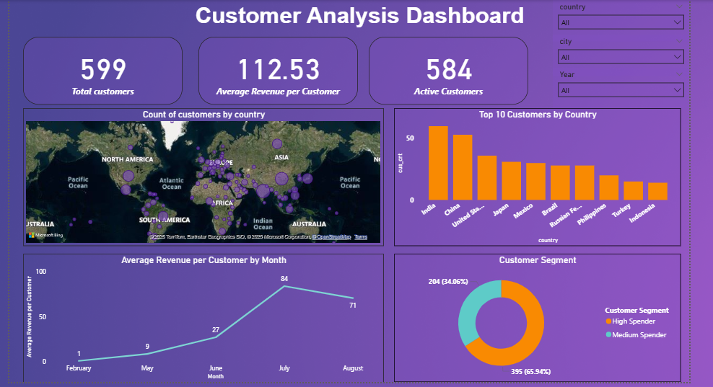

Slide 11
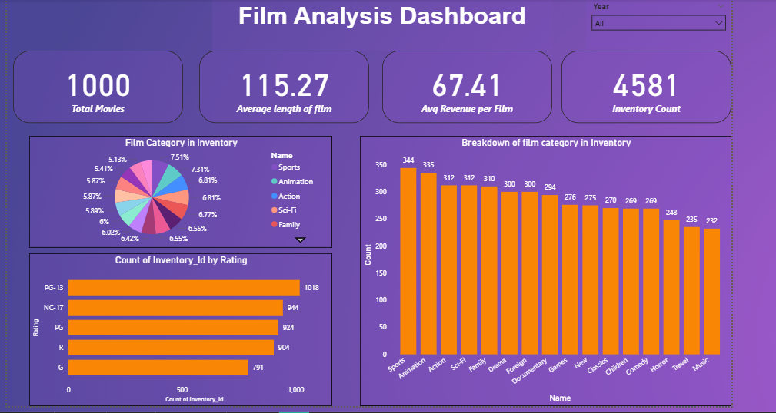

Slide 12
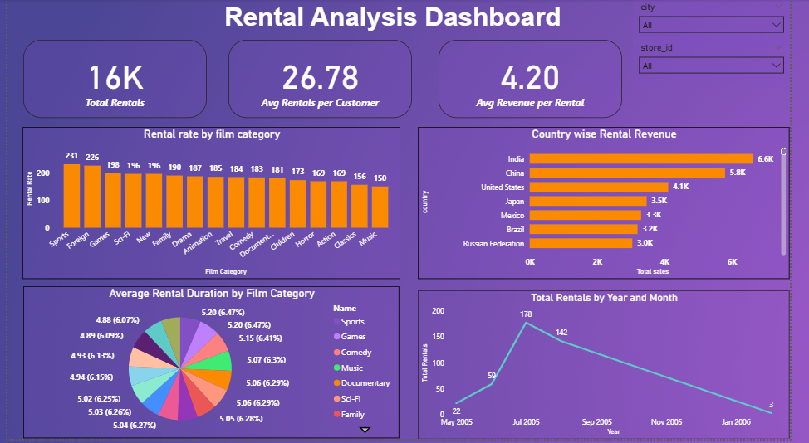

Slide 13
KEY KPIS
TOTAL CUSTOMERS
TOTAL RENTALS
TOTAL REVENUE
AVERAGE RENTAL DURATION
RENTAL GROWTH RATE
TOP MOVIE CATEGORY
ACTIVE STORES

Slide 14
RECOMMENDATIONS
Customer Engagement: Loyalty programs & personalized recommendations.
Inventory Optimization: Boost high-demand genres; cut underperforming stock.
Marketing Focus: Target high-revenue regions digitally.
Data Integration: Merge rental data with social trends for forecasting.
Operational Efficiency: Real-time dashboards for store performance monitoring.

Slide 15
CONCLUSION
This analysis provides valuable insights into rental performance, customer preferences, and store operations.
By implementing data-driven strategies, the business can achieve:
✅ Improved customer retention
✅ Higher rental revenue
✅ Optimized movie inventory
✅ Enhanced decision-making

Slide 16
THANK YOU

