Slide 1



NORTHWIND TRADERS: DATA-DRIVEN SALES ANALYTICS
By Santhosh Kumar P

Slide 2
AGENDA
Project Overview / Objective
Data Source & Description
EDA Findings
Dashboards & Insights
Key KPIs
Recommendations / Next Steps
Conclusion

Slide 3
PROJECT OVERVIEW
Objective:
Analyze Northwind Traders’ sales data tO UNDERSTAND TRENDS, CUSTOMER BEHAVIOR, AND PRODUCT PERFORMANCE.
GOAL:
PROVIDE ACTIONABLE INSIGHTS TO IMPROVE SALES STRATEGY AND BUSINESS DECISIONS.

Slide 4
DATA SOURCE & DESCRIPTION
Datasets Used: Customers, Orders, Order Details, Products, Categories, Suppliers, Shippers, Employees
Key Columns:
Customers: CustomerID, Country, City
Orders: OrderID, CustomerID, OrderDate, ShipCountry
Products: ProductID, ProductName, CategoryID, UnitsInStock

Slide 5
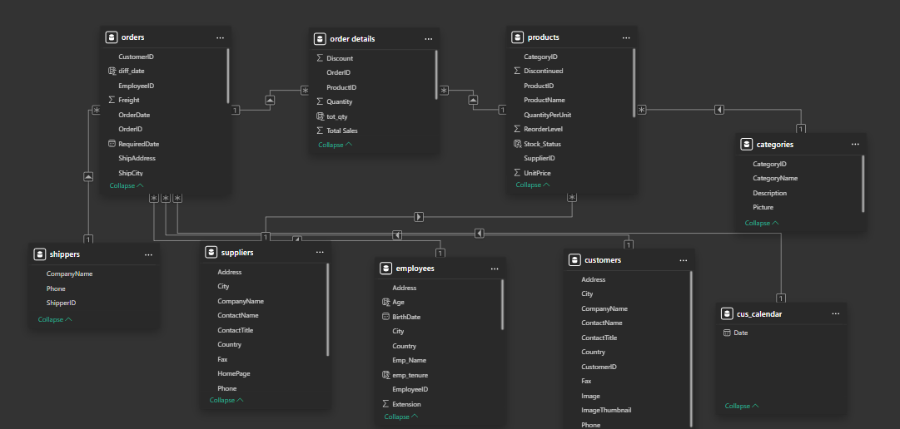
DATA

Slide 6
EXPLORATORY DATA ANALYSIS (EDA) FINDINGS
TOP-SELLING PRODUCTS AND CATEGORIES
MOST PROFITABLE REGIONS OR COUNTRIES
SEASONAL SALES TRENDS OR PATTERNS
CUSTOMER SEGMENTATION INSIGHTS

Slide 7
DASHBOARDS & INSIGHTS
Sales Performance: Top products, monthly trends, revenue highlights.
Customer Behavior: Churn, repeat customers, segments.
Product Performance: Best/worst performing products, trends.
Customer Dashboard – Churn, repeat customers, segment orders.
Product & Inventory Dashboard – Best/worst products, stock vs orders, turnover trends.

Slide 8
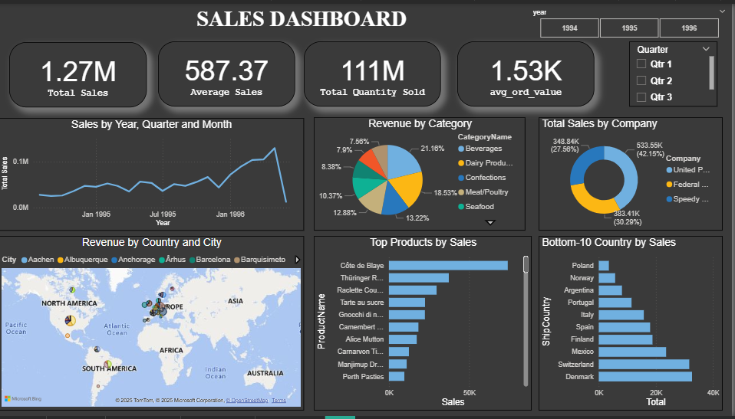

Slide 9
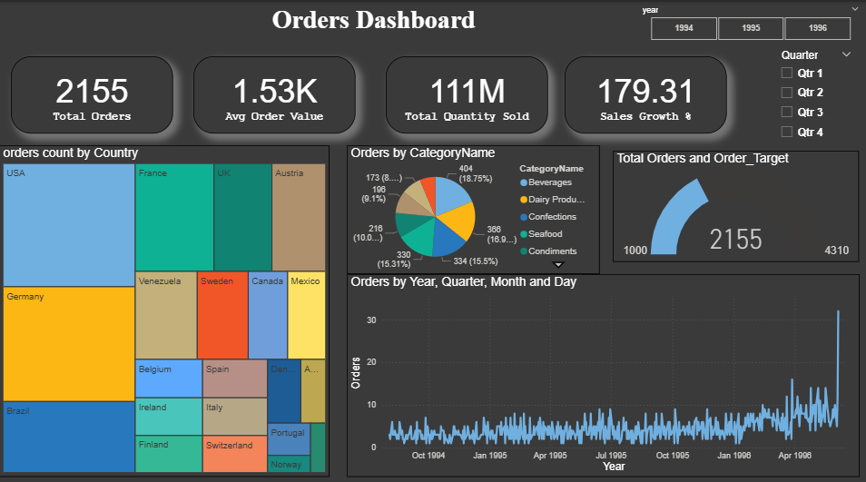

Slide 10
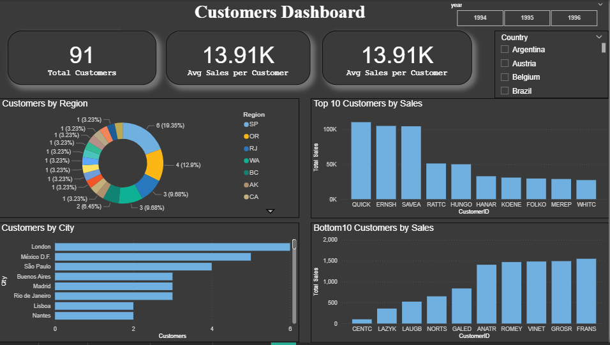

Slide 11
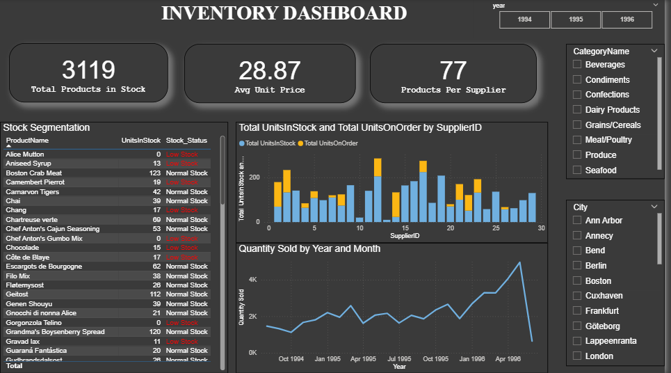

Slide 12
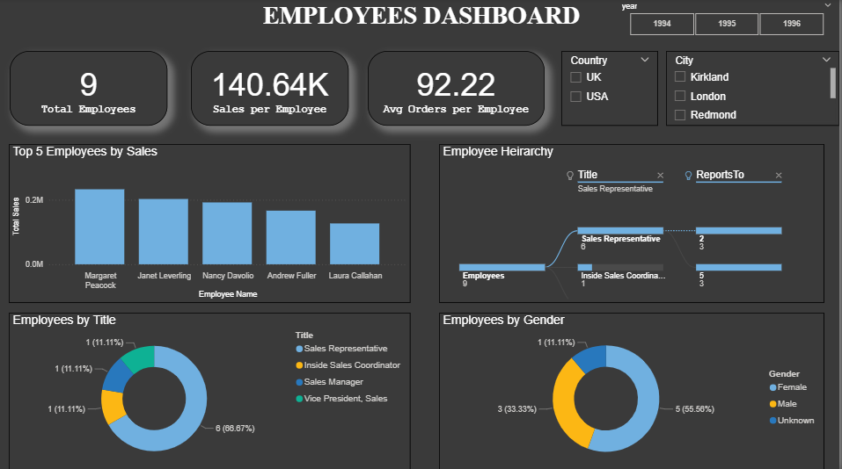

Slide 13
KEY KPIS
TOTAL CUSTOMERS
TOTAL REVENUE
TOTAL ORDERS
TOTAL QUANTITY
TOTAL EMPLOYEE
TOP PRODUCTS
SALES GROWTH RATE

Slide 14
RECOMMENDATIONS
Focus marketing on high-performing regions
Promote top-selling products for upselling
Engage top customers with loyalty programs
Explore opportunities to increase sales in underperforming regions
Enhance dashboard for real-time sales monitoring

Slide 15
CONCLUSION
The analysis provides actionable insights into sales trends, customer behavior, and product performance.
Key KPIs and dashboards enable data-driven decision-making.
Following the recommendations can help optimize sales strategy and drive business growth.

Slide 16
THANK YOU

