Slide 1
SPOTIFY TREND ANAYSIS
SANTHOSH S
BATCH- DMT6

Slide 2
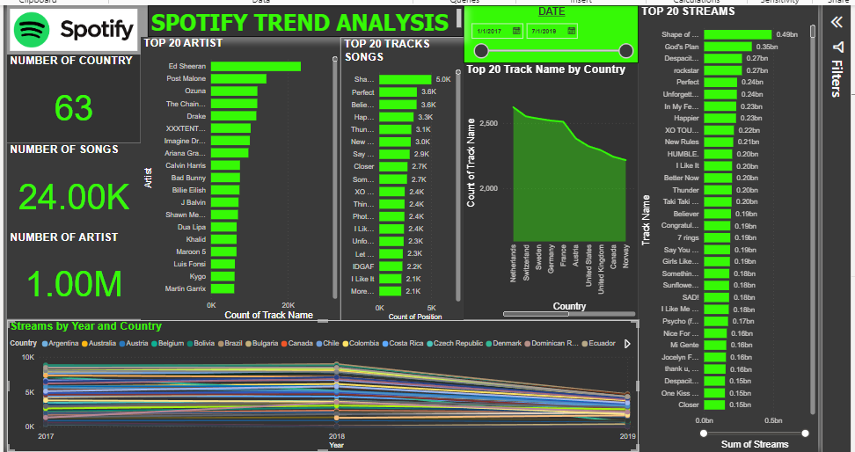
DASHBOARD

Slide 3
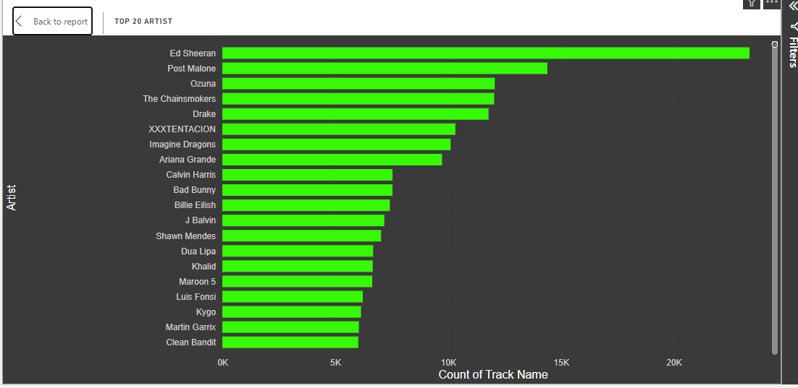
MOST POPULAR TRACKS AND ARTISTS
TOP 20 ARTISTS
Count of Track Name was highest for Ed Sheeran at 23,360, followed by Post Malone and Ozuna.
Ed Sheeran accounted for 2.33% of Count of Track Name
﻿Across all 7,222 Artist, Count of Track Name ranged from 1 to 23,360.

Slide 4
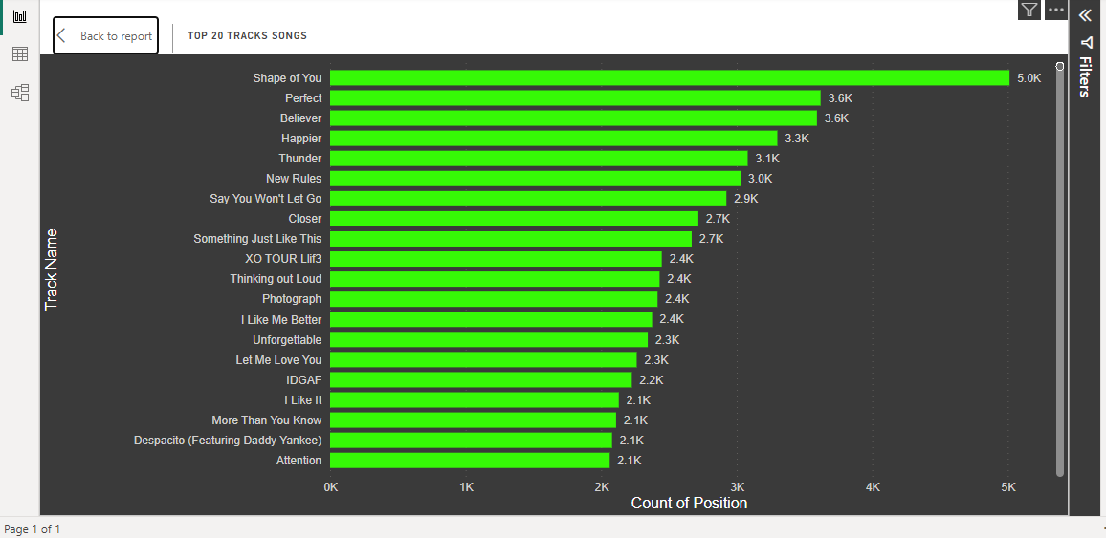
TOP 20 TRACK SONGS
Across all 24,002 Track Name, Count of Position ranged from 1 to 5,013.
Shape of You accounted for 0.50% of Count of Position.

Slide 5
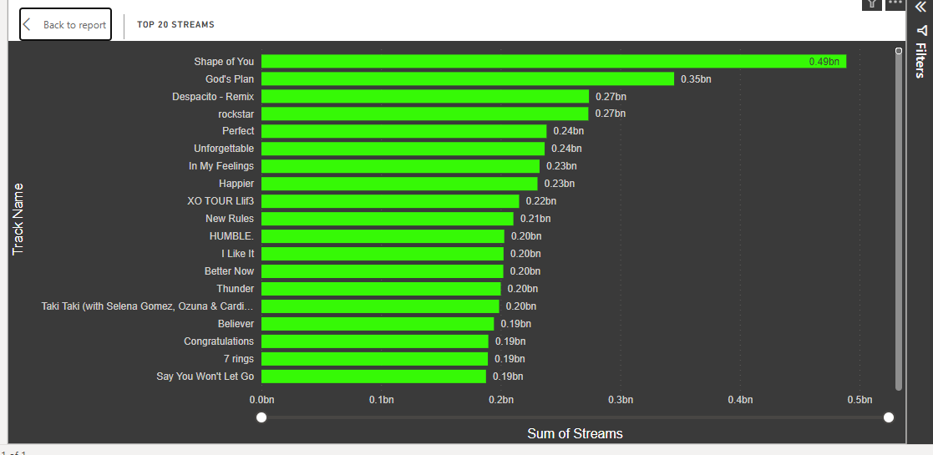
STREAMS OVER TIME
Shape of You accounted for 0.87% of Sum of Streams.
﻿Across all 24,002 Track Name, Sum of Streams ranged from 1001 to 489024467

Slide 6
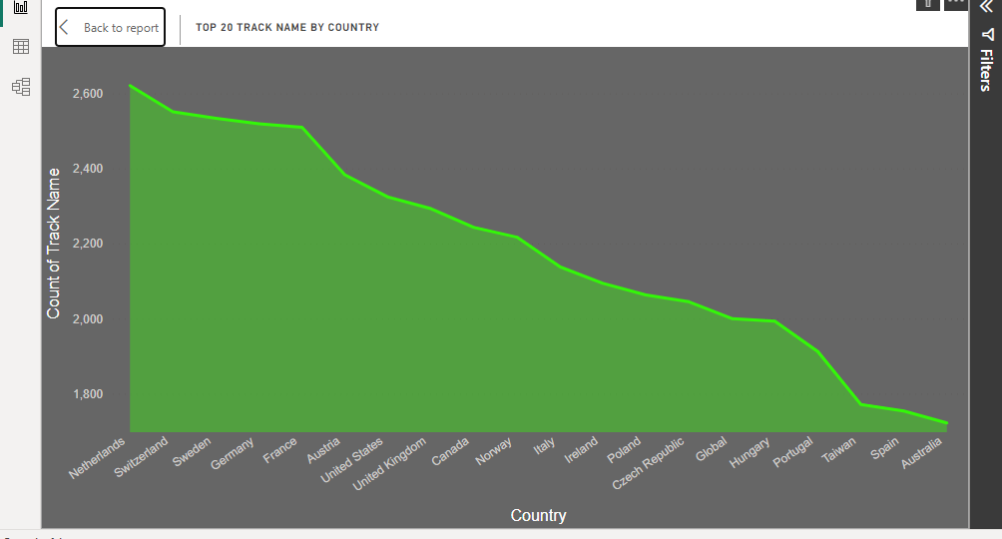
TOP 20 COUNTRY LIESTING SONGS
﻿At 2,621, Netherlands had the highest Count of Track Name and was 52.21% higher than Australia, which had the lowest Count of Track Name at 1,722.
﻿Across all 20 Country, Count of Track Name ranged from 1,722 to 2,621.

Slide 7
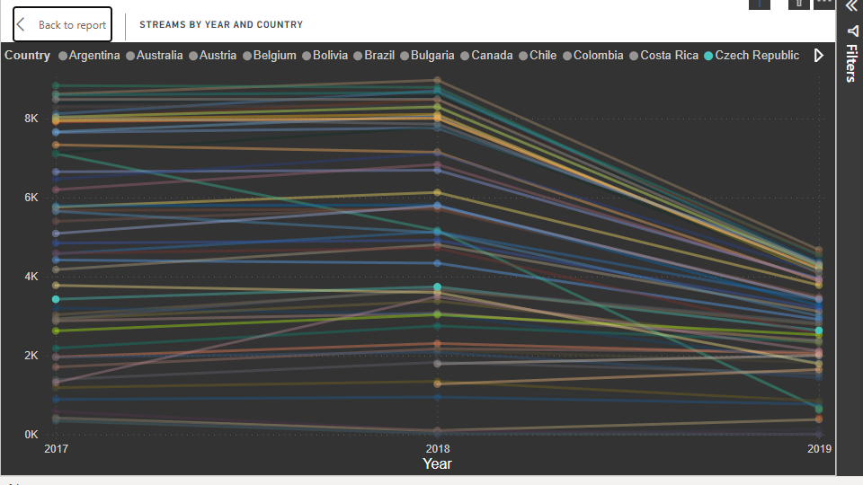
STREAMS BY YEAR AND COUNTRY
Between 2017 and 2019, Thailand had the largest increase in Count of Streams (60.53%) while Denmark had the largest decrease (90.47%).
﻿Across Country, Luxembourg had the most interesting recent trend and started trending down on 2017, falling by 96.84% (337) in 2 years.

