Slide 1
SALARY AND COMPENSATION ANALYSIS THROUGH EXCEL STATEMENT
STUDENT NAME: SANTHOSHKUMAR.S
REGISTER NO:312214544/2066DB571E70225A49E4F3F72B186D97
DEPARTMENT:B.COM(COMPUTER APPLICATIONS)
COLLEGE:ST. THOMAS COLLEGE ARTS AND SCIENCE

Slide 2
PROJECT TITLE
SALARY AND COMPENSATION ANALYSIS THROUGH EXECEL DATA MODELING

Slide 3


AGENDA
Problem Statement
Project Overview
End Users
Our Solution and Proposition
Dataset Description
Modelling Approach
Results and Discussion
Conclusion
3/21/2024 Annual Review

Slide 4

PROBLEM STATEMENT
Lack of Comprehensive Data Integration: Salary and compensation data often come from various sources, making it difficult to consolidate and analyze comprehensively.
Inconsistent Compensation Structures: Different departments or job roles may have varying compensation practices, leading to inconsistencies and potential dissatisfaction among employees.
Inefficient Data Analysis Tools: Many organizations rely on manual processes or outdated tools for compensation analysis, which can be time-consuming and prone to errors.

Slide 5

PROJECT OVERVIEW
1.Data Collection: Consolidation of salary, demographic, performance, and market data. 2.Data Analysis: Examination of salary structures, compensation equity, and benchmarking against industry standards. 3.Data Modeling: Application of Excel functions and tools to analyze and visualize data. 4.Reporting: Presentation of findings and recommendations to inform strategic compensation decisions.

Slide 6

WHO ARE THE END USERS?
1.Human Resources (HR) Professionals
2.External Stakeholders
3.Employees and Managers
4.Data Analysts and Business Intelligence (BI) Teams
5.Executives and Senior Management

Slide 7

OUR SOLUTION AND ITS VALUE PROPOSITION
1.Our solution leverages Excel's powerful analytical and data management capabilities to conduct a comprehensive salary and compensation analysis. It includes customizable templates, advanced formulas, and automated reports to streamline the analysis process.
2.Analyzing salary and compensation through an Excel-based solution can be highly valuable for organizations seeking to manage their payroll efficiently, ensure competitive compensation, and optimize their budgeting. Here’s a structured breakdown of your solution and its value proposition:

Slide 8
Dataset Description
➤ Employee KAGGLE ➤ 26-Features ➤ 9-Features
➤ Emp Id- Number
➤ Name Text
➤ Emp- Type
➤ Current Employee Rating- Number
➤ Gender- Male Female

Slide 9

THE "WOW" IN OUR SOLUTION
=IFS(Z8>=5,"VERY HIGH",Z8>=4,"HIGH",Z8>=3,"MED",TRUE,"LOW")
3/21/2024 Annual Review
9

Slide 10
MODELLING
1.Data Collection
Gather Relevant Data:
Employee Data: Names, job titles, departments, levels, locations, etc.Compensation Data: Base salary, bonuses, stock options, benefits, etc.Benchmark Data: Industry salary data, geographic salary differentials, etc.
2. Data Organization
Create a Clean Data Structure:
Sheets: Organize data into different sheets if necessary (e.g., Employee Data, Compensation Data, Benchmark Data).Tables: Use Excel Tables (Insert > Table) to structure data, which makes it easier to manipulate and analyse.
10

Slide 11
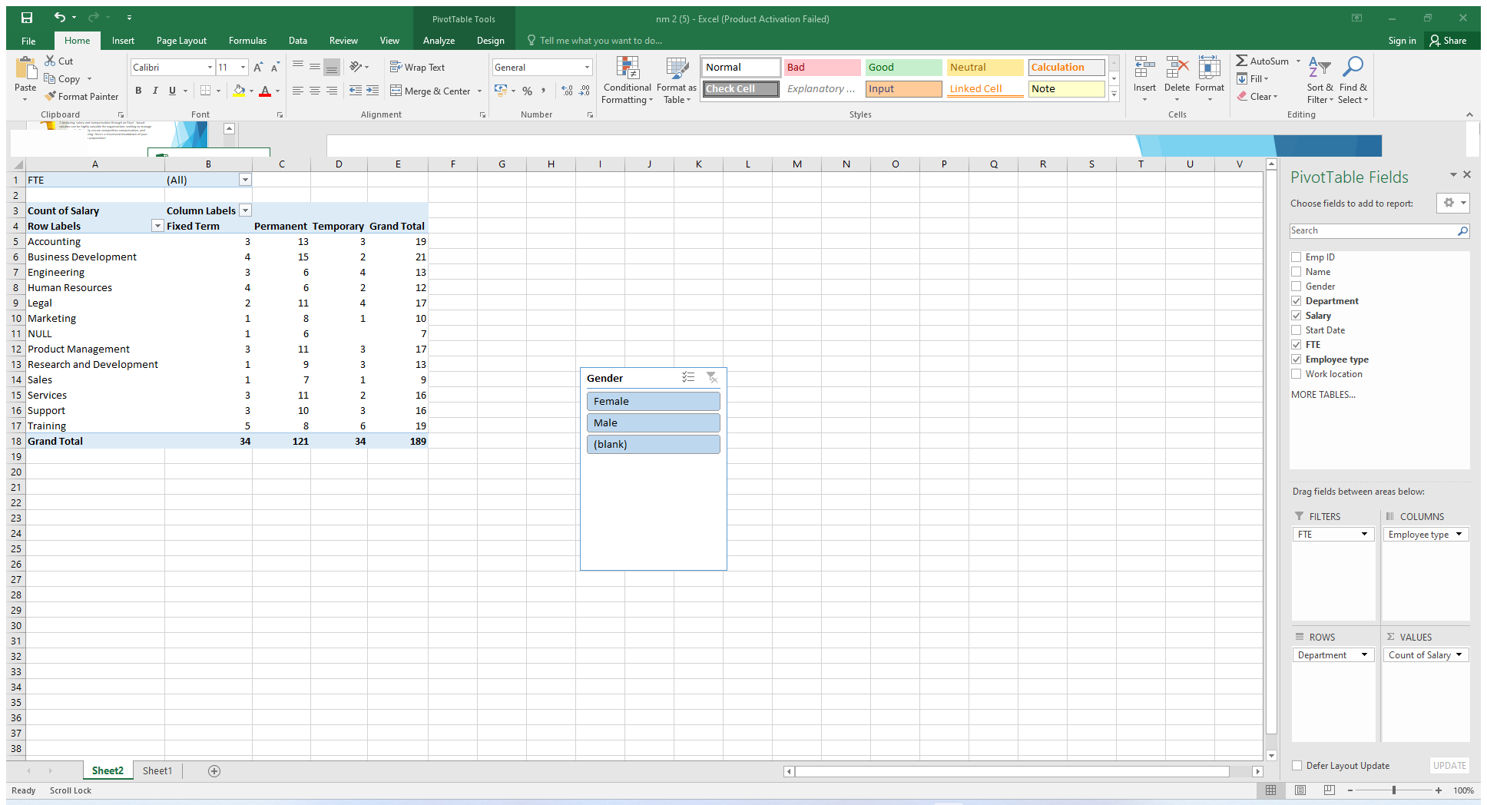
RESULTS
11

Slide 12
RESULTS
12

Slide 13
conclusion
In conclusion, the salary and compensation analysis through Excel data modeling provides a comprehensive understanding of compensation structures and trends within an organization. By leveraging Excel's powerful data analysis tools, we can identify key patterns and insights, such as salary distribution, compensation disparities, and the impact of various factors like experience, education, and job role on overall pay. This analysis not only helps in making informed decisions regarding pay equity and competitive compensation strategies but also aids in budgeting and forecasting future compensation needs. Ultimately, using Excel for this purpose enables organizations to align their compensation practices with industry standards, improve employee satisfaction, and support strategic HR planning.

