Slide 1
CUSTOMER SHOPPING BEHAVIOR · DATA READOUT
Customer shopping behavior:
what the data says to do next
3,900 purchases. One clear opportunity: convert loyalty into measurable growth.
DECISION BRIEF · CUSTOMER SHOPPING BEHAVIOR ANALYSIS

Slide 2
THE FILE
3,900 purchases reveal a broad but under-converted customer base
3,900
$59.76
NEXT
PURCHASES
AVERAGE PURCHASE
OPPORTUNITY
Across 25 products, 4 categories, and 50 locations.
Average review rating: 3.75.
Turn transactional breadth into repeat behavior and subscription growth.
SOURCE · CUSTOMER SHOPPING BEHAVIOR ANALYSIS
2

Slide 3
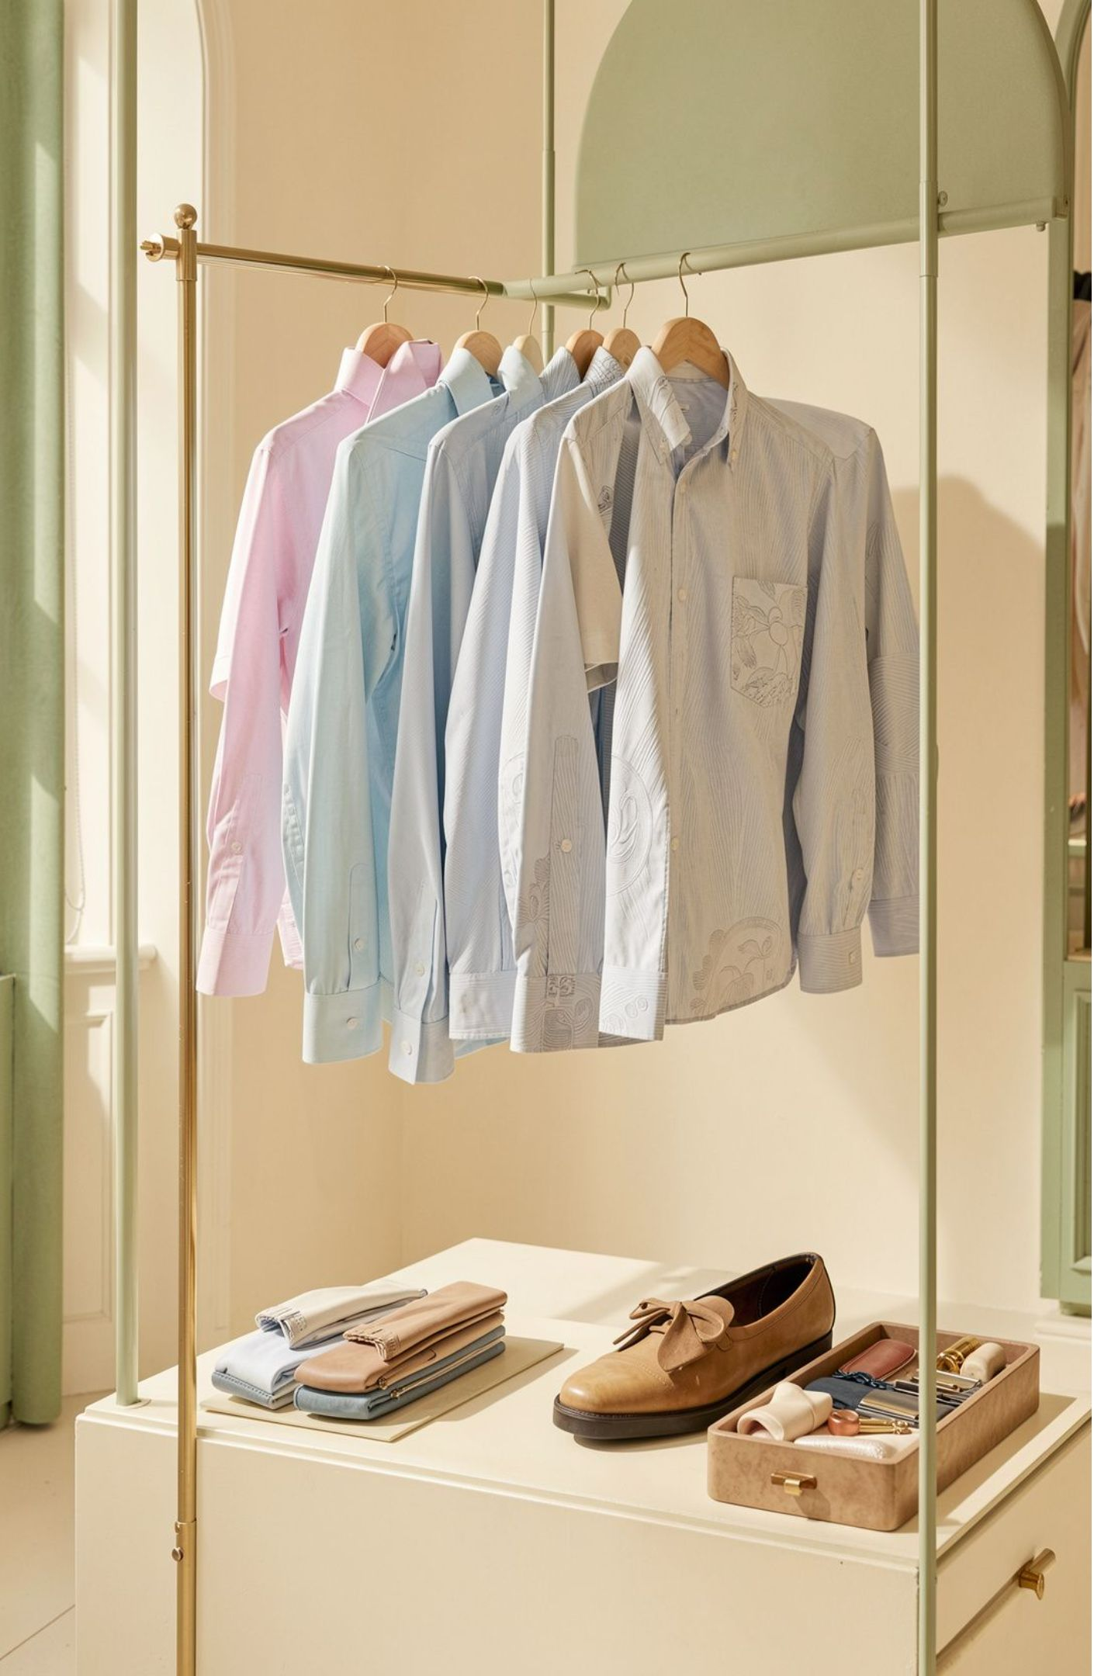
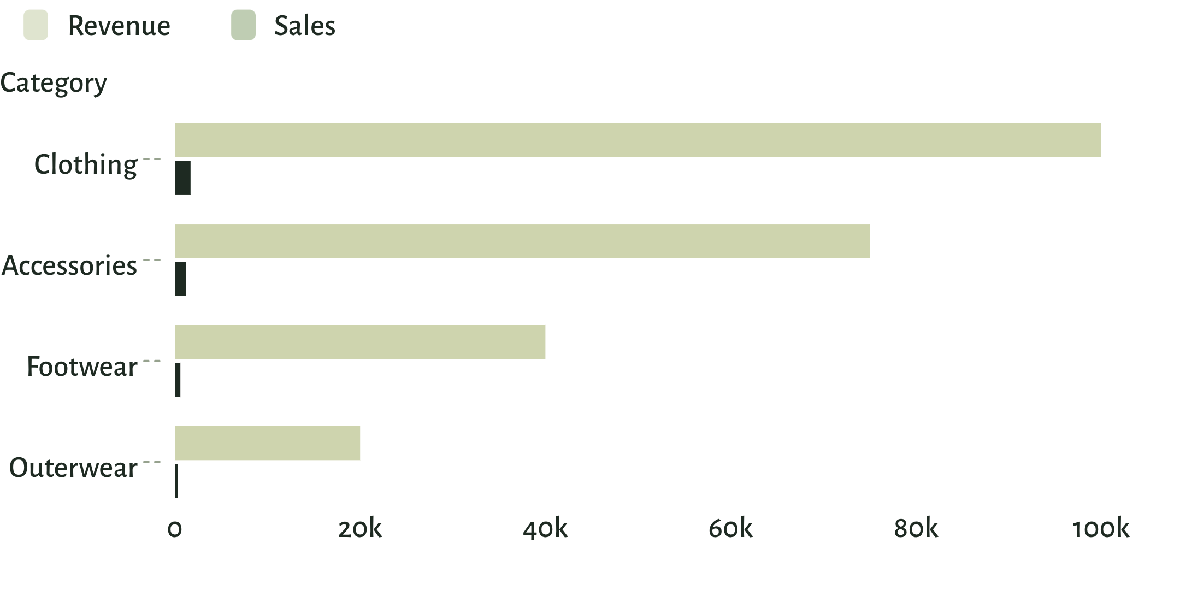
CATEGORY PERFORMANCE
Clothing is the commercial center of gravity
Use the category mix to anchor merchandising and campaign priorities.
Revenue and sales by category · values shown exactly as supplied.
3

Slide 4
CUSTOMER MIX
Loyal customers dominate the file, but subscriptions lag
The strongest relationship base is not yet converting into subscription participation.
01
02
03
04
3,116
701
83
27%
Loyal
Returning
New
Subscribed
Customer segment.
Customer segment.
Customer segment.
Versus 73% not subscribed.
Revenue still comes primarily from non-subscribers: $170,436 versus $62,645 from subscribers.
4

Slide 5
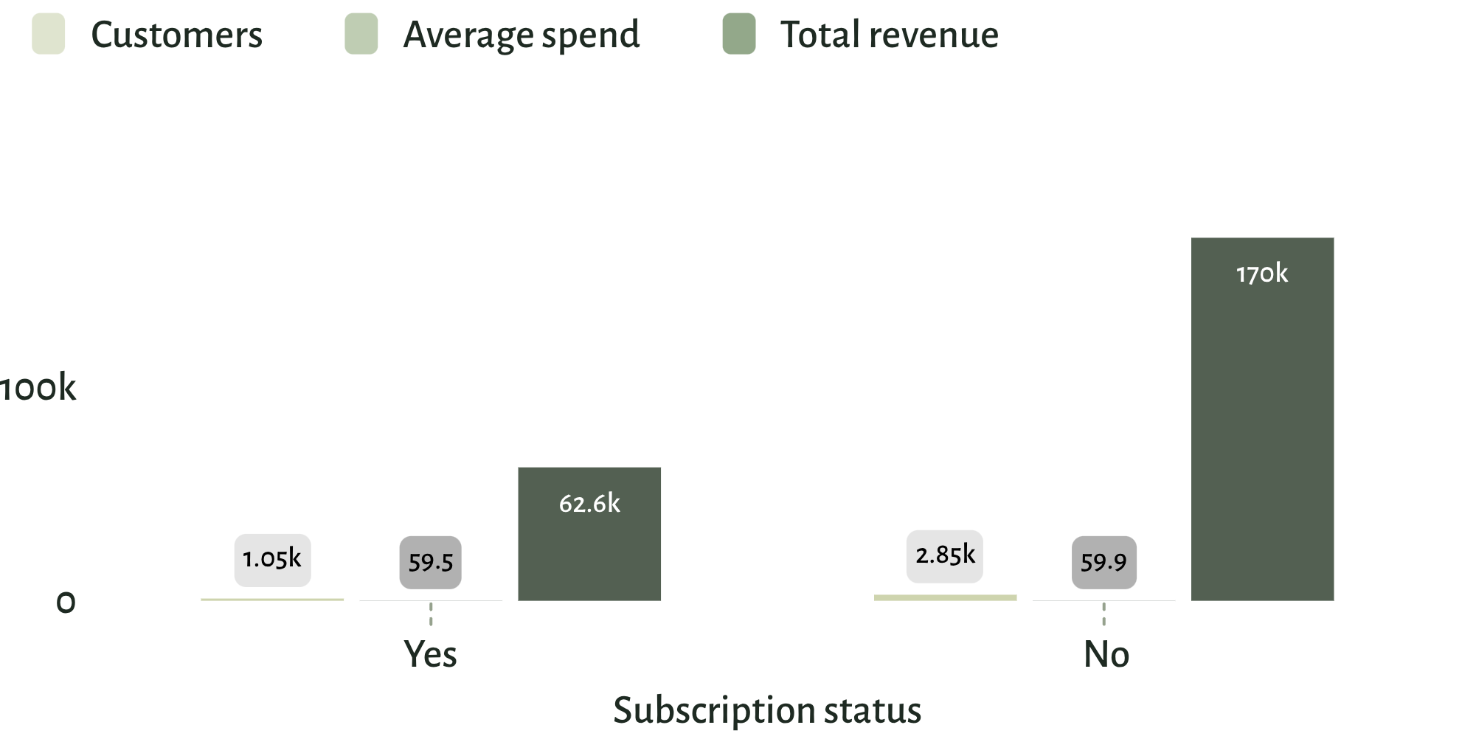
SUBSCRIPTION PERFORMANCE
THE GAP TO FIX
Subscription status is not yet translating into higher spend
$59.49
subscribers
Reframe the offer around exclusive value, not simply access.
$59.87
non-subscribers
Customers, average spend, and total revenue by subscription status.
Average spend is nearly identical.
5

Slide 6

DISCOUNT BEHAVIOR
Discounts attract high-value shoppers, but some categories may be over-dependent
01
High-spending discount users
839 customers still spent above the average purchase amount.
02
Highest discount rates
Hat 50.00% · Sneakers 49.66% · Coat 49.07% · Sweater 48.17% · Pants 47.37%
03
Decision
Protect conversion while testing margin-aware discount rules.
6

Slide 7
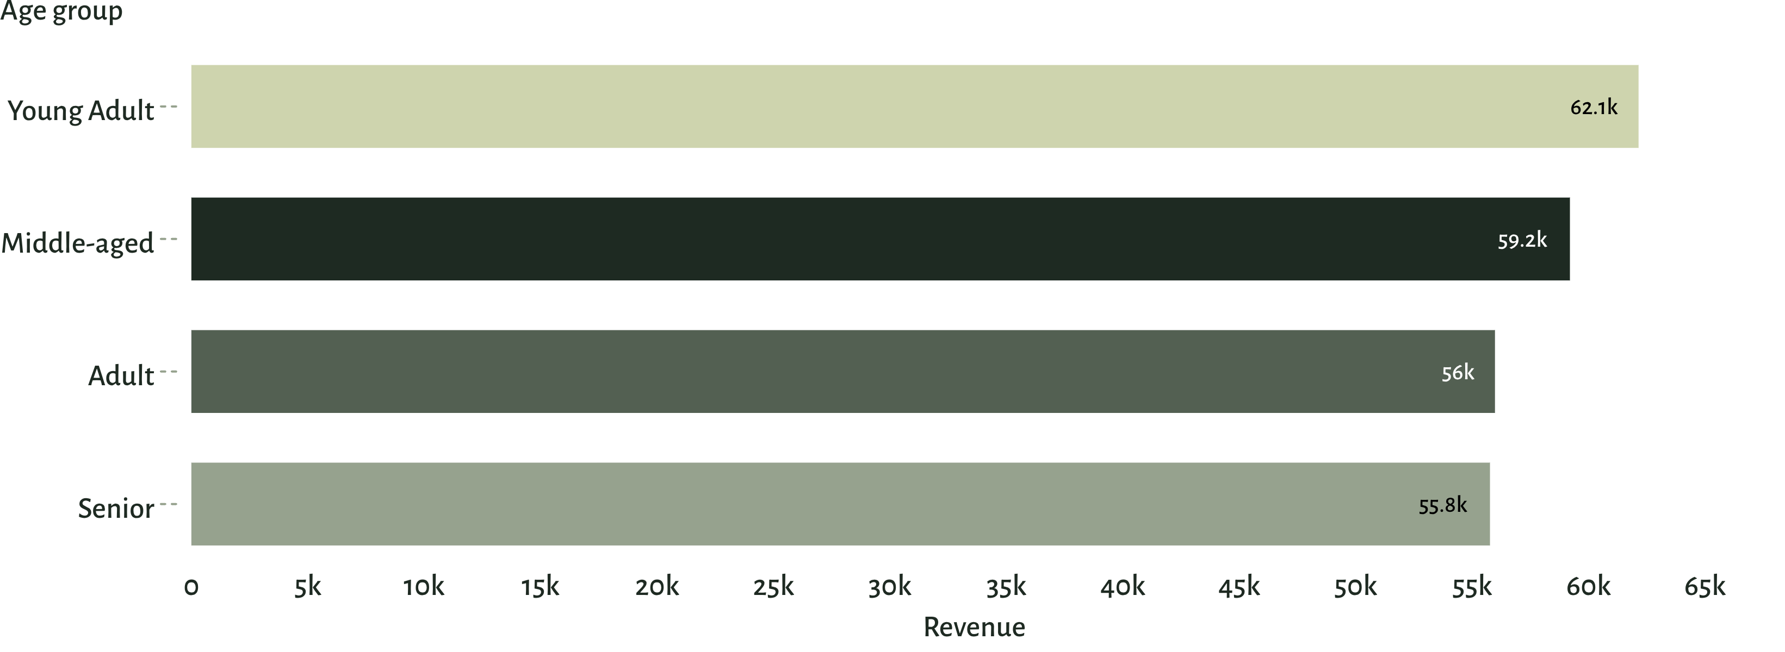
AGE GROUP PERFORMANCE
Young adults lead revenue, with meaningful demand across every age group
Prioritize young-adult acquisition while keeping creative relevant to the broader base.
Revenue by age group · young adults lead, while every group remains substantial.
7

Slide 8
MERCHANDISING SHORTLIST
Product signals point to a clear merchandising shortlist
01
02
03
Top-rated products
Category leaders
Use the signals
Gloves 3.86 · Sandals 3.84 · Boots 3.82 · Hat 3.80 · Skirt 3.78
Jewelry, Blouse, Sandals, and Jacket lead their respective categories by orders.
Use top-rated and best-selling products as campaign anchors and cross-sell entry points.
8

Slide 9
01
02
$60.48
3,476
RETENTION LEVERS
Shipping and repeat purchase behavior create two retention levers
Express shipping
Repeat buyers
Average purchase amount versus $58.46 for Standard.
Customers had more than five purchases; 958 were subscribers.
Connect faster fulfillment and loyalty benefits to customers already showing repeat intent.
9

Slide 10
THE DECISION
Recommended actions: convert loyalty into measurable growth
Boost subscriptions with exclusive, visible benefits
Reward repeat buyers and move Returning customers toward Loyal
Review discount policy in high-dependency categories
Lead campaigns with top-rated and best-selling products
Target young adults while tailoring offers to high-revenue segments
These recommendations are grounded in the analysis findings.
10

