Slide 1
Ideation Phase
Brainstorm & Idea Prioritization Template
Date | 31 January 2025
Team ID | LTVIP2025TMID35084
Project Name | Grain Palette-A-Deep-Learning-Odyssey-In Rice-Type- - Through-Transfer-Learning Classification
Maximum Marks | 4 Marks
Brainstorm & Idea Prioritization Template:
Brainstorming provides a free and open environment that encourages everyone within a team to participate in the creative thinking process that leads to problem solving. Prioritizing volume over value, out-of-the-box ideas are welcome and built upon, and all participants are encouraged to collaborate, helping each other develop a rich amount of creative solutions.
Use this template in your own brainstorming sessions so your team can unleash their imagination and start shaping concepts even if you're not sitting in the same room.
Reference: https://www.mural.co/templates/brainstorm-and-idea-prioritization
Step-1: Team Gathering, Collaboration and Select the Problem Statement
Step-2: Brainstorm, Idea Listing and Grouping Step-3: Idea Prioritization

Slide 2


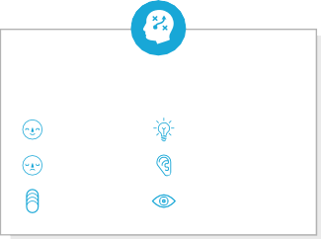
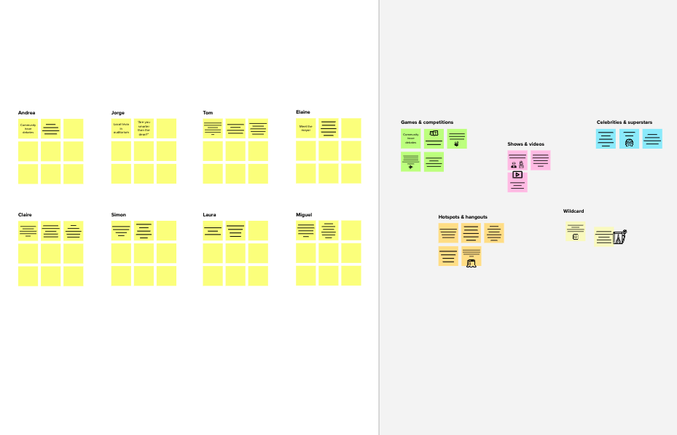
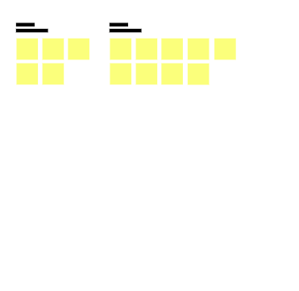
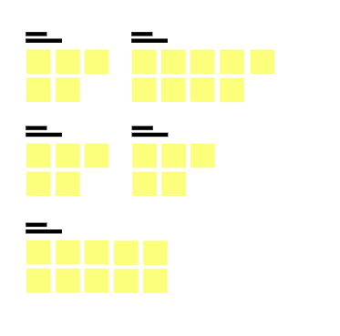
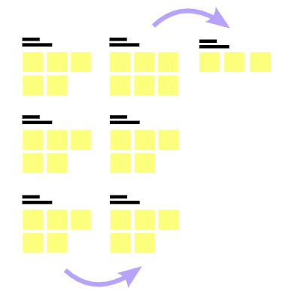
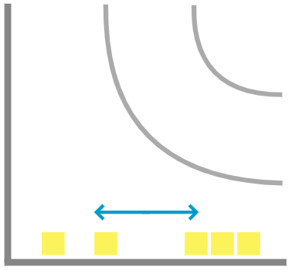
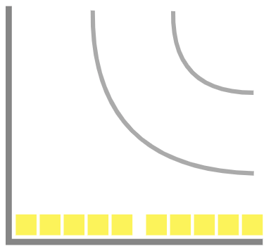
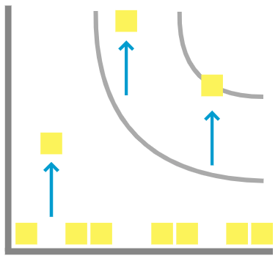
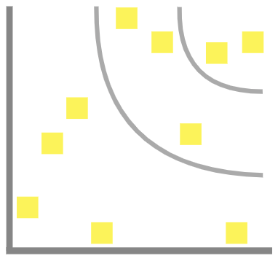

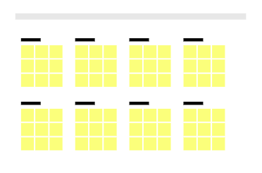
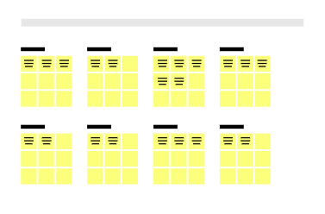
Template
1
3
4
TIP
Participants can use their cursors to point at where sticky notes should go on the grid. The facilitator can confirm the spot by using the laser pointer holding the H key on the keyboard.
Before you collaborate
A little bit of preparation goes a long way with this session. Here’s what you need to do to get going.
10 minutes
Define your problem statement
What problem are you trying to solve? Frame your problem as a How Might We statement. This will be the
Group ideas
Take turns sharing your ideas while clustering similar or related notes as you go. Once all sticky notes have been grouped, give each cluster a sentence-like label. If a cluster is bigger than six sticky notes, try and see if you and break it up into smaller sub-groups.
TIP
Add customizable tags to sticky notes to make it easier to find, browse, organize, and categorize important ideas as themes within your mural.
Prioritize
Your team should all be on the same page about what's important moving forward. Place your ideas on this grid to determine which ideas are important and which are feasible.
focus of your brainstorm.
20 minutes
20 minutes
5 minutes
2
Brainstorm
& idea prioritization
Use this template in your own brainstorming sessions so your team can unleash their imagination and start shaping concepts even if you're not sitting in the same room.
_{A} Team gathering
Define who should participate in the session and send an invite. Share relevant information or pre-work ahead.
PROBLEM
How might we classify Rice Type Through Transfer Learning ?
Brainstorm
Write down any ideas that come to mind that address your problem statement.
TIP
You can select a sticky note and hit the pencil [switch to sketch] icon to start drawing!
+
B
Set the goal
Think about the problem you'll be focusing on solving in the brainstorming session.
10 minutes
Here’s how we can group and label the ideas from above into meaningful clusters:
1. Data Collection & Preparation
Collect and label images of different rice types. Preprocess images by resizing, normalizing, and augmenting them.
Split the dataset into training, validation, and test sets.
2. Model Selection & Training Select a pre-trained deep learning model (ResNet, VGG, MobileNet, or
EfficientNet).
Apply transfer learning to fine-tune the model for rice classification. Train the model using TensorFlow or PyTorch with GPU acceleration.
Optimize hyperparameters for better accuracy and performance.
Choose a pre-trained deep learning model like ResNet, VGG, or EfficientNet.
Apply transfer learning to adapt the model for rice type classification.
By making a model of machine learning user uploads different images of different rice types.
To make a website that takes images of different types of rice types.
C
Learn how to use the facilitation tools
Use the Facilitation Superpowers to run a happy and productive session.
Person 1
Person 2
Person 3
Person 4
5. Enhancements & Continuous Learning
Optimize the system for offline predictions (mobile or embedded AI).
Collect feedback and retrain
the model with new rice images.
Integrate cloud storage for logging predictions and improving AI accuracy.
To build a website for rice type classification using GrainPalette: A Deep Learning Odyssey in Rice Type Classification Through Transfer Learning, follow these steps in simple one-line sentences:
10 minutes to prepare
1 hour to collaborate
2-8 people recommended
Open article
To make a website that takes images of different types of rice types.
To build a website for rice type classification using GrainPalette: A Deep Learning Odyssey in Rice Type Classification Through Transfer Learning, follow these steps in simple one-line sentences:
Collect high-quality images of different rice types.
Preprocess images by resizing, normalizing, and augmenting them.
By making a model of machine learning user uploads different images of different rice types.
o build a machine learning model for rice type classification using GrainPalette: A Deep Learning Odyssey in Rice Type Classification Through Transfer Learning, follow these steps in simple one- line sentences:
Collect images of different rice types with proper labeling.
Preprocess images by resizing, normalizing, and augmenting for better model training.
To make a Virtual assistant just like a chatbot that takes images of different rice types.
To build a virtual assistant chatbot for rice type classification using GrainPalette: A Deep Learning Odyssey in Rice Type Classification Through Transfer Learning, follow these steps in simple one- line sentences:
Collect and label high- quality images of different rice types.
Preprocess images by resizing, normalizing, and augmenting them.
To make a App that also takes images of different types of rice.
To build a mobile app for rice type classification using GrainPalette: A Deep Learning Odyssey in Rice Type Classification Through Transfer Learning, follow these steps in simple one-line sentences:
Collect and label images of different rice types for model training.
Preprocess images by resizing, normalizing, and augmenting them.
3. Model Deployment & Integration
Convert the model into a deployable format (TensorFlow Lite, ONNX, or SavedModel).
Deploy the trained model as
an API using Flask or FastAPI. Host the model on a cloud server for real-time predictions.
4. User Interaction & Application Development
Develop a Website to allow users to upload images for classification. Build a Mobile App with camera functionality for instant rice classification.
Create a Chatbot that accepts images and provides rice classification in a conversational format.
Implement an AI-powered Virtual Assistant that suggests rice cooking methods, nutritional values, etc.
To make a App that also takes images of different types of rice.
Use Transfer Learning with a pre-trained deep learning model (e.g., ResNet, VGG, or EfficientNet).
Fine-tune the model with labeled rice type datasets.
Train the model on a GPU to improve accuracy and speed.
Evaluate the model's performance using accuracy, precision, and recall metrics.
Deploy the trained model on a web server using Flask or FastAPI.
Create a Web Interface using HTML, CSS, and JavaScript to allow users to upload images.
Choose a pre-trained deep learning model like ResNet, VGG, or EfficientNet.
Apply transfer learning to adapt the model for rice type classification.
Fine-tune the model with domain-specific rice images.
Split the dataset into training, validation, and test sets for evaluation
Train the model using a deep learning framework like TensorFlow or PyTorch.
Use GPU acceleration to speed up training and improve performance.
Select a pre-trained deep learning model like ResNet, VGG, or EfficientNet.
Apply transfer learning to fine-tune the model for rice classification.
Train the model using TensorFlow or PyTorch with a labeled dataset.
Evaluate and optimize the model for better accuracy and performance.
Deploy the trained model as an API using Flask or FastAPI.
Integrate the model API into a chatbot framework (e.g., Dialogflow, Rasa, or GPT-based bot).
Select a pre-trained deep learning model (ResNet, VGG, or MobileNet).
Apply transfer learning to fine-tune the model for rice classification.
Train the model using TensorFlow or PyTorch on a labeled dataset.
Optimize the model for mobile deployment using TensorFlow Lite or ONNX.
Develop a mobile app UI using Flutter, React Native, or native Android/iOS.
Integrate camera functionality to allow users to take and upload images.
Key rules of brainstorming
To run an smooth and productive session
Integrate the AI model with the website backend for real- time predictions.
Optimize the website for fast image processing and user- friendly interaction.
Test the system with various rice images to improve reliability.
Launch the website and allow users to classify rice types instantly.
Evaluate the model using accuracy, precision, recall, and F1-score metrics.
Optimize hyperparameters (learning rate, batch size, epochs) for better results.
Test the model on unseen rice images to check its real-world accuracy.
Convert the model into a deployable format (e.g., TensorFlow SavedModel or ONNX).
Deploy the model using Flask, FastAPI, or a cloud service like AWS or Google Cloud.
Build an API to take image inputs and return classified rice type predictions.
Develop a chatbot interface using HTML, CSS, JavaScript, and chatbot UI tools.
Enable image input in the chatbot to accept rice images from users.
Process the uploaded image and pass it to the ML model for classification.
Generate rice type predictions and return results in a conversational format.
Provide additional insights like nutritional value, best cooking methods, etc.
Host the chatbot on a cloud server or integrate it into messaging apps like WhatsApp, Telegram, or a website.
Continuously improve the model by retraining with new rice images.
Process the image input and pass it to the AI model for classification.
Provide additional insights like rice characteristics, best uses, and nutritional value.
Enable offline predictions by embedding the AI model into the app.
Deploy the app on Google Play Store and Apple App Store.
Continuously improve by collecting user feedback and updating the model.
Integrate cloud storage for logging predictions and improving AI accuracy.
Stay in topic.
Encourage wild ideas.
Improve the model continuously by retraining with new rice images Improve the model continuously by retraining with new rice images
Display rice type predictions along with confidence scores.
Importance
If each of these tasks could get done without any difficulty or cost, which would have the most positive impact?
Collect and label images of different rice types for model training.
Preprocess images by resizing, normalizing, and augmenting them.
Collect images of different rice types with proper labeling.
Preprocess images by resizing, normalizing, and augmenting for better model training.
Defer judgment.
Listen to others.
Go for volume.
If possible, be visual.
To make a Virtual assistant just like a chatbot that takes images of different rice types.
-
Train the model using TensorFlow or PyTorch with a labeled dataset.
Evaluate and optimize the model for better accuracy and performance.
By making a model of machine learning user uploads different images of different rice types.
-
Feasibility
Regardless of their importance, which tasks are more feasible than others? (Cost, time, effort, complexity, etc.)
+
Need some inspiration?
See a finished version of this template to kickstart your work.
Open example

Slide 3
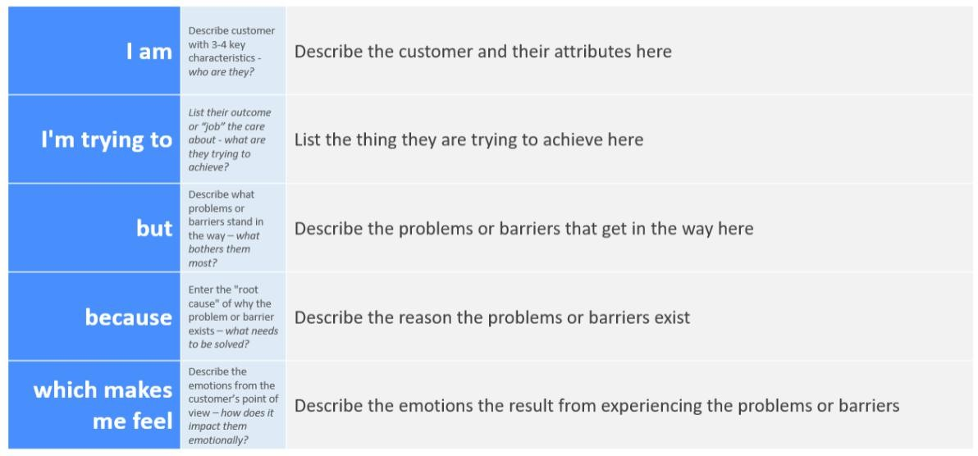
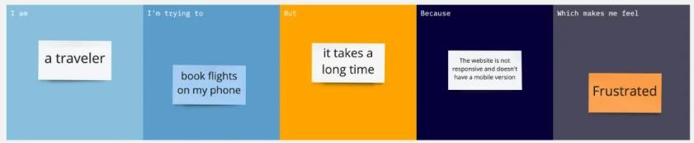
Ideation Phase
Define the Problem Statements
Date | 31 January 2025
Team ID | LTVIP2025TMID35084
Project Name | Grain Palette-A-Deep-Learning-Odyssey-In Rice-Type- -Through-Transfer-Learning Classification
Maximum Marks | 2 Marks
Customer Problem Statement Template:
Create a problem statement to understand your customer's point of view. The Customer Problem Statement template helps you focus on what matters to create experiences people will love.
A well-articulated customer problem statement allows you and your team to find the ideal solution for the challenges your customers face. Throughout the process, you’ll also be able to empathize with your customers, which helps you better understand how they perceive your product or service.
Reference: https://miro.com/templates/customer-problem-statement/
Example:

Slide 4
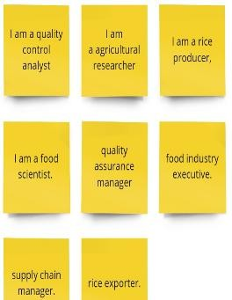
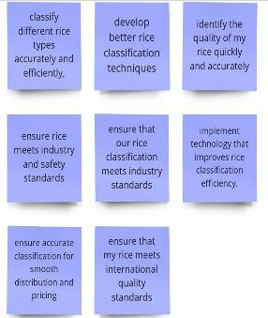
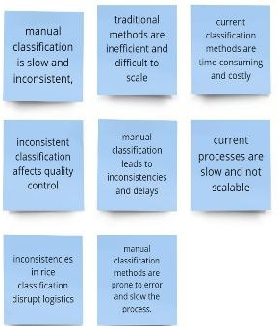
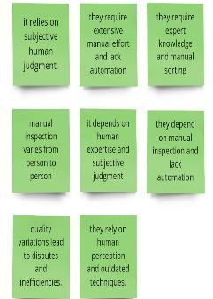
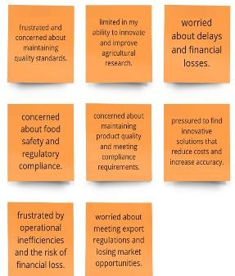
P r o bl e m St at e m e n t (P S) | I am (Customer) | I’m trying to | But | Because | Which makes me feel
P S- 1

Slide 5
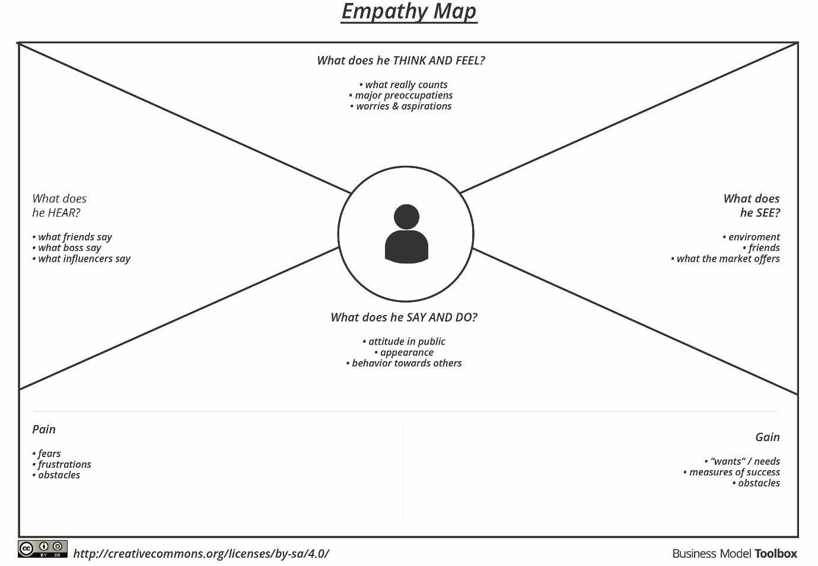
Ideation Phase Empathize & Discover
Date | 31 January 2025
Team ID | LTVIP2025TMID35084
Project Name | Grain Palette-A-Deep-Learning-Odyssey-In Rice-Type- - Through-Transfer-Learning Classification
Maximum Marks | 4 Marks
Empathy Map Canvas:
An empathy map is a simple, easy-to-digest visual that captures knowledge about a user’s
behaviours and attitudes.
It is a useful tool to helps teams better understand their users.
Creating an effective solution requires understanding the true problem and the person who
is experiencing it. The exercise of creating the map helps participants consider things from
the user’s perspective along with his or her goals and challenges.
Example:
Reference: https://www.mural.co/templates/empathy-map-canvas

Slide 6




WHO are we empathizing with?
Who is the person we want to understand? What is the situation they are in?
What is their role in the situation?
GOAL
What do they need to DO?
What do they need to do differently? What job(s) do they want or need to get done? What decision(s) do they need to make?
How will we know they were successful?
They struggle with manual rice classification, which is time-consuming, prone to human error, and lacks consistency.
They need a faster, more reliable AI-driven solution.
We are empathizing with quality control analysts, agricultural researchers, food scientists, and rice producers who need an efficient way to classify rice types accurately.
Their job is to analyze and verify rice types, ensuring that the correct classification is applied for packaging, distribution, and regulatory compliance. They must evaluate AI-based classification models for accuracy and usability.
Trust machine learning models for decision- making.
Implement an AI- based system to classify rice types accurately.
Accurately classify rice types for quality control.
Choose the right AI model and approach (e.g., transfer learning).
Time spent on classification is significantly reduced.
Increasing adoption of AI and machine learning in agriculture.
What do they THINK and FEEL?
Manual rice classification still being used, leading to slow and inconsistent results.
What do they HEAR?
What are they hearing others say? What are they hearing from friends? What are they hearing from colleagues? What are they hearing second-hand?
A quality control analyst working in a rice production company, responsible for ensuring accurate classification of rice types to maintain quality and meet industry standards.
PAINS
What are their fears, frustrations, and anxieties?
GAINS
What are their wants, needs, hopes, and dreams?
"AI can revolutionize agriculture and food quality control."
Dreams of automating the classification process to reduce manual labor and operational costs.
"AI is advancing fast; you should consider using it."
Worry that the AI model might misclassify rice types, leading to poor-quality control.
What do they SEE?
What do they see in the marketplace? What do they see in their immediate environment? What do they see others saying and doing?
What are they watching and reading?
"We need a solution that is both accurate and easy to use."
Concern about the availability and quality of rice grain image datasets for training the model.
Want a model that can be applied across different regions and rice varieties.
"Big companies are already adopting AI for food quality control."
"Some AI models struggle with bias—how will this system avoid that?"
What do they SAY?
What have we heard them say? What can we magine them saying?
What other thoughts and feelings might influence their behavior?
Users may hesitate to fully trust an AI-driven system, especially if they have relied on traditional manual classification for years.
They may want a customizable model that can be fine- tuned for different rice types or quality standards in different regions.
"Manual classification is slow and inconsistent."
"AI sounds promising, but can we trust its accuracy?"
"We need a more efficient way to classify rice types."
They might question the transparency of the model—how it makes decisions and whether they can verify its accuracy.
Expect an easy integration of AI models into existing agricultural workflows.
"This AI system is making classification so much faster!"
"We need to keep improving the model to ensure accuracy."
"More companies are adopting AI—we should stay ahead of the curve."
"Let’s integrate this technology into our daily workflow."
What do they DO?
What do they do today?
What behavior have we observed? What can we imagine them doing?
Manually inspect and classify rice grains based on size, shape, and color.
Struggling with the time- consuming nature of manual classification.
Showing hesitation toward AI adoption due to lack of expertise.
Using an AI-powered system to automate classification and improve accuracy.
Training staff to use AI-based tools in daily workflows.
Comparing AI results with manual classification to build trust.

Slide 7
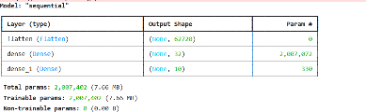
Project Development Phase Model Performance Test
Date | 10 February 2025
Team ID | LTVIP2025TMID35084
Project Name | Grain Palette-A-Deep-Learning-Odyssey- In-Rice-Type- -Through-Transfer- Learning Classification
Maximum Marks | -
Model Performance Testing:
Project team shall fill the following information in model performance testing template.
S. No. | Parameter | Values | Screenshot
1. | Model Summary | -
2. | Accuracy | Training Accuracy –0.9688 Validation Accuracy -0.9892
3. | Fine Tuning Result (if done) | Validation Accuracy - | -

Slide 8
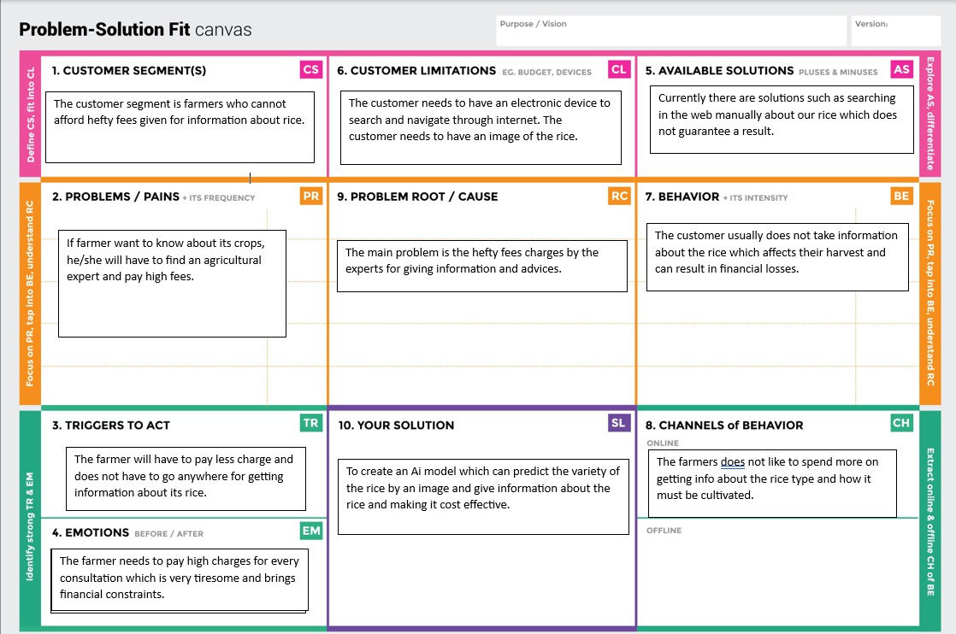
Project Design Phase Problem – Solution Fit Template
Date | 15 February 2025
Team ID | LTVIP2025TMID35084
Project Name | GrainPalette-A-Deep-Learning-Odyssey-In-Rice- Type-Classification-Through-Transfer-Learning
Maximum Marks | 2 Marks
Problem – Solution Fit Template:
The Problem-Solution Fit simply means that you have found a problem with your customer and that the solution you have realized for it actually solves the customer’s problem. It helps entrepreneurs, marketers and corporate innovators identify behavioral patterns and recognize what would work and why
Purpose:
Solve complex problems in a way that fits the state of your customers.
Succeed faster and increase your solution adoption by tapping into existing mediums and channels of behavior.
Sharpen your communication and marketing strategy with the right triggers and messaging.
Increase touch-points with your company by finding the right problem-behavior fit and building trust by solving frequent annoyances, or urgent or costly problems.
Understand the existing situation in order to improve it for your target group.
Template:

Slide 9
Project Design Phase Proposed Solution Template
Date | 15 February 2025
Team ID | LTVIP2025TMID35084
Project Name | Grain Palette-A-Deep-Learning-Odyssey-In- Rice-Type-Classification-Through-Transfer- Learning
Maximum Marks | 2 Marks
Proposed Solution Template:
Project team shall fill the following information in the proposed solution template.
S. No. | Parameter | Description
1. | Problem Statement (Problem to be solved) | It is not possible for the farmers to pay the agriculture experts hefty fees every time they have a new produce. We have to come up with a solution to this problem
2. | Idea / Solution description | Train an AI model which can be used by farmers to check the type of rice. The users need to upload image of a rice grain and click on the submit button.
3. | Novelty / Uniqueness | The prediction will be done automatically without any human intervention using a machine learning model.
4. | Social Impact / Customer Satisfaction | The model can predict the rice in very less time and provide services to a very large customer base.
5. | Business Model (Revenue Model) | We can charge amount per prediction which can generate a good profit.
6. | Scalability of the Solution | The model can be scalable by training the model on various different types of rice.

Slide 10
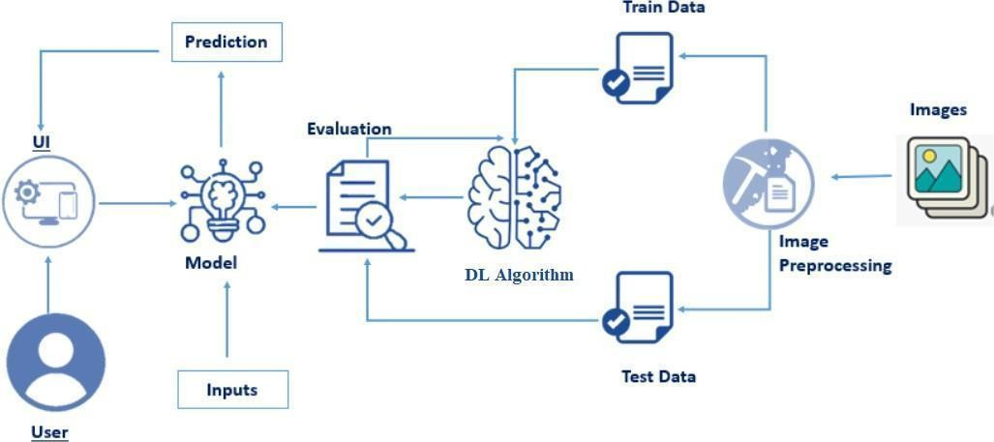
Project Design Phase Solution Architecture
Date | 15 February 2025
Team ID | LTVIP2025TMID35084
Project Name | Grain Palette-A-Deep-Learning-Odyssey-In- Rice-Type- -Through-Transfer-Learning Classification
Maximum Marks | 4 Marks
Solution Architecture:
Solution architecture is a complex process – with many sub-processes – that bridges the gap between business problems and technology solutions. Its goals are to:
Find the best tech solution to solve existing business problems.
Describe the structure, characteristics, behaviour, and other aspects of the software to project stakeholders.
Define features, development phases, and solution requirements.
Provide specifications according to which the solution is defined, managed, and delivered.
Example - Solution Architecture Diagram:
Key Components of the solution:
User Interface (Frontend)
Provides an interface for users to upload rice images and view classification results. Uses HTML, JavaScript, or React to send images to the backend and display predictions.
Backend Logic (Flask API)

Slide 11
Handles image preprocessing, runs inference using MobileNetV2, and returns classification results as JSON. Built with Flask/ Fast API for easy deployment.
MobileNetV2 (Deep Learning Model)
A lightweight CNN optimized for mobile/web, trained to classify different rice types. Uses depth wise separable convolutions for efficiency and is fine-tuned for accuracy.
Output (Rice Classification Result)
Returns a predicted rice category (e.g., Basmati, Jasmine) as JSON, which is displayed on the frontend. Can be integrated into web or mobile apps for real-time use.
Features and Deployment phases:
Features:
User-Friendly UI: Simple interface for image upload and displaying results. Efficient Backend: Uses Flask/Fast API to handle requests and process images. Accurate Predictions: MobileNetV2 ensures fast and reliable rice classification.
Deployment phases:
Model Training & Saving: Train MobileNetV2, fine-tune it, and save as .h5. Backend & API Setup: Develop a Flask API for model inference and JSON response. Hosting & Deployment: Deploy on Render, AWS, or Google Cloud for public access.
Solution Requirements:
Technical requirements:
Frameworks & Libraries: TensorFlow/ Keras for model training, Flask/Fast API for API, and React/HTML for frontend.
Infrastructure: A cloud server (AWS, GCP) or containerized deployment (Docker, Kubernetes). Storage & Processing: GPU support for training, cloud or local storage for model files and images.
Functional requirements:
Image Upload & Processing: Users can upload rice images for classification.
Model Inference & Prediction: Backend processes images and returns the rice type.
Result Display & API Integration: Predictions are displayed in the UI with real-time responses.

Slide 12
Project Planning Logic
Date | 15 February 2025
Team ID | LTVIP2025TMID35084
Project Name | Grain Palette-A-Deep-Learning-Odyssey In- Rice-Type- -Through-Transfer Learning Classification
Maximum Marks | -
A Sprint fixed period or duration in which a team works to complete a set of tasks
An Epic is a big task or project that is too large to complete in one sprint. It is broken down into smaller tasks (stories) that can be completed over multiple sprints.
A Story is a small task. It is part of an Epic.
A Story Point is a number that represents how much effort a story takes to complete. (usually in form of Fibonacci series)
Very Easy task
Easy task
Moderate task
5- Difficult task
Sprint 1: (2 Days)
Data Collection
Collection of Data 2
Loading Data 1
Sprint 2: (3 Days)
Data Preprocessing
Handling Missing Values 3
Handling Categorical values 2 Sprint 3: (5 Days)
Model Building
Model Building 5
Testing Model 3

Slide 13
Sprint 4: (3 Days)
Deployment
Working HTML Pages 3
Flask deployment 5
Sprint 3 (5 days) Total Story Points Sprint 1 = 3
Sprint 2 = 5
Sprint 3 = 8
Sprint 4 = 8
Velocity= Total Story Points Completed/ Number of Sprints Total story Points= 3+5+8+8 =24
No of Sprints= 4
Velocity = 24/4=6
6 (Story Points per Sprint)
Your team’s velocity is 6 Story Points per Sprint.

Slide 14
Project Planning Phase
Project Planning Template (Product Backlog, Sprint Planning, Stories, Story points)
Date | 15 February 2025
Team ID | LTVIP2025TMID35084
Project Name | GrainPalette-A-Deep-Learning-Odyssey-In- Rice-Type-Classification-Through-Transfer- Learning
Maximum Marks | 5 Marks
Product Backlog, Sprint Schedule, and Estimation (4 Marks)
Use the below template to create product backlog and sprint schedule
Sprint | Functional Requirement (Epic) | User Story Number | User Story / Task | Story Points | Priority | Team Members
Sprint-1 | Visiting website | USN-1 | As a user, I can visit the site simply using website URL. | 2 | High | Kabir
Sprint-2 | Accessing upload page | USN-2 | To use the model for prediction, I need to go to image upload page. | 1 | High | Kushagra Singh
Sprint-3 | Image uploading | USN-3 | In the Image upload page, I can simply upload the image from my device files. | 2 | Low | Rishi Pal
Sprint-4 | Rice type prediction | USN-4 | After uploading the image, I get the rice type prediction and addition information related to farming of that particular rice variety. | 2 | Medium | Kishan Kumar Sharma

Slide 15
Project Tracker, Velocity & Burndown Chart: (4 Marks)
Sprint | Total Story Points | Duration | Sprint Start Date | Sprint End Date (Planned) | Story Points Completed (as on Planned End Date) | Sprint Release Date (Actual)
Sprint-1 | 20 | 2 Days | 25 Feb 2025 | 26 Feb 2025 | 20 | 10 Mar 2025
Sprint-2 | 20 | 3 Days | 27 Feb 2025 | 01 Mar 2025 | 20 | 10 Mar 2025
Sprint-3 | 20 | 5 Days | 02 Mar 2025 | 06 Mar 2025 | 20 | 10 Mar 2025
Sprint-4 | 20 | 3 Days | 07 Mar 2025 | 09 Mar 2025 | 20 | 10 Mar 2025
Velocity:
Imagine we have a 10-day sprint duration, and the velocity of the team is 20 (points per sprint). Let’s calculate the team’s average velocity (AV) per iteration unit (story points per day)
AV=(sprint duration)/Velocity=13/6=2.16
Burndown Chart:
A burn down chart is a graphical representation of work left to do versus time. It is often used in agile software development methodologies such as Scrum. However, burn down charts can be applied to any project containing measurable progress over time.

Slide 16
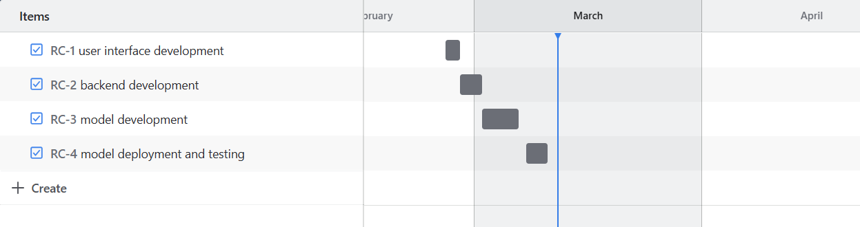
https://www.visual-paradigm.com/scrum/scrum-burndown-chart/
https://www.atlassian.com/agile/tutorials/burndown-charts
Reference:
https://www.atlassian.com/agile/project-management https://www.atlassian.com/agile/tutorials/how-to-do-scrum-with-jira-software
https://www.atlassian.com/agile/tutorials/epics https://www.atlassian.com/agile/tutorials/sprints https://www.atlassian.com/agile/project-management/estimation https://www.atlassian.com/agile/tutorials/burndown-charts

Slide 18


Scenario: Upload image of any type of rice, processing and see results of what
type of rice it is.
Entice
How does someone become aware of this service?
Enter
What do people experience as they begin the process?
Engage
In the core moments in the process, what happens?
Exit
What do people typically experience as the process finishes?
Extend
What happens after the experience is over?
Experience steps
What does the person (or people) at the center of this scenario typically experience in each step?
Potential users discover GrainPalette through social media ads, agricultural forums, and industry conferences.
Positive reviews and testimonials from farmers and agricultural experts build curiosity.
A compelling value proposition, such as "Accurate Rice Classification in Seconds," grabs attention.
Users are welcomed with a simple onboarding process explaining the app’s purpose.
A guided tutorial demonstrates how to upload rice grain images for classification.
Users upload images of rice grains through the app’s camera or file upload feature.
The deep learning model quickly processes the images and provides classification results.
The app suggests insights such as grain quality, type, and potential market value.
Real-time feedback allows users to refine their inputs for better accuracy.
User satisfaction grows as the app’s high accuracy saves time and effort.
The app displays a summary report of the classification results.
Users receive recommendations for improving rice quality and market positioning.
Users receive periodic updates and new features via notifications.
Feedback channels allow users to report issues and suggest improvements.
Data from past classifications helps improve future accuracy through machine learning.
Interactions
What interactions do they have at each step along the way?
Users may see promotional content from social media influencers, agricultural experts, or industry leaders.
They encounter GrainPalette through online ads, agricultural fairs, and farming seminars.
They interact with social media platforms (e.g., Facebook, Instagram), the GrainPalette website, and online video demos.
Users interact with customer support through chat or FAQs during onboarding.
They are usually at home, on the farm, or in agricultural offices while setting up the app.
Users may seek guidance from customer support or other farmers when using the app.
They are typically in rice fields, warehouses, or grain processing centers during use.
They use smartphone cameras to capture rice images and the app’s interface to process them.
Some users might |  | Real-time feedback |  | Users may share their |  | They are usually back |  | Users receive follow-ups |  | They might discuss app |  | Push notifications
consult experts or team |  | through the app’s |  | results with agricultural |  | at home or in their |  | from the GrainPalette |  | performance and results |  | inform users about app
members to validate |  | dashboard enhances |  | experts or other |  | office while reviewing |  | team through emails or |  | with industry peers at |  | updates and new
results. |  | user interaction. |  | farmers. |  | reports. |  | notifications. |  | events or meetings. |  | features.
People: Who do they see or talk to?
Places: Where are they?
Things: What digital touchpoints or physical objects do they use?
Goals & motivations
At each step, what is a person’s primary goal or motivation? (“Help me...” or “Help me avoid...”)
"Help me find a reliable solution for rice classification."
"Help me improve the efficiency of sorting rice grains."
"Help me reduce errors in rice type identification."
"Help me understand how to use the app quickly and easily."
"Help me avoid confusion during the onboarding process."
"Help me classify rice types accurately and quickly."
"Help me understand the differences between rice varieties."
"Help me make informed decisions based on classification results."
"Help me avoid misclassifications that could affect quality and pricing."
1. "Help me improve efficiency and reduce
labor costs."
"Help me understand the classification report clearly."
"Help me apply the insights to improve rice quality and sales."
"Help me stay updated with app improvements and new features."
"Help me track classification accuracy over time."
"Help me compare past and present classification trends."
Positive moments
What steps does a typical person find enjoyable, productive, fun, motivating, delightful, or exciting?
Discovering that GrainPalette can automate and simplify rice classification is exciting.
Positive testimonials and high ratings build motivation to try the app.
Seeing a demo of quick and accurate rice classification feels impressive and promising.
A smooth and quick onboarding process feels easy and welcoming.
Successfully uploading the first image without issues creates confidence.
Getting fast and accurate results from the deep learning model feels satisfying.
Seeing detailed insights about rice quality and type boosts confidence.
Real-time feedback and improvement suggestions feel empowering.
High accuracy rates make the process feel productive and rewarding.
The ability to compare different rice types side- by-side adds an element of curiosity and learning.
Viewing a detailed and well-organized classification report feels informative and useful.
Being able to share or export the results with one click feels seamless.
Receiving helpful tips and updates through notifications feels engaging.
Tracking classification history and trends over time builds a sense of progress.
Seeing improvements in classification accuracy over repeated use feels rewarding.
Negative moments
What steps does a typical person find frustrating, confusing, angering, costly, or time-consuming?
Difficulty finding reliable information about the app online creates frustration.
Confusing or inconsistent marketing messages reduce trust and interest.
Lack of clear pricing or hidden costs can make users feel hesitant.
A complicated or lengthy onboarding process can discourage users.
Poor internet connectivity causing delays during setup creates annoyance.
Inaccurate classification results can frustrate and discourage users.
Slow processing times during image analysis can waste time.
Poor camera integration or image quality issues may lead to failed classification.
Lack of detailed insights or explanations about the classification process may confuse users.
Receiving inconsistent results from similar images reduces confidence in the app’s accuracy.
Confusing report formats make it hard to understand the results.
Difficulties in exporting or sharing results can create frustration.
Frequent or irrelevant push notifications may feel intrusive.
Poor customer support when seeking clarification reduces trust.
Data loss or unavailability of previous reports can anger users.
Areas of opportunity
How might we make each step better? What ideas do we have? What have others suggested?
Improve visibility by partnering with agricultural organizations and influencers.
Create targeted social media campaigns to reach farmers and agribusinesses directly.
Develop a series of short, clear demo videos to explain the app’s benefits.
Introduce a step-by- step onboarding wizard to simplify the setup process.
Improve UI/UX design for better navigation and faster understanding of features.
Enhance the image recognition model to improve accuracy and reduce processing time.
Introduce a progress bar to show how long the classification will take.
Provide detailed insights about classification criteria to increase user understanding.
Allow users to compare classification results side- by-side for better decision- making.
Offer an offline mode for areas with poor internet connectivity.
Provide a clear summary of classification results with actionable insights.
Improve report formatting to make data easier to interpret and share.
Send personalized notifications about app updates and new features.
Allow users to track classification history and trends over time.
Use machine learning to improve classification accuracy based on user feedback.

Slide 19
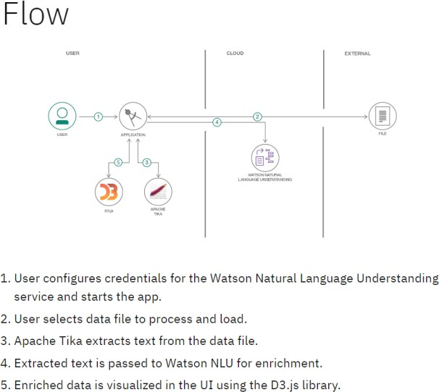
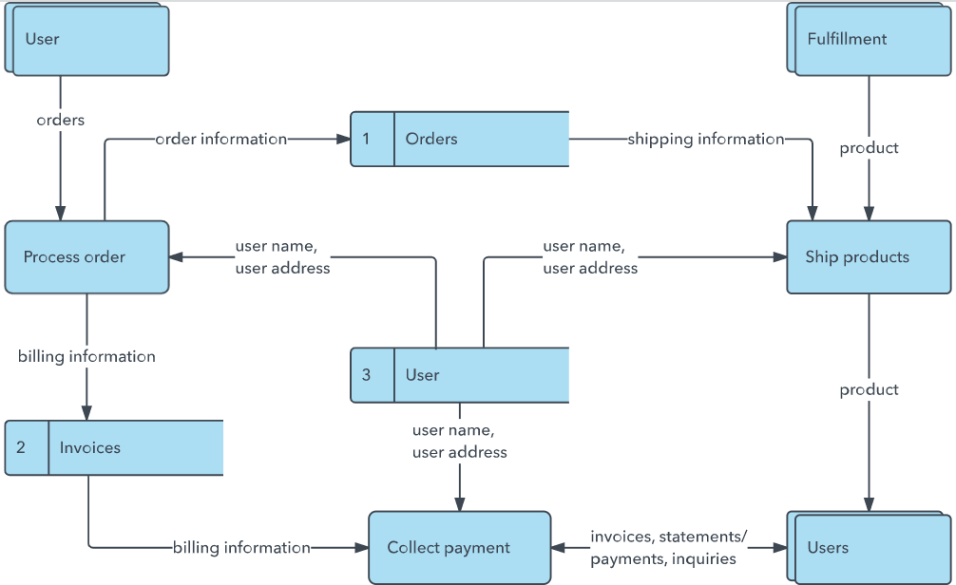
Project Design Phase-II
Data Flow Diagram & User Stories
Date | 31 January 2025
Team ID | LTVIP2025TMID35084
Project Name | Grain Palette-A-Deep-Learning-Odyssey-In-Rice Type- Through-Transfer-Learning Classification
Maximum Marks | 4 Marks
Data Flow Diagrams:
A Data Flow Diagram (DFD) is a traditional visual representation of the information flows within a system. A neat and clear DFD can depict the right amount of the system requirement graphically. It shows how data enters and leaves the system, what changes the information, and where data is stored.
Example: (Simplified)
Example: DFD Level 0 (Industry Standard)

Slide 20
User Stories
Use the below template to list all the user stories for the product.
User Type | Functional Requirement (Epic) | User Story Number | User Story / Task | Acceptance criteria | Priority | Release
Customer (Web user) | Browsing | USN-1 | As a user, I first need to browse through the url to go to the website. | I can use any browsing platform to go to through the url. | High | Sprint-1

Slide 21
User Type | Functional Requirement (Epic) | User Story Number | User Story / Task | Acceptance criteria | Priority | Release
 | upload | USN-2 | As a user, I will have to upload the image for the model to predict. | Image must be uploaded in the correct place. | Medium | Sprint-2
 | Processing and prediction | USN-3 | After uploading the image, the model processes the image and give result based on the image. | The model gives prediction based on the image. | Medium | Sprint-3
 | results | USN-4 | As a user, I can review the related information with the uploaded rice type image. | The result must be displayed. | High | Sprint-4

Slide 22
Project Design Phase-II
Solution Requirements (Functional & Non-functional)
Date | 31 January 2025
Team ID | LTVIP2025TMID35084
Project Name | GrainPalette-A-Deep-Learning-Odyssey-In-Rice-Type- Classification-Through-Transfer-Learning
Maximum Marks | 4 Marks
Functional Requirements:
Following are the functional requirements of the proposed solution.
FR No. | Functional Requirement (Epic) | Sub Requirement (Story / Sub-Task)
FR-1 | Browsing through URL | website link
FR-2 | Get Image | Upload the image
FR-3 | Prediction | Machine learning model
FR-4 | Details | View the details based on prediction
Non-functional Requirements:
Following are the non-functional requirements of the proposed solution.
FR No. | Non-Functional Requirement | Description
NFR-1 | Usability | The system should have an intuitive, user-friendly interface with clear instructions.
NFR-2 | Reliability | The prediction must be correct and accurate.
NFR-3 | Performance | The model must not take much time to predict.
NFR-4 | Availability | The availability to everyone must be maintained.
NFR-5 | Scalability | It must be scalable for predicting other types of rice too.

Slide 23
Project Design Phase-II Technology Stack (Architecture & Stack)
Date | 31 January 3035
Team ID | LTVIP2025TMID35084
Project Name | Grain Palette-A-Deep-Learning-Odyssey-In-Rice- Type- -Through-Transfer-Learning Classification
Maximum Marks | 4 Marks
Technical Architecture:
The Deliverable shall include the architectural diagram as below and the information as per the table1 & table 2
Rice Type Classification:
User Interface: Flask web app
Backend: Upload image
Image processing and Model Prediction
Generating rice type and details of rice

Slide 24
Table-1: Components & Technologies:
S. No | Component | Description | Technology
1. | User Interface | The user interacts with the application via a web interface. | Flask, HTML, CSS
2. | Application Logic-1 | Handles user input and processes it for Image prediction. | Python
3. | Application Logic-2 | Predicts the Image | MobilenetV2, python
4. | Database | If data storage is required | MySQL
5. | File Storage | Use internal storage to upload the image | Flask
6. | External API-1 | Purpose of External API used in the application | IBM Weather API, etc.
7. | Machine Learning Model | Predicts the Image | Image classification
8. | Infrastructure (Server / Cloud) | Application Deployment on Local System | Flask

Slide 25
Table-2: Application Characteristics:
S. No | Characteristics | Description | Technology
1. | Open-Source Frameworks | List the open-source frameworks used | MobilenetV2, Flask, Python
2. | Scalable Architecture | Justify the scalability of architecture (3 – tier, Micro-services) | Parallel processing (if required)
3. | Availability | Justify the availability of application (e.g. use of load balancers, distributed servers etc.) | Flask
4. | Performance | Design consideration for the performance of the application (number of requests per sec, use of Cache, use of CDN’s) etc. | MobilenetV2
References:
https://c4model.com/
https://developer.ibm.com/patterns/online-order-processing-system-during-pandemic/ https://www.ibm.com/cloud/architecture
https://aws.amazon.com/architecture
https://medium.com/the-internal-startup/how-to-draw-useful-technical-architecture-diagrams-2d20c9fda90d

