Slide 1
MCA FINAL-YEAR PROJECT
Academic Year 2025–2026
PROJECT PRESENTATION
Email to SMS/Call Notification System
Monitoring incoming emails, filtering what matters, and delivering critical alerts straight to your phone as SMS — even when the internet isn't around.
PRESENTED BY
Santosh S
25205077 · MCA – B

Slide 2
OVERVIEW
Project Abstract
INTRODUCTION
Email to SMS Converter (Offline Notifier) is an intelligent notification system that automatically monitors incoming emails and converts important emails into SMS notifications.
The system identifies critical messages using predefined keywords such as URGENT, ALERT, ASSIGNMENT, DEADLINE, and IMPORTANT. The application integrates React.js for the frontend, Node.js and Express.js for backend services, Gmail API/IMAP for email monitoring, and an Android SMS Gateway (httpSMS) for SMS delivery.
When an important email is detected, the system instantly sends an SMS alert to the user's mobile device. This solution reduces the chances of missing critical information, improves response time, and provides a reliable notification mechanism even when users are not actively checking their email accounts.

Slide 3
WHERE WE ARE TODAY
Existing System
01
02
03
Gmail Notifications
Push Notifications
Manual Email Checking
Standard email client alerts that depend on the app being open and connected.
Limited to smartphones with active data and the right app installed.
Users open inboxes periodically — slow and error-prone for urgent mail.

Slide 4
THE GAP
Problems in the Existing System
01
Internet Dependency
All notifications stop the moment connectivity drops.
02
Notifications Ignored
Constant pings cause alert fatigue — users tune them out.
03
Missing Important Emails
Critical messages get buried under newsletters and promotions.

Slide 5
OUR SOLUTION
Proposed System
MODULE 01
MODULE 02
Email Monitoring
Keyword Filtering
Continuously watches the inbox for new messages via Gmail API / IMAP.
Identifies important mail by sender, subject, and keyword rules.
MODULE 03
MODULE 04
SMS / whatsapp Notification’s
Dashboard Monitoring
Delivers the summary to the user's phone via the httpSMS gateway.
Web dashboard to view emails detected, SMS sent, and delivery status.

Slide 6
WHAT WE SET OUT TO DO
Objectives
01
Monitor Emails
02
Detect Important Emails
Listen to the inbox in real time.
Filter using keywords and sender rules.
03
Send SMS Alerts
04
Maintain Logs
Notify the user even without internet.
Track every email and SMS for audit.

Slide 7
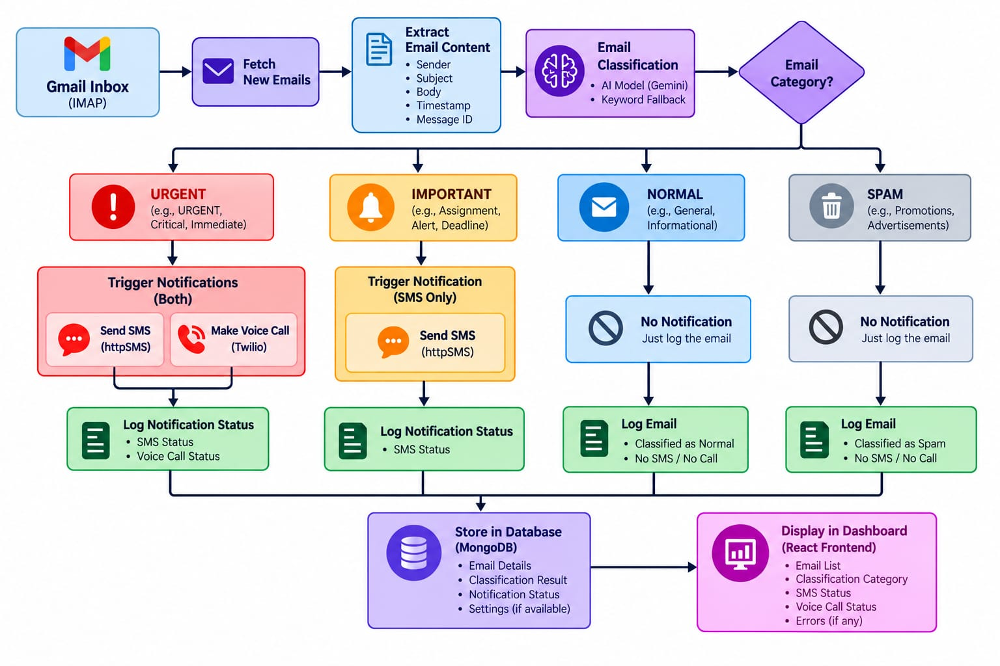
Data Flow Diagram

Slide 8
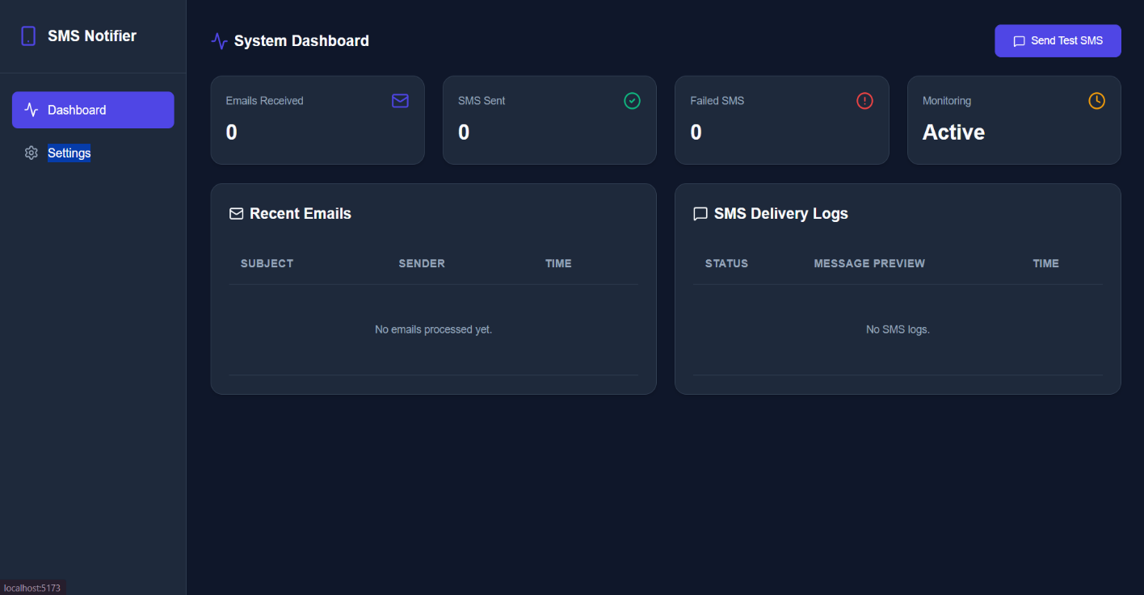
Implementation Results

Slide 9
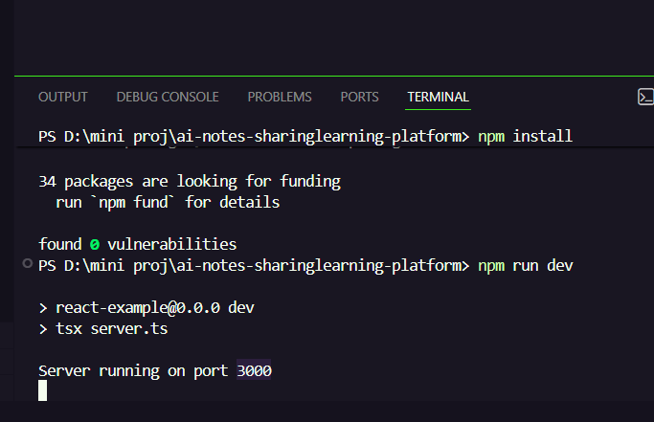
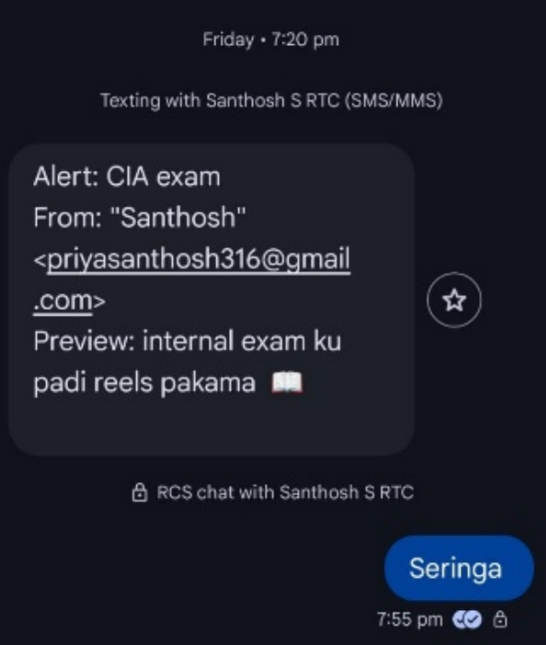
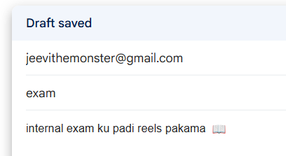
Screenshots
Dashboard Page
SMS Logs Page
httpSMS Integration
[ Add screenshot ]
[ Add screenshot ]
[ Add screenshot ]

Slide 10
FUTURE SCOPE
WHAT'S NEXT
FROM THE TEAM
Future Enhancements
Thank You
Mobile App
Dedicated companion app for monitoring.
Voice Alerts
Questions are welcome.
Read out critical emails as voice calls.

