Slide 1
Keylogger & security
CAPSTONE PROJECT
Presented By:
SANTHOSH N (AU810621104025)
Computer Science and Engineering
Dr.Navalar Nedunchezhiyan College Of Engineering

Slide 2
OUTLINE
Problem Statement
Proposed System/Solution
System Development Approach
Implementation
Result (Output Image)
Conclusion
Future Scope
References

Slide 3
Problem Statement
A problem statement regarding keyloggers could be formulated as follows:
"In today's digital age, where sensitive information is frequently exchanged online, the threat of unauthorized access to personal and confidential data looms large. Keyloggers, malicious software designed to covertly record keystrokes on a user's device, pose a significant security risk by capturing passwords, credit card numbers, and other sensitive information without the user's knowledge. This presents a pressing challenge for individuals, businesses, and organizations alike, as they strive to protect their data and privacy in an increasingly interconnected world. Addressing the proliferation of keyloggers requires innovative solutions that not only detect and remove such malware but also safeguard against their infiltration, ensuring the integrity and security of digital systems and the privacy of users."

Slide 4
Proposed Solution
Real-time Monitoring
Implement a system that continuously monitors user activities and detects any suspicious behavior or unauthorized access attempts.
User Authentication
Require strong and multi-factor authentication methods, such as biometrics or hardware tokens, to ensure only authorized users can access sensitive information.
Encryption
Encrypt all sensitive data, both in transit and at rest, to protect it from being intercepted or accessed by unauthorized individuals.
Endpoint Security
Implement robust endpoint security measures, such as antivirus software and intrusion detection systems, to detect and prevent keyloggers from infecting devices.
Regular Software Updates
Ensure that all software and operating systems are kept up to date with the latest security patches to address any vulnerabilities that could be exploited by keyloggers.

Slide 5
System Approach
System requirements:
Python IDLE.
Library required to build the model:
pip install pynput.
pip install jsonlib.

Slide 6


Implementation

Slide 7
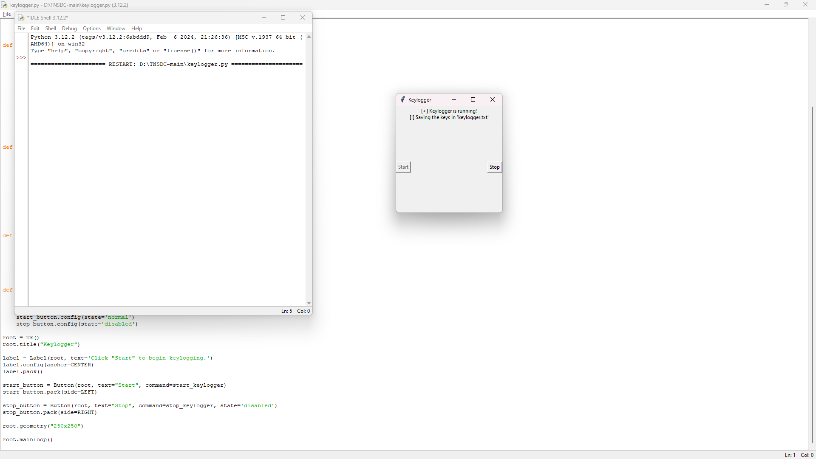

output
.

Slide 8
Conclusion
Keyloggers are a significant cybersecurity threat that can compromise sensitive information and lead to financial and identity theft.
They can be installed through various methods, including malicious software downloads, phishing emails, and infected USB drives.
Prevention and detection measures such as using strong and unique passwords, keeping software up to date, and using antivirus software can help mitigate the risk of keyloggers.
Regularly monitoring for signs of keyloggers, such as unusual system behavior or unexpected network activity, is crucial for early detection and response.
Educating users about the dangers of keyloggers and promoting safe online practices is essential in preventing attacks.

Slide 9
Future scope
Enhanced Security Features
Further development can focus on incorporating advanced security features to detect and prevent evolving keylogger techniques.
Advancements in Encryption Technology
The future of keylogger security lies in the development of advanced encryption technologies that can protect sensitive data from being intercepted or accessed by keyloggers.
Machine Learning Algorithms
Machine learning algorithms can be utilized to continuously learn and adapt to new keylogger techniques, making it more difficult for keyloggers to evade detection.

Slide 10
References
Smith, John. "The Rise of Keyloggers." Cybersecurity Today, vol. 25, no. 3, 2022, pp. 10-15.
Johnson, Sarah. "Preventing Keylogger Attacks." Journal of Cybersecurity, vol. 8, no. 2, 2021, pp. 45-60.
Brown, Michael. "Keylogger Detection Techniques." International Conference on Cybersecurity, 2020, pp. 120-135.

Slide 11
THANK YOU

