Slide 1
Water Level Control System
(Automatic and Manual)

Slide 2
Name | Roll Number
D M Shaahid | CB.EN.U4ECE21011
D Santhosh | CB.EN.U4ECE21012
N Sumanth | CB.EN.U4ECE21033
P Ganesh | CB.EN.U4ECE21036

Slide 3
Introduction
What is Water Level Control system ?
A Water level control system is a device or mechanism that automatically monitors and regulates the level of water In the tank, reservoir, or any other water storage system
Importance of Water Level Control
Prevent Overflow and Flooding.
Ensures optimal water usage.
Maintains consistent water pressure.
Protects Equipment from damage.
Enables efficient water management.

Slide 4
Literature Survey
Title of Literature | Source Type | Authors | Publication Year | Key Insights
Fundamentals of Digital Logic with Verilog Design | TextBook | Stephen Brown and Zvonko Vranesic | 2002 | Combinational circuits; Flip-Flops, Registers, Counters; 3. Synchronous Sequential Circuits
Microelectronic Circuits | TextBook | Adel S. Sedra Kenneth C. Smith | 2015 | Signal Generators and Waveform Shaping Circuits

Slide 5
System Components
Breadboard | 2
Connecting wires | As Requried
AND Gate (IC7408) | 1
NOR Gate(IC7402) | 1
JK flipflop(IC74112) | 2
4⤫1 MUX(IC74153) | 2
NOT Gate(IC7404) | 1
555 Timer(IC555) | 1
3⤫8 decoder (IC74138) | 1
Relay(5V) | 1
Resistors (68K Ω,39K Ω,1K Ω) | 1,1,4
Capacitors (10nF,100nF,1µF) | 2,1,1
Float switches | 5

Slide 6
Explanation
Our project is based on a “Water Level Control System”.
The water is controlled in two ways
Manual Method.
Automatic Method
Cont…

Slide 7
Water Level Control System:
1. Automatic :
A Water Level Control System is a technological solution designed to automatically regulate and maintain the water level within a specific range or at a predetermined set point.
This system typically employs float switches to detect the water level and actuator (Relay) to adjust the flow of water accordingly.
It is commonly used in applications where precise and continuous control of water levels is required, such as in industrial processes, irrigation systems, and water treatment plants.
Cont…

Slide 8
2. Manual Method:
The manual method of controlling water levels is designed for users who prefer to operate the system manually, without relying on automated controls.
This method provides users with the flexibility to control the water level according to their specific needs and preferences, but it may require more attention and effort compared to automated systems.

Slide 9
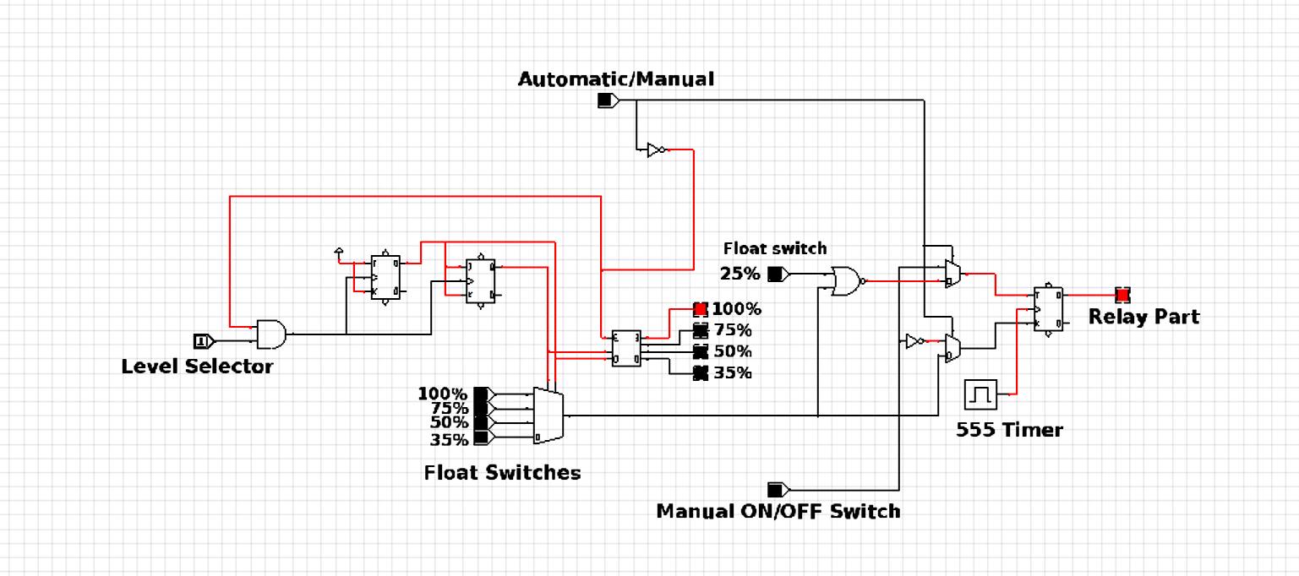
Simulation

Slide 10
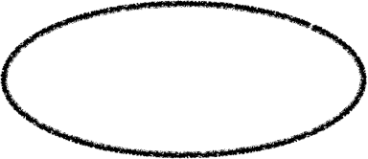
  If switch is in LOW it depicts automatic mode and when HIGH it depicts Manual mode.

Slide 11
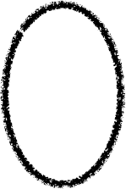
Working
  Now This Automatic/ Manual switch acts as select line to the encircled Multiplexers (2⤫1).
Cont…

Slide 12
Manual Mode
 | J | K
On | 1 | 0
Off | 0 | 1

Slide 13
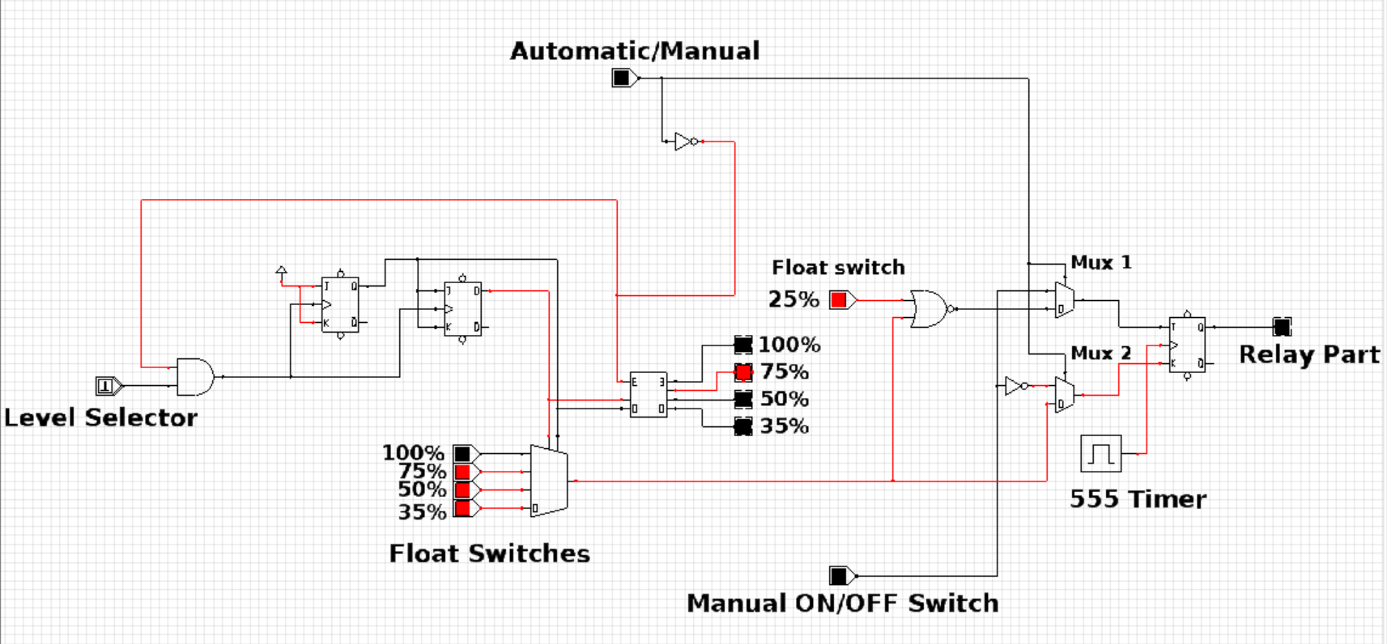

Working
  In automatic mode, the NOR GATE output and the output from the 4⤫1 MUX serve as inputs to MUX 1 and MUX 2, respectively.
  The outputs of MUX 1 and MUX 2 then become the inputs for the JK flip-flop.

Slide 14
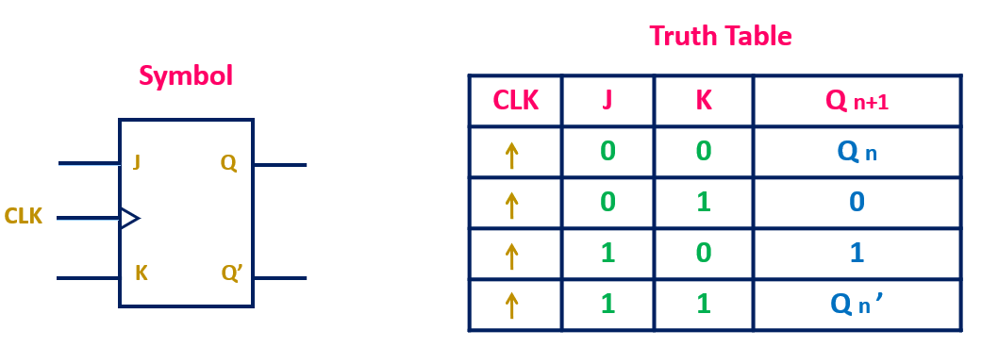
Working
  By Default the inputs fed to JKFF 1 is J = 1 and K = 1. Clock is assigned by the LEVEL SELECTOR which intact given by the user.
Cont…

Slide 15
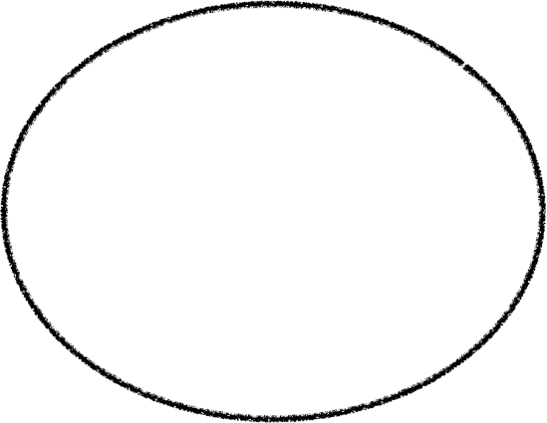
Working
  The output of JKFF1 is connected as the input to JKFF2, further the outputs of JKFF1 and JKFF2 are connected as select lines to the mux(4⤫1).
Cont…

Slide 16
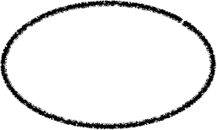
Working
  Similarly, the same outputs of JKFF1 and JKFF2 are connected as inputs to the 2×4 Decoder in order to reflect the input provided by the user at the LEVEL SELECTOR.
Cont…

Slide 17
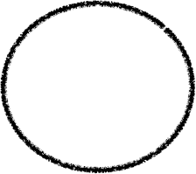
Working
  These float switches are connected to 4⤫1 mux.
  Float switches facilitate automatic tank filling according to the desired input from the user.
Cont…

Slide 18
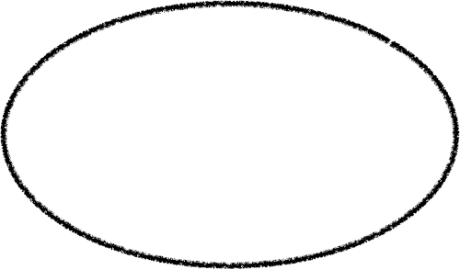
Working
  When the user selects Automatic mode, if the water level drops below a certain threshold (set at 25%), the motor turns on automatically.
Cont…

Slide 19
UPPER THRESHOLD% | LOWER THRESHOLD% | J | K
0 | 0 | 1 | 0
0 | 1 | 0 | 0
1 | 0 | 0 | 1
1 | 1 | 0 | 1
J = Upper Threshold NOR Lower Threshold
K = Upper Threshold

Slide 20
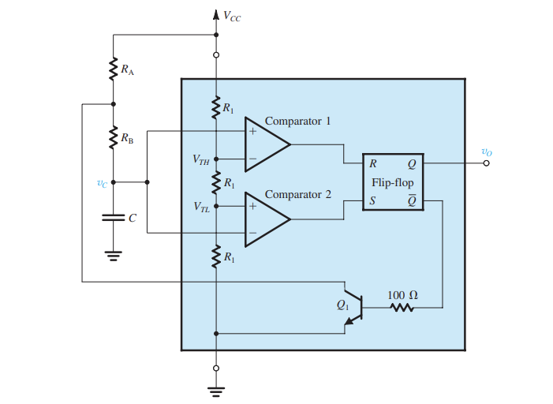
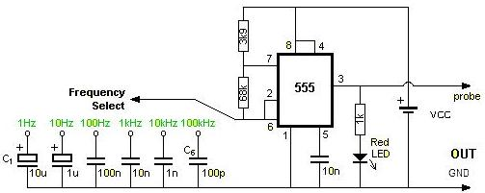

Working
  Theoretical calculation
  T = 0.7 ⤫ (39K + 2(68K)) ⤫ 100n
    T = 0.01225 sec
    f = 81.63 Hz

Slide 21
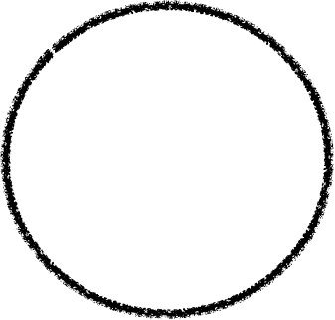
Working
  When the water level falls below 25%, a HIGH signal is fed to the ‘J’ of the JK flip-flop.
  Similarly the output of 4⤫1 is fed to ‘K’ of the JK flip-flop.

Slide 22
Benefits
Improved Efficiency :
Water level control systems optimise water usage by maintaining the desired water level automatically. This ensures that water is not wasted or overused, leading to increased efficiency in water management.
Reduced Waste :
By accurately controlling the water level, these systems prevent overflows and leaks, reducing water wastage. This not only helps conserve water resources but also minimizes water-related damages and costs.
Increased Safety :
Water level control systems ensure the safety of water-related processes and equipment. By maintaining the optimal water level, potential hazards such as flooding, equipment damage, and accidents are prevented, creating a safer environment.

Slide 23
References
  LM555 Timer
  https://www.ti.com/lit/ds/symlink/lm555.pdf?ts=1710064034359&ref_url=https%253A%252F%252Fwww.google.com%252F
  Relay Switch
  https://components101.com/switches/12v-relay
  JK Flip-Flop
  https://www.ti.com/lit/ds/symlink/sn54ls76a.pdf?ts=1710050565943&ref_url=https%253A%252F%252Fwww.google.com%252F
  NOR Gate
  https://www.ti.com/lit/ds/symlink/sn74ahc1g02-ep.pdf?ts=1710149482660&ref_url=https%253A%252F%252Fwww.google.com%252F

Slide 24
References
  NOT Gate
  https://www.ti.com/lit/ds/symlink/sn74lvc1g04.pdf?ts=1710149517735&ref_url=https%253A%252F%252Fwww.google.com%252F
  AND Gate
  https://www.ti.com/lit/ds/symlink/sn74lvc2g08-ep.pdf?ts=1710149410655&ref_url=https%253A%252F%252Fwww.google.com%252F
  4⤫1 Mux
  https://www.ti.com/lit/ds/symlink/sn54als153.pdf?ts=1710149278799&ref_url=https%253A%252F%252Fwww.google.com%252F
  2⤫1 Mux
  https://www.ti.com/lit/ds/symlink/sn74lvc2g157.pdf?ts=1710149327154&ref_url=https%253A%252F%252Fwww.google.com%252F

Slide 25
THANK YOU

