Slide 1
A Deception-Driven Multimodal AI System for Intelligent Scam Detection and Adversarial Engagement
Under the guidance of, Dr. Prajna S
Assistant Professor
Department of computer application
Submitted by, Santhosh G Rao
02JST24PMC041

Slide 2
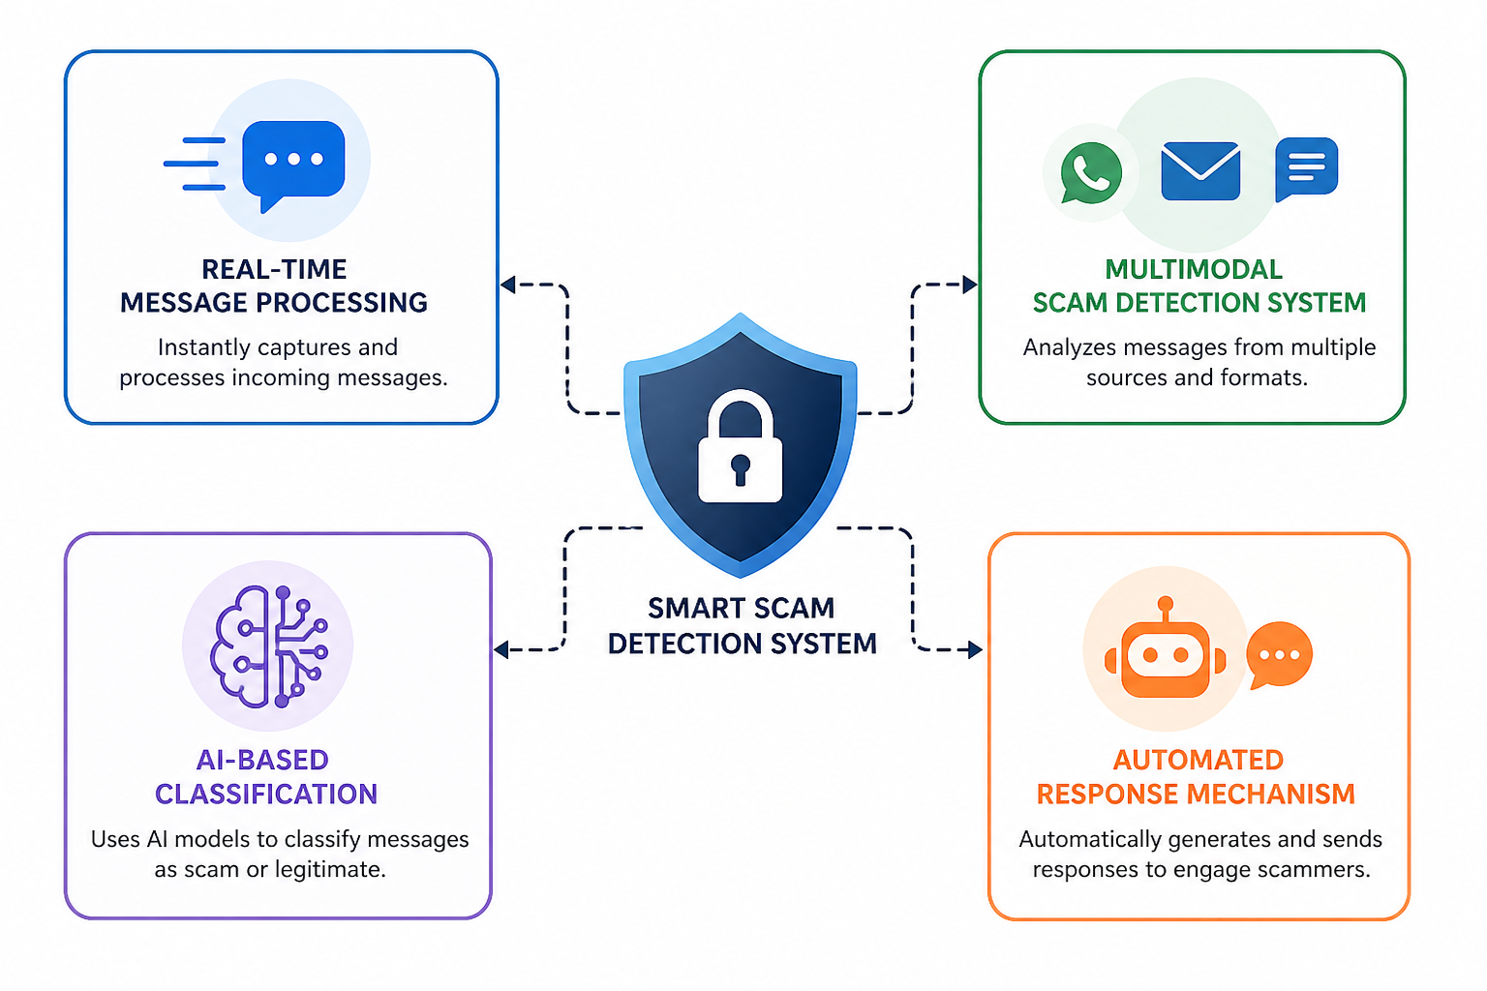
DIGITAL DECEPTION AND MODULES
PAGE 02

Slide 3
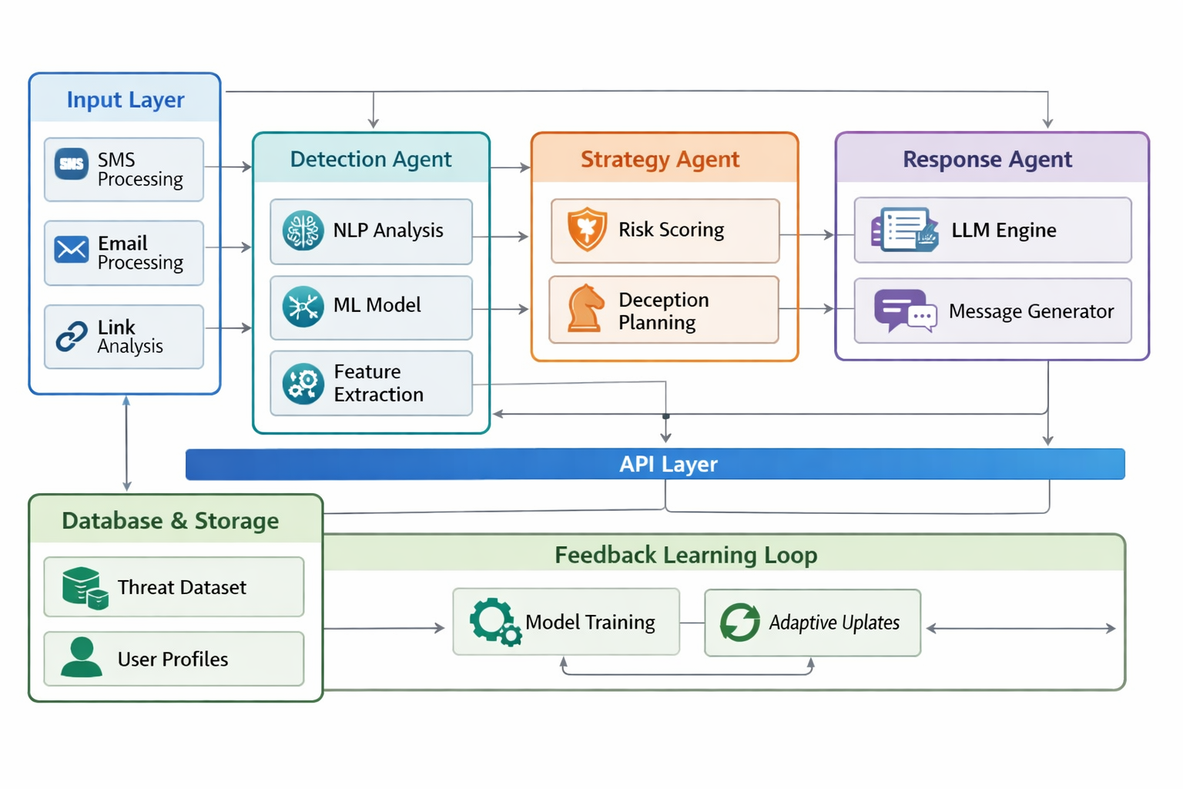
SYSTEM ARCHITECTURE
PAGE 03

Slide 4

INPUT AND ACQUISITION MODULE
Captures incoming messages
SMS → direct access (android.provider.Telephony.SMS_RECEIVED)
Email → API-based
App data → limited access(Through notification listener)
PAGE 04

Slide 5
Text Processing
01
Tokenization & normalization
Stopword removal
URL & keyword extraction
PROCESSING AND AI DETECTION
FEATURE ENGINEERING
02
TF-IDF / keyword patterns
Scam phrase detection
Sender & metadata analysis
AI CLASSIFICATION
03
ML/NLP model (e.g., Logistic Regression / Naive Bayes / LLM)
Confidence scoring
PAGE 05

Slide 6
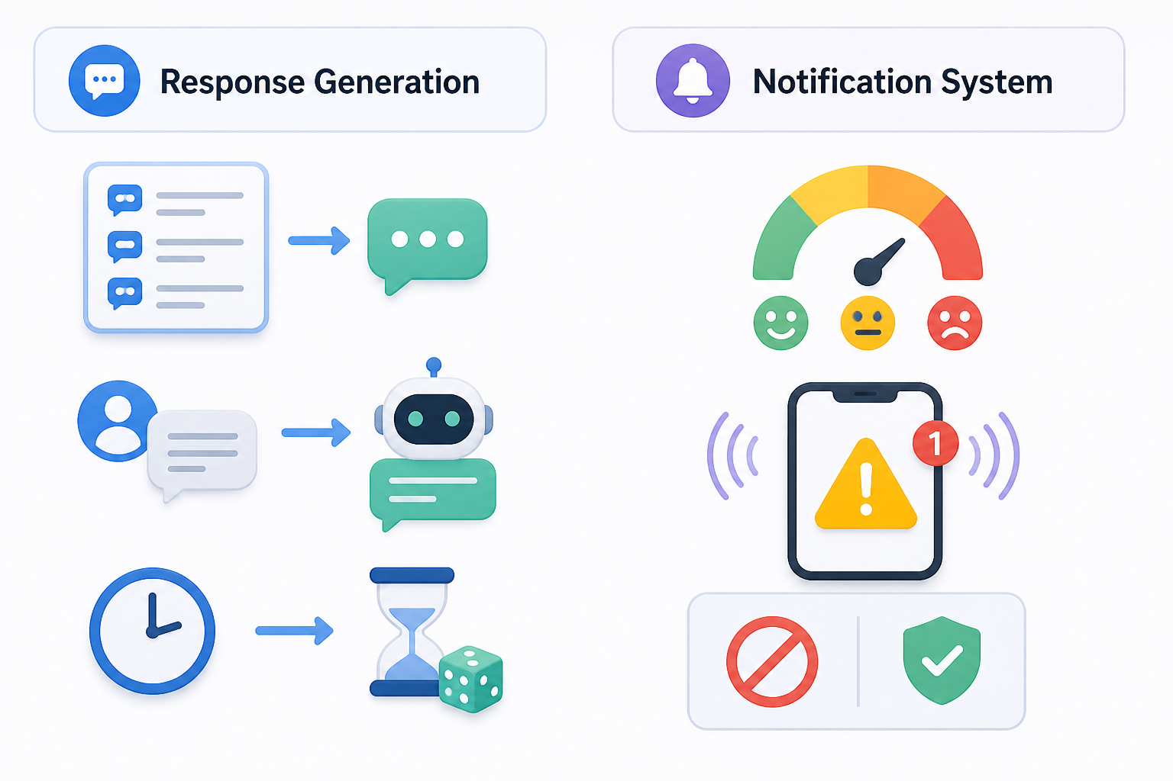
RESPONSE AND NOTIFICATION MODULE
RESPONSE MODULE
01
Rule-based reply templates
Context-aware message generation Delay/randomization (human-like behavior)
NOTIFICATION MODULE
02
Risk score (Low / Medium / High)
Real-time alerts to user Action suggestions (block / ignore)
PAGE 06

Slide 7
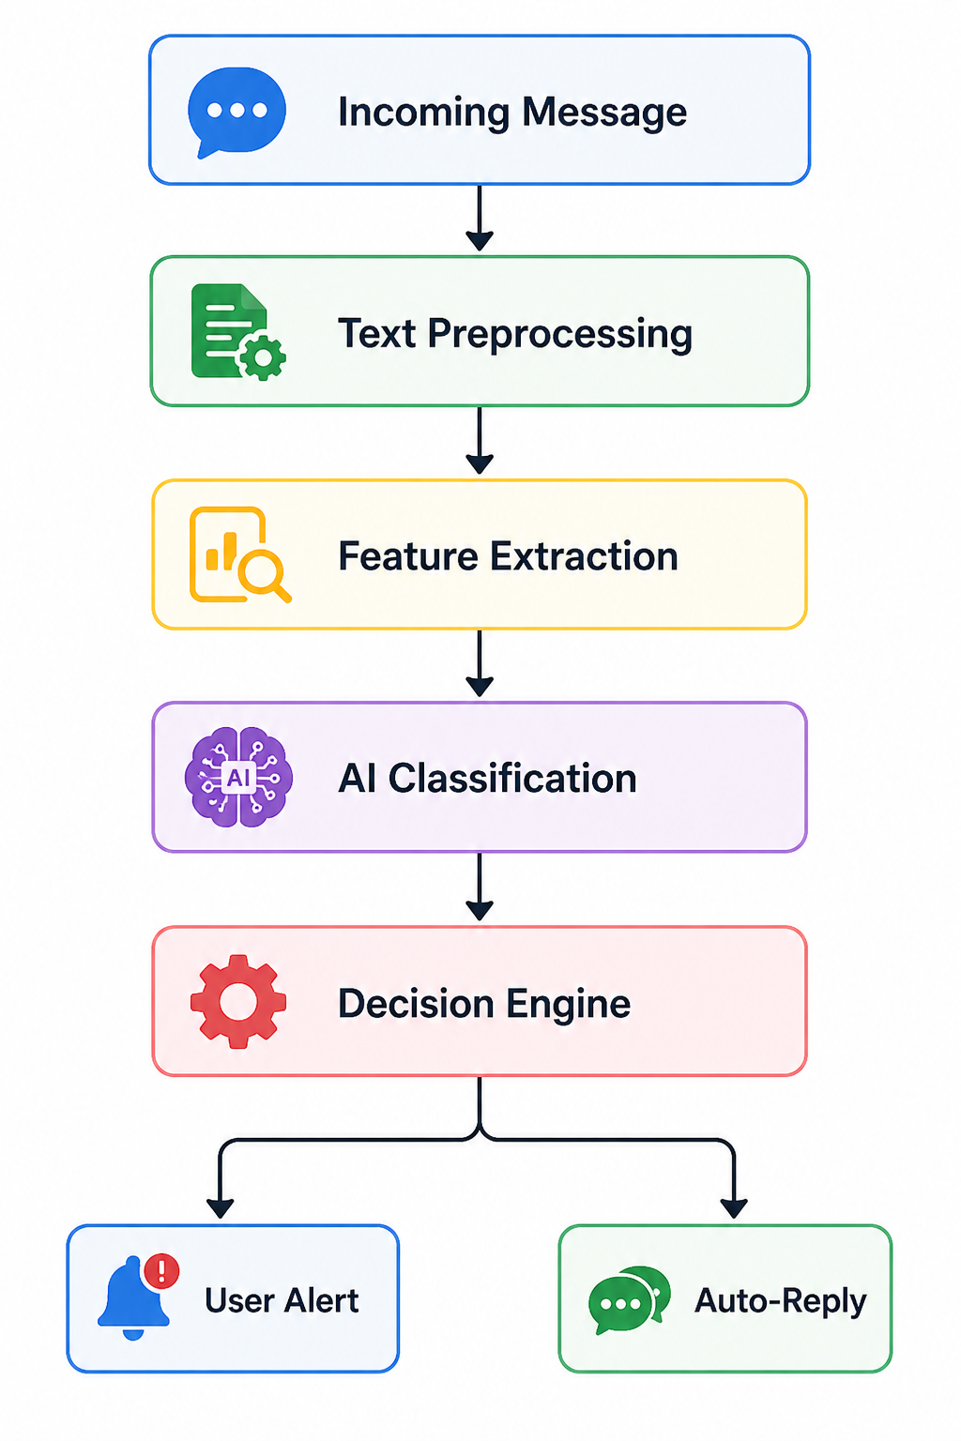
SYSTEM WORKFLOW
PAGE 07

Slide 8
FUNCTIONAL REQUIREMENTS
FR1: System shall capture incoming SMS using OS-level access
FR2: System shall retrieve emails via IMAP/API
FR3: System shall preprocess and analyze message content
FR4: System shall classify messages using ML models
FR5: System shall generate automated responses for scam messages
FR6: System shall notify users with risk levels
PAGE 08

Slide 9
NON - FUNCTIONAL REQUIREMENTS
Performance: < 1 second response time
Security: No storage of sensitive personal data, Secure API communication
Reliability: Continuous background execution
Scalability: Modular architecture supports expansion
PAGE 09

Slide 10
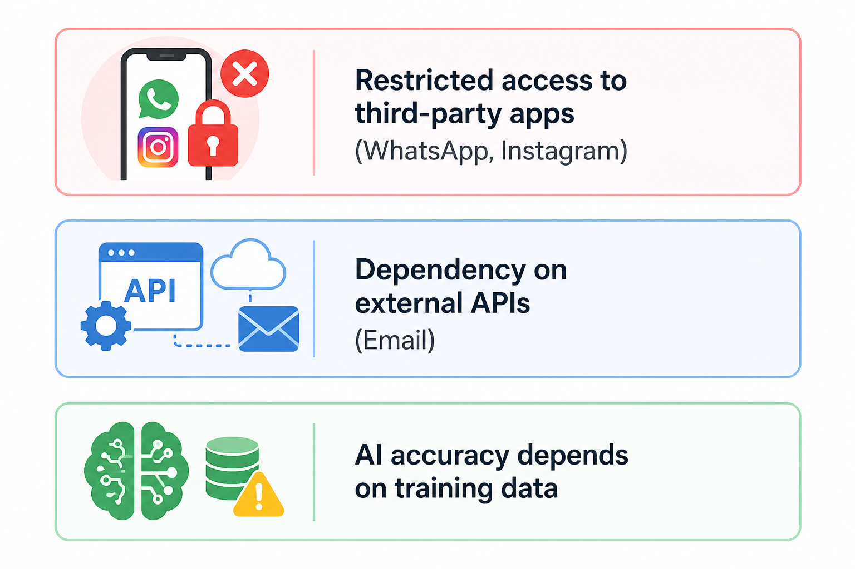
CONSTRAINTS
PAGE 10

Slide 11
PHONE
+123-456-7890
THANK YOU
WEBSITE
www.reallygreatsite.com
EMAIL
hello@reallygreatsite.com
ADDRESS
123 Anywhere St., Any City

