Slide 1
AI Workflows and Agents

Slide 2
Problem Statement
Migrating ETL jobs from low-code tool to AWS Glue jobs
The migrated jobs should replicate all functionalities of the original jobs
The jobs need to be tested against the provided test cases to verify their correctness
Once tested, the jobs should be deployed to AWS Glue
After deployment, a dry run should be performed to verify the deployment

Slide 3
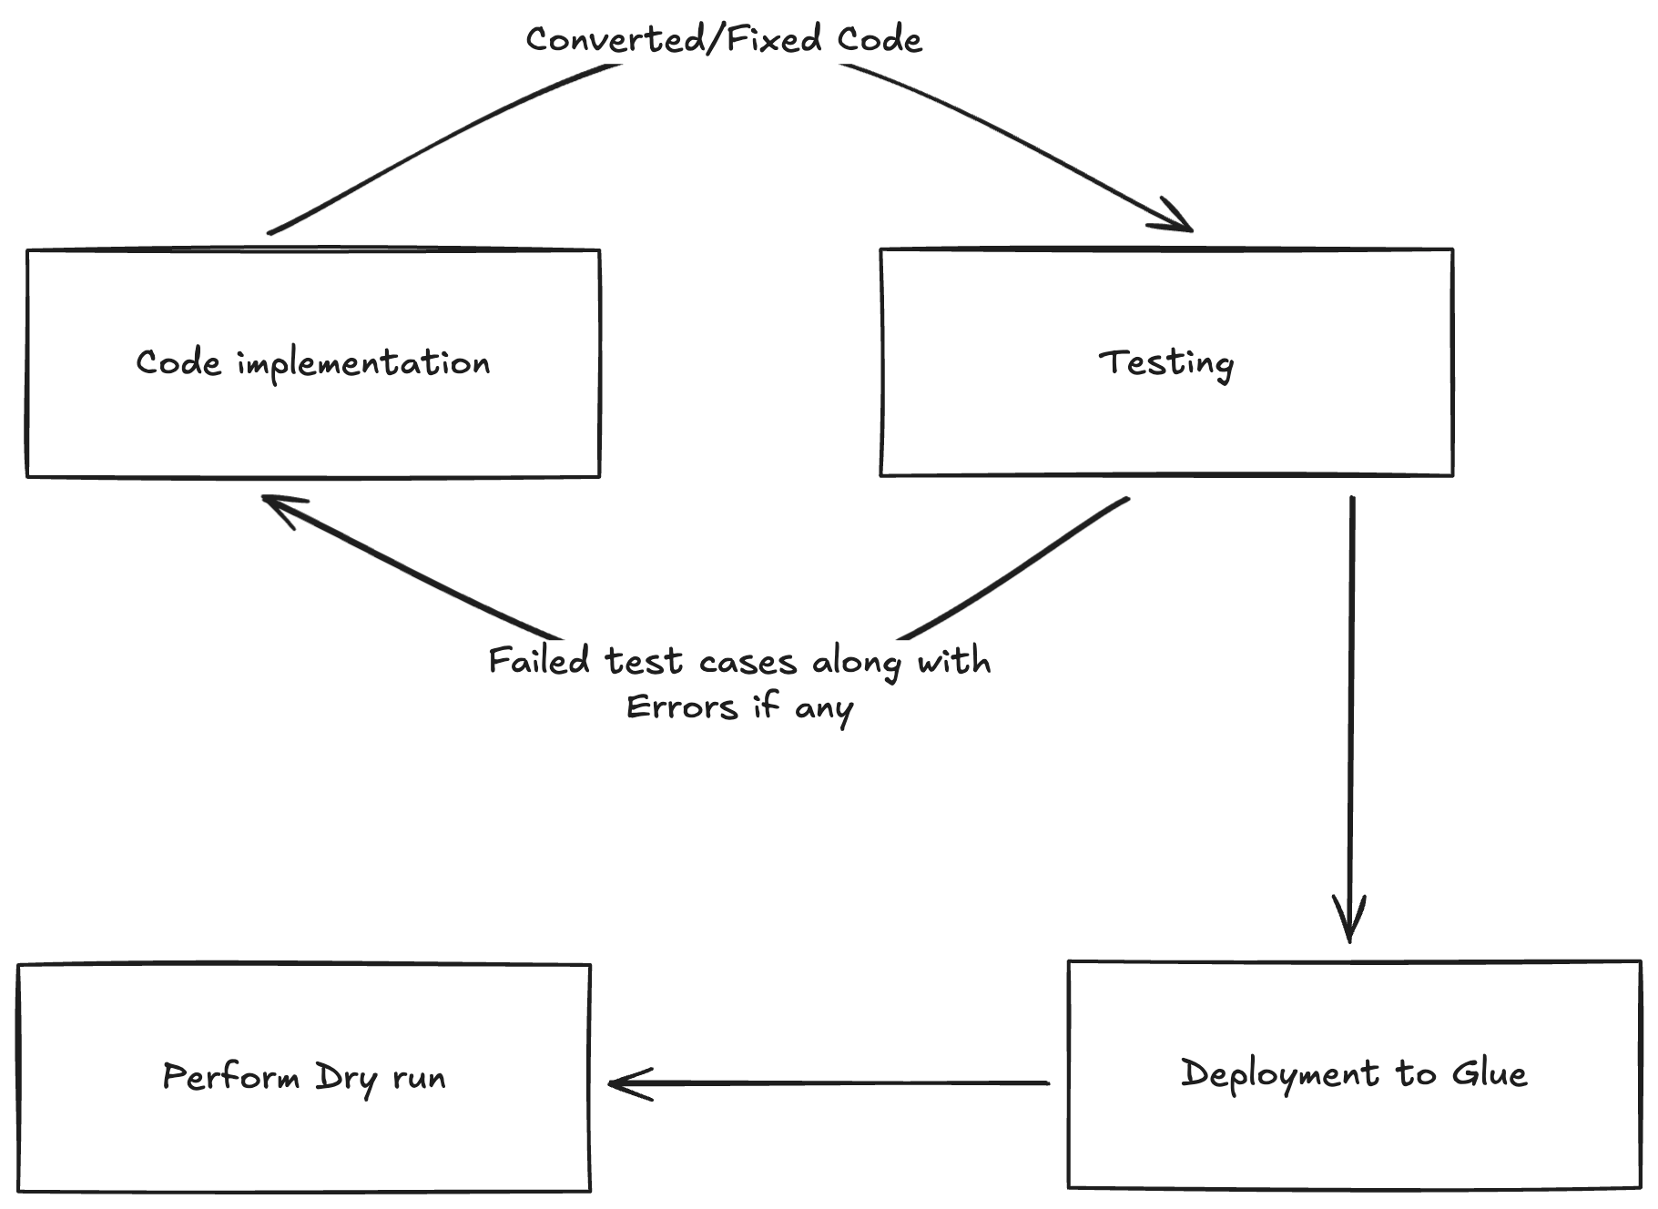
AI Workflow

Slide 4
Limitations of Workflow
All possibilities needs to be predefined (Python or Pyspark job, Error handling)
Cannot perform multi-step reasoning for jobs with complex transformation logic
Tool orchestrator needs to be predefined
Reusability is limited when using with a different low-code tool migration

Slide 5
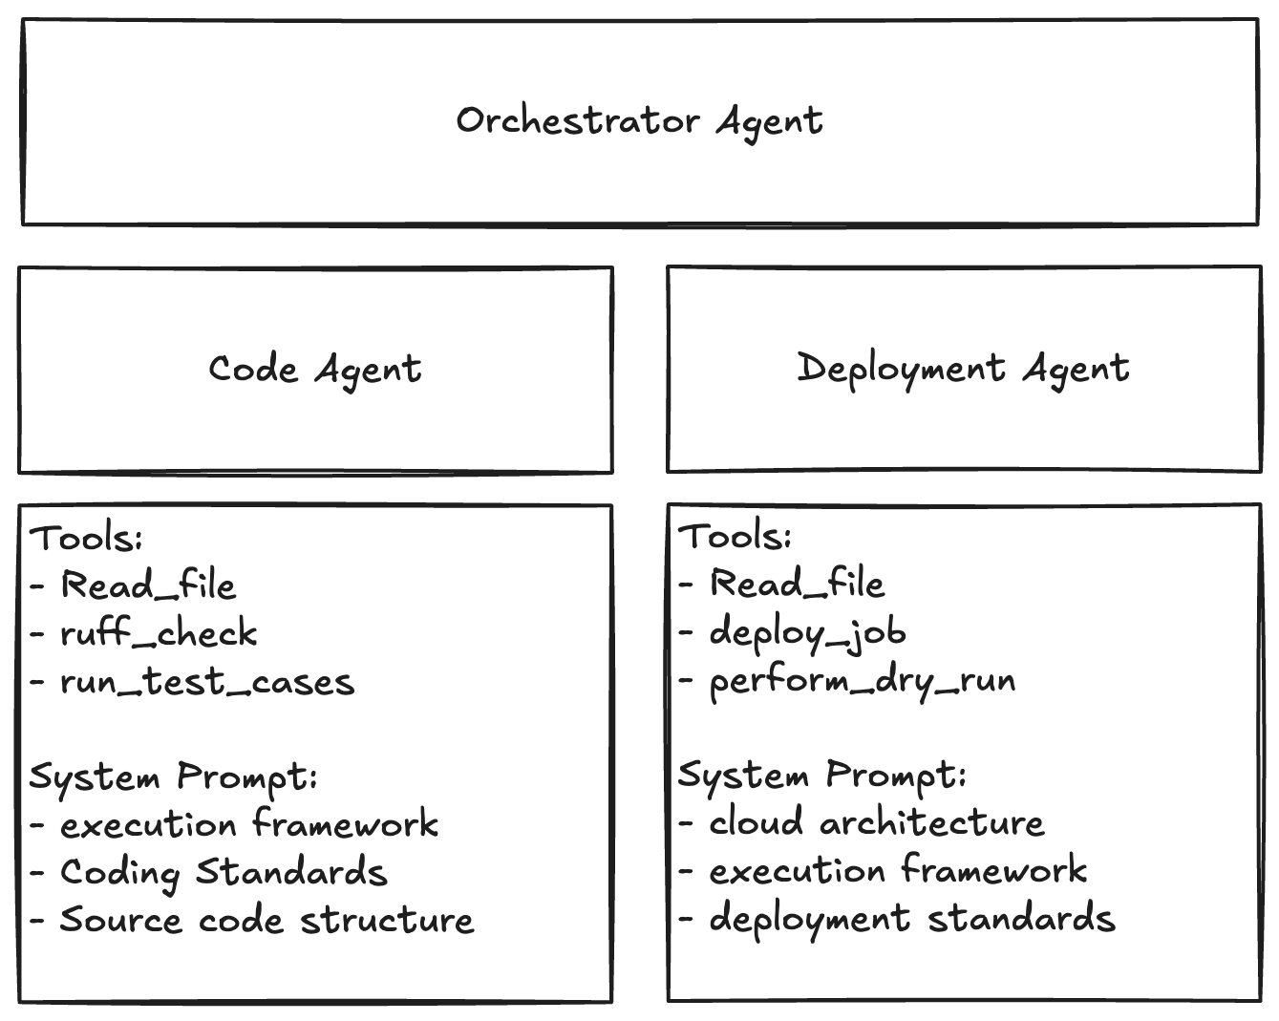
AI Agent

Slide 6
Limitations of Agent
Execution may take a long time
Expensive
Agent may try to over-engineer simple problems
Difficult to debug and monitor the agents

Slide 7
When to Use
Workflows
Task is predictable and easily definable as steps
Need control over execution
Need to be cost-effective
Agents
Tasks are open-ended and exploratory
Human-like reasoning is needed for better output
Adaptability is required

