Slide 1

PORTFOLIO PROJECT
Automated PO Booking
AI-powered purchase order processing and automated registration.
9 automated stages
PDF in, booked PO out
Santhoshkumar | IT
Notes:
Introduce the project: an internal web tool that reads purchase order PDFs and books them automatically.

Slide 2



OVERVIEW
Replaces manual PO entry
Reads the PDF
9
The user drops one PDF. One file can contain several purchase orders.
Checks the data
The agent extracts the details, checks the PO number and validates them.
automated stages from upload to saved booking
Books the order
A work order number is generated and the booking is saved.
Notes:
Explain the before and after: one upload replaces typing PO details by hand.

Slide 3








HOW IT WORKS
Nine stages, one upload
1 PDF uploaded
2 Reading document
3 Extracting details
File accepted, PDF only, up to 10 MB
The agent reads the PO content
Key PO fields are pulled out
4 Generating WO number
5 Checking PO number
6 Validating information
A new work order number is assigned
PO number checked before booking
Extracted data is validated
7 Finding customer
8 Saving
9 Uploading PDF
Customer matched to the record
Booking saved to the database
Source PDF stored with the booking
Notes:
Walk through the nine stages the user sees on the live progress screen.

Slide 4
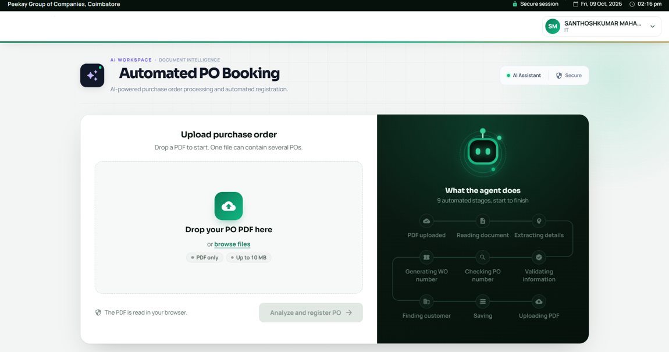
STEP 1
Upload the PO
Drop the PDF or browse for it
PDF only, up to 10 MB
One file can contain several POs
The PDF is read in the browser
Notes:
Start screen: drop zone on the left, the agent's stages on the right.

Slide 5
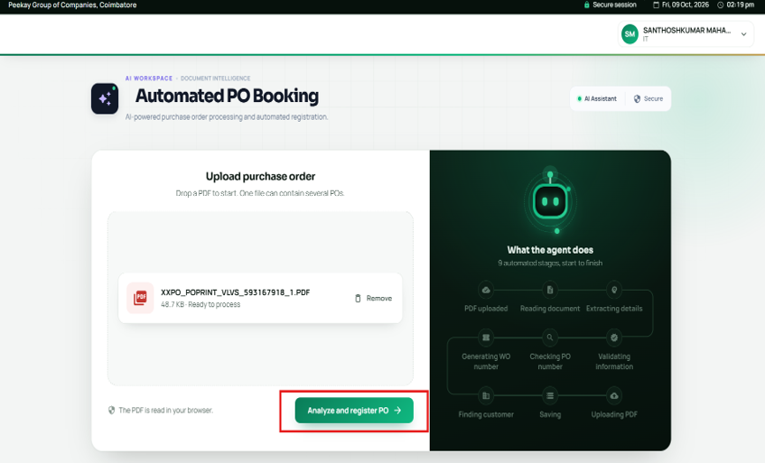
STEP 2
Ready to process
File name and size are confirmed
Remove the file if it is the wrong one
One action starts the run: Analyze and register PO
Notes:
The file is staged. A single button starts the whole pipeline.

Slide 6
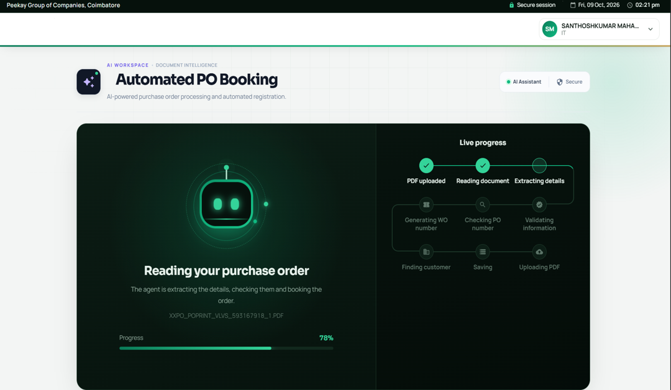
STEP 3
Live progress
Progress bar shows the percentage
Stage tracker ticks off each step as it finishes
Current file name stays visible
Notes:
The user can watch the agent work through the stages instead of waiting blindly.

Slide 7
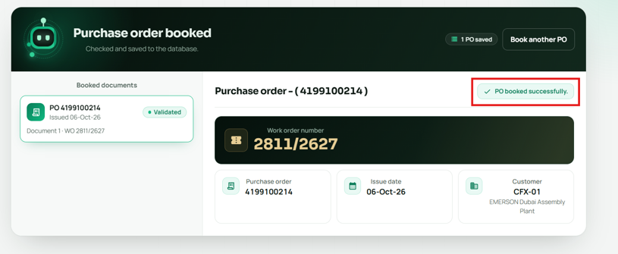
STEP 4
Booked and numbered
Confirmation: PO booked successfully
Each PO is listed and marked Validated
Work order number shown prominently
Customer matched, then Book another PO
Notes:
Result screen: the booking is saved and the work order number is ready to use.

Slide 8

SUMMARY
From PDF to saved booking in one run
Faster entry
Checked data
Ready to use
One upload replaces typing PO details by hand.
PO number and information are validated before saving.
A work order number is generated and stored with the PDF.
Notes:
Close with the three outcomes and invite questions.

