Slide 1

PORTFOLIO PROJECT
Fettling IMF Area QR Scanner
Operators scan in at a booth and every job is tracked live.
Scan. Select. Track.
QR scanning in the fettling area
Santhoshkumar | IT
Notes:
Introduce the project: operators in the fettling IMF area scan a QR code or heat number on a phone, choose the work type, and the job is timed and tracked on a live shop floor dashboard.

Slide 2
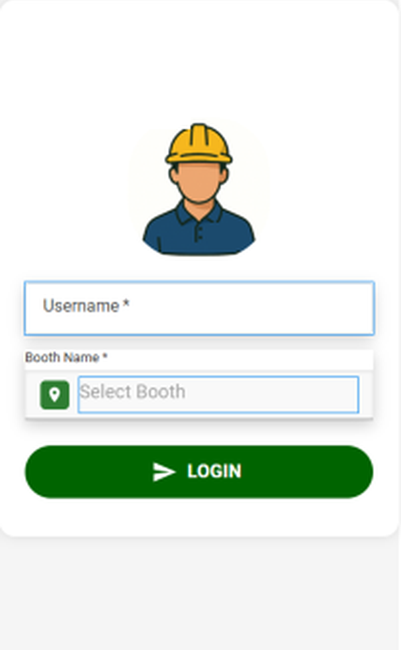
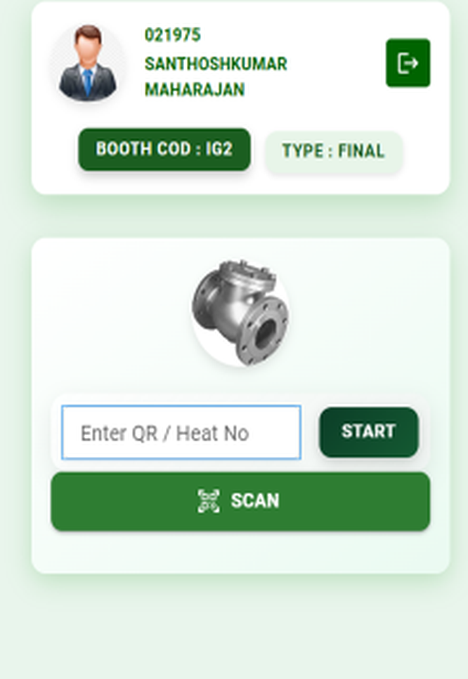
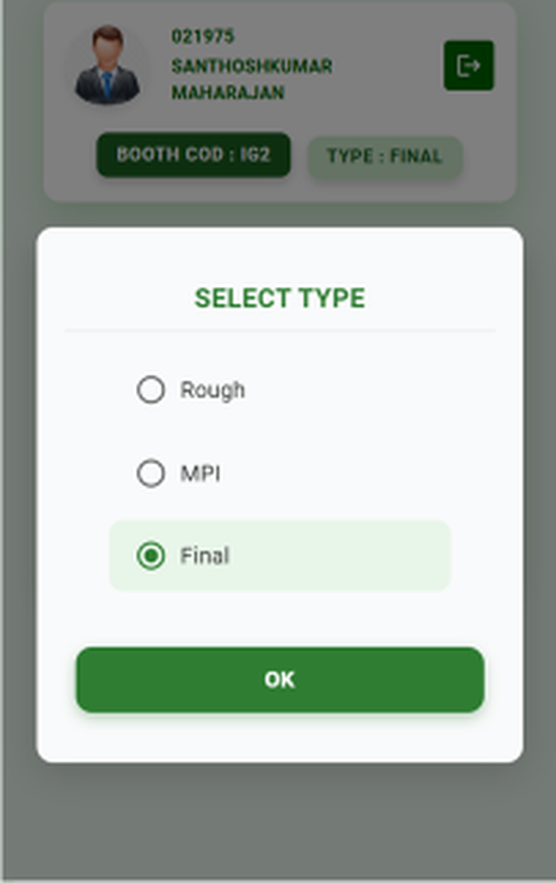
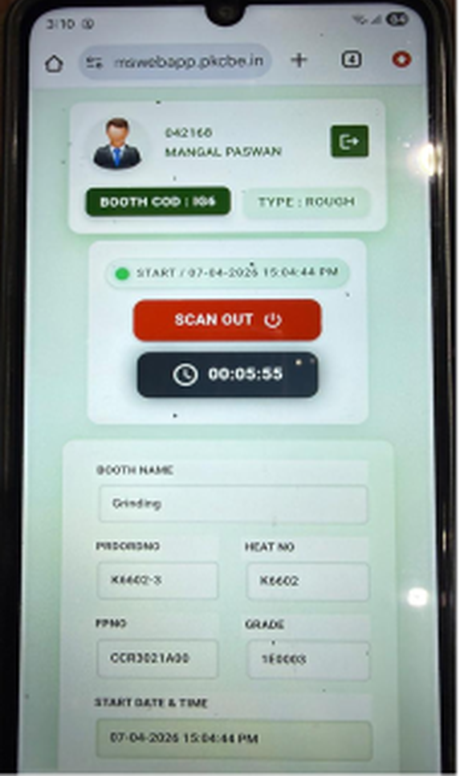
OPERATOR FLOW
From login to running timer
1 Login
2 Scan QR
3 Select type
4 Live timer
Notes:
The operator logs in and picks a booth, scans the QR or types the heat number, selects Rough, MPI or Final, and the timer starts with a Scan Out button.

Slide 3
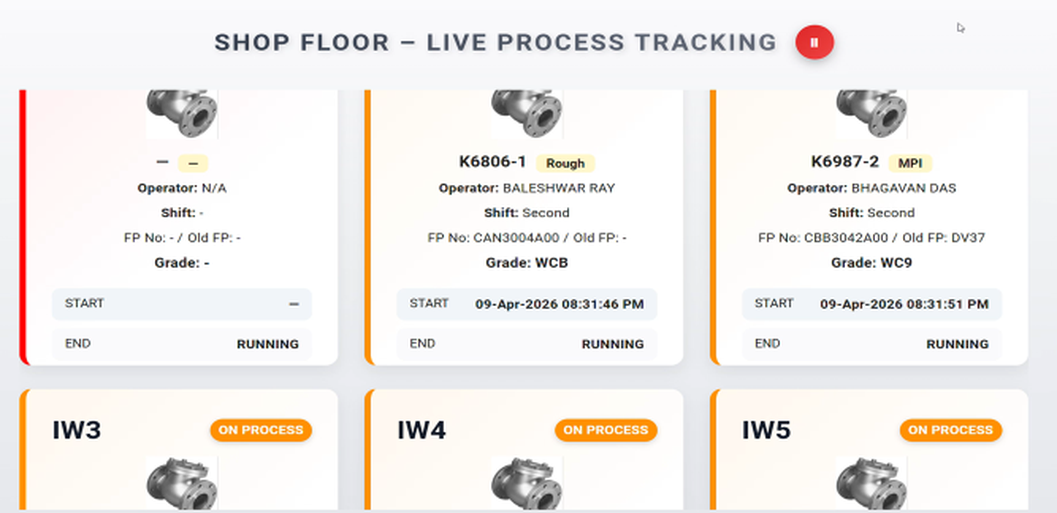



LIVE TRACKING
Live process tracking
Station cards
Each card shows part, operator, shift and FP no.
Start and status
Start time and a Running status show for every job.
Clear status
Stations on process are marked at a glance.
Shop floor dashboard, live view.
Notes:
The dashboard shows one card per station with part, operator, shift, FP number, grade, start time and running status.

Slide 4
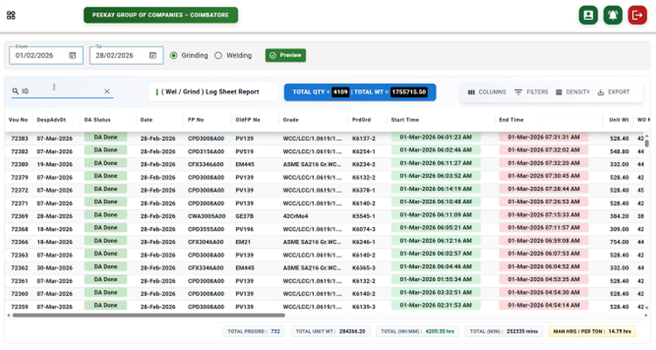



REPORTS
Live tracking reports
Date and operation
Pick a date range and Grinding or Welding.
Log sheet
Each job lists FP no., grade, start and end time.
Totals and export
Quantity and weight totals, with filters and export.
Grinding and welding log sheet report.
Notes:
The log sheet report lists every job with its times and totals for quantity and weight. Columns, filters and export are available.

Slide 5


SUMMARY
Scan, track, report
Scan at the booth
Tracked live
Reported
QR or heat number starts the job on a phone.
A shop floor dashboard shows every station.
Log sheets with totals and export.

