Slide 1
MPI Document Automation
CASE STUDY · DIGITALIZATION
A digital-first approach to accurate and traceable Magnetic Particle Inspection.

Slide 2
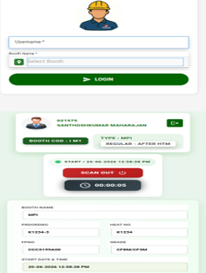
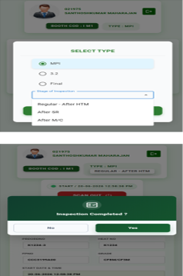
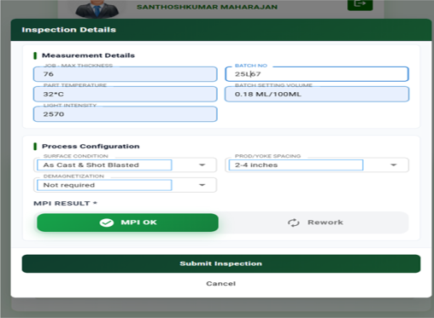
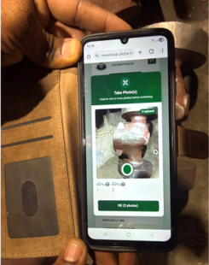
Inspection data captured on mobile
01
02
03
04
Login & select type
Choose inspection
Enter inspection details
Capture image
Log in and select the required MPI process.
Select inspection type and stage.
Enter measurement and process details, then submit.
Capture casting photo(s) at the inspection point.
MPI Document Automation
2

Slide 3
What the digital workflow delivers
Faster documentation
Accurate & traceable
Smart automation
Less manual paperwork and faster reporting.
Photo evidence helps locate defects precisely.
Mobile data supports consolidated documentation.
MPI Document Automation
3

