Slide 1

MACHINE SHOP DIGITALIZATION
Machine Cell Operations Center
Scan-in job tracking and a live dashboard for CNC and machining cells.
17 machines
Live status, one screen
Santhoshkumar | IT
Notes:
Machine shop digitalization: operators scan in and out of jobs, and supervisors watch every machine on one live dashboard.

Slide 2





OPERATOR FLOW
From login to live job tracking
1
2
3
4
Scan In
Select Process
Live Timer
Scan Out
Operator enters their Podium ID and the assigned machine is detected.
The QR scanner opens, the operator selects the process and starts the job.
Job details show and a running timer tracks the job.
One tap logs the end time and frees the station for the next job.
Notes:
Four steps: scan in, select the process, run the live timer, scan out.

Slide 3
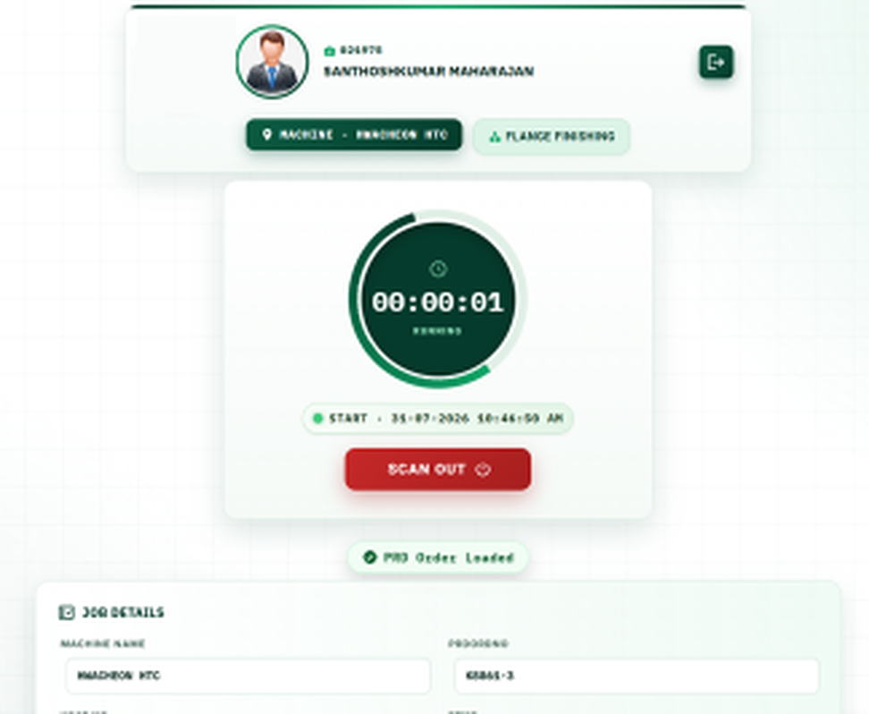
JOB SCREEN
Every job carries full context
Machine, production order, heat number, grade and FP number fill in the moment the QR is scanned. No manual entry.
Start time and a live timer give supervisors an accurate record of cycle time.
One Scan Out completes the loop and the system is ready for the next casting.
Notes:
The job screen shows operator, machine, process, a running timer and the job details pulled in from the scan.

Slide 4
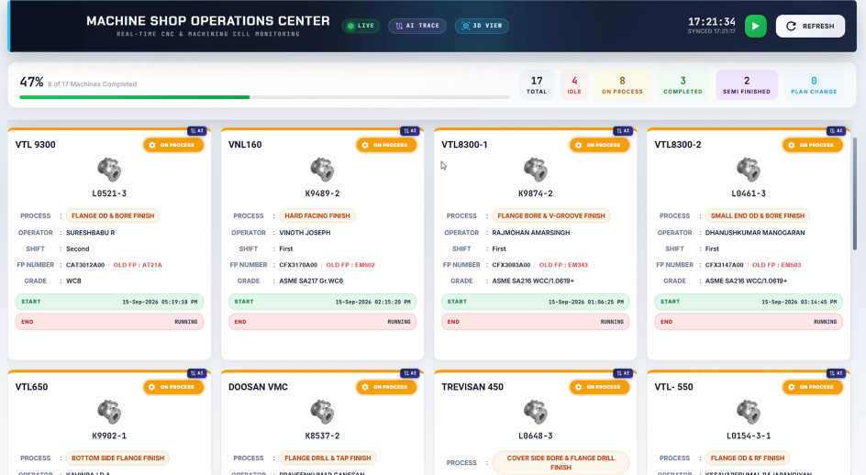



SUPERVISOR VIEW
Machine Cell Operations Center
Live machine status
All 17 machines show a live, colour-coded status.
Operator accountability
Operator, shift and job tied to each running machine.
Instant escalation
Idle capacity is spotted immediately, not at shift end.
Notes:
The dashboard shows total, idle, on process, completed and semi finished machines, with a card for each machine.

Slide 5


SUMMARY
Scan in, track live, scan out
Scan in and out
Live dashboard
Full job context
One scan starts the job and one ends it.
Every machine and its status on one screen.
Order, heat, grade and FP number fill in automatically.

