Slide 1

PORTFOLIO PROJECT
Pattern Shop QR Scanner
Scan a pattern QR code to find it and update its record from the shop floor.
Scan. Find. Update.
Paperless pattern control
Santhoshkumar | IT
Notes:
The pattern shop QR scanner replaces paper notes and manual searching with a phone scan.

Slide 2
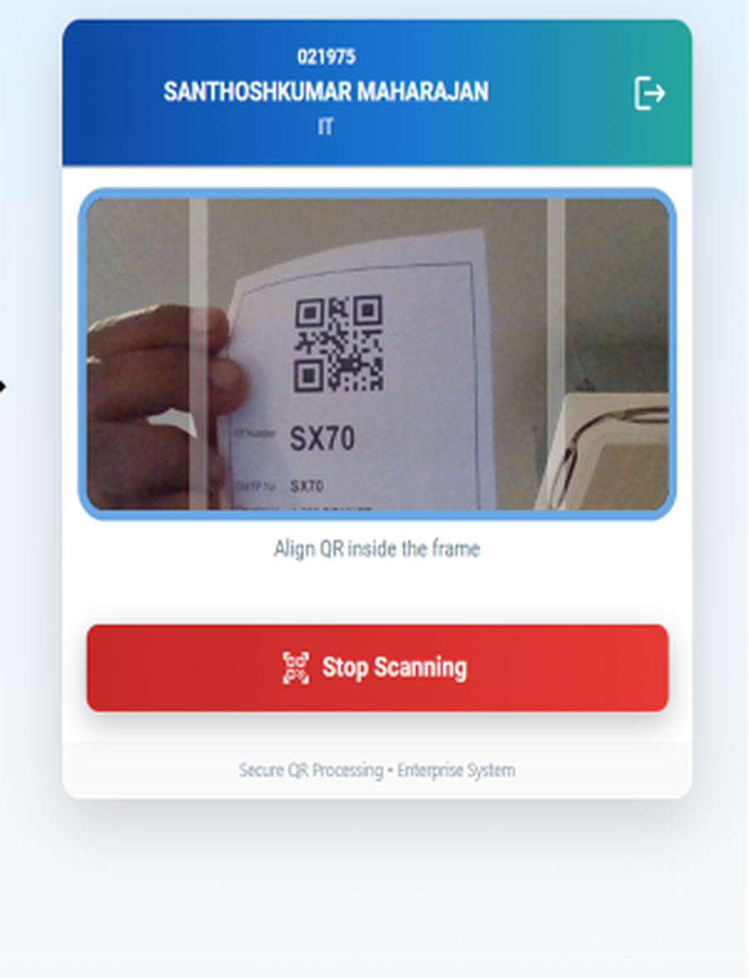
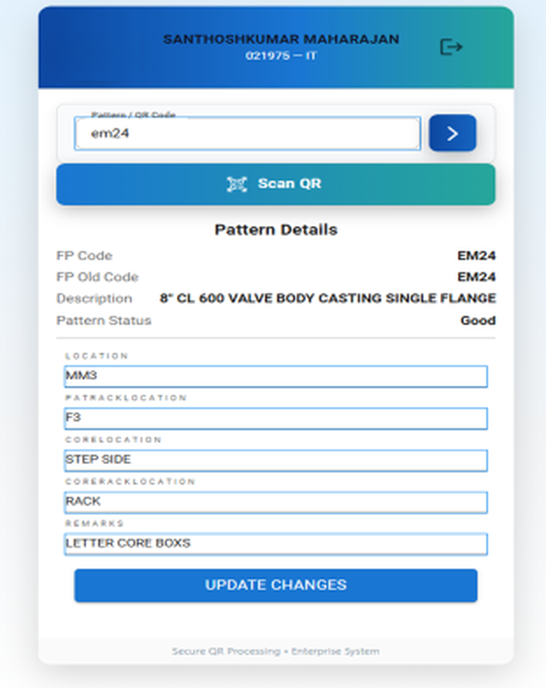
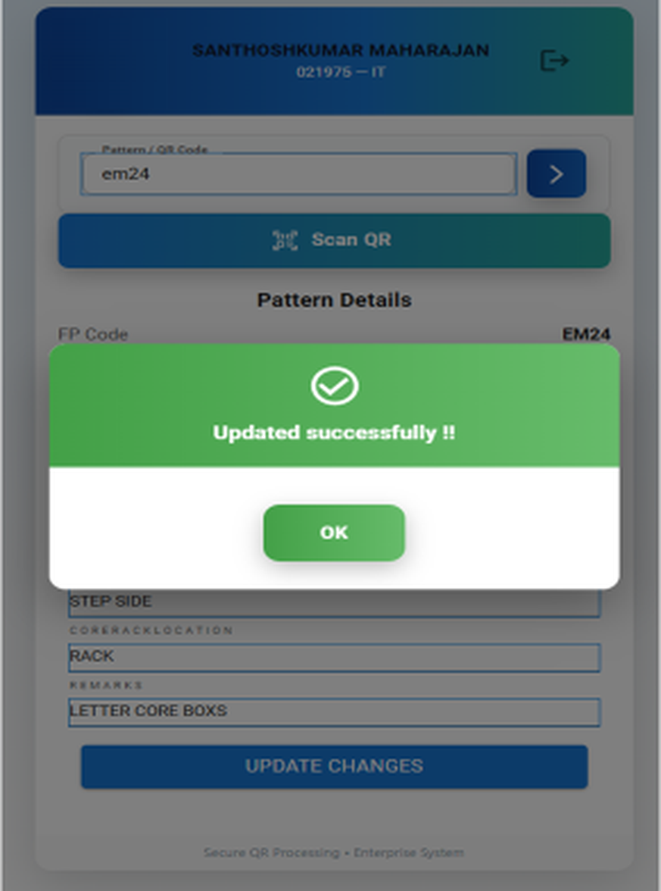
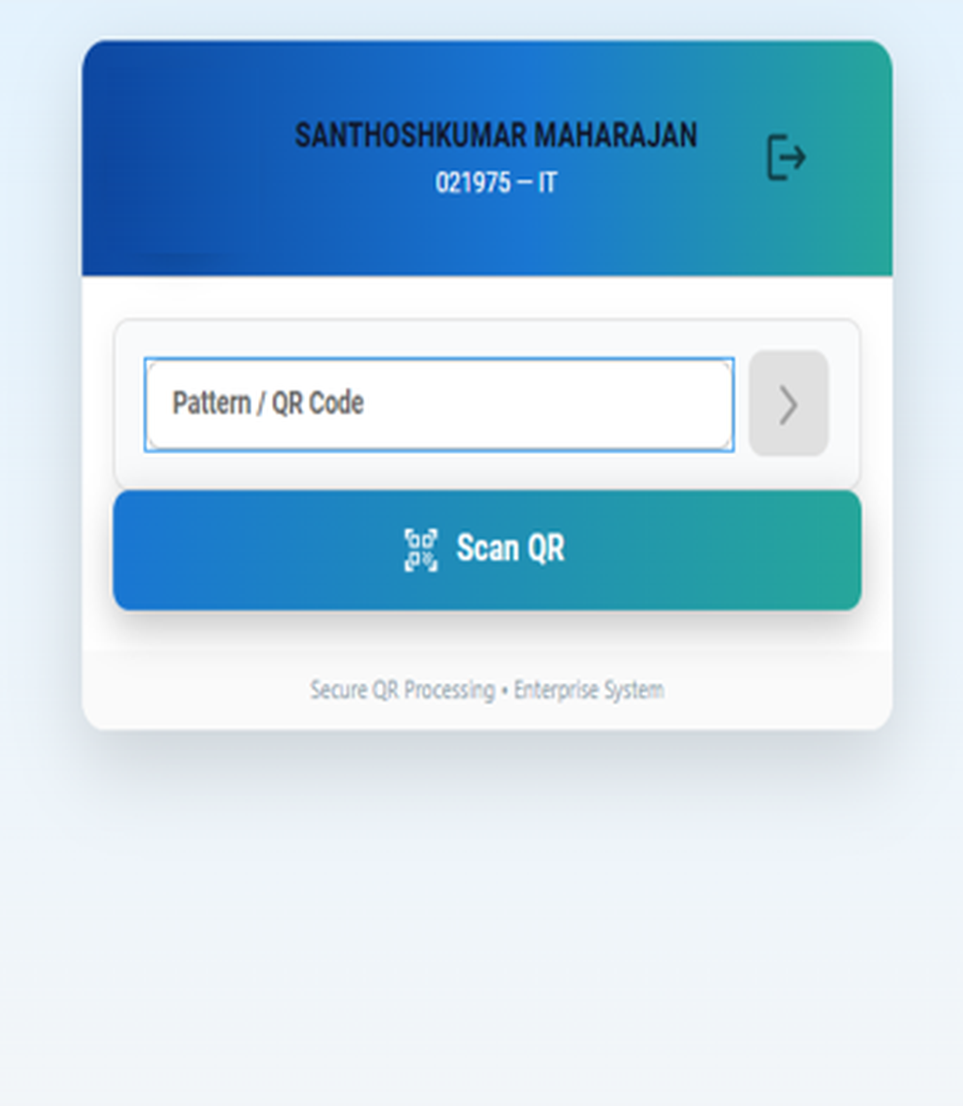
HOW IT WORKS
Scan, check, update
1 Scan QR
2 Align the code
3 Pattern details
4 Updated
Notes:
The operator enters or scans a pattern QR code, aligns the code in the frame, sees the pattern details, edits the location fields and taps Update Changes. A confirmation appears.

Slide 3
SPEED AND EFFICIENCY
Pattern traceability
BEFORE: MANUAL EFFORT
AFTER: QR-ENABLED TRACKING
~100 min / day
In seconds
spent tracing patterns
to locate a pattern
About 1 minute to trace each pattern
100+ patterns every day
Heavy dependence on manual search and operator effort
Instant pattern identification by QR scan
Zero search time
Effortless tracking across the shop floor
About 100 minutes a day saved
Notes:
Tracing took about a minute per pattern across 100+ patterns a day, roughly 100 minutes daily. With QR scanning a pattern is located within seconds.

Slide 4
ACCURACY AND REAL-TIME CONTROL
Pattern master update
BEFORE: MANUAL PROCESS
AFTER: DIGITAL WITH QR SCANNER
Paper first
Real time
system updated later
updated from the shop floor
Pattern details and location noted on paper
High risk of errors and missing data
No real-time view of pattern condition
Direct system update using QR scan
No delay, no backlog
Completely paperless
Instant status update: Good / Bad
Notes:
Before, details were written on paper and entered later. Now the update is made directly on the shop floor and the pattern status changes instantly.

Slide 5



SUMMARY
Faster, accurate, paperless
~100 min saved daily
Real-time updates
Paperless process
Patterns are located in seconds, not minutes.
Records change the moment a pattern is scanned.
No paper notes and no later data entry.

