Slide 1

PORTFOLIO PROJECT
StageWise Product Image
Upload product photos from the shop floor and view them in the FMS web app.
Capture. Save. Search.
Mobile photo to PDF in FMS
Santhoshkumar | IT
Notes:
Introduce StageWise Product Image: staff take photos at each production stage on a phone, and the photos are saved as a PDF that anyone can search and open in the FMS web app.

Slide 2





OVERVIEW
From phone camera to FMS
Login
Capture
Save as PDF
View in FMS
Sign in on the mobile web app.
Find the job, pick the process, take photos.
Photos are merged into one PDF and saved to the server.
Open the FMS web app and search for the PDF.
Notes:
Four steps: login, capture, save as PDF, view in FMS.

Slide 3
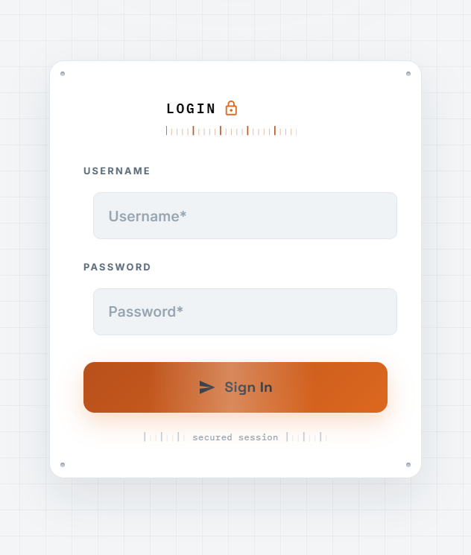
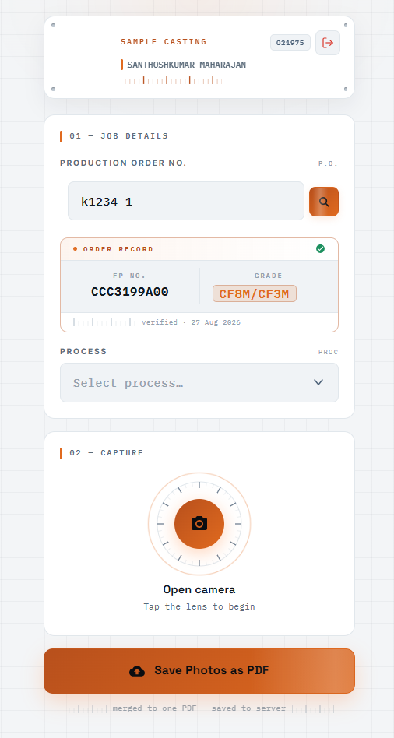
STEP 1 | LOGIN
Sign in and open the camera
Sign in with username and password
The job screen opens with the signed-in user shown
Tap the lens to open the camera
Login
Open camera
Notes:
Login screen on the left, the capture screen with the camera lens on the right.

Slide 4
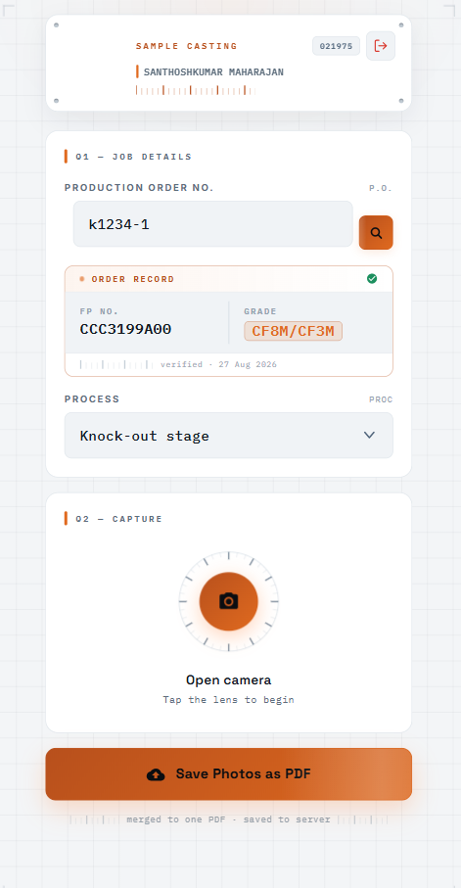
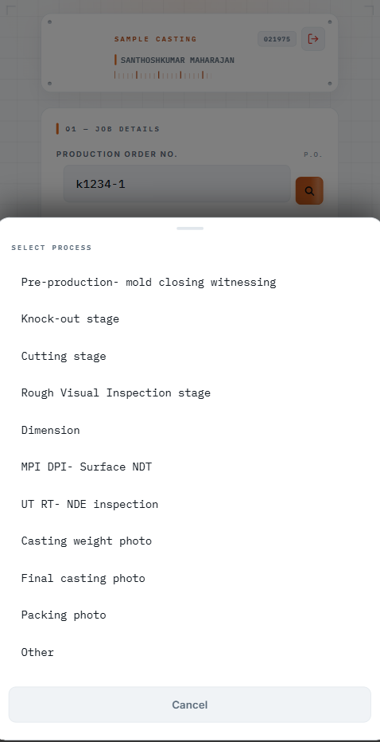
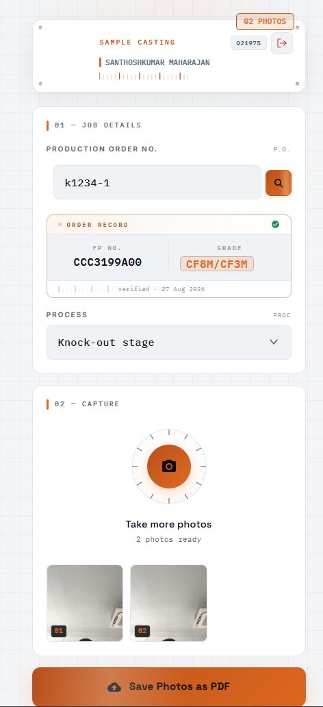
STEP 2 | CAPTURE
Job, process, photos
1 Check FP no. and grade
2 Select process
3 Save photos as PDF
Notes:
Enter the production order, confirm the FP number and grade, choose the process stage, take photos and save them as one PDF.

Slide 5
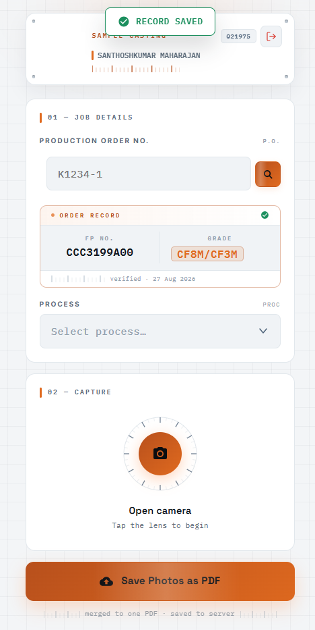
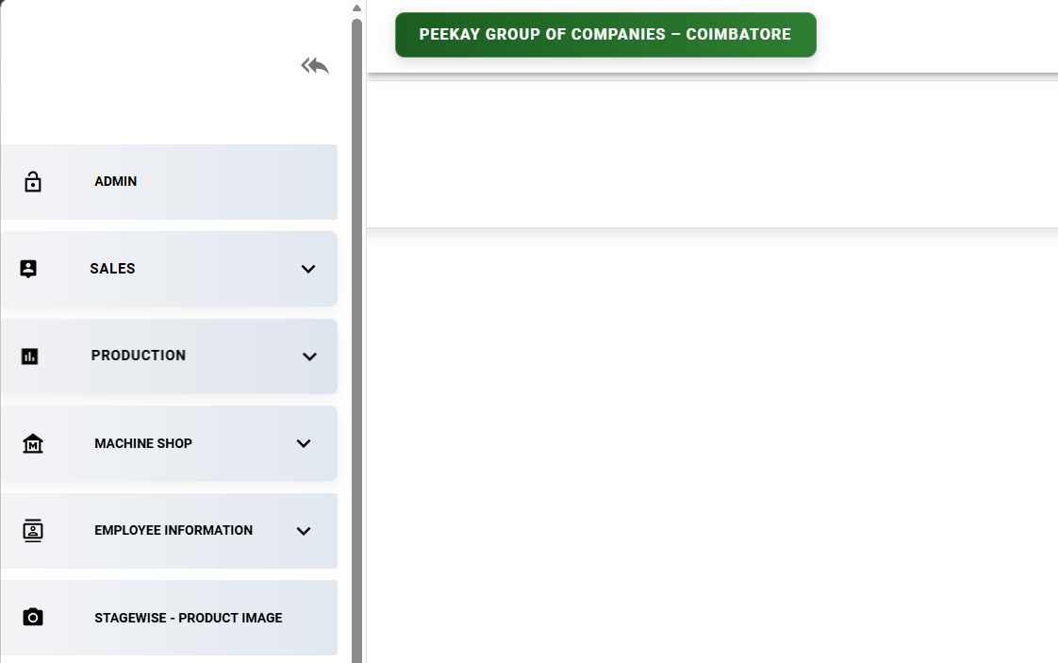
STEP 3 | SAVED
Record saved, then open FMS
Record saved
StageWise - Product Image menu in the FMS web app
Notes:
After saving, the confirmation appears. The PDF is then available from the StageWise - Product Image menu in the FMS web app.

Slide 6
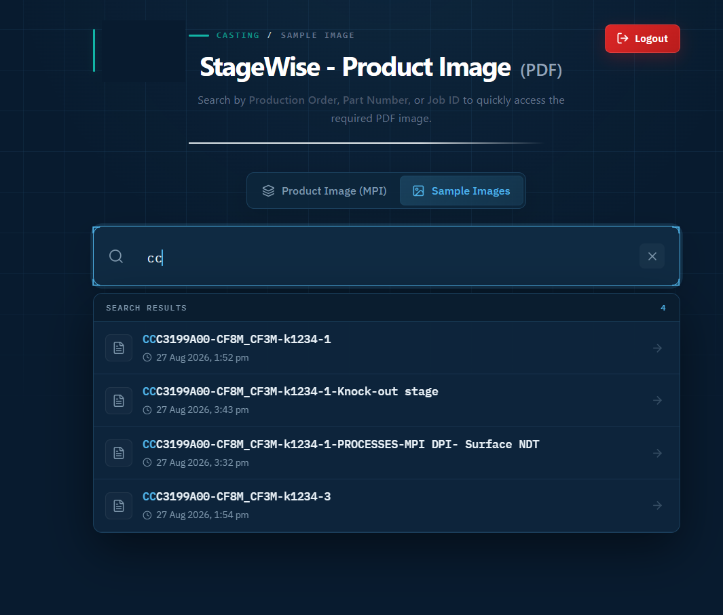
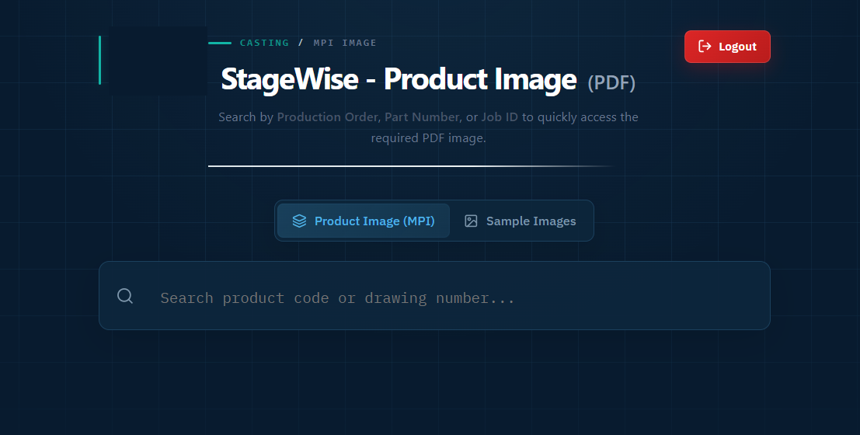
STEP 4 | SEARCH
Search the saved PDFs
Search by
FP no.
Grade
Process
Production order
Notes:
Search the saved PDFs by FP number, grade, process or production order. Matching records list as you type.

Slide 7
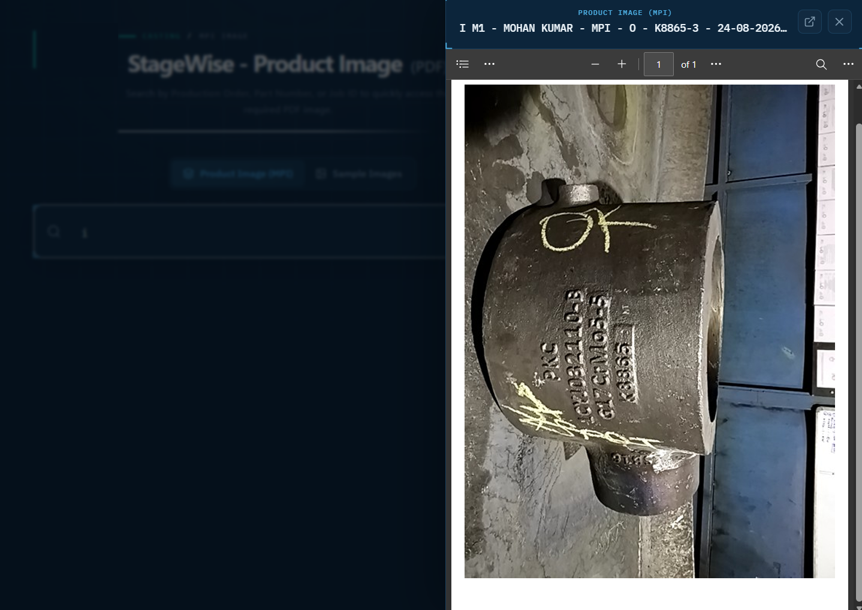
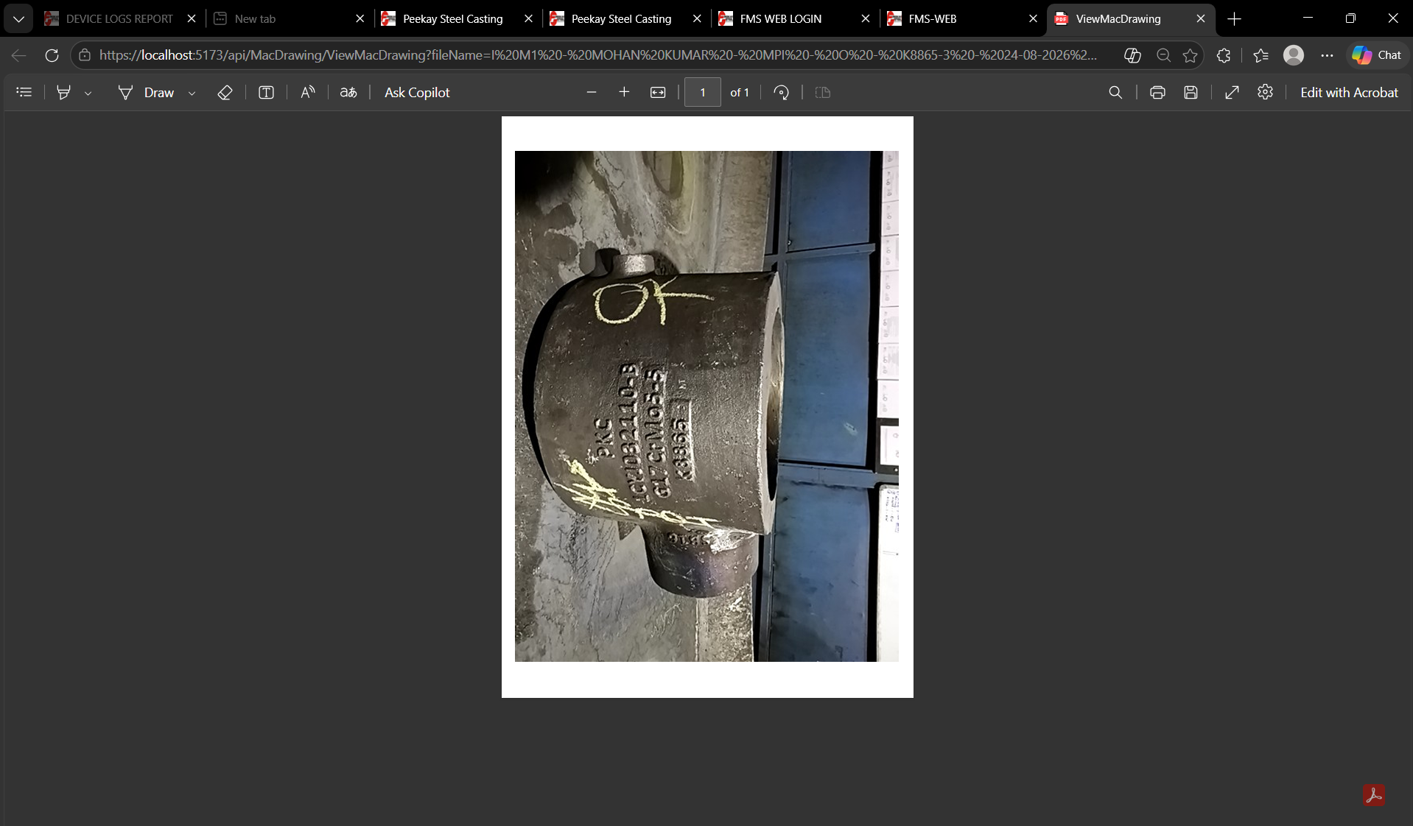
STEP 5 | VIEW
Product image opens as a PDF
Preview inside FMS
Full view in the PDF viewer
Notes:
Selecting a record opens the saved product image as a PDF, first as a preview, then in the full PDF viewer.

Slide 8


SUMMARY
Photo to searchable PDF
Captured on mobile
Saved as one PDF
Found in FMS
Photos are taken against the job and process stage.
Photos are merged and stored on the server.
Search by FP no., grade, process or production order.
Notes:
Close with the three outcomes.

