Slide 1
Radial Stacked Bar Chart Using Tableau
Presented By:
Santhosh Kumar Thadka
44599:Introduction to Data Visualization
April 13, 2017

Slide 2
Outline
What is a Radial stacked bar chart?
Tableau
Features
Steps to use Tableau
Goals
Sample data set
Demonstration
Pros and Cons
Lessons learned

Slide 3
What is a Radial stacked bar chart?
A radial variant of stacked bar chart
Ideal for representing various categories in data
Bars are arranged radially in a circle

Slide 4
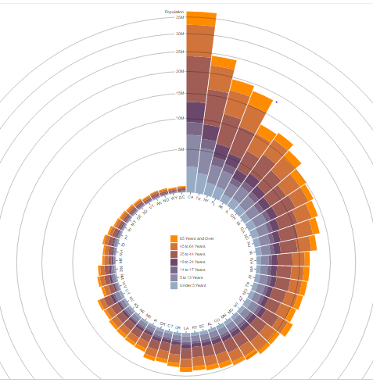
Example
Source: https://bl.ocks.org/mbostock/5479367295dfe8f21002fc71d6500392
Notes:
https://bl.ocks.org/mbostock/5479367295dfe8f21002fc71d6500392
This is an example of radial stacked bar graph representing the population of United States of different age groups.each bar represent each state. Age groups are categorized and colored for each bar..Here by seeing this graph we can conclude that California has the highest population .Wyoming and the district of Columbia are having the lowest population.

Slide 5
Tableau
Tableau is groundbreaking data visualization software created by Tableau Software
It can connect easily to any data source like web based data, excel,etc.,
For the third time, Tableau has been named a leader in the Magic Quadrant for Business Intelligence and Analytics Platforms report by Gartner
Notes:
It is an innovative software created by tableau software
Cons
Need to buy a product key

Slide 6
Features
Easy to learn User Interface
Drag and drop functionality
Can create charts by writing some custom SQL queries
Quickly create interactive dashboards and plots

Slide 7
Steps to use Tableau
Step 1: Download Tableau either with a free trial or purchase using a licensed product key
Step 2: Load data by connecting to the appropriate file format and open it using legacy connection if you need to write some custom SQL queries
Step 3: Add the attributes that define your goal and select an appropriate graph
Step 4: Customize it accordingly
Step 5: Save and Share the results

Slide 8
Sample Data set
Statistical Research
Data Processing
Data Science
Machine Learning
Data set has 21 attributes and 9995 records

Slide 9
Goals
To visualize a Radial stacked bar chart showing sales of different categories of products of various states in the U.S.A in the years 2013 to 2016
Data Source: https://community.tableau.com/docs/DOC-10198

Slide 10
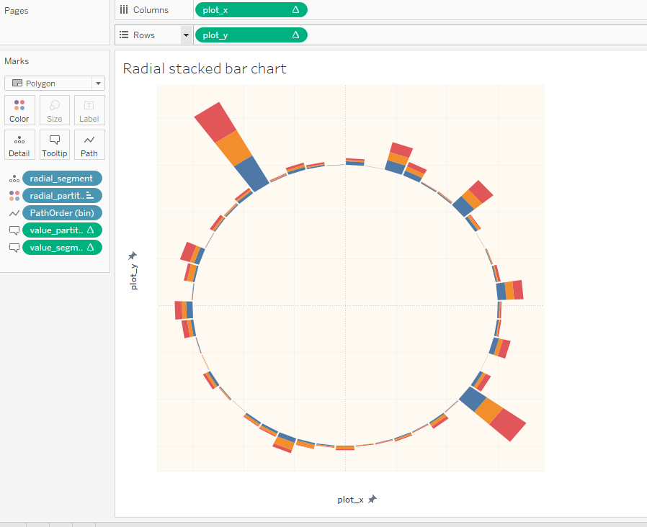
Radial stacked bar chart for the dataset
Fig 1.1 Drawn using tableau

Slide 11

Demonstration
https://www.google.com/search?q=demonstration+icon&source\fsdjf

Slide 12
Pros and Cons
Data that is categorized can be visualized easily using the radial stacked bar graph
There is no large difference between stacked bar chart and radial stacked bar chart
Could not get the full version of the tool unless has a product key

Slide 13
Lessons Learned
Analyze data and get an appropriate chart from it
More familiar with settings in tableau
Significance of other tools
Explored and learned different tools in the process of learning
Notes:
How to analyze the data and filter it
Learned advanced settings in tableau

Slide 14


