Slide 1
Radial Stacked Bar Chart Using Tableau
Presented By:
Santhosh Kumar Thadka
44599:Introduction to Data Visualization
April 13, 2017
Notes:
Hello,
Good Morning everyone I am Santhosh Kumar Thadka and I am here to present on Radial Stacked Bar chart using tableau

Slide 2
Outline
What is a Radial stacked bar chart?
Tableau
Features
Steps to use Tableau
Sample data set
Goals
Demonstration
Pros and Cons
Lessons learned
Notes:
This is the outline and the contents of the presentation that we are going to discuss today
Before I start the presentation can any one say what is a bar chart
It is used to show the comparision between different categories.For example if we consider marks of a student 1 for three subjects ….take Java WebApps HCI java 90% web apps 85% and HCI 80% if we show in the graph ………….show on board……………… so what if I need to show the chart for the whole class consisting of 100 students.It is hard to show on a bar graph.To overcome this we can usie a stacked bar graph or a radial stacked bar graph
we can visualize them easily and we can give a conclusion

Slide 3
What is a Radial stacked bar chart?
A radial variant of stacked bar chart
Ideal for representing various categories in data
Bars are arranged radially in a circle
Notes:
It is a radial version of the stacked bar graph which is circular in shape
This chart is ideal for representing different categories and the bars in this chart are arranged in a circular form

Slide 4
Why radial stacked bar chart ?
Easy to compare different categories of data
Most efficient use of screen space
Aesthetic look of diagrams
Time variable data can be presented in a good manner
Notes:
Radial stacked bar chart is preferable over stacked bar chart when we have more number of records as representing bars in a linear from is difficult
In the same way radial stacked bar chart uses the efficient use of the screen space
As visualization is all about presenting the data in a aesthetic and appropriate manner, the graph does it job
Time variable data can be presented in a good manner
Research also shows that eye tracking is easy when the data is shown in a radial stacked bar chart

Slide 5
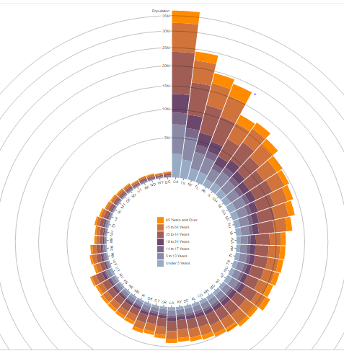
Example
Source: https://bl.ocks.org/mbostock/5479367295dfe8f21002fc71d6500392
Notes:
https://bl.ocks.org/mbostock/5479367295dfe8f21002fc71d6500392
This is an example of radial stacked bar chart representing the population of United States of different age groups and here each bar representing each state. Age groups are categorized and colored for each bar.Here by seeing this graph we can conclude that California has the highest population .Wyoming and the district of Columbia are having the lowest population

Slide 6
Tableau
Tableau is groundbreaking data visualization software created by Tableau Software
It can connect easily to any data source like web based data, excel,etc.,
For the third time, Tableau has been named a leader in the Magic Quadrant for Business Intelligence and Analytics Platforms report by Gartner
Notes:
As discussed earlier tableau is a groundbreaking(innovative) DV software created by Tableau software
Easy to connect to any file format
No 1 in the magic quadrant consecutively for three times reported by gartner
It is an innovative software created by tableau software
Cons
Need to buy a product key

Slide 7
Features
Easy to learn User Interface
Drag and drop functionality
Can create charts by writing some custom SQL queries
Quickly create interactive dashboards and plots

Slide 8
Steps to use Tableau
Step 1: Download Tableau either with a free trial or purchase using a licensed product key
Step 2: Load data by connecting to the appropriate file format and open it using legacy connection if you need to write some custom SQL queries
Step 3: Add the attributes that define your goal and select an appropriate graph
Step 4: Customize it accordingly
Step 5: Save and Share the results
Notes:
These are the steps to use tableau and I think you all are familiar with these steps

Slide 9
Sample Data set
Statistical Research
Data Processing
Data Science
Machine Learning
Data set has 21 attributes and 9995 records
Notes:
This is the data set I have chosen to draw my chart and it has 21 attributes and 9995 records.The data represents the sales , orders information of a company which has product information for different categories like office supplies, furniture and technology and also has the country and the state names where the products are shipped.

Slide 10
Goals
To visualize a radial stacked bar chart showing sales of different categories of products of various states in the U.S.A in the years 2013 to 2016
Data Source: https://community.tableau.com/docs/DOC-10198
Notes:
My goal is to visualize a radial stacked bar chart using Tableau to show different categories of products that were sold by a company in different states of USA in the years 2013 to 2016.
This is the source for my data

Slide 11
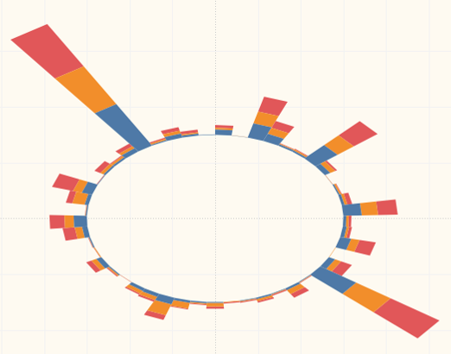
Radial stacked bar chart for the dataset
Notes:
This is the chart generated based on the goal
Repository link: https://github.com/SanthoshKumarThadka/Thadka_Tableau

Slide 12

Demonstration
https://www.google.com/search?q=demonstration+icon&source\fsdjf
Notes:
https://github.com/SanthoshKumarThadka/Thadka_Tableau

Slide 13
Pros and Cons
Data that is categorized can be visualized easily using the radial stacked bar graph
There is no large difference between stacked bar chart and radial stacked bar chart
Could not get the full version of the tool unless has a product key

Slide 14
Lessons Learned
Analyze data and get an appropriate chart from it
More familiar with settings in tableau
Significance of other tools
Explored and learned different tools in the process of learning
Notes:
How to analyze the data and filter it
Learned advanced settings in tableau

Slide 15


