Slide 1
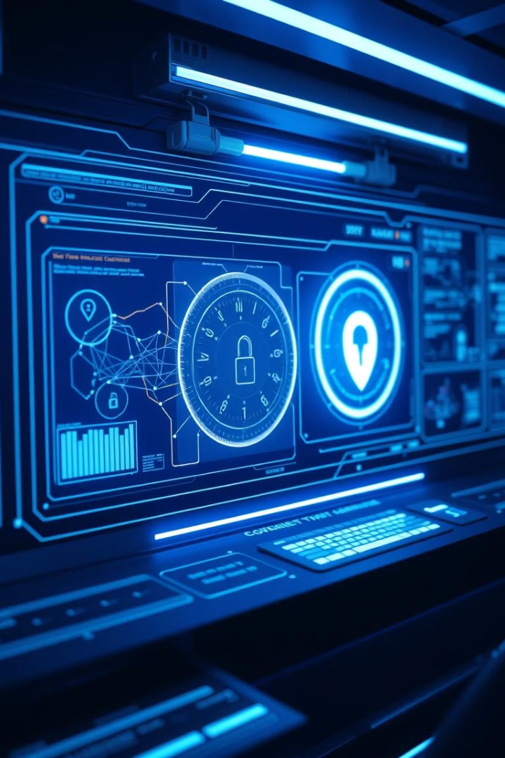
MIS for Cybersecurity Incident Tracking and Reporting
This presentation outlines a Management Information System for cybersecurity incident tracking and reporting is a structured approach to recording, managing, and analyzing security incidents within an organization. It helps organizations respond efficiently to cyber threats
V.Rajarajeshwaran(192124173)
B.santhosh Kumar(192110544)

Slide 2
Objective, Incident Logging & Classification: The Foundation
Objective
Logging
Classification
The system is designed to Identify and log cybersecurity incidents. Automate reporting for compliance. Analyze incidents for better security planning..
record and stored the data or incidents and Users record details of security breaches(e.g., phishing attacks, malware infections).
Categorize incidents based on type and severity for prioritization.

Slide 3

Phishing Unveiled: Types and Staying Safe
Phishing
Phishing Types
Staying Safe
Phishing is a cyberattack where scammers impersonate legitimate entities (e.g., banks, companies, or government agencies) to trick people into revealing sensitive information like passwords, credit card numbers, or personal data.
1.Email phishing -send fake emails for getting credentials ( mail id and password)
Verify sender, check links, and never share sensitive info via email.
2.spear phishing -send email act like as individual (An hacker act like as HR to send mail to the company staffs to get credentials)
3.whaling - targeting high profiles like company CEO ( send email to the company financial department like as CEO for money transfer)
4.Smishing- send sms
5.vishing - fake phone calls threat the people's and get money

Slide 4
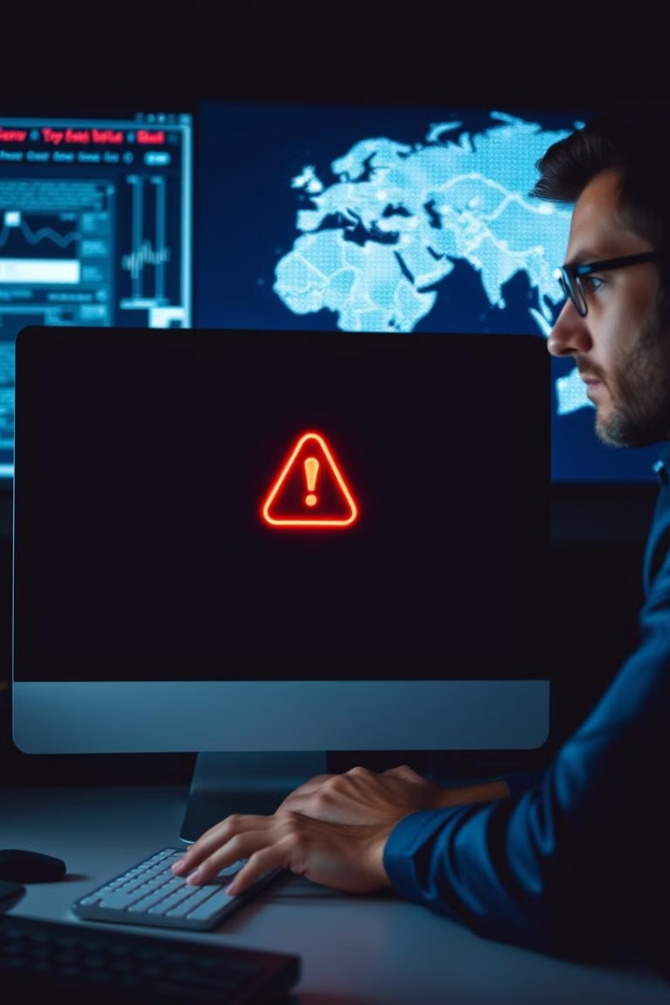



Automated Alerts & Notifications: Your First Line of Defense
Real-time Monitoring
Threat Detection
Send alerts to security teams
Implement automated alerts to promptly notify security teams. Early detection is critical to minimizing impact and preventing lateral movement. Configure alerts based on predefined thresholds and suspicious activity patterns.

Slide 5

Ransomware: Understanding the Threat Landscape
1
Ransomware is a type of malicious software (malware) that encrypts a victim’s files or locks them out of their system. The attacker then demands a ransom, usually in cryptocurrency, to restore access.
2
If the victim not paid the money the data will be loss or leak
3
Prevention
Regular backups, patch management, and user awareness training.

Slide 6
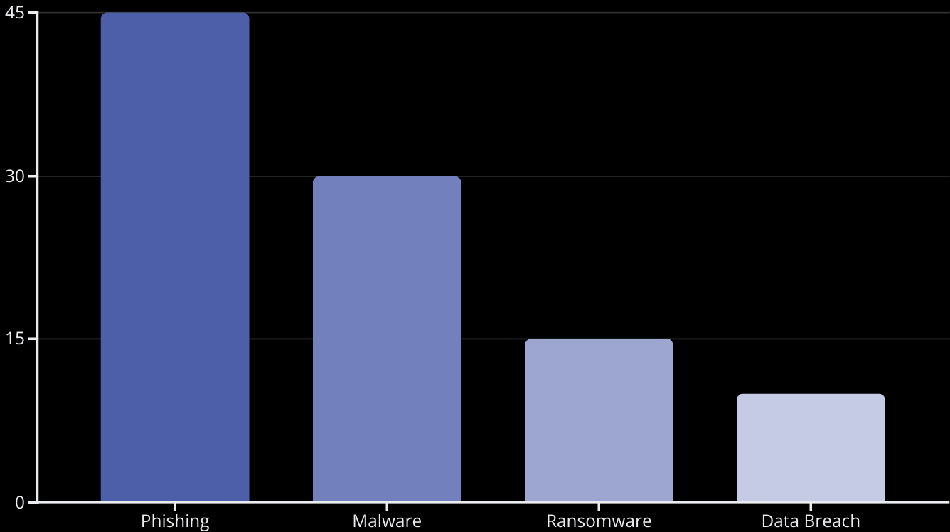
Dashboard & Analytics: Visualizing Incident Data
Displays trends and statistics on cyber threats. Example: A retail company identifies that most security breaches happen due to weak passwords and decides to implement stricter password policies.

Slide 7

Compliance & Reporting: Meeting Regulatory Requirements
1
Data Collection
Collect all relevant incident data securely.
2
Documentation
Maintain detailed incident documentation.
3
Reporting
Generate reports for regulatory compliance.
Generates reports for cybersecurity regulations (e.g., GDPR, ISO 27001). Example: A healthcare provider uses the system to generate a compliance report showing that all patient data breaches were reported within the required 72-hour window

Slide 8
User Access Control & Security
Ensures only authorized personnel can access sensitive information.
Example: In a corporate network, only the IT manager has access to critical security logs, preventing unauthorized data access.

Slide 9
Importance in Cyber Security
Faster incident response: Helps organizations react quickly to threats.
Regulatory compliance: Avoids legal and financial penalties.
Risk mitigation: Reduces security vulnerabilities through data-driven insights.

Slide 10
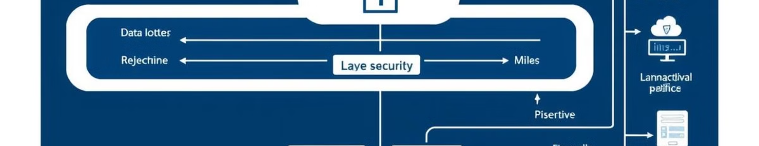
Conclusion: Problem, Solution, Architecture, and Flow
Problem: Inefficient cybersecurity incident management. Solution: Implement a MIS for centralized tracking, reporting, and response. The architecture features automated alerts, a visual dashboard, and secure data storage. This results in a proactive and compliant cybersecurity posture. The diagram shows a flow chart for the architecture.

Slide 11
Real-World Case Studies of Phishing Attacks
Google & Facebook – $100 Million Scam (2013–2015)
1. Type: Spear Phishing What Happened? A Lithuanian hacker, Evaldas Rimasauskas, tricked Google and Facebook employees by sending fake invoices while impersonating a legitimate vendor (Quanta Computer). The emails looked authentic, and employees unknowingly transferred over $100 million to fraudulent accounts.
Impact: Both companies lost millions before discovering the fraud. They later recovered some funds after legal action.
Lesson: Always verify invoices and payment requests, especially for large transactions.

Slide 12
Real-World Case Studies of Ransomware Attacks
1.Colonial Pipeline Ransomware Attack (2021)
Type: Credential Phishing + Ransomware What Happened? Hackers used a phishing email to steal employee login credentials, which they used to access Colonial Pipeline’s network. They then deployed ransomware, shutting down fuel distribution across the U.S. East Coast
Impact: Fuel shortages led to panic buying. Colonial Pipeline paid a $4.4 million ransom in Bitcoin.
Lesson: Use multi-factor authentication (MFA) and cybersecurity training to prevent phishing-related breaches.

