Slide 1

ADVANCED DIGITAL SIGNAL PROCESSING EECE8030
FINAL PROJECT PRSENTATION
IMAGE THRESHOLDING USING
NON-PRAMETRIC
FISHER INFORMATION
SANTHOSH NAGENDRAN
8272767

Slide 2
OBJECTIVE
The aim is to make a binary image (object and background) by which all the pixels with grey level higher than the determined threshold is classified as object and rest pixels are assigned to background or vice versa.

Slide 3
FISHER INFORMATION
Fisher Information (FI) is an important concept in statistical estimation theory and information theory. Novel algorithm is developed based on non-parametric FI measure.

Slide 4
DESCRIPTION OF FI
This FI based thresholding considers an image histogram to be a probability distribution and then selects an optimal thresholding value that yields maximum fisher information (FI).

Slide 5
FISHER INFORMATION THERSHOLDING
Pi = ni./N;
w1 = sum (Pi);
w2 = 1 - w1;
Ia = 1. /w1. * (sum ((((Pi+1) - Pi). ^2). /Pi));
Ib = 1. /w2. * (sum ((((Pi+1) - Pi). ^2). /Pi));
It = (w1. * Ia) + ((1-w1). * Ib);
tOpt = angle(max(((w1.*Ia) + ((1-w1).*Ib))));
Suppose that the pixel in the image are divided into two classes A and B by a gray level cutoff t. A is set of pixels with levels [0,1,…….,t], and the remaining pixels belong to B. A and B usually corresponds to the object class and the background class, or vice versa.

Slide 6
ALGORITHM
Let max=0 be the optimal threshold, and let max be the maximum value of the objective function. I
For t =1 to Maximum of gray intensities
Compute the function objective value that corresponds to the gray level t
If I(t) > max,
Then max = I(t), Topt = t.
end
Take Topt as the optimal threshold for segmenting the image.

Slide 7
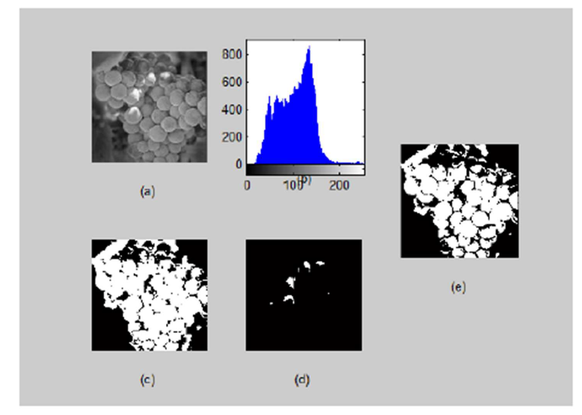
EXPERIMENTAL TEST

Slide 8
