Slide 1
Intro to python - 3
Textbook Chapter 3 - How You Run Programs

Slide 2
How to run Python:
Interactive coding
Writing modules (aka programs) with text editors
IDE Developer platforms
Notes:
Integrated Development Enviro.

Slide 3

Interactive Coding:
Just type “python” at the prompt..
Notes:
To exit an interactive session like this one and return to your system shell prompt, type
Ctrl-D on Unix-like machines; on MS-DOS and Windows systems, type Ctrl-Z to exit.
In the IDLE GUI discussed later, either type Ctrl-D or simply close the window

Slide 4


Commands are executed as they are entered..
Notes:
print statements are required only in files. Because the interactive interpreter
automatically prints the results of expressions, you do not need to type complete
print statements interactively. This is a nice feature, but it tends to confuse users
when they move on to writing code in files: within a code file, you must use
print statements to see your output because expression results are not automatically
echoed. Remember, you must say print in files, but not interactively

Slide 5


Interactive mode does not save the code
But its great to experiment and test code.
If in doubt, use the interactive mode to test.
If you don’t know what a line of code does, cut and paste into interactive mode.
Ideal place to test code you have written in files.
Sub-blocks:

Slide 6
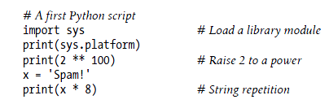

Writing modules (aka programs) with text editors
Open a new file called my.py using vi, nano, IDLE or other text editor ..
Run it..
Notes:
Note the comments..
Run it!
Note that we could redirect to a file.. >

Slide 7

*nix executable scripts
First line of file must tell the shell how this program is to be executed.
File must be “chmod” to executable
To make your code more portable..
Notes:
Note that the file does not have to end with .py (even when typing python at prompt) but it is a good convention
The trick sends the shell down the local env..
Or do a “which python3” command to find out where the exe is..

Slide 8
Module-based services model
In simple terms, every file of Python source code whose name ends in a .py is a module.
Other files can access module code by importing that module.
Import operations load another file and grant access to the contents.
Contents of a module are made available to the outside world through its attributes
This module-based services model turns out to be the core idea behind Python program architecture
Notes:
Good details here: https://docs.python.org/3/reference/import.html

Slide 9
Module Imports and Reloads
Larger programs usually take the form of multiple modules files
which themselves import tools from other module files.
One module is designated “main” or top-level file
This launches the entire program
Import operations run the code in a file that is being loaded
i.e. -> Importing a file is yet another way to launch it.
Notes:
Aka packages..

Slide 10
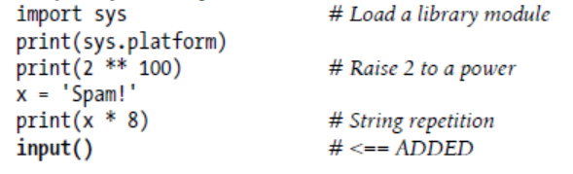
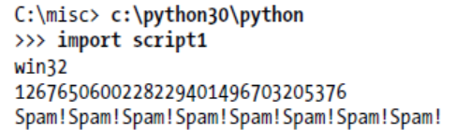
Notes:
Top box is a module called my.py in the example. We would run it > python3 \home\bill\my
Note the input() trick to stop the screen from closing after the program is run from an icon.. But you have to put something in the brackets..like
Input(“ input a value “)
NOTE that the script file must be script.py (will not work otherwise!)

Slide 11
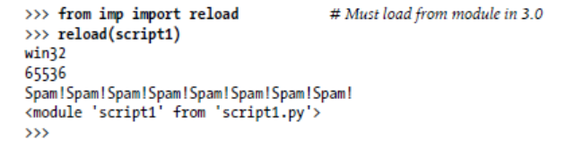
Imports are expensive and will only be done once per file per run
To force a reload ..
Note that import is a “statement” and reload is a called function
Reloads aren’t transitive—reloading a module reloads that module only, not any modules it may import—so you sometimes have to reload multiple files.
Notes:
Statements are commands to the interpreter... Examples: def, class, and import
Force a reload is necessary if the code does not change (then it is still in mem).. Not sure why you would have to reload if not changed..

Slide 12
Modules serve the role of libraries of tools
A module is mostly just a package of variables-functions-classes referred to as a “namespace”.
“names” (variables, functions, methods, etc.) within the package are called attributes.
Importers gain access to all the names assigned at the top level of a module’s file.

Slide 13

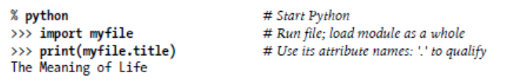
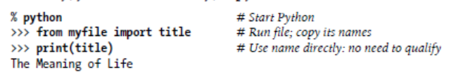
Example:
Technically, “from” copies a module’s attributes, such that they become simple variables in the recipient
Notes:
There’s only one such name in this simple example—the variable title, assigned to a string—but the
concept will be more useful when you start defining objects such as functions and
classes in your modules: such objects become reusable software components that can
be accessed by name from one or more client modules.

Slide 14
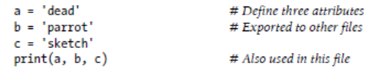
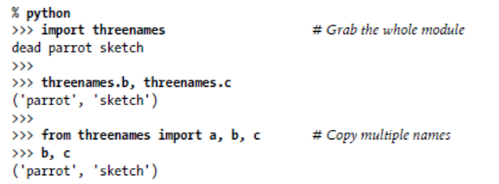
Notes:
The results here are printed in parentheses because they are really tuples

Slide 15
The built-in dir function fetches a list of the names available inside a module.

Slide 16
Exercise
Write a Python program called mod1.py that contains the following:
def M1_F1(x):
print(“from mod one we see namespace …”, __name__)
print(“the passed value is “,x)
Then write a main program that imports mod1 and sys does the following:
print(“from main pgm we see namespace …“, __name__)
mod1.M1_F1(“your_name_here”)
print(“the current module path is “,sys.path)
Finally, do a dir(mod1) and report on what you see..
FYI: sys.path shows the path Python follow to modules
sys.path.append(os.getcwd())
Notes:
Import sys.
Then help(sys) to see the tools.
One attribute is “path”
Print(sys.path) to see the path that Idle follows to find modules..
Note: dir will not work unless the module has been imported!

Slide 17
Python programs are composed of multiple module files, linked together by import statements.
Each module is a self-contained package of variables—a namespace.
Modules minimize name collisions - each file is a self-contained namespace
Classes and function scopes also separate name spaces
NOTE: the from statement defeats the namespace partitioning!
Many avoid “from” for this reason

Slide 18
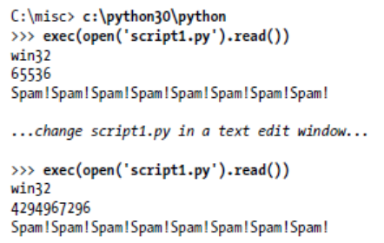
Another way to run a file
Notes:
Note how this method does not actually load the file into the prompt..
Exec (like open) is a python statement. Exec executes python code.. MAKE SURE TO USE SINGLE QUOTES..
On the downside, because it works as if pasting code into the place where it is called,
exec, like the from statement mentioned earlier, has the potential to silently overwrite
variables you may currently be using.

Slide 19
When a module named spam is imported, the interpreter first searches for a built-in module with that name. If not found, it then searches for a file named spam.py in a list of directories given by the variable sys.path
After initialization, Python programs can modify sys.path.
Notes:
In My Computer, right-click Properties (or press Win-Break), System tab, Environment Variables, System. You can add it if it's not already there.
In the CMD prompt:
set PYTHONPATH C:\Python25\Lib;C:\MyPythonLib
Or in bash:
PYTHONPATH=/usr/share/python/lib:/home/me/python export PYTHONPATH
Or, more succinctly:
export PYTHONPATH=/home/me/python

Slide 20
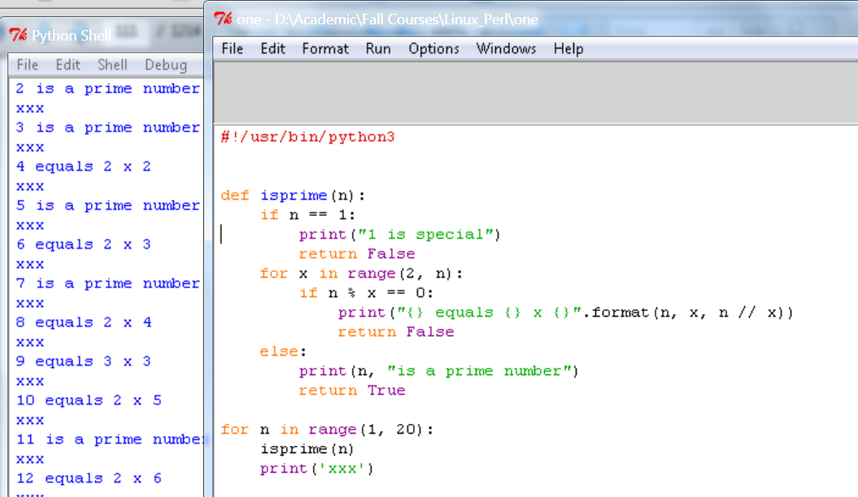
IDLE:
Free, portable, and a standard part of Python, it’s a good first development tool..
Notes:
On some Unix-like systems you may need to launch IDLE’s top-level script from a command line, or by clicking
on the icon for the idle.pyw or idle.py file located in the idlelib subdirectory of Python’s
Lib directory. On Windows, IDLE is a Python script that currently lives in C:\Python30\
Lib\idlelib (or C:Python26\Lib\idlelib in Python 2.6
IDLE hint of the day: If you want to repeat prior commands in IDLE’s
main interactive window, you can use the Alt-P key combination to
scroll backward through the command history, and Alt-N to scroll forward
(on some Macs, try Ctrl-P and Ctrl-N instead

Slide 21
Debugging Python Code:
Insert print statements
IDEs all have debuggers
Use “pdb”, available as a module in Python’s standard library.
Type commands to step line by line, display variables, set and clear breakpoints, continue to a breakpoint or error, and so on.
pdb can be launched interactively by importing it, or as a top-level script
Notes:
Run it as a top level script.. > pdb my_prog.py

Slide 22
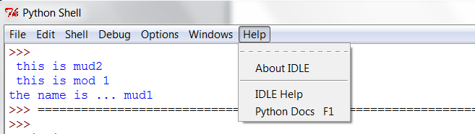
Where to find help -> python docs..
or..
http://www.python.org/doc/

Slide 23
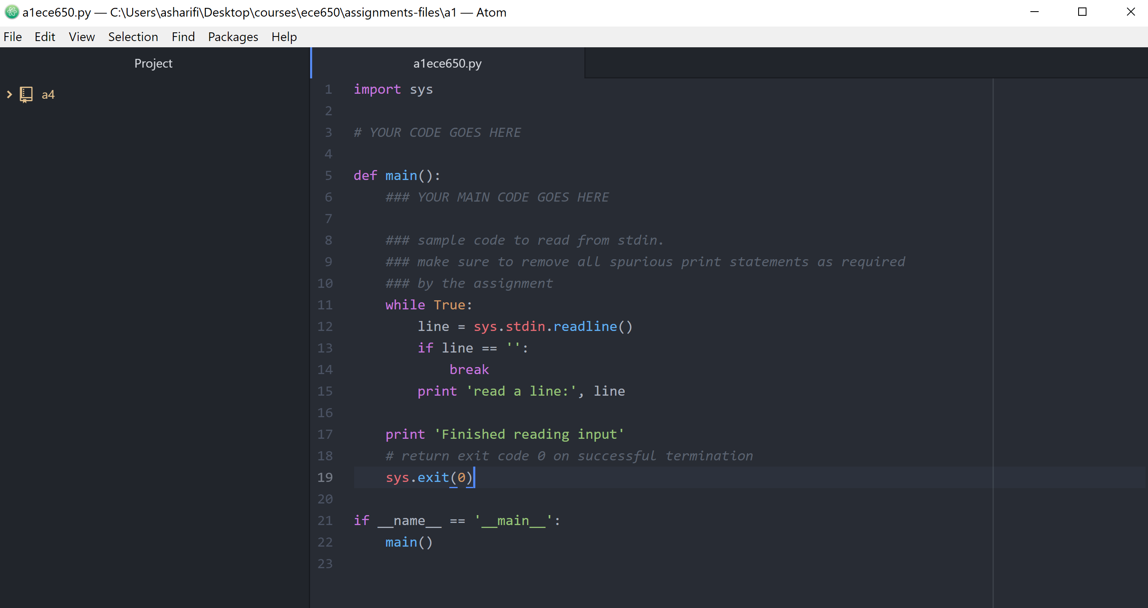
ATOM

Slide 24
Exercise:
Write a program to open a file and print each line in the program to screen prefixed by the line number.
Hint:
Store the file somewhere on the python path (sys.path)
F=open(“myfile”)
help(F) to see what built-in functions let you iterate through the file.
Notes:
Use sys.path to see where Idle goes looking..

